Slide 1










Artificial Intelligence
2D Object Tracking using
Kalman Filter

Slide 2

Contents
Kalman Filter
Object Tracking
Introduction
Working
Conclusion
How does it works

Slide 3
Kalman Filter
A Kalman filter is used to estimate the state of a linear system where the state is assumed to be distributed by a Gaussian.
Kalman filtering is composed of two steps, prediction and correction(Bar-Shalom and Foreman, 1988).
To compute the estimate for the current state only the estimated state form the previous time step and the current measurement are needed.
In contrast to batch estimation techniques, no history of observations and/or estimates is required.

Slide 4
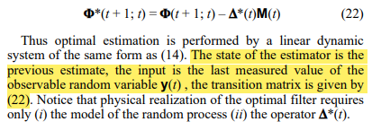
Kalman Filter
“The Kalman filtering is a relatively simple state-space algorithm to produce estimates of the hidden variables based on uncertain and inaccurate measurements. It predicts the systems future state based on past estimations.”
- Rudolph Emil Kalman. 1960. A New Approach to Linear Filtering and Prediction Problems. Transactions of the ASME–Journal of Basic Engineering 82, Series D (1960), 35–45

Slide 5
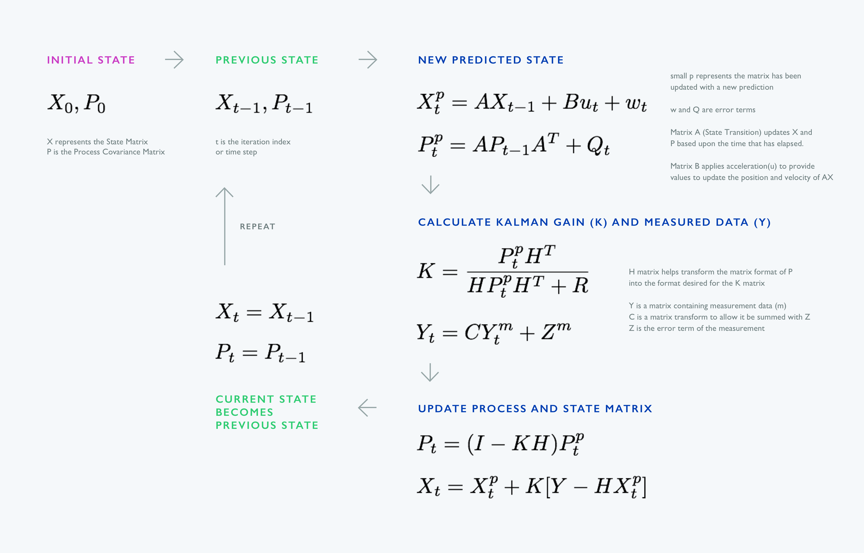
Working

Slide 6
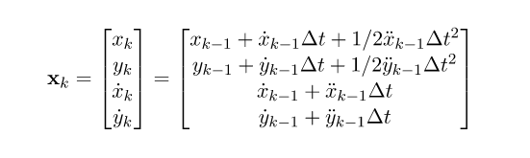
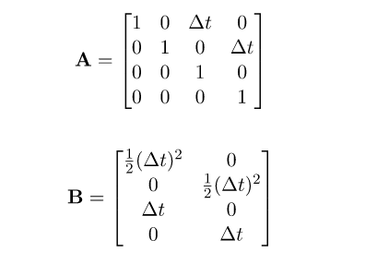
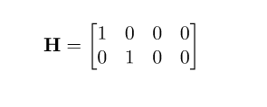
Working

Slide 7
Thank You

