Slide 1
JobRole : Devops Engg
Sector : IT IT-eS
NOS No : SSC/N8120
Module : Developing a CI/CD pipeline
PMKK, VIJAYAWADA

Slide 2
INTRODUCTION TO DOCKER
PMKK, VIJAYAWADA

Slide 3
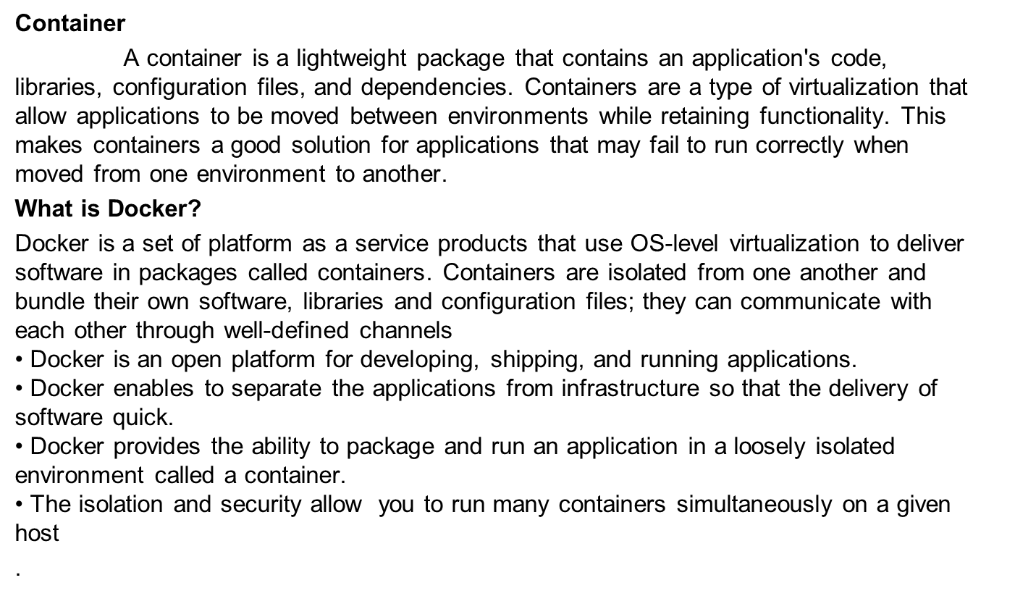
PMKK, VIJAYAWADA

Slide 4
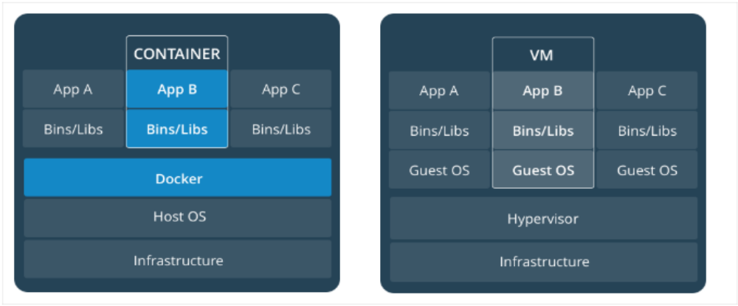
Docker is a tool that allows you to create, deploy, and run applications by using containers. Using docker you can run your software on different systems and environments like a development environment, a production environment. And, the software will run consistently, regardless of what kind of environment it's on.
PMKK, VIJAYAWADA

Slide 5
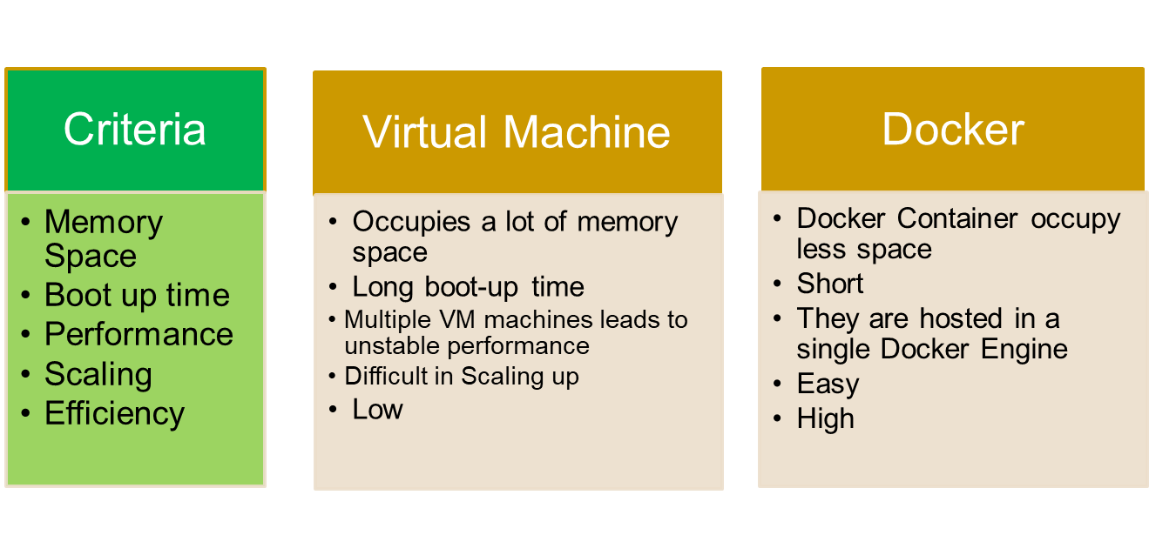
PMKK, VIJAYAWADA

Slide 6
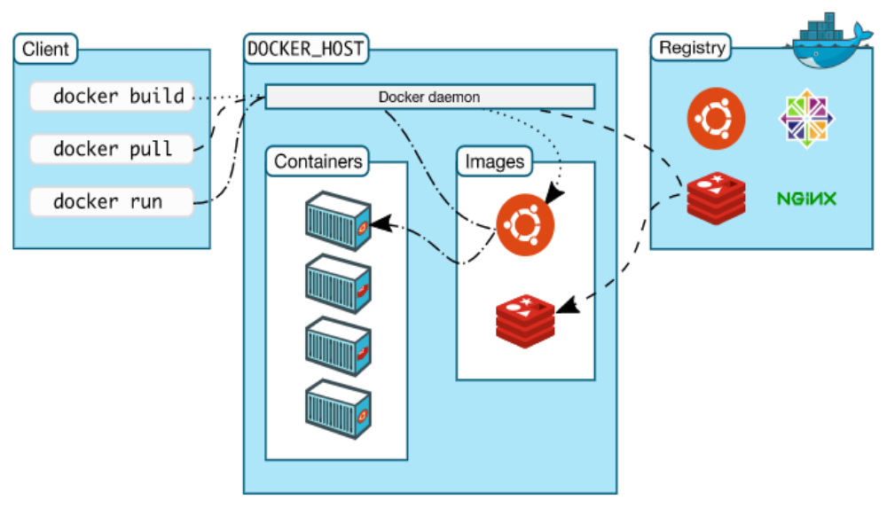
DOCKER ARCHITECTURE
PMKK, VIJAYAWADA

Slide 7
Docker Client:
The Docker client and daemon communicate using a REST API, over UNIX sockets or a network interface.
Docker Daemon (dockerd):
The Docker daemon (dockerd) listens for Docker API requests and manages Docker objects
Docker Registries:
A Docker registry stores Docker images.
DOCKER INSTALLATION
Docker CE Installation Commands: CentOS
Step 1: Package Installation.
▪ sudo yum install -y yum-utils\
device-mapper-persistent-data \
lvm2
device-mapper-persistent-data: This package provides the data management tools needed for the device-mapper, which is a component used in LVM (Logical Volume Manager) and other storage management tasks.
lvm2: This package includes the Logical Volume Manager 2 (LVM2), which is a system for managing disk drives and other storage devices in a more flexible manner than traditional partitioning schemes.
PMKK, VIJAYAWADA

Slide 8
Step 2: Add Docker CE Repo.
▪ sudo yum-config-manager \
--add-repo \
Step 3: Install Docker CE packages
▪sudo yum install docker-ce docker-ce-cli containerd.io
Reference Doc : https://docs.docker.com/install/linux/docker-ce/centos/
DOCKER IMAGES
Docker image is a file which contains dependencies, binaries and required configurations to run software inside a container.49
▪docker pull [Image Name]:[tag]
▪docker image pull [Image Name]:[tag]
PMKK, VIJAYAWADA

Slide 9
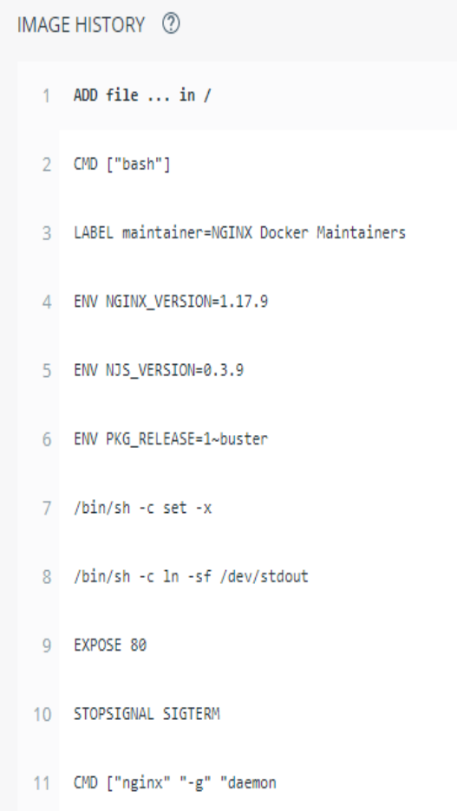
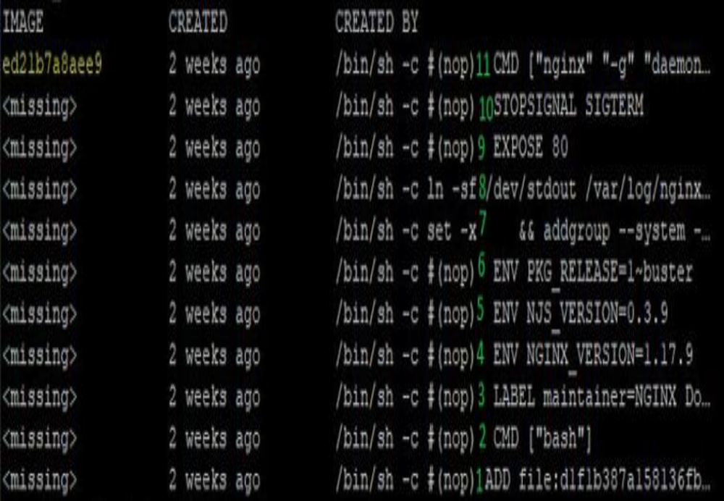
List all layers of an image:
▪docker image history nginx
PMKK, VIJAYAWADA

Slide 10
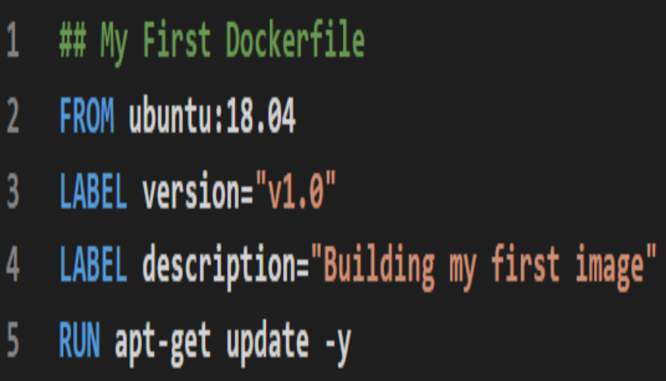
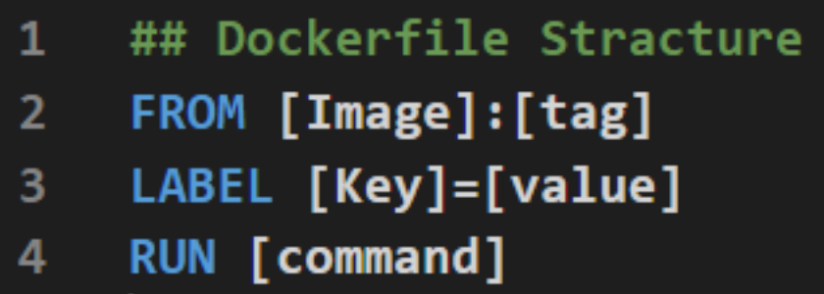
Dockerfile:
Dockerfile is a set of instructions and commands used to build an image.
Build Image:
▪docker image build -t [TAG] .
▪docker image build -t [TAG] -f [Dockerfile Name] .
▪docker image build --no-cache -t [TAG] .
PMKK, VIJAYAWADA

Slide 11
Frequently used Dockerfile Instructions:
▪FROM
Sets base/parent Image.
▪LABEL
Adds metadata to the image.
▪RUN
Creates new layer.
▪EXPOSE
Intend port to publish.
▪CMD
Setting default command for container. It can be overridden.
▪ENTRYPOINT
Specify executable inside the container. It does not get overridden.
However, it can be overridden by --entrypoint flag.
Reference Doc : https://docs.docker.com/engine/reference/builder/
PMKK, VIJAYAWADA

Slide 12
Frequently used Dockerfile Instructions (cont..):
▪WORKDIR
Sets current working directory.
▪COPY
Copy file from one location to container.
If spaces include quotes
▪ADD
Similar to ADD instruction with additional features.
if spaces include quotes.
Download a file from URL.
✓ADD http://<www.abcxyz.com>/downloads/file.zip
PMKK, VIJAYAWADA

Slide 13
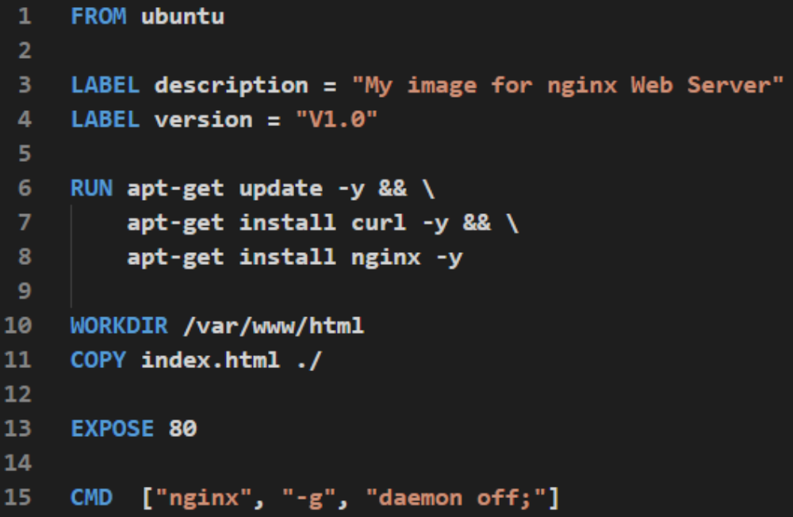
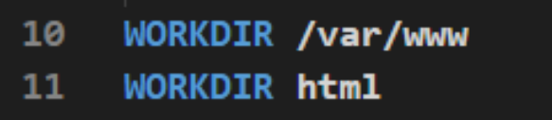
In the above snapshot, html does not start with / (slash) so it becomes relative to /var/www.
Which is same as WORKDIR /var/www/html
PMKK, VIJAYAWADA

Slide 14
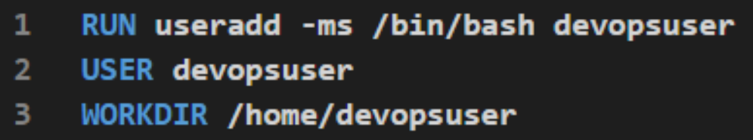
Frequently used Dockerfile Instructions (cont..):
▪ENV
Set environment variables.
Can be overridden by –env flag.
ENV [Key]=[Value]
▪USER
Set user.
PMKK, VIJAYAWADA

Slide 15
Frequently used Dockerfile Instructions (cont..):
▪HEALTHCHECK
Checks the health of a container by running a command inside the container.
Can be only one Health check instruction in a Dockerfile.
Options for CMD:
✓--interval=DURATION (default: 30s )
✓--timeout=DURATION (default: 30s )
✓--start-period=DURATION (default: 0s)
✓--retries=N (default: 3)
HEALTHCHECK --interval=5s CMD curl localhost:<port>
▪ARG
Declared before the FROM instruction.
Reference Doc : https://docs.docker.com/engine/reference/builder/
PMKK, VIJAYAWADA

Slide 16


Slide 17

PMKK, VIJAYAWADA

