Slide 1

Interactive Circulatory System
https://observablehq.com/d/436687aff3067647
Kensho Gendzwill
Bioengineering
kenshog@uw.edu
Benjamin Han
Bioengineering
bhan830@uw.edu
Yuki Kuo
Bioengineering
yutzukuo@uw.edu
Vicky Yeh
Bioengineering
shuyiyeh@uw.edu

Slide 2

Project Goal
Our project aims to illustrate the human cardiovascular system and various associated heart conditions through visual diagrams and interactive charts. Through interaction with the diagrams, we intend to provide an initial understanding and concept of different heart diseases to the audience.
Notes:
~1-3 sentence overview of your project goal
Can include screenshots, images, animated gifs
Should be a quick overview before going to next slide

Slide 3

Project Motivation
Why is this project important?
Many people suffer from heart disease around the world
We would like to raise awareness and understanding of heart disease
Educates the public about the importance of heart health
Notes:
By illustrating the cardiovascular system and detailing a variety of information about heart conditions, we would like to Raise awareness
Educates the public about the importance of heart health.

Slide 4
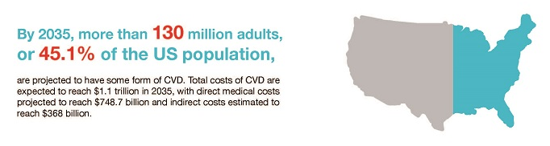
Project Motivation
How does it relate to social and/or scientific importance?
Notes:
https://www.heart.org/en/news/2019/01/31/cardiovascular-diseases-affect-nearly-half-of-american-adults-statistics-show

Slide 5
Key Questions
What are the most common diseases related to specific heart regions?
What are the causes of heart disease?
What are the main risk factors of the disease?
What is the prevalence or mortality of heart disease among different states in the United States of America?
How are individuals of different genders and races/ethnicities affected by heart disease?
How has the medical cost for treating heart disease changed over time?
Notes:
Introduce key questions that you attempted to address via your interactive article

Slide 6




Approach and Audience
Technologies:
Used p5 to generate a interactive cardiovascular diseases information diagram
Used vega lite to create charts for demographic and financial cost datasets
  Bar chart
  Choropleth chart
  Line chart
Intended audience:
Individuals seeking deeper understanding of cardiovascular diseases
  Students studying medicine
  People who are experiencing or know someone who is experiencing heart problems

Slide 7



Datasets
Datasets selected from authorized organizations:
CDC (Centers for Disease Control and Prevention)
Heart disease mortality data available at: CDC Heart Disease Mortality
USDHHS (U.S. Department of Health and Human Services)
Rates and trends in heart disease and stroke mortality among U.S. adults 35+ by county data available at: Rates and Trends in Heart Disease and Stroke Mortality
New York State Department of Health
Medical cost for treating heart disease complication data available at: Hospital Inpatient Cost Transparency: Beginning 2009

Slide 8
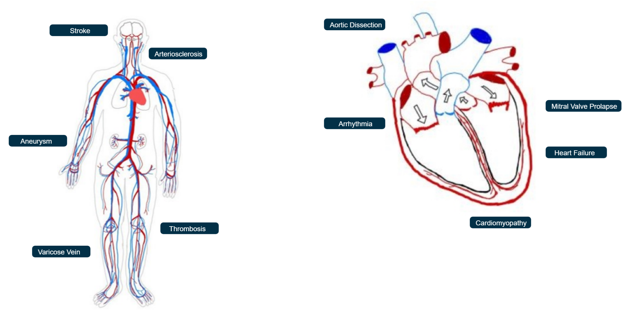
What are the most common diseases related to specific heart regions? What are the causes and main risk factors of heart disease?

Slide 9
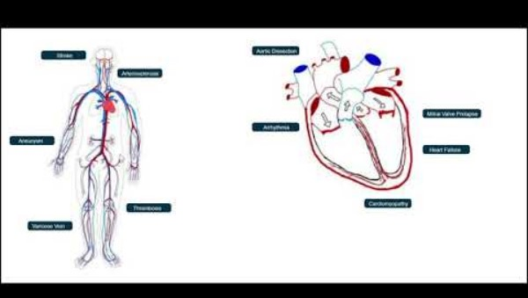
Visualization 1: Information Diagram
Click on the labels for disease details:
  Causes
  Symptoms
  Risk factors
  Complications
Blood vessels change to indicate disease impact on veins, arteries, or both

Slide 10
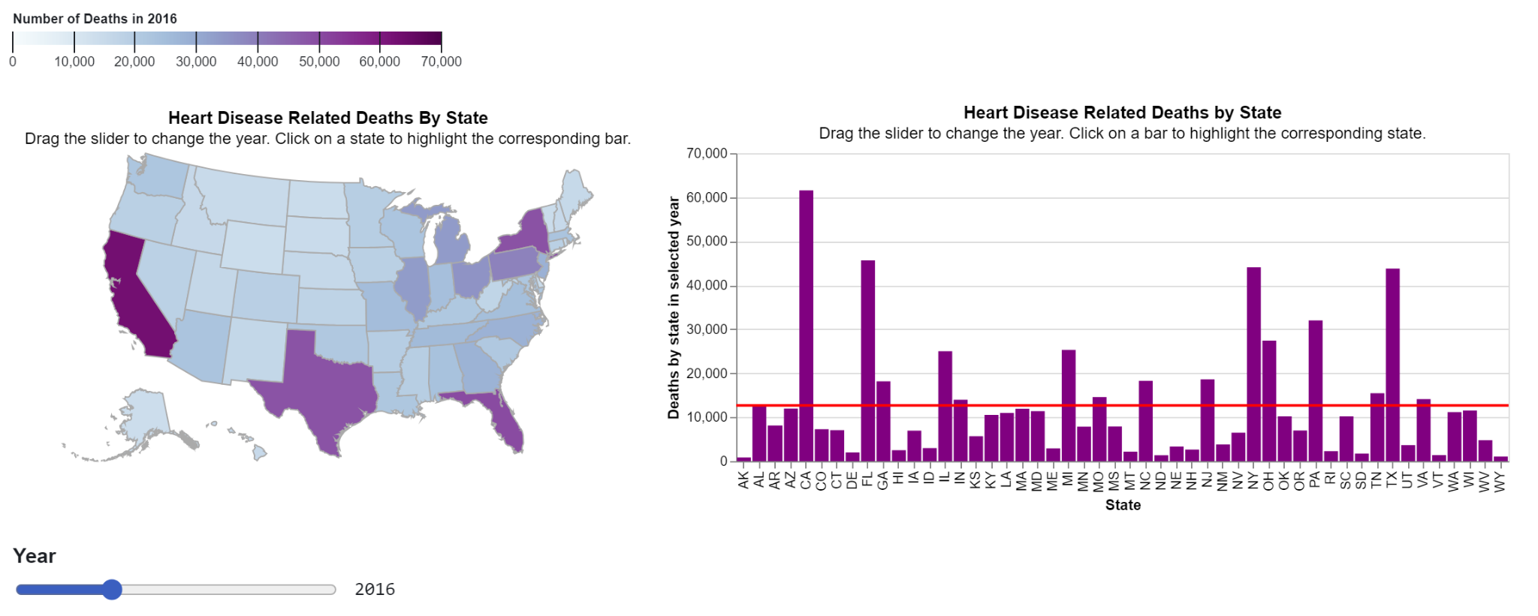
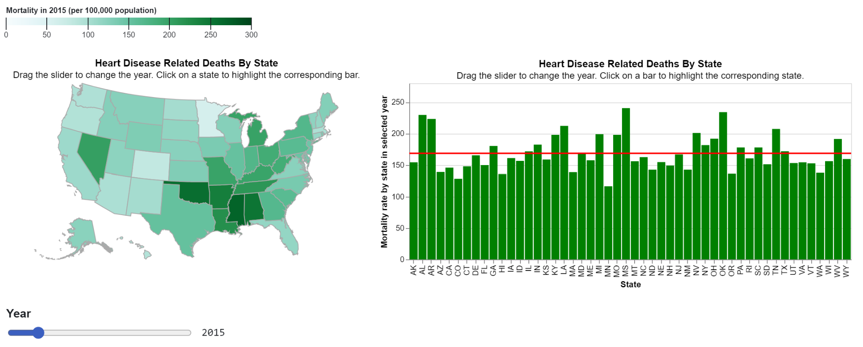
What is the prevalence or mortality of heart disease among different states in the United States of America?

Slide 11
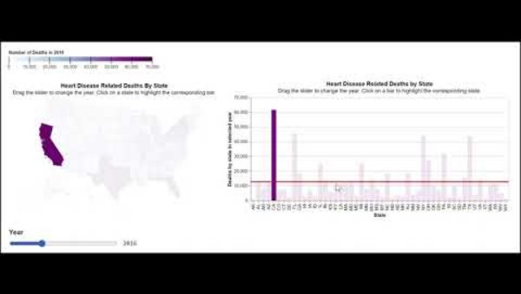
Visualization 2: Deaths by States
Slider:
Filter the years to see the changes over a certain time period
Tooltip:
Reveal the specific number of heart disease associated mortalities for that year
Click on a state or bar:
Highlight its corresponding counterpart
Notes:
Slider allows the viewer to filter the years to see the changes over a certain time period
Hovering over each state will reveal the specific number of heart disease associated mortalities for that year.
Click on a state or bar to highlight its corresponding counterpart, and double click to deselect.

Slide 12
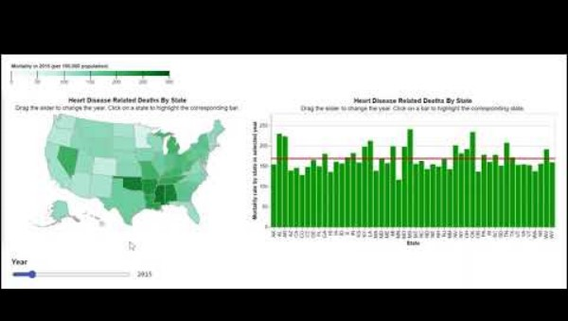
Visualization 3: Mortality Rate by State
Change death number to mortality rate
Raw death numbers can be misleading due to variations in state populations.
"The rate per 100,000 population" is employed as a standardized baseline for comparison.

Slide 13
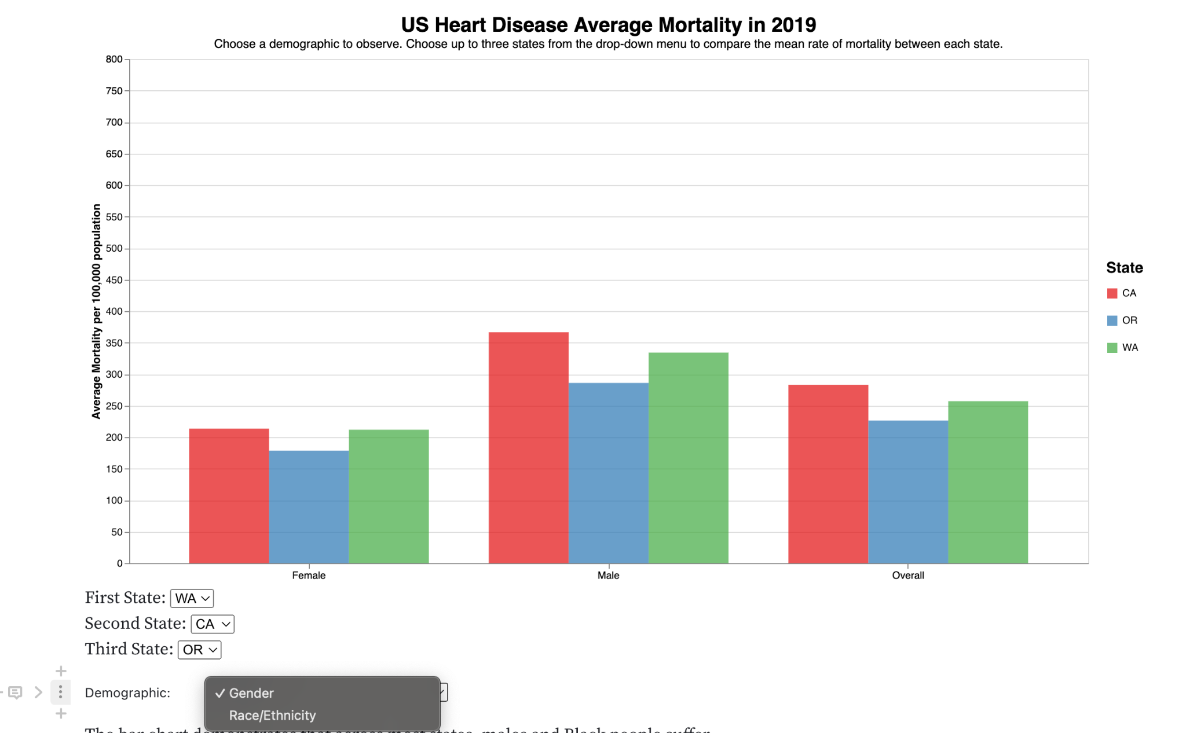
How are individuals of different genders and races/ethnicities affected by heart disease?

Slide 14
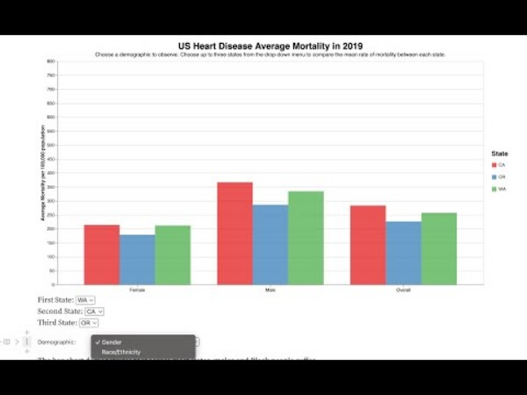
Visualization 4: Mortality by Demographic
Grouped bar chart that displays the average mortality per 100,000 people
A drop-down menu:
Display mean mortality by either gender or race/ethnicity
Three more drop-down menus: Choose up to three states to visualize

Slide 15
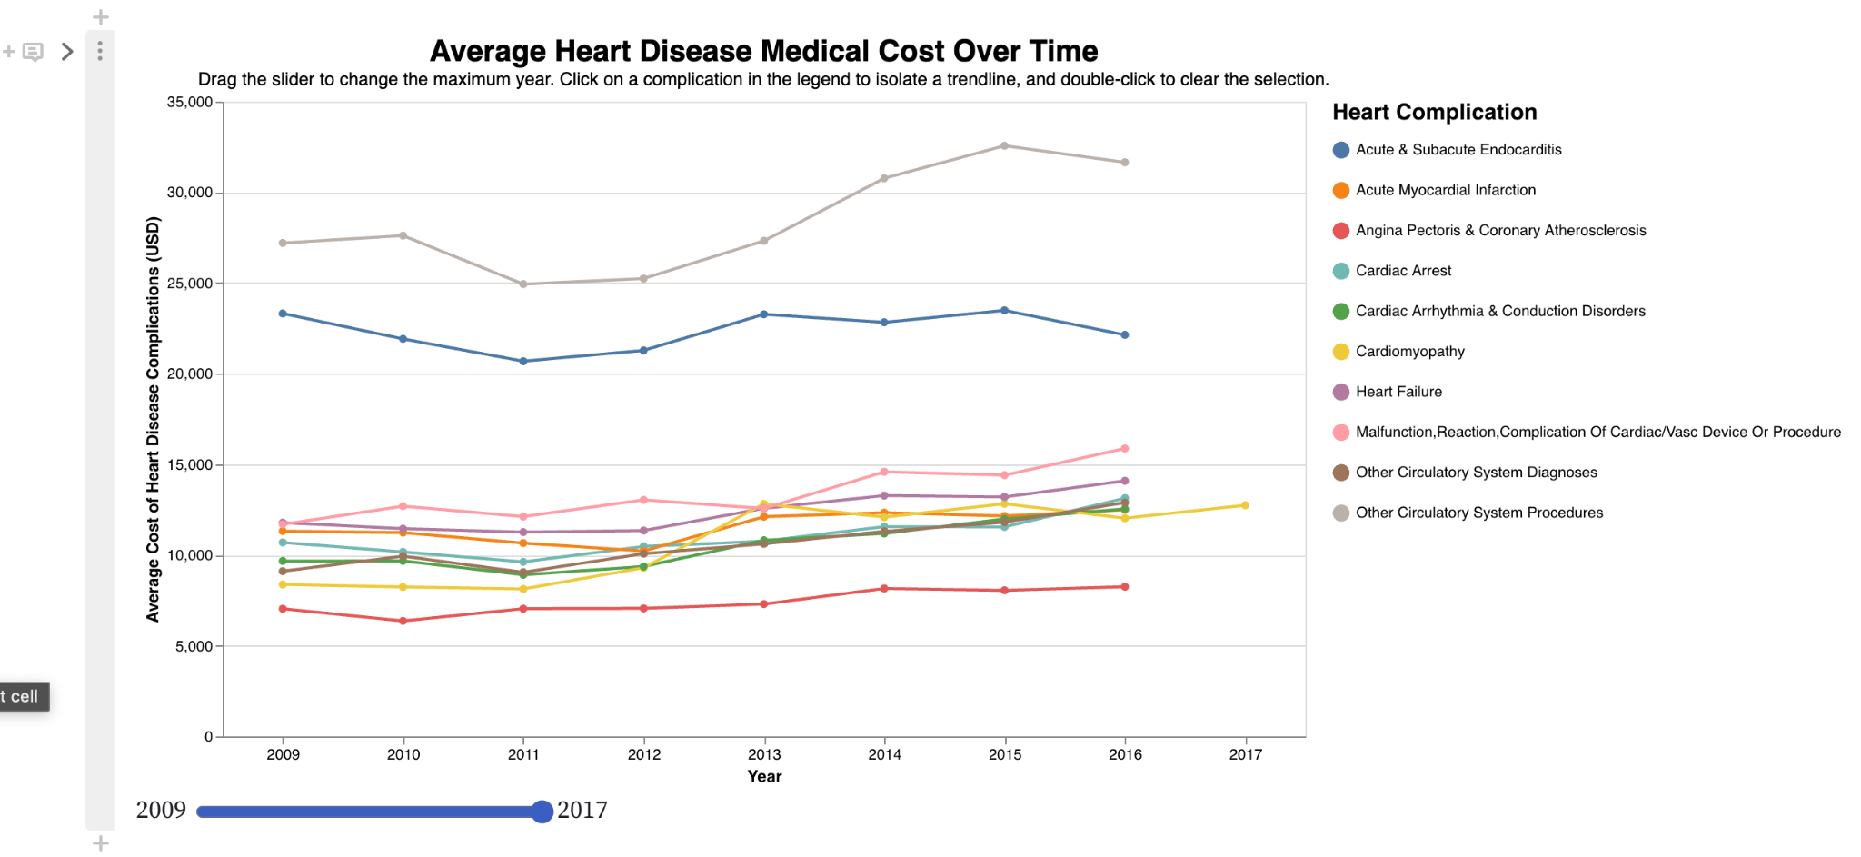
How has the medical cost of treating heart disease changed over time?

Slide 16
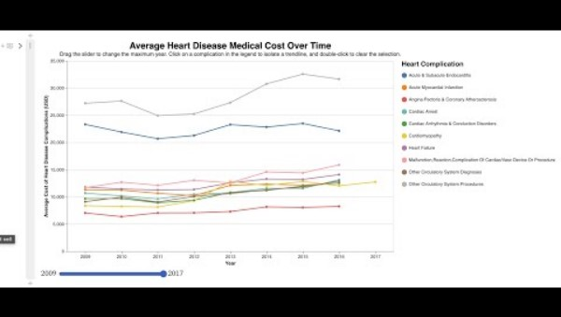
Visualization 5: Cost of Treating Heart Disease
Line plot that displays the average cost for treating heart disease complications over time
Slider:
Filter the year range
Interactable Legend:
Click on a specific heart condition to isolate a trendline

Slide 17

Conclusion
Limitations:
Medical cost data is only from New York State hospitals
Mortality dataset only provides data from 2019
Future Work:
Further investigation of treatment cost using more general data
Analysis of how certain risk factors affect prevalence of heart disease
Additional improvements to circulatory system visual with charts within pop-up boxes
In summary, through interactive features in our notebook, readers can explore the cardiovascular system, learn about specific heart conditions, and delve into demographic disparities in disease prevalence.

