Slide 1
Manufacturing: an Adaptive Road to Digital Transformation
Activate the full benefits of Industry 4.0
Find out how with SUSE

Slide 2

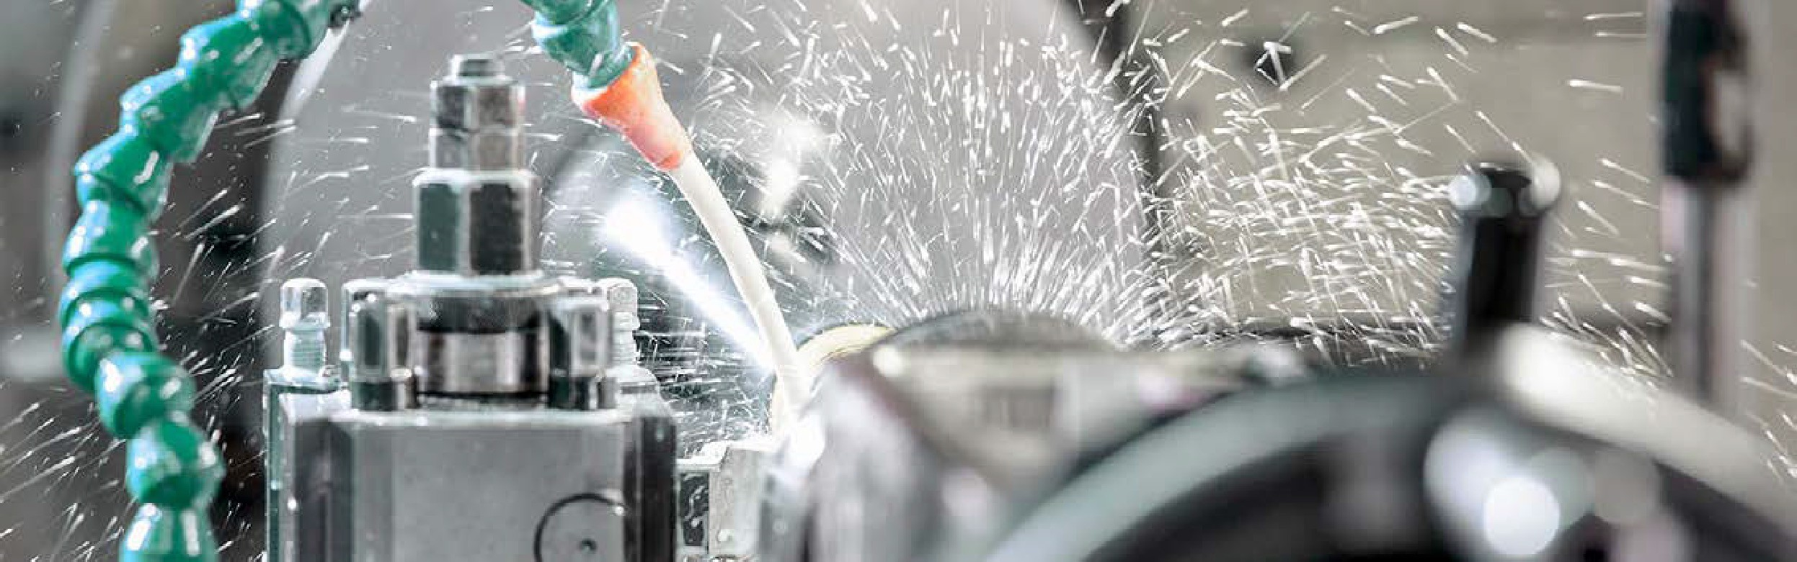

The manufacturer’s challenge
Four manufacturing imperatives
01
Digital transformation. The future of manufacturing will be technology-enabled and Industry 4.0 provides the framework. Cloud, Edge computing, digital twin, IoT and AI/ML will fuel process reinvention, operational efficiency and state-of-the art innovation.
Faced with continued disruption to global supply chains, heightened demand pressure and threats from new entrants, manufacturers can’t opt for inertia. Business as usual is not an option. Every ambitious manufacturing organization needs to reassess its operating and business model and embed resilience and agility. Every organization must look to attract and retain new talent. And every organization should aspire to innovate like a nimble tech company.
In short, it is time to accelerate digital transformation.
Most manufacturers have begun the journey but few are fully digitized. Each faces differing budget priorities, the complexities of fragmented deployments and difficulties executing on initial digitalization plans.
At SUSE, we believe that transformation can be enhanced and accelerated by open
innovation. The most successful businesses will be those that capitalize on interoperable solutions that let them harness modernization, no matter where it occurs.
02
Business Resilience. In the wake of disruption, manufacturers must mitigate risk through improved visibility and predictability, strengthened supply chain risk management and predictive maintenance that eliminates unplanned downtime.
03
Security. Surging threats during the pandemic, coupled with insider threats, have added to the sense of business risk. For manufacturers, cybersecurity – inside and outside the organization – is increasingly vital.
91
% of industrial companies
04
Recruitment. New workforce entrants want to use the latest and greatest tech. To overcome the challenge of talent scarcity, making the workplace attractive means making it modern. Cloud-native operators should have access to a full stack of enterprise-ready open-source tools. Developers want to work with the best technologies.
in the EU are investing in digital factories, yet so far only 6% of factories are “fully digitized.”
PwC

Slide 3
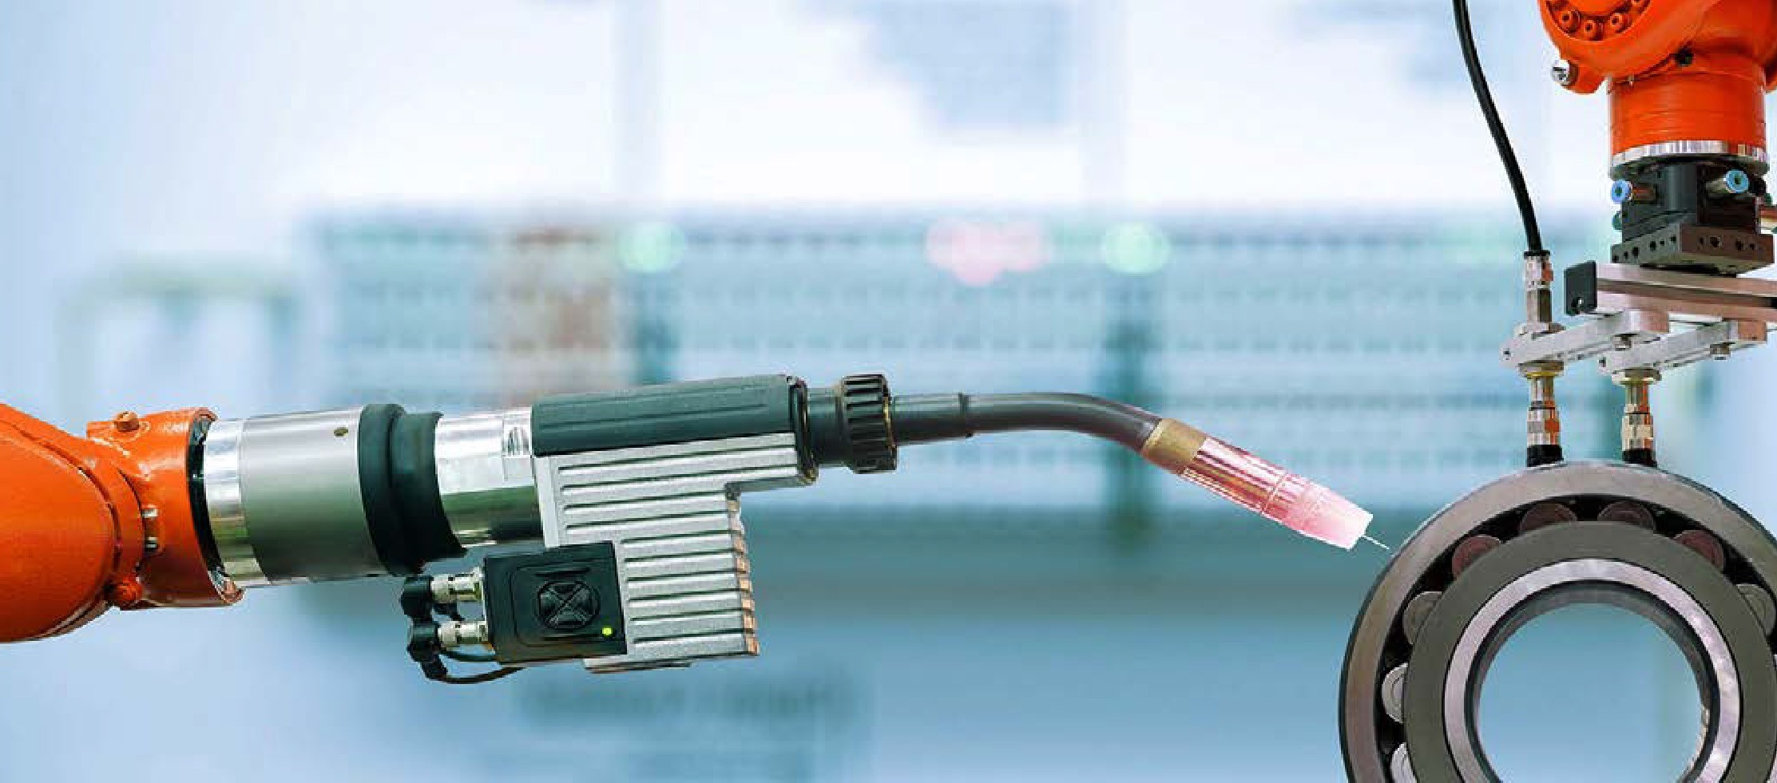
How to meet manufacturing imperatives
1. Adaptable IT for agile operations
Building business resilience and agility is essential to combat future shocks to supply chains and local changes in customer behavior.
How SUSE can help: SUSE Manager automates and orchestrates environments, delivering a single tool for broader visibility across the IT stack – and with solutions such as SUSE Rancher container management, manufacturers can build, deploy and scale faster than ever, reducing time to market.
Only by applying flexibility, optimal performance, reliability, and scalability across the entirety of the operating environment, can manufacturers meet the challenges and opportunities of today’s industry. And that’s why key sector players are turning to SUSE.
With an easy-to-deploy, comprehensive
open-source platform, SUSE helps organizations realize the full benefits of Industry 4.0.
+50
% of manufacturers
believe they will realize benefits from digital transformation strategy in less than five years
PwC
2. Effective digital transformation
Manufacturers have been continuing their digital transformation efforts in a time of flux. Pandemic-enforced restrictions on movement, supply chain fragility, growing demand and rising prices for raw materials have contributed to a challenging environment.
How SUSE can help: SUSE Rancher unifies clusters to ensure consistent operations, workload management and enterprise-grade security – from core to cloud to Edge.
3. Enhanced talent retention
Facing talent scarcity and with an increasingly remote workforce, manufacturers are analyzing how best to adapt and digitize the working environment across roles, levels and geographies.
How SUSE can help: By deploying SUSE Linux Enterprise and SUSE Rancher, cloud- native operators can access a full stack of enterprise-ready open-source tools. The result: innovative environments for creative developers.

Slide 4

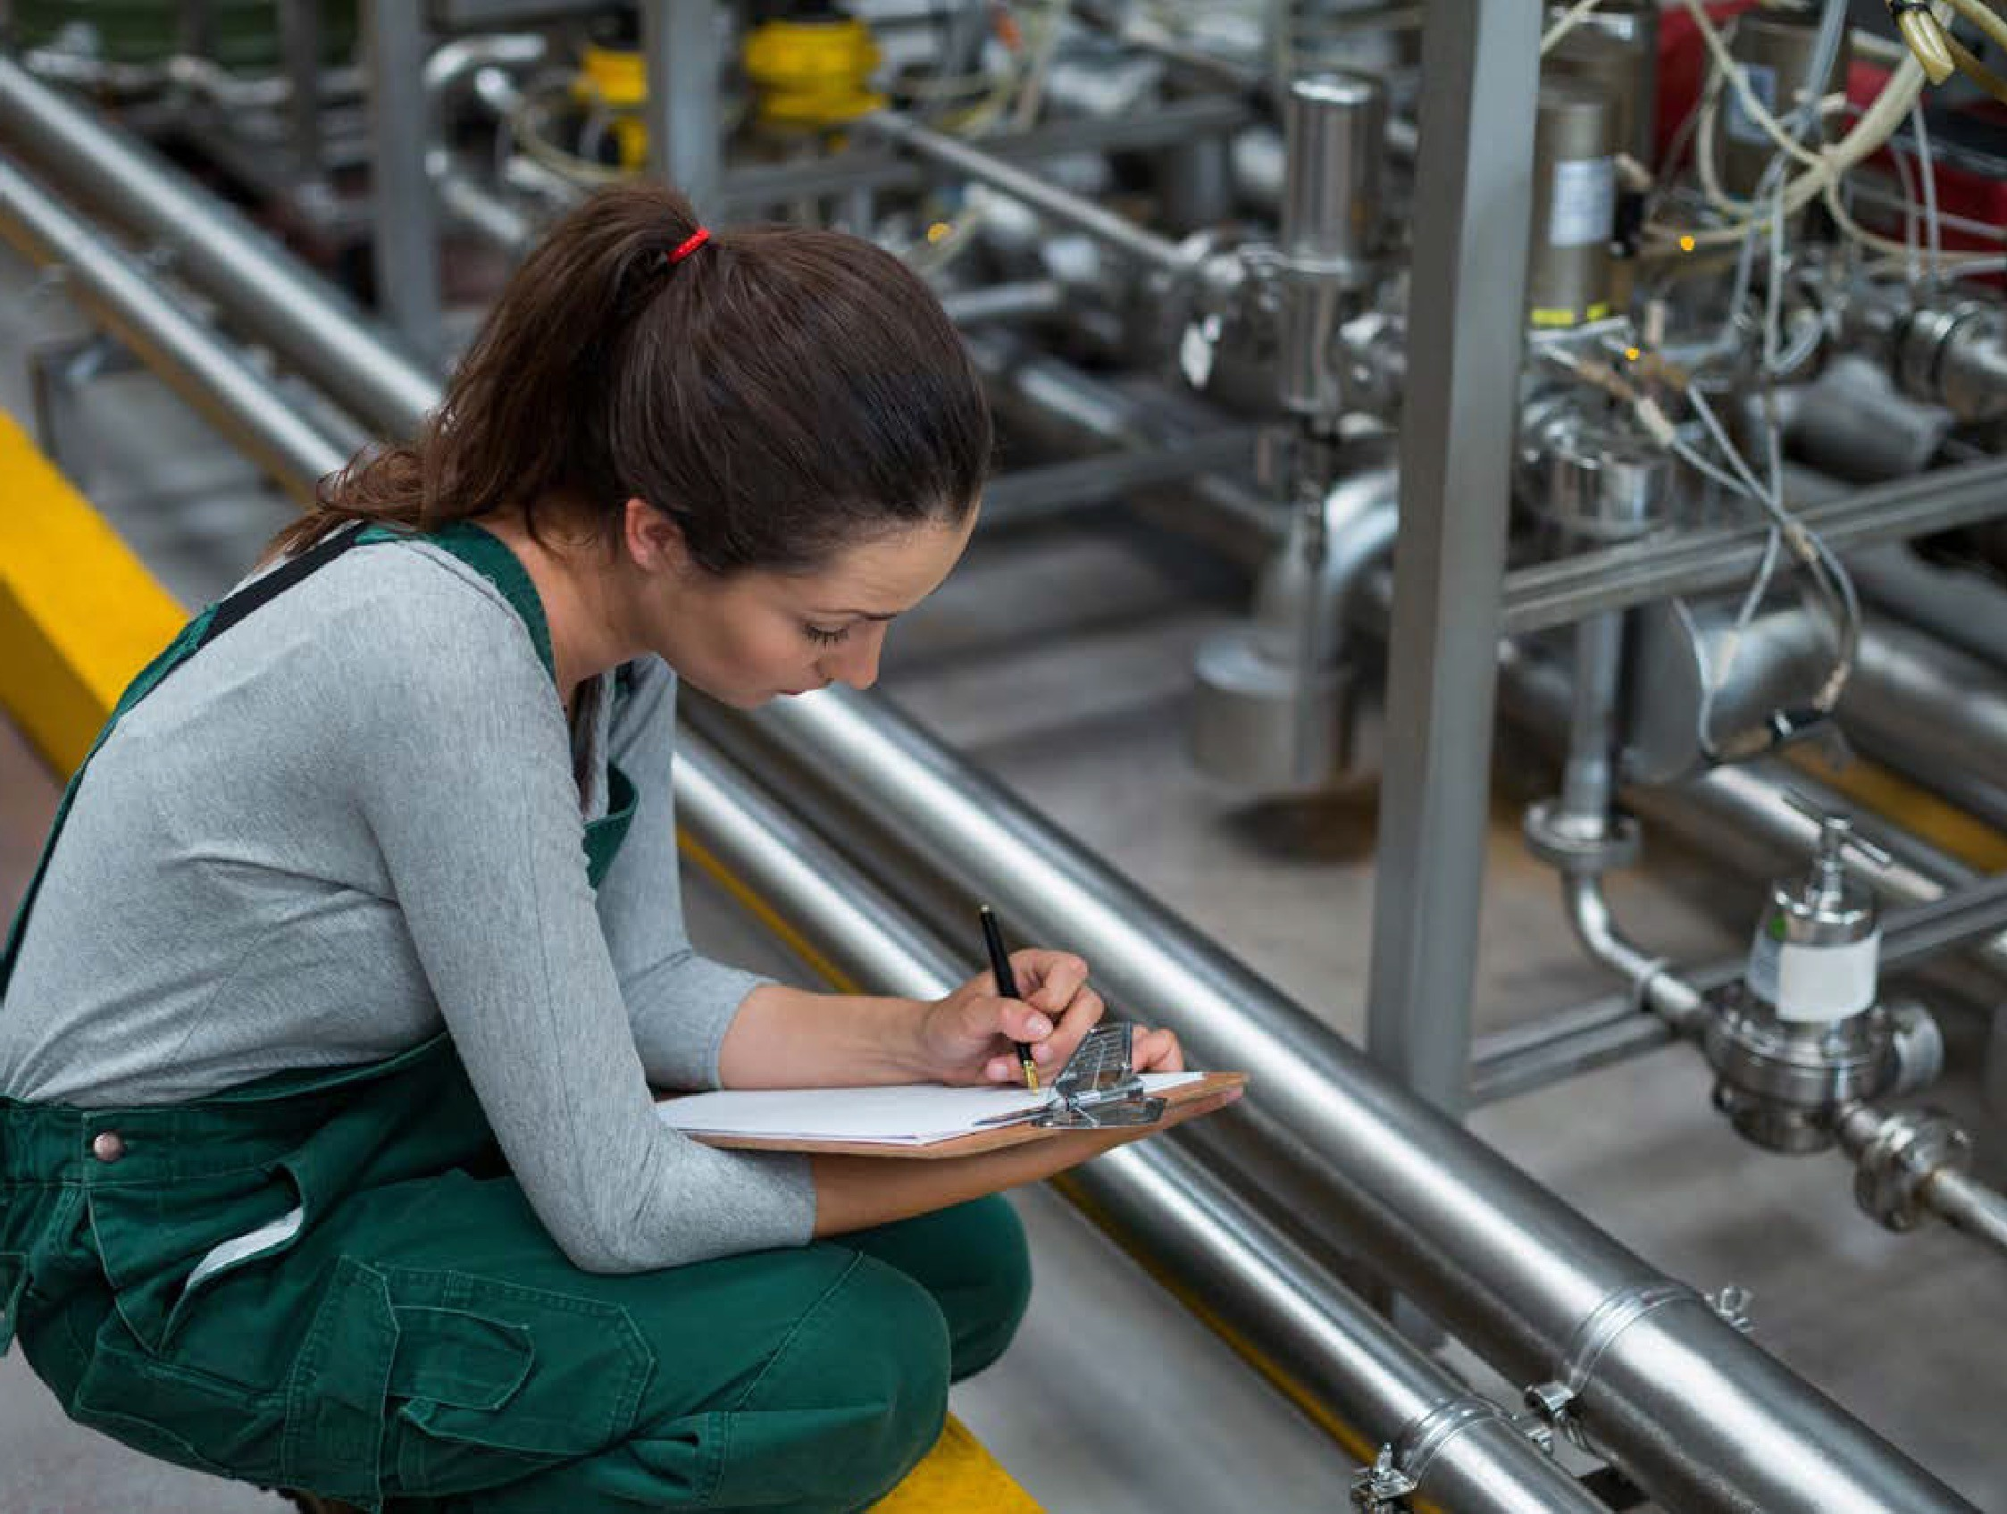
Why SUSE?
Business-critical Linux
The widest range of architectures, virtualization, container runtime, storage and network options.
Benefits: Accelerate innovation and respond to markets faster.
80
% reduction in upgrade time
Enterprise Container Management
With Kubernetes and SUSE Rancher.
Benefits: Maximize development agility, unify clusters to
ensure consistent operations, workload management and enterprise-grade security – from core to cloud to Edge.
at Continental AG after
SUSE Rancher replaced complexity with simple centralized updates
SUSE
Run SAP
SUSE Linux Enterprise for SAP Applications is the premiere Linux platform for SAP HANA, SAP NetWeaver and SAP S/4HANA solutions in manufacturing.
Benefits: Reduce service outage risks and deploy SAP services faster on-premises and in the cloud.
IT Operations at the Edge
Based on lightweight Linux, Kubernetes and storage products for x86 or Arm hardware.
Benefits: Consistency, performance, reliability, security – all vital for manufacturing Edge use cases.

Slide 5

Security embedded
Stay ahead of the curve with SUSE:
SUSE provides a foundational layer of security and resilience across critical systems to overcome the increased risk of exposure
that accompanies digital transformation. For manufacturers that means embedded
security across applications end to end. SUSE also provides a framework for compliance with internal policies and external regulations.
Given the increased attack volume and increased levels of attack sophistication, older security mindsets are no longer adequate.
CyberTalk.org
01
Delivers adaptable and agile backbone so manufacturers can innovate at pace
02
Always evolving products and services to align with the latest technology
03
Overcomes vendor lock-in with integration-ready solutions
04
Offers interoperable open architecture for ease and speed of adoption
05
Guarantees trusted security and stability

Slide 6


How SUSE is already transforming the global manufacturing industry
Continental AG
Pioneering the evolution of manufacturing with Kubernetes
Find out more
Greenpanel
Optimizing manufacturing and supply chain with highly available ERP landscape
Find out more
With SUSE, you’re one step closer to a digitized and agile future.
Find out how SUSE can help reshape your organisation and drive Industry 4.0 innovation on our manufacturing web page.
Barbier Group
Pursuing always-on, eco-friendly manufacturing
Find out more

