Slide 1




SICK AG makes uninterrupted production possible for manufacturing companies
SICK AG
Industry and Location
Manufacturing | Germany
Products and Services
Rancher Prime
Success Story

Slide 2
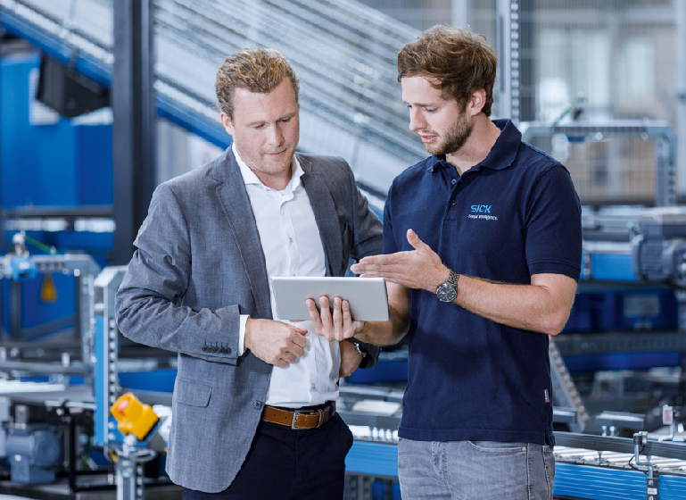
At-a-Glance
Sensor and application solution provider for manufacturers, SICK AG, is strategically expanding its product portfolio to help the industrial sector digitize its processes. To do so, the company is leaning into container architectures to develop and operate modern applications.
By providing digital services that rely on deep learning, automation, analysis tools and even augmented reality, SICK AG would help client manufacturing plants circumvent downtime, facilitate planning for maintenance intervals, and improve safety and security. It therefore started looking at container technologies, agile processes and DevOps methods.
In 2018, SICK AG was developing a new container-based application for surface-mount device (SMD) production lines. The application would monitor placement of electronic components on printed circuit boards and tap into various data sources to give manufacturers real-time insights into production and quality. The application had to connect as easily as possible with other services. In addition, SICK AG wanted to be able to provide new features and versions quickly without any downtime.
To develop and operate this and other container-based applications, SICK AG looked for a powerful container management platform.
Introducing SICK AG
From factory automation to logistics automation to process automation, the company's intelligent sensors and applications are used in manufacturing plants, logistics centers, recycling plants, power plants and refineries. Among other uses, SICK AG sensors ensure people and robots work together safely in production facilities, suitcases are loaded onto the right plane at the airport, and energy generators do not exceed permissible emission levels.
The opportunity: provide manufacturers with real-time insights
As the onset of Industry 4.0 (the latest phase of the Industrial Revolution focusing on interconnectivity, automation, machine learning and real-time data) began to digitally transform manufacturing processes, SICK AG recognized it needed to transform itself to help its manufacturing clientele lead in the new age.

Slide 3

"[Rancher Prime] greatly simplifies managing and protecting Kubernetes clusters, whether they are running in our data center or with a cloud provider."
Roman Hess IT Consultant SICK AG
Rancher Prime stands out as the most flexible and robust container management solution
After gaining initial experience with Docker Swarm, the IT team decided relatively quickly to use Kubernetes as its container orchestration tool. With automation and self-healing features out of the box, Kubernetes was the best technology to run large container environments securely and efficiently.
To make Kubernetes clusters easy to deploy, manage and monitor, SICK AG then tested different management solutions in proof-of-concept installations. In the end, the team decided to use Rancher Prime.
"Rancher Prime was able to best meet our requirements for a robust and flexible solution for the industrial environment," says Roman Hess, IT consultant at SICK AG. "The solution greatly simplifies managing and protecting Kubernetes clusters, whether they are running in our data center or with a cloud provider. We can use Rancher Prime to apply consistent security policies and access rights across the entire environment, as well as securely separate different software development projects. This is a great added value compared to standard Kubernetes."
SICK AG had learned about Rancher Prime from IT service provider, Erik Sterck, which had developed a complete solution architecture, FramES, to help clients rapidly and securely implement Rancher Prime clusters at the push of a button. In addition, the architecture includes the SUSE NeuVector container security solution and provides support for different hypervisors, cloud platforms and hyper-converged infrastructures.
The impact
Accelerated transformation
By using this solution architecture, SICK AG was able to move very quickly into productive operation of Rancher Prime and accelerate the transformation of its application landscape. Ever since the project started in 2018, the team has doubled the number of containerized applications each year, with many business-critical applications running on various Kubernetes clusters.

Slide 4
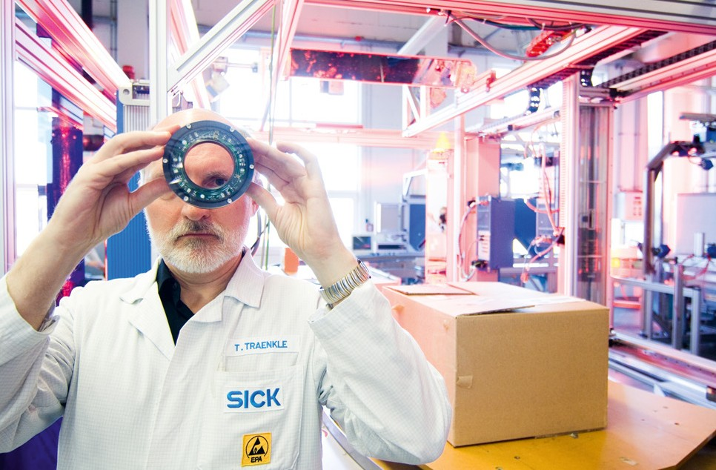
"We can use Rancher Prime to apply consistent security policies and access rights across the entire environment, as well as securely separate different software development projects. This is a great added value compared to standard Kubernetes."
Roman Hess IT Consultant SICK AG
Faster insights
The IT team now runs its resource-intensive workloads (for things like deep learning analysis) on cluster nodes equipped with powerful graphics cards; this enables new insights to be gained much faster when developing products and services.
Centralized management
"The biggest added value for us is how easily we can manage our environment," says Hess. “Whether we want to deploy a new cluster or expand an existing cluster, we can control all processes with a few clicks through Rancher Prime. Our employees don't have to deal with the details and complexities of Kubernetes; instead, they perform all tasks through the intuitive user interface.”
24/7 uninterrupted production
Rancher Prime also makes software updates very simple and straightforward. Today, when new versions of the operating system, Kubernetes or individual applications are deployed, these updates are largely automated and run in the background. Operating system migrations finish within hours instead of weeks, and new application releases are immediately available without interrupting production staff workdays, enabling 24/7 production.

Slide 5
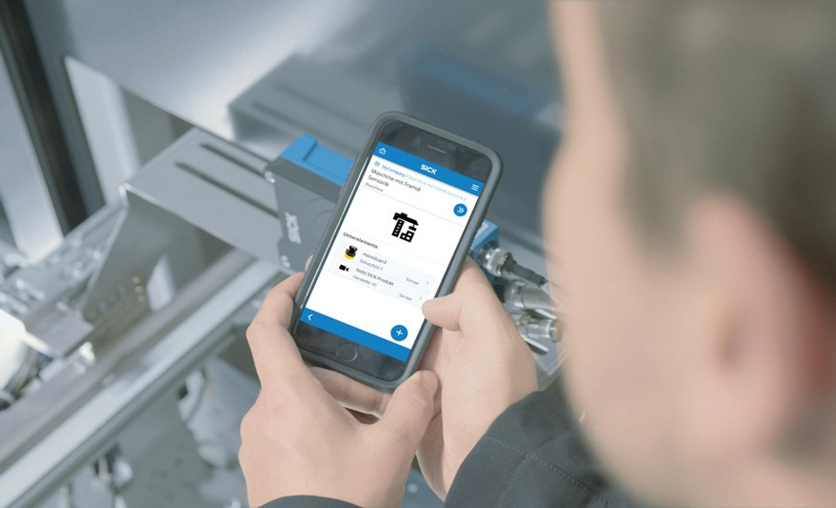
"Operating system migrations that would otherwise have taken days or even weeks can now be done within hours while the system is running. New releases of applications are also immediately available to production staff without them having to interrupt their work. We are thus equipped for 24/7 production."
Roman Hess IT Consultant SICK AG
A self-service model for faster time-to-market
Rancher Prime allows SICK AG to provide Kubernetes as a reliable service to its developers. With very little manual effort, the IT team delivers the needed resources, including persistent storage, for different projects. This allows developer teams to get started right away, add new people or allocate additional resources on their own as needed. This self-service model accelerates development processes and ultimately shortens the time-to-market of new digital services.
High availability and reliable support
Rancher Prime ensures consistent cluster operations at all levels and helps SICK AG run modern industrial applications reliably and with high performance. In the four years after implementing Rancher Prime, SICK AG hasn't had disruptions or failures.
Full security control
The team maintains full control over the security of the environment and can manage user rights and security policies centrally for the entire environment, ensuring employees only ever have access to projects they're approved for.

Slide 6
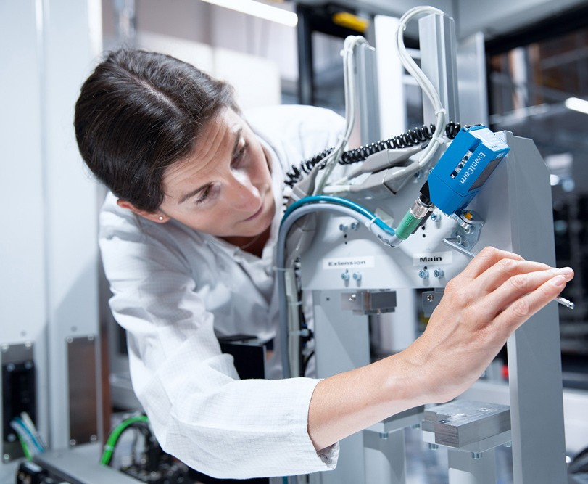
"In the four years since the introduction of Rancher Prime, there have been virtually no disruptions or failures that have affected our work."
Roman Hess IT Consultant SICK AG
The team also praises the quality of SUSE’s product support: “Requests are handled extremely professionally and at short notice,” reports Hess. “The support specialists always knew immediately what the issue was during our previous calls and were able to present us with a solution very quickly. From our point of view, it’s a huge advantage that SUSE supports the entire technology stack and can also help with questions about components such as monitoring and service mesh.”
What's next for SICK AG?
As SICK AG continues to call on Erik Sterck for technology support, its next step is to talk about container security and take a closer look at the possibilities offered by SUSE NeuVector.
With pieces of its container-based environment all in place, SICK AG will be ready to tackle sensor-intelligent solutions for the Edge.
Innovations such as K3s are therefore also of interest to SICK AG. "We will certainly investigate where the use of Kubernetes and Rancher Prime at the Edge makes sense for us," says Hess.

Slide 7
Benefits
Accelerated transformation of application landscape.
Faster insights when developing products and services.
Simplified Kubernetes cluster deployments, extensions and management.
24/7 uninterrupted production.
Accelerated development processes and time-to-market of new digital services.
Zero disruptions or failures in the four years after implementation.
Find out how SUSE can help you become an innovation hero!
Sales-Inquiries-APAC@suse.com
Sales-Inquiries-EMEA@suse.com
Sales-Inquiries-LATAM@suse.com
Sales-Inquiries-NA@suse.com

Slide 8



Learn More
Access SUSE Chinese website: https://www.suse.com/zh-cn/
Call SUSE at 010-65339000
Scan and follow SUSE WeChat account
SUSE WeChat account
Rancher WeChat account
Innovate Everywhere
SC000017 | © 2023 SUSE LLC. All Rights Reserved.
SUSE and the SUSE logo are registered trademarks of SUSE LLC in the United States and other countries. All third-party trademarks are the property of their respective owners.

