Slide 1



From automotive to software-driven mobility
Digitized. Innovative. Industry-leading.

Slide 2

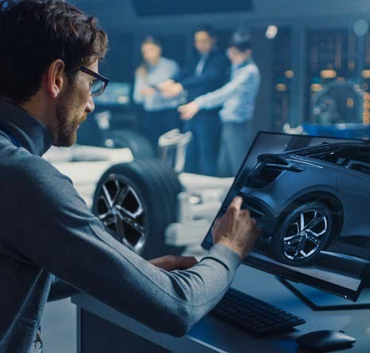
In the near future, software will define vehicles
We'll see the biggest impacts in…
Digitized supply chains and manufacturing -software-enabled production is essential as the sector confronts its lack of agility and the new flexibility needed to transform rapidly.
01
02
Transferring content to and from vehicles – multiple opportunities exist – everything from servicing and aftersales to data sharing – as OEMs explore software over-the-air (SOTA) and firmware over-the-air (FOTA) updates.
With new entrants and enlivened incumbents, competition is fierce as automakers tackle the reality of CASE - Connected, Autonomous, Shared and Electric driving.
Disruption is transforming the automotive industry, and the next five years will bring a reengineering of the competitor landscape. However, it’s the next 12 months that will be a defining period as focus hardens, particularly around electrification, software integration, and digitization of customer journeys.
Software will be what differentiates players in the automotive industry within a few years.
McKinsey Center for Future Mobility
03
Building a culture of innovation – collaboration with technology providers will be essential for automotive businesses looking to add expertise, agility and resilience to power growth.
04
Embracing cloud technology – success will be based on the deployment of open, reliable and flexible app platforms to the Vehicle Edge for monetization using cloud-based products.
05
Adoption of connected platform hardware – avoidance of vendor lock-in and the need for open network governance required for use of multi-cloud, on-premises and Edge use cases.

Slide 3
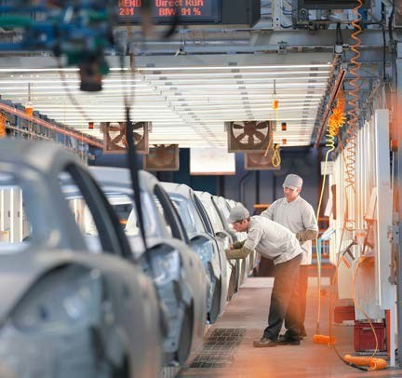


Automotive industry's digital transformation journey
Where is the industry today?
How will the industry get there?
The automotive industry is making huge investments in R&D, IT systems and talent. Currently, it's one of the top ten R&D spenders. Partnerships with Google, Microsoft, AWS, and other IT providers are producing world-leading software that makes this industry a digitalization and product innovation leader. However, approximately just 10% of its coding takes place in-house.
Where does the industry want to go tomorrow?
By 2030, all new vehicles will run on manufacture's own software and 60% of coding will be in-house. Its ambition is to make their major plants "a flagship for innovative and fully networked production". This means intelligently networked supply chains, digitized aftersales, and climate neutrality by 2050. This is an industry standard plan for a return to profitable growth.
Innovation in the next 5-10 years is crucial if companies want to stay ahead of industry entrants, as is the development of a standardized group platform so the industry can stay technologically independent.
As part of the industry's digitization program, most companies will:
Realize a 10% reduction in fixed costs by 2026
Increase productivity by 5% each year
Reduce material costs by 5-8%
Spend $3 billion a year on its software capabilities
Grow their IT workforce by 150% in five years
Make coding part of their DNA
"We have to become a software-driven car company."
Herbert Diess, Chairman, Management Board at Volkswagen Group.

Slide 4
How can auto manufacturers use software to overcome critical challenges?
Developing reliable vehicle autonomy to grow acceptance
Concerns around passing control of cars to computers, safety and security of vehicles that rely on streamed data are well founded. Acceptance of greater vehicle autonomy relies on the reliability and advancement of automated driver assistance features. This software-driven technology can bridge the gap between driver control and computer-controlled vehicles.
Connected cars – turn vehicles into devices to boost CX and safety
Developing proprietary software solutions and digital services that will be delivered through SOTA and FOTA network connections will help create new revenue streams for carmakers and greater satisfaction for vehicle users.
Data generated by cars can be applied for safety and other services and help connect vehicles to each other and the road environment.
The answer is openness and interoperability.
Linux will be the common operating system across the automotive sector. It will enable simpler partnerships and collaboration through the creation of custom-made distribution.
By making use of open source technology, every player in the automotive sector can help power innovation. Customer feedback cycles for product releases can become much more frequent and the industry can start to move beyond its major obstacles.
56m+
developers contribute to open-source projects
BCG
Secure talent pipeline with the latest technology
The best people don't want to work with legacy technology, they want new and exciting projects. To continue a growth trajectory, automakers need to attract and retain the best developers by making it possible for them to work on the latest platforms and a rich spectrum of technology applications with a wide ecosystem of partners.
Gain agility and resilience with Industry 4.0
With automated and digitized manufacturing, end-to-end supply chain visibility, and agile processes supporting resilience, carmakers can optimize efficiency and cost-effectiveness.
Through smart applications of technology and the right partnerships, carmakers can future-proof their organizations and better understand innovations impacting the sector.

Slide 5
The future of the auto sector will be built on:
Linux – the OS of choice for both SAP and in-car apps
Containers – We have Rancher – the leading container management platform
SLES – the recommended Operating
System to run SAP
SLE Micro – the Linux OS for Edge
K3s – the Kubernetes distribution for Edge
SUSE is the ideal software partner for the automotive industry because of our experience, trust and broad integrations.
SUSE is a leader in intelligent Edge computing solutions based on lightweight Linux, Kubernetes, and storage products for x86 or Arm processors.
In the production line
Modernized manufacturing IT will enable predictive maintenance, machine learning, and services on the shopfloor like stock picking apps and the use of mobile Edge devices in place of fixed PCs. As an early innovator, SUSE can enable your Industry 4.0 transformation with critical Edge Kubernetes distribution and Edge operating systems.
Auto sector transformation is a race – here's how SUSE can help:
In the CX chain
As every part of customer experience is digitized, rapid development of new services will be critical. Fast feedback loops between users and developers, continuous delivery, and improvement of software-based services demand high-quality DevOps, organizational software agility, and cutting-edge tools.
Containerized applications and Kubernetes are at the heart of cloud-native transformation.
With Rancher, SUSE offers the most widely adopted platform for container management,
whether the application runs on-premises, in the cloud, or on an Edge device.
SUSE has a long history of delivering open source technologies to the automotive sector. We were the first Enterprise Linux distributor to go to market in 1992 and currently, 12 of the 15 largest automotive vendors run our solutions.
Our embedded automotive solutions will underpin the advanced autonomous driving of the future. Make use of our our Edge systems and network capabilities.
that have unmatched security, intelligent computing and resilient open-source development.
SUSE can help you manage Edge and Embedded Devices from a single location, providing you a central management platform. As a specialist provider, we bring consistency, performance, reliability and security to all automotive Edge use cases.
In the car
With SUSE, gain an open and secure software platform on which to develop the future of driving. Make use of a single, unified code base (Intel, ADM, Arm), and real-time and safety-certified Linux.
Benefit from multi-layered quality assurance, long lifecycles, and our partnership with Bosch Car Multimedia – which powers more than a billion connected devices across millions of vehicles.

Slide 6
Discover how we're already transforming the global auto industry
Daimler AG
Discover how SUSE software cut IT service provision services time to 20 minutes and reduced the number of UNIX instances by 40%.
Honda Pakistan
Discover how to use SUSE and SAP to create better Customer Experiences, ensuring uptime and system availability.
Find out more
Find out more
Bosch Car Multimedia
Discover how use of multiple SUSE products reduced IT expenditure and improved system reliability.
Continental AG
Discover how use of Rancher enabled an 80% reduction in migration time and 80% reduction in upgrade time.
Find out more

Slide 7
Know more
To discover how SUSE can help you to complete your digital transformation into a software-enabled automotive business, please get in touch.
Please visit:
https://suse.to/automotive

