Slide 1

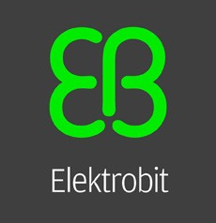
Elektrobit: Driving the Future of Automotive with Open Source and SUSE
Elektrobit
Industry and Location
Automotive | Germany
Product(s) and Service(s)
Safety Linux
Long Term Service Support
Success Story

Slide 2

At-a-Glance
As a leader in automotive software solutions, Elektrobit looked to open source and SUSE to build a secure foundation for the future of driving automation.
Figure 1: Alexander Kocher, President of Automotive Business Segment and Managing Director
Introducing Elektrobit
Elektrobit (EB) is an award-winning and visionary global supplier of embedded and connected software products and services for the automotive industry, operating as a wholly owned subsidiary of Continental AG.
The Digital Revolution Meets the Automobile
Having transformed the way we learn, communicate and work, the digital revolution is about to redefine the way we drive. Due to technical maturity making advancements possible, the automobile industry is poised to invest $52 billion in automotive software for autonomous driving and connectivity features by 2025. As a result, the autonomous driving software market is expected to increase at a compound annual growth rate of 17 percent between 2019 and 2025, and 30 percent of a car’s value will come from its software by 2030.¹ This shift has captured the interest of vendors and manufacturers in the forefront of reinventing the modern automobile.
Elektrobit: Driving Solutions for the Future of Automotive
One such innovative vendor is Elektrobit. Founded in 1988, and now a wholly owned subsidiary of Continental AG (one of the largest multinational automotive parts manufacturing companies), Elektrobit provides the automobile industry with embedded and connected software products and services. Already powering over 1 billion devices in more than 100 million vehicles, their pioneering solutions support connected car infrastructures, human machine interface technologies, driver assistance, electronic control units and software engineering services. Their customers include world-renowned brands such as Audi, BMW, Ford, Mercedes, Tesla and VW, helping these companies deliver compelling, software-based experiences for end-users.
As automotive manufacturers rely more heavily on software to redefine the way we drive, Elektrobit is well positioned to become an increasingly strategic vendor for organizations focused on automated driving.
1 In 2010, software made up 10% of a car's value.

Slide 3
"The key point in openness is freedom and flexibility—open source software within automotive allows car manufacturers to innovate on the base technology and implement their innovations."
Alexander Kocher
President of Automotive Business Segment and Managing Director Elektrobit
Automation Speed Bumps
Hands-free driving is not a pipedream. Experts predict out of all passenger-kilometers traveled in 2040, 66% will be facilitated by autonomous vehicles.² If fully adopted, autonomous driving will have a dramatic impact on public benefit. Not only will cars become productive living spaces, health care costs will decline as accidents decrease, and road congestion will lessen as demand for private vehicle ownership shifts to shared vehicle usage.³
As the industry races toward these advancements, Elektrobit considered the best way to stay competitive while tackling a robust set of accompanying challenges:
Scale of Coding: Today’s connected carsrun on 100 million lines of code. Adding
in the lines needed for full automation would be hugely complex.
Interoperability: The software would need to work with various automotive manufacturer system requirements.
Safety: It would need to comply with government safety regulations that vary regionally.
Cybersecurity: A significant enough concern to recruit government agencies and automotive companies to work on creating protected environments for both the upload and download of updates, traffic information, diagnostic details and more.
Elektrobit needed a partner that could help deliver interoperable software innovations faster while meeting each safety requirement and regulation. Elektrobit believed such a partner could be found in the world of open source.
The Power of Open Source for Automotive
The value in open source software, from the data center to the open road, is made possible by the power of many. Developers from around the world, free of any bureaucratic limitations to innovation, contribute to the Linux code base to enable technology that can be used to solve real world challenges and advance emerging technologies, such as autonomous driving.
https://www.mckinsey.com/industries/automotive-and-assembly/our-insights/how-china-will-help-fuel-the-revolution-in-autonomous-vehicles McKinsey, January 2019
https://www.mckinsey.com/industries/automotive-and-assembly/our-insights/the-future-of-mobility-is-at-our-doorstep McKinsey, January 2019

Slide 4
Advancing Open-Source Innovation with SUSE
Arriving in 1992 as the first enterprise distribution to go to market, SUSE has a long-standing heritage of delivering rock-solid Linux infrastructure to the enterprise. Additionally, the organization has supported the automotive industry with its hardened enterprise Linux solutions since 2008. Currently, 12 of the 15 largest automotive vendors run SUSE solutions, but experience isn't the only thing about SUSE that captured Elektrobit's attention.
SUSE's approach to open-source technology—whether it be in the data center, cloud or embedded system development—ensures a truly open environment. SUSE's open-source philosophy is based on a customer-centric approach that eliminates vendor lock-in, keeping options open and costs predictably low.
Additionally, SUSE's powerful support agreements, including product lifecycle support for 15 years, allows businesses like Elektrobit to focus on developing their innovations rather than consuming time with updates and patch management.
As a leader in embedded technology, Elektrobit also found alignment in SUSE’s flexible, embedded business model. By partnering with SUSE, they could build a hardened security system for computing at the Edge with advanced methods for collecting, processing, managing and storing data that will power the required systems to make autonomous driving a reality. With SUSE’s truly open-source approach to doing business and developing technology, the two partners agreed to create a foundation for the future—Safety Linux.
When talking about the value of a publicly accessible code base, Elektrobit's President of Automotive Business Segment and Managing Director, Alexander Kocher, explains, "Transparency provides both the end customer and the OEMs with insights into the system. A transparent system allows faster detection of issues or vulnerabilities and thus more control. If the software is out in the open, this can help to make it more secure, and this ultimately also benefits the consumer trust."
Kocher continues: “Open source has been used in automotive for over 10 years and is considered a standard in today’s vehicles, especially when we think of infotainment and communication systems. The key point in openness is freedom and flexibility—open-source software within automotive allows car manufacturers to innovate on the base technology and implement their innovations.”
In other words, Elektrobit would not have to start from nothing. They would be able to leverage the millions of lines of code already available as a means to jump-start their path toward innovative advancements, making driving automation a reality much faster.
Understanding their solution needed to be Linux-based, Elektrobit needed to select one out of almost 600 Linux distributions. Their criteria: a hardened, supported, enterprise version that would be flexible, reliable and secure.
In SUSE, they found a partner that could not only meet such criteria. SUSE would also help them deliver software innovations faster while adhering to each safety requirement and regulation.

Slide 5
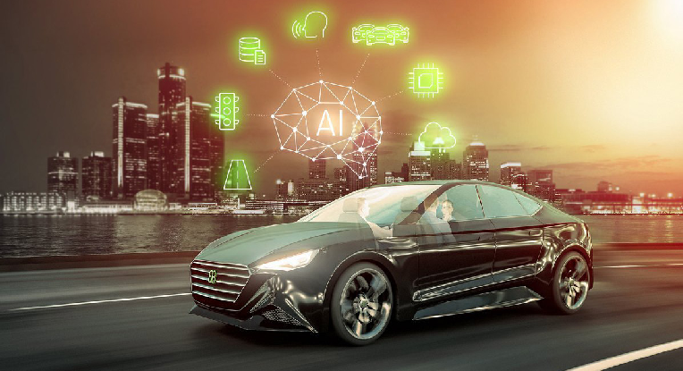
Why Elektrobit partnered with SUSE:
Agility and interoperability
Edge computing capabilities
15-year product lifecycle support
Truly open source environment—no vendor lock-in
Hardened security
Simplistic implementation
World class engineering
Competitive and flexible pricing
What is Safety Linux?
Safety Linux will be an embedded Linux solution designed for automotive manufacturers and industrials committed to advancing autonomous driving through Edge computing systems and networks. With unmatched security, intelligent computing power, and the strengths of open source development, Safety Linux will earn consumers’ trust to let go of the wheel while paving the way for driving automation innovation. It will incorporate intelligent, real-time, data-driven decision making in secured, certified environment that is both reliable and scalable.
It will address the binary needs of security and flexibility, connecting with older systems and operating just as effectively with future technologies. It will speak a variety of code languages with seamless interoperability, allowing it to adapt invisibly to manufacturer trade secrets and local jurisdiction requirements.
By bringing together the best features of SUSE Linux Enterprise Server and the capabilities of the SUSE Linux Enterprise Real Time kernel into a consolidated, light weight platform for the automotive industry, SUSE will help Elektrobit provide its end users with high availability and reduced latency while increasing the predictability and reliability of time-sensitive and mission-critical ap plications. As a result, auto manufacturers will have the security, connectivity, and reliability needed to take autonomous driving to the next level.
Conclusion
When it comes to autonomous driving, there is no room for error. Consumers will not accept uncertainty from autonomous vehicles in the same way they tolerate unpredictability from other human drivers. Faulty systems could overturn the industry direction overnight. As the largest independent open-source company in the world with a global partner ecosystem and an open-source ethos to help its customers and partners solve complex problems across a wide range of industries, SUSE is committed to helping Elektrobit develop Safety Linux carefully and deliberately to foster global confidence in adopting driving automation.
Manufacturers and vendors only have one shot to do this right, otherwise they could face years of setbacks. Aiming for their greatest chance of success, Elektrobit decided to leverage the ingenuity of open source through SUSE and is moving forward with confidence.

Slide 6
Benefits
+ Agility and interoperability
+ Edge computing capabilities
+ 15-year product lifecycle support
+ Truly open source environment—no ven- dor lock-in
+ Hardened security
+ Simplistic implementation
+ World class engineering
+ The creation of a foundation for the future of driving automation—Safety Linux.
Find out how SUSE can help you become an innovation hero!
Sales-Inquiries-APAC@suse.com
Sales-Inquiries-EMEA@suse.com
Sales-Inquiries-LATAM@suse.com
Sales-Inquiries-NA@suse.com

Slide 7

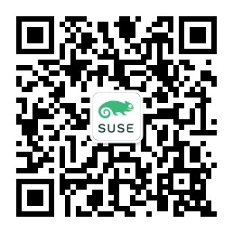

Learn More
Access SUSE Chinese website: https://www.suse.com/zh-cn/
Call SUSE at 010-65339000
Scan and follow SUSE WeChat account
SUSE WeChat account
Rancher WeChat account
Innovate
Everywhere
268-002689-002 | © 2021 SUSE LLC. All Rights Reserved. SUSE and the SUSE logo are registered trademarks of SUSE LLC in the United States and other countries. All third-party trademarks are the property of their respective owners.

