Slide 1

ARDUINO
VICKY JENDRA N.D

Slide 2
Arduino is an open source single board microcontroller / micro controller and is one of the most popular Open Source Hardware projects. Designed to facilitate the use of electronics in various fields.

Slide 3
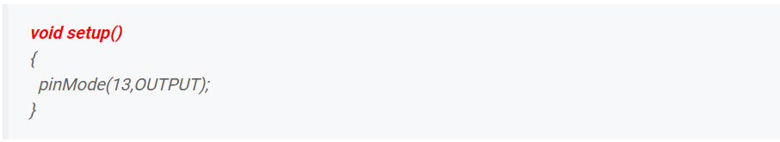
Arduino structure
1. void setup()
The void setup function on the Arduino is as a form of initialization or introduction in the Arduino program and is only executed once since the program is run.

Slide 4
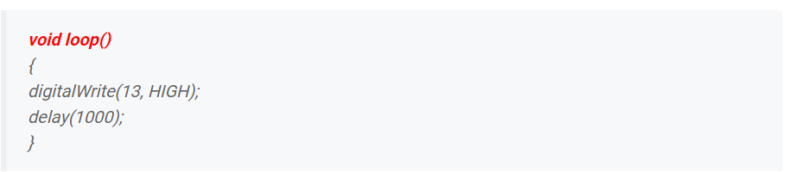
arduino structure
2. void loop()
After void setup() is executed, then the program will run the void loop() function.
This function will be executed continuously in sequence until the program stops executing. Have a look at the sample void loop() function below:

Slide 5
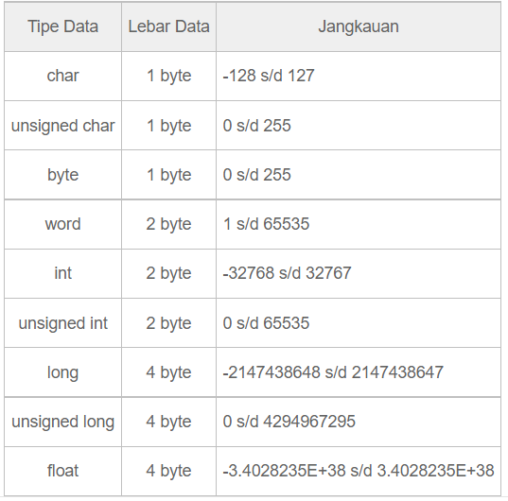
Arduino C Language Data Type

Slide 6
Arduino Variabel
Variables in the Arduino programming language can be defined as a container for storing or storing data.
We are free to choose the desired variable name, as long as it complies with the following conditions:
Don't use spaces
Maximum 32 characters
Do not use standard terms in Arduino C language
For example, suppose you want to define the value of pin 2 with the variable "handsome" and use the integer data type. So an example of writing is:

Slide 7
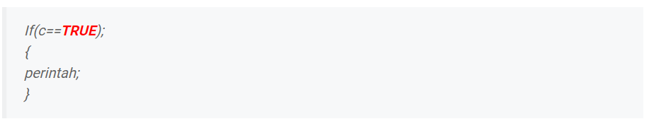
Constant Value In Arduino Programming
TRUE/FALSE
TRUE and FALSE are boolean constants used to define logical levels. Is it true (TRUE) or false (FALSE).
TRUE is defined as 1 and FALSE as 0. See the following example of writing format:

Slide 8
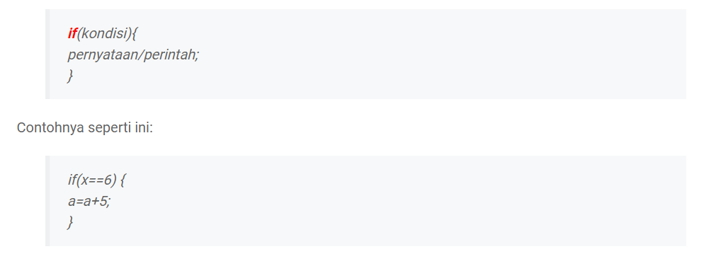
Testing Conditions in Branching Arduino Programs
1. if
This command is used when there is only one statement to be executed. So if the condition is met then the statement will be executed. And if it does not meet then the statement is not executed. The format for writing the command is as follows:

Slide 9
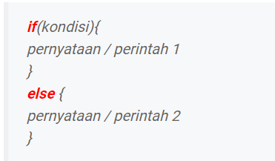
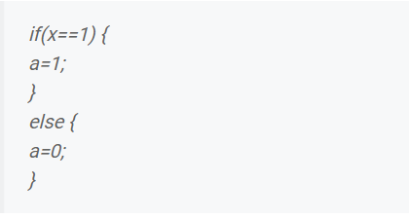
2. if ... else
Unlike if, the if ... else command is used when there are two choices of statements to be executed.
If the condition is met, then the command in the if will be executed. And if not, then the statement inside the else will be executed. The form of the writing format is:

Slide 10
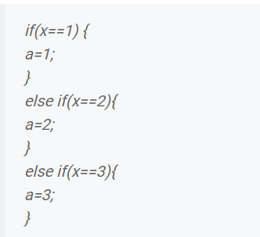
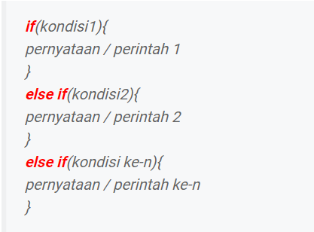
3. if ... else if
The difference between the if ... else if command and other if commands is that it can test more than one condition.
That's the reason why this command is often called the Arduino nested if command. An example of the writing format is as follows:

Slide 11
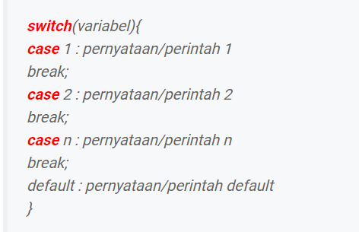
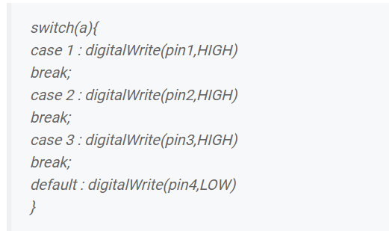
4. switch case
This command is used to select the correct statement based on the existing conditions. Unlike the if command, the switch case command uses variable values ​​for testing.
If the value of the variable meets the conditions of one of the cases, it will execute the statement in that case.
And if there is no variable value that matches one of the cases, the default statement/command will automatically be executed.
The structure of writing a switch case on the Arduino IDE is as follows:

Slide 12

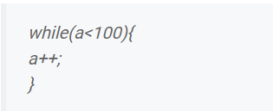
Loops in Arduino Programming
1. while()
The while function on Arduino allows for an infinite loop as long as the conditions in it are met. The writing format is like this:

Slide 13
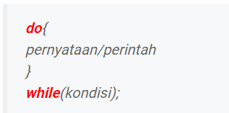
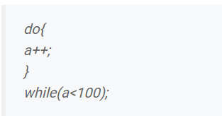
2. do ... while()
This command serves to execute a statement or command and then see the conditions in the while.
If the conditions match, the statement will be executed again. And if not then the statement will not be executed. The writing format is:

Slide 14
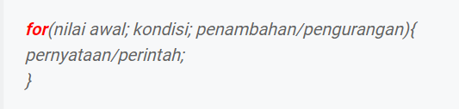
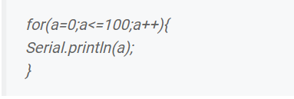
3. for()
The for function on the Arduino is to perform a limited loop. In the for command must include the initial value, condition, and addition (increment) or decrement (decrement).

Slide 15




4. goto
This command is usually used to jump directly or to a command that has been labeled. The format for writing commands that have been labeled like this.
And to call or run command in label use this command
Suppose I want to make a command to turn on the light on pin 1 with the label name "on", then you have to type this command
As for the call using this command.

Slide 16
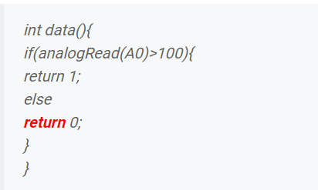
5. return
The return function on Arduino is to provide the return value of a function. See an example of Arduino's return function below:

Slide 17
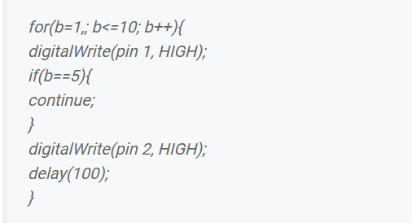
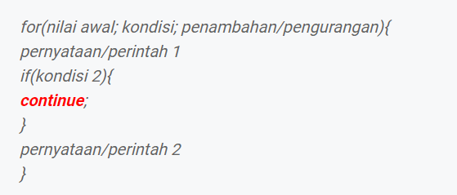
6. continue
The continue command is generally used to skip the remaining loops of the loop structure. Whether it's do, for, or while.
The following is an example of using the continue command in a for loop.

Slide 18
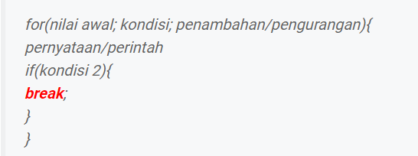
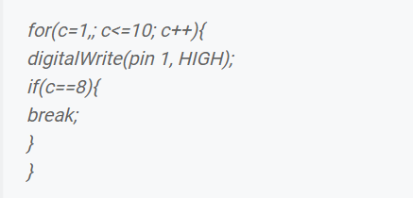
7. break
Simply put, the Arduino's break function is to force a loop to stop prematurely. Whether it's in a for, while, or do ... while loop.

