Slide 1
MOOCversity – Deep Learning based Dropout Prediction in MOOCs over Weeks
By
Raghul S
Vignesh M
Guided By
Dr. N. Bhalaji

Slide 2
Abstract
Massive Open Online Courses (MOOCs) has seen a dramatic increase of participants in the last few years with an exponential growth of internet users all around the world.
MOOC allows users to attend lectures of top professors from world class universities.
Despite flexible accessibility, the common trend observed in each course is that the number of active participants appears to decrease exponentially as the weeks progress.
The structure and nature of the courses affects the number of active participants directly.

Slide 3
Abstract
In this project, we take an initial step to use the deep learning algorithm to construct the dropout prediction model and produce the predicted individual student dropout probability.
The deep learning algorithm takes the weekly history of student data into account and thus is able to notice changes in student behaviour over time.
Additional improvements are made to optimize the performance of the dropout prediction model and provide the course providers with appropriate interventions based on a temporal prediction mechanism.

Slide 4
Objectives
Provide a set of comparisons between various models to find which of them performs accurately. We use metrics such as Area under the curve, Precision, Recall, and Confusion Matrix to compare the results.
Provide improvements in the structure of the course so that the course providers can see how each week's course content is accessed and get an estimate of the number of students completing or not completing the week.
Provide suggestions to students based on their previous week's probability of completion and compare them with similar features in the training dataset.
To promote MOOCs within university premises.

Slide 5
Motivation
Great scholars around the world are primarily motivated to make education accessible to everyone. This can only be achieved if the traditional education methods go hand in hand with the modern technological mediums like MOOCs.
With a "one size fits all" approach followed by MOOCs, and lack of face - to - face interaction, the motivation of students to follow the course oscillates.
A common trend observed in each course is that as the weeks progress, the number of active participants appears to drop exponentially.
Main motive is to predict the dropout of learners using their interaction activities with MOOCs and popularize their usage.

Slide 6
Literature Review
The authors in [12] identify four different learner engagement classes within MOOCs based on two core attributes: accessing of video lectures and grades obtained from assignments. In this case, the authors used clustering techniques to describe engagement activity in MOOCS.
The research conducted in [7] highlights the prediction of dropout using the activity features of the learner. The dropout was predicted based on the students' total absence time instead of the student's last visit to the course. This includes students who drop off the course after several days after their inactivity.
By considering the users' clickstream data, the authors of [3] presented a novel solution to predict weekly dropout rates in a particular course. They provided a comparative study between different machine learning algorithms.

Slide 7
Literature Review
In [5], Feed forward Neural Network has been implemented to predict student attention in MOOCs, taking into account student sentiments. In this case, only the behavioural attributes are used to measure the performance of learners.
Research in [18] includes building prediction models in MOOCs in three interrelated directions and also discussed the limitations present in each of the method.
The experiment done by the authors of [9] provided a deep insight into how Deep Neural Networks will help predict the dropout using clickstream data. This work helped us understand the functioning of Neural Networks.
[6] Discusses how Neural Networks reinforces the sentiment analysis process that predicts the attrition of students in MOOCs.

Slide 8
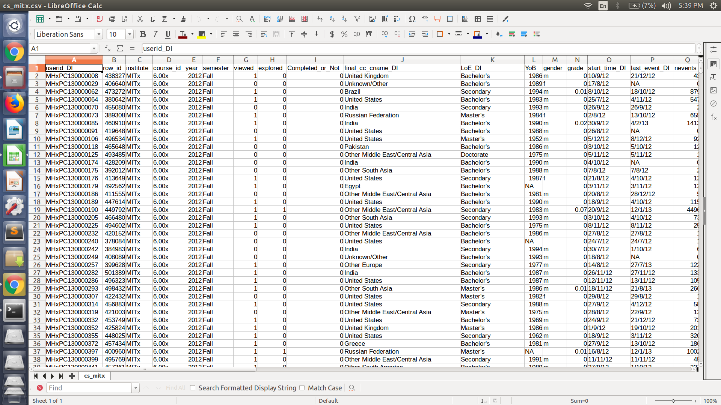
Dataset
The project uses the online datasets containing the student’s activities in course Introduction to Computer Science and Programming.
The dataset consists the detailed course-student interaction informations of around 83,383 students over 5 weeks duration.

Slide 9
Feature Engineering
Feature engineering was done to choose the best features from the entire dataset. We started with the full model and eliminated one variable at a time until the parsimonious model is reached. This was done using two methods.
Feature Importance: By using the feature importance property of our model, we can get the feature importance of each feature in our dataset.
Correlation Matrix: Correlation indicates how the features are related to each other or the target variable. Correlation can be positive (increase in one feature value increases the target variable's value) or negative (increase in one feature value decreases the target variable's value).

Slide 10
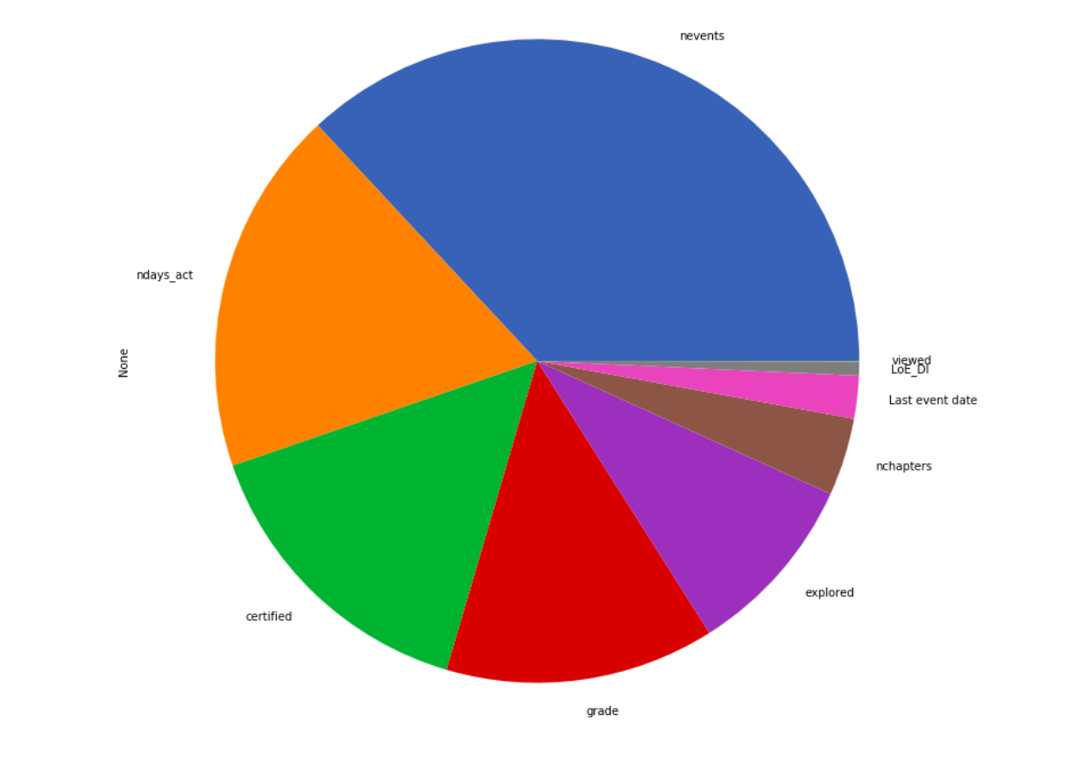
Feature Importance

Slide 11
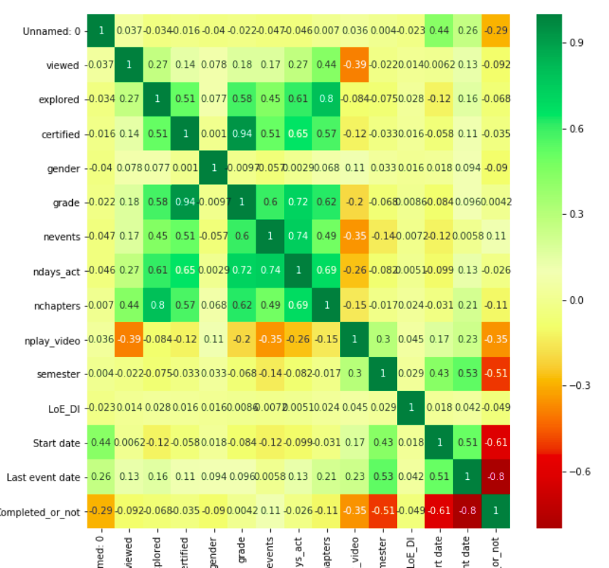
Correlation Matrix

Slide 12
Features
After performing feature engineering, the best features chosen are:
Viewed - A binary valued feature which specifies whether the particular week lecture has been viewed or not.
Explored - A binary valued feature which is set to 1 if more than 50% of the week’s content has been explored.
Grade - Value of grade obtained in that particular week. Value ranges from (0 to 1).
Nevents - Specifies number of events performed in that particular course page including pausing and playing videos, quiz activities, page navigations, forum posts etc.
Ndays_act - Specifies number of days the student has been active in that particular week lecture.
LoE_DI - Categorical feature which has information about the highest level of education of every course taker.

Slide 13
Features
Nplay_videos - Specifies number of seconds the video has been played.
Nchapters - Specifies number of chapters viewed in that particular week lecture.
Last event date - Specifies the last date of accessing the weeks’ course content. Value is converted into timestamp.
Completed_or_Not - The binary class that specifies if every student has completed the particular week lecture.

Slide 14
Data Preprocessing
After choosing the features, the data was cleaned and the missing values were imputed using various pre-processing methodologies. They are:
KNN was used to fill the missing numerical values to the nearest cluster that was present.
For categorical data, “One-Hot Encoding” was performed to dichotomize into binary values.
Converting Last event date into timestamp values.
Using Tomek Links to perform undersampling by removing the instances of majority classes of each pair and increase the space between the two classes.

Slide 15
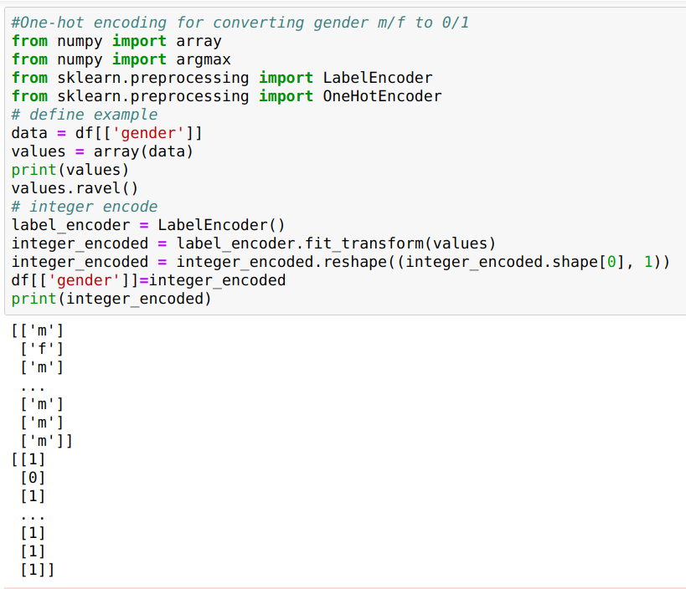
One-Hot Encoding

Slide 16
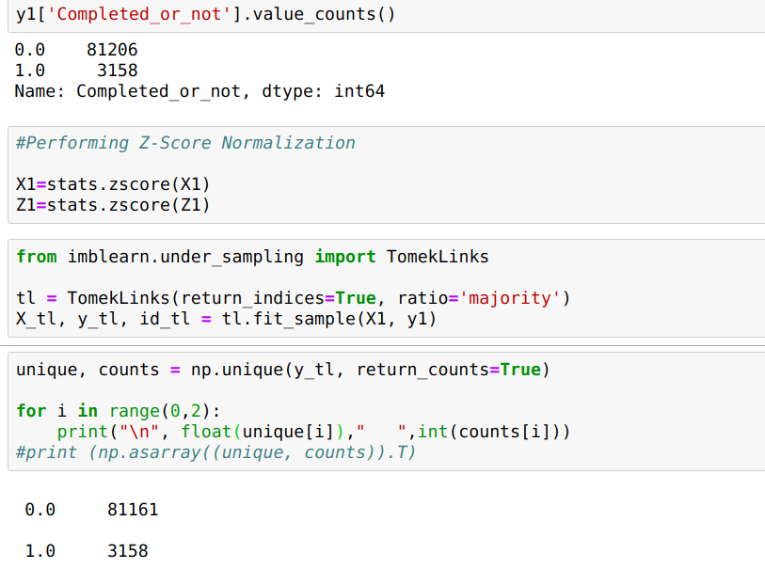
Undersampling using Tomek Links

Slide 17
Proposed System
The main goal of MOOCversity is to predict student dropout in a particular MOOC over weeks.
The system is fed weekly information from all the students who have enrolled 5 weeks for the course.
This includes personal user details as well as clickstream details. The clickstream data is our main feature that can tell how each student has interacted with the course over weeks.
Various linear and nonlinear supervised machine learning has been employed to predict learners’ dropout. Some of the models are Logistic Regression, LDA, Naive Bayes, SVM, Decision Tree and Multilayer feed forward (MLF) neural network. Among the six models, the neural network showed better precision and recall values and was chosen to build the entire system.

Slide 18
Proposed System
A binary class output is provided by the model: learners who have completed and those who have not.
The course instructors are given a detailed weekly analysis where they can find out which week has the most dropouts. They can also view about how various students have fared out over these weeks.
Students are also provided with interventions based on their performance. The probability with which the student completes or not is carried over to subsequent weeks as it shows how the performance of a student in the current week is dependent on his previous weeks’ cadence to provide more personalized suggestions.
Each student obtains a weekly rank for their performance.

Slide 19
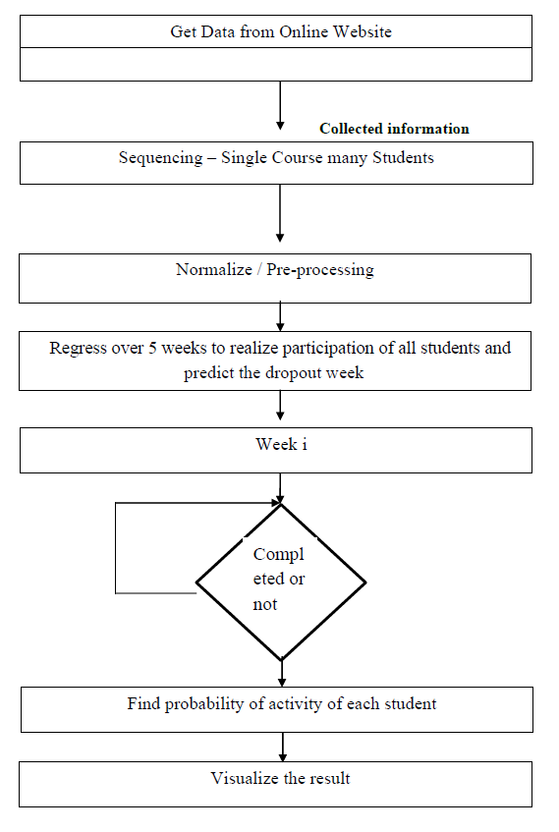
Workflow Diagram

Slide 20







Technological Stack
Software used :
Languages used:
Machine Learning Frameworks used:

Slide 21
Implementation - Algorithms
In this module we made use of six algorithms and varying certain features to have an initial phase of comparison. The algorithms used are:
Machine Learning Approaches
Support Vector Machines
Logistic Regression
Naive Bayes Classification
Linear Discriminant Analysis
Decision Tree
Deep Learning Approach
Multilayer feedforward Neural Network

Slide 22
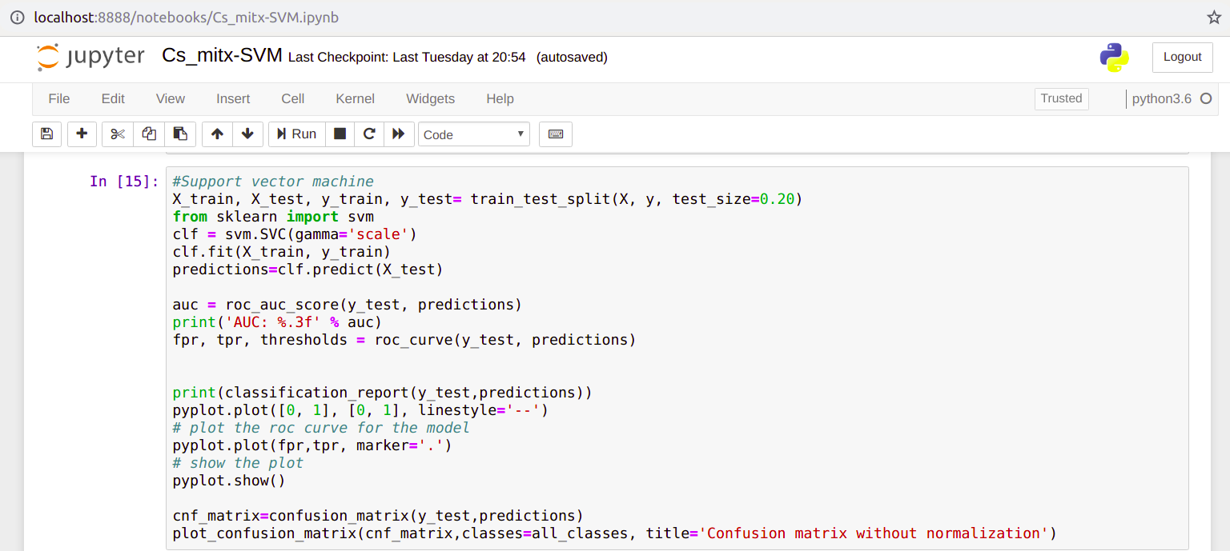
Code Snapshots - SVM

Slide 23
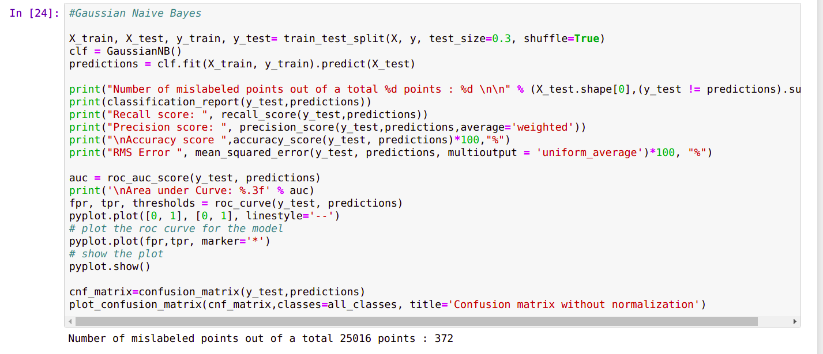
Code Snapshots - Naive Bayes

Slide 24
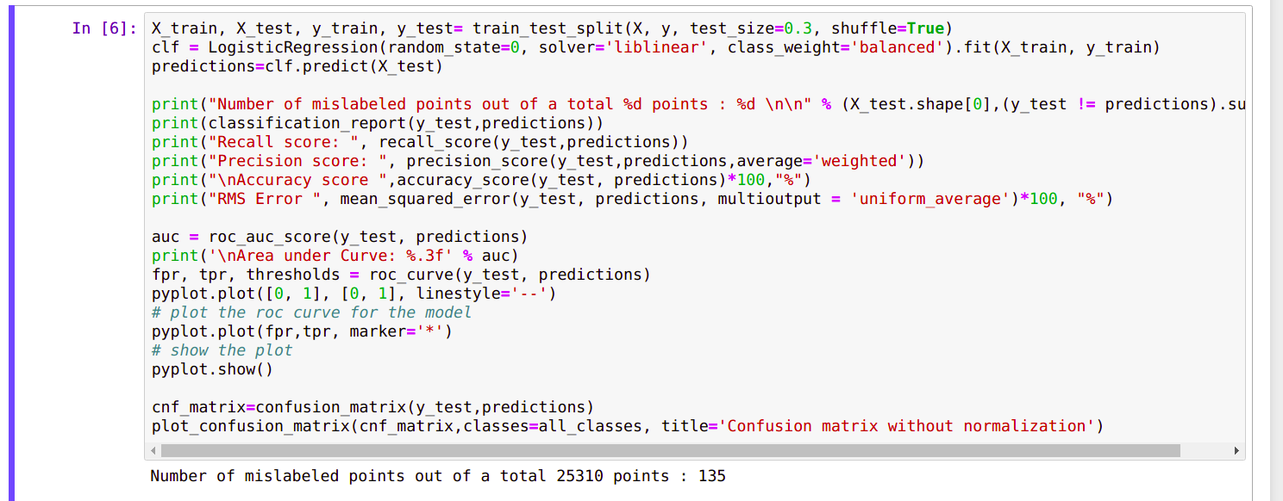
Code Snapshots - Logistic Regression

Slide 25
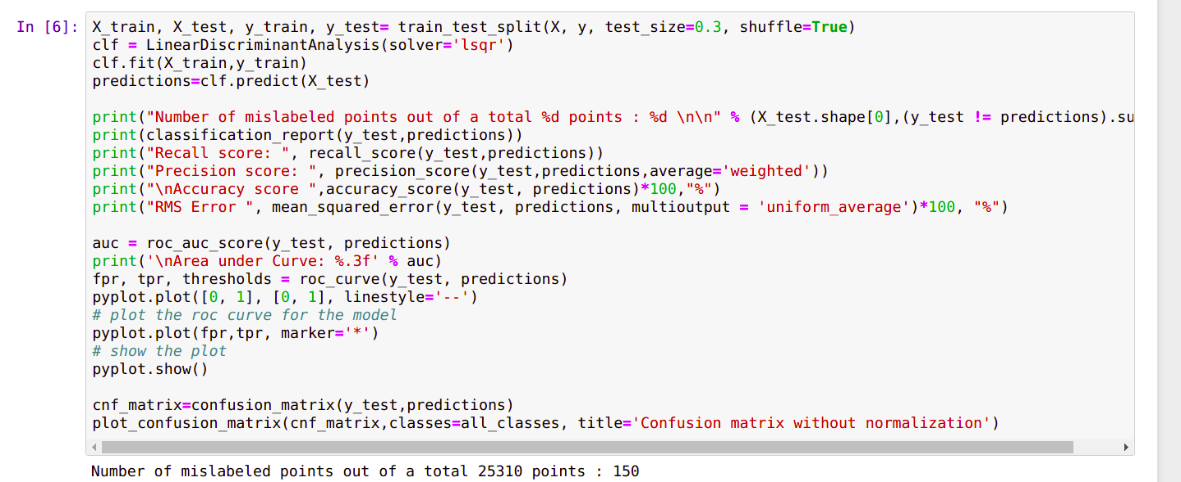
Code Snapshots - LDA

Slide 26
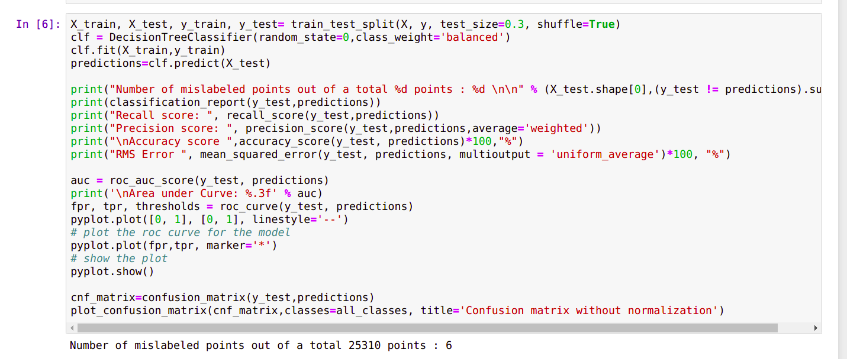
Code Snapshots - Decision Tree

Slide 27
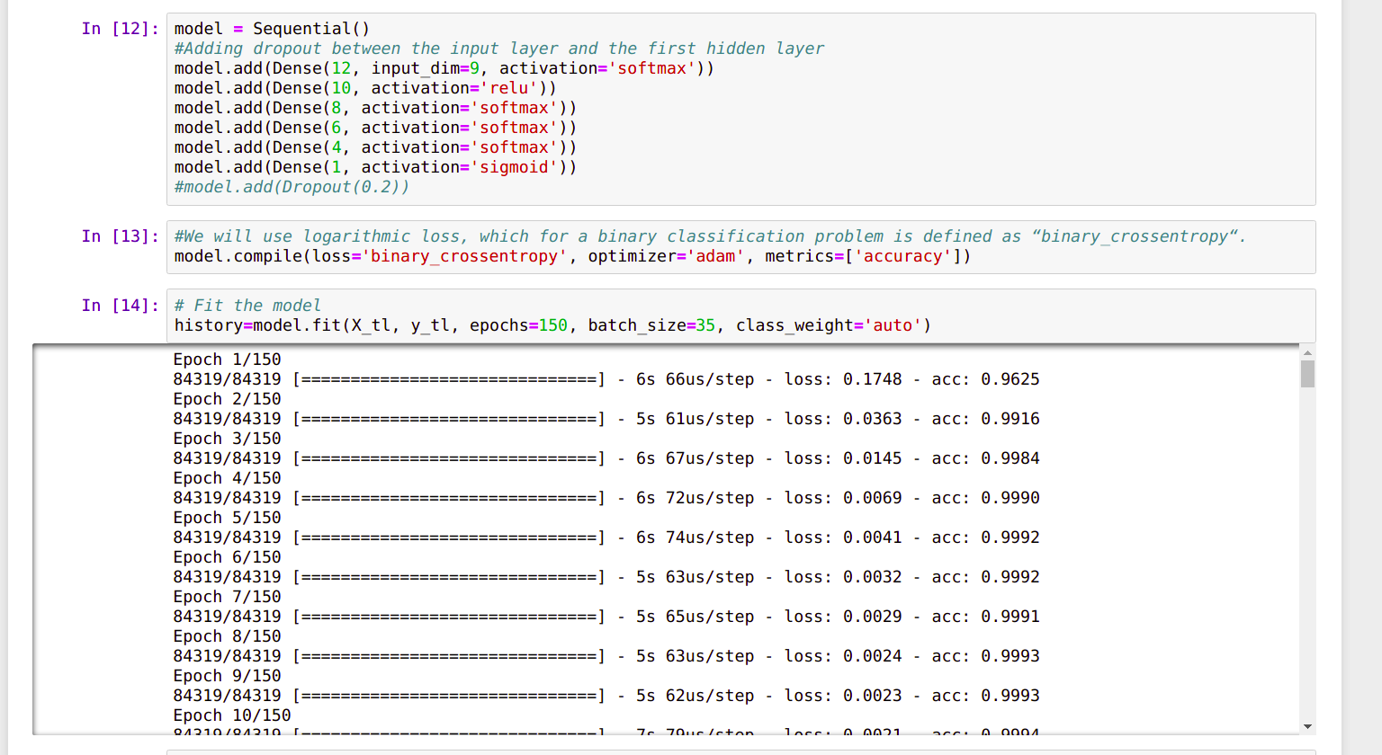
Code Snapshots - Deep Learning

Slide 28
Results and Discussions
The performance of each model is compared in terms of its Precision, Recall and AuC characteristics.
Then the interventions for the course providers are discussed.
Finally personalized suggestions to the students were made by providing ranks for their weekly performance.

Slide 29
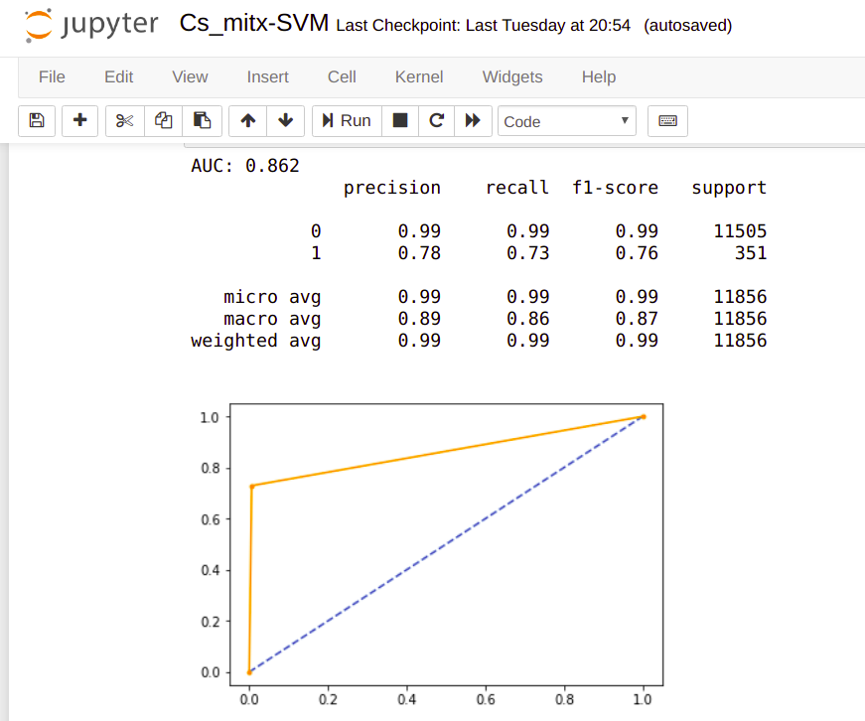
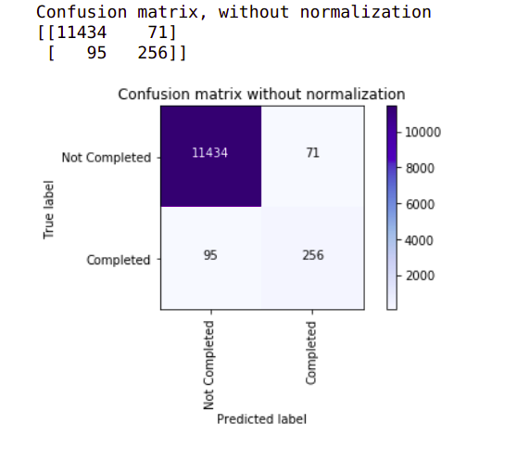
Output Snapshots - SVM

Slide 30
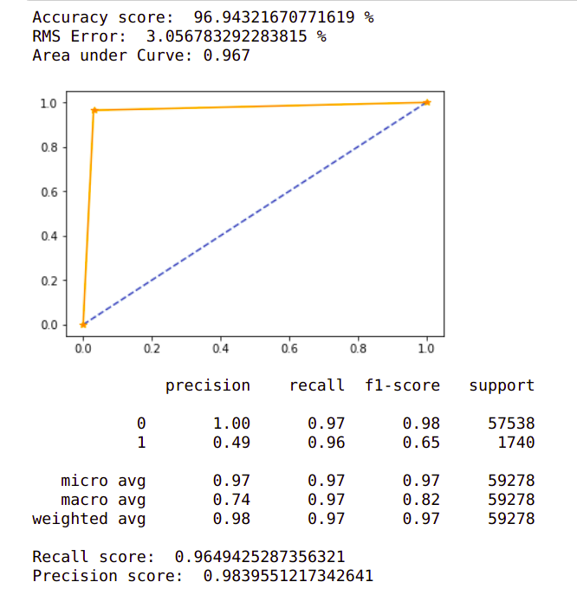
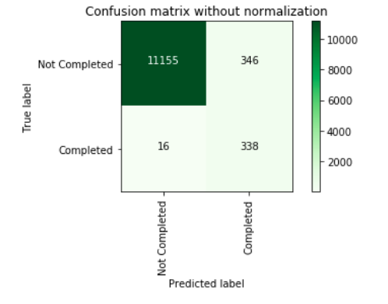
Output Snapshots - Naive Bayes

Slide 31
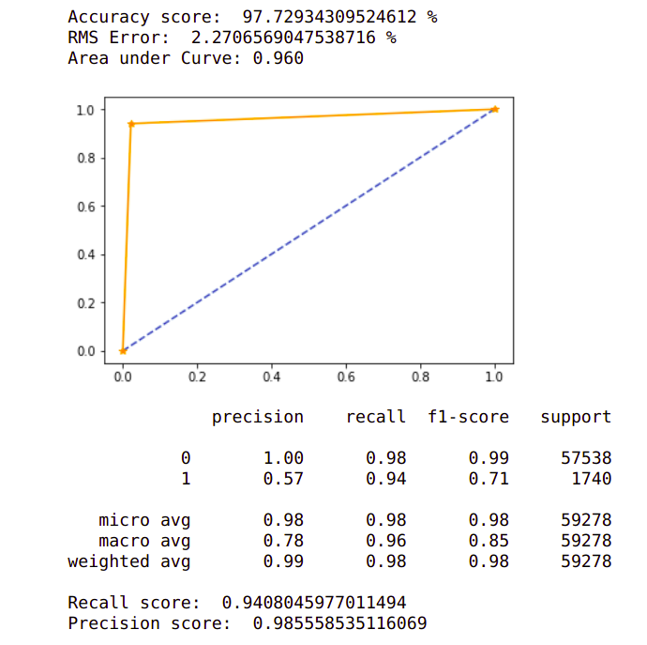
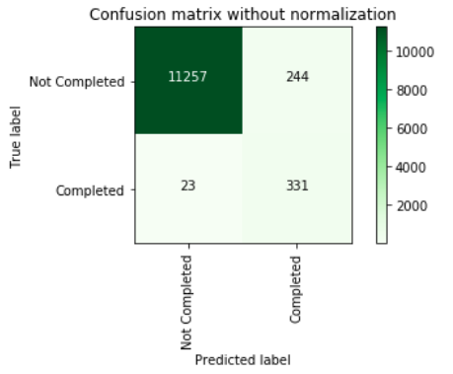
Output Snapshots - Logistic Regression

Slide 32
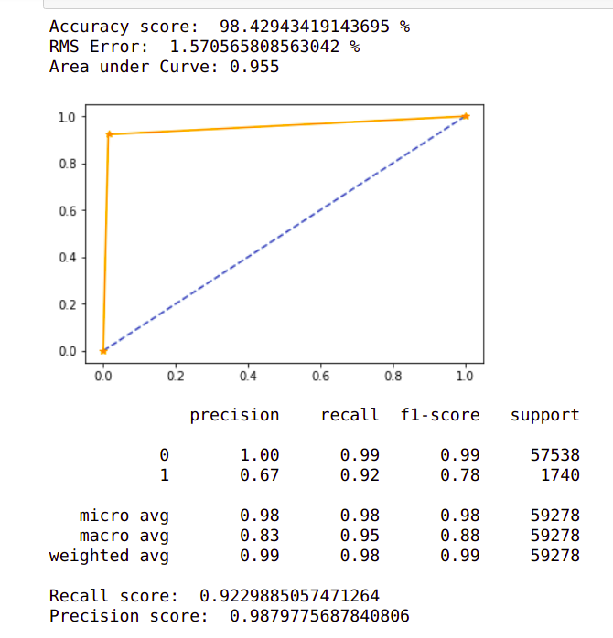
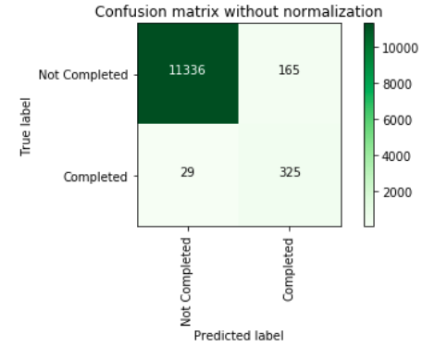
Output Snapshots - LDA

Slide 33
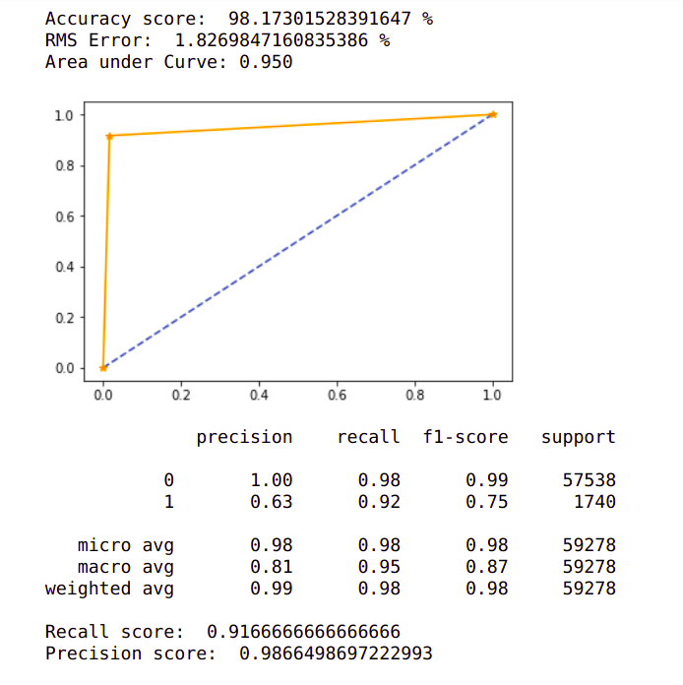
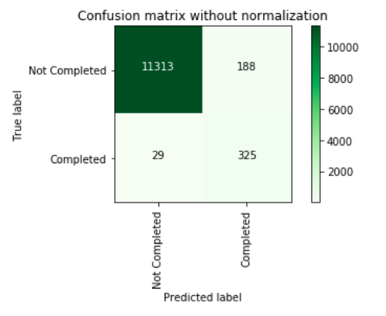
Output Snapshots - Decision Tree

Slide 34
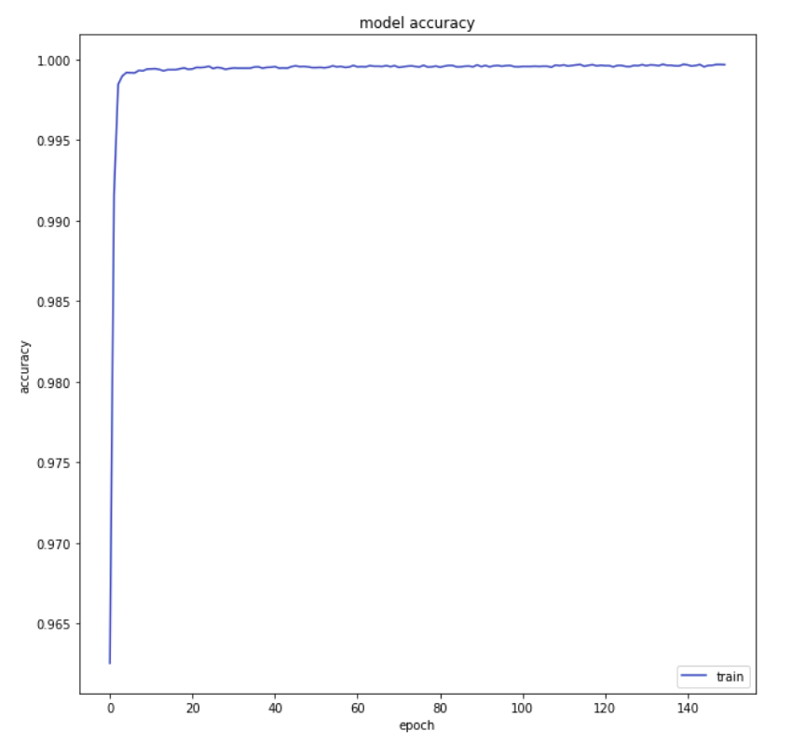
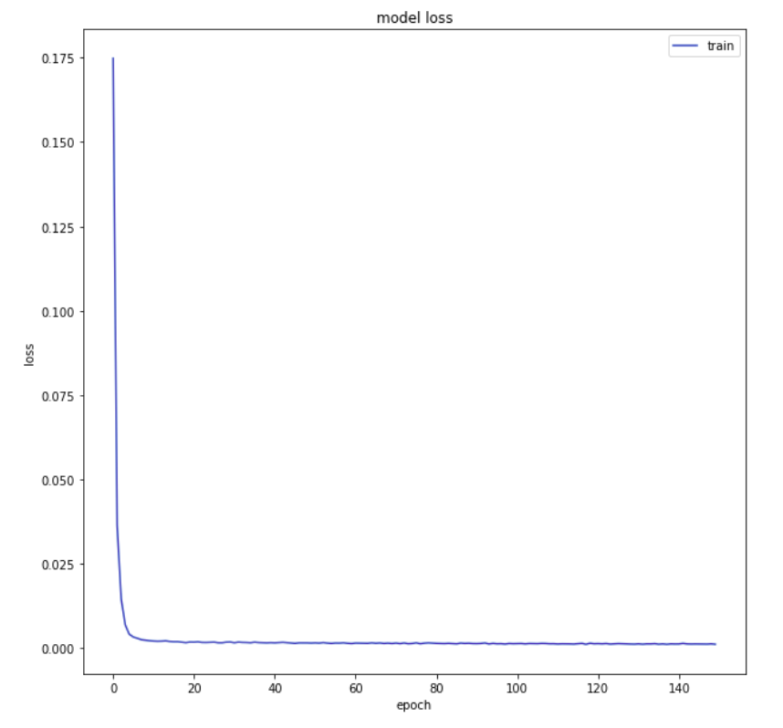
Output Snapshots - Deep Learning

Slide 35
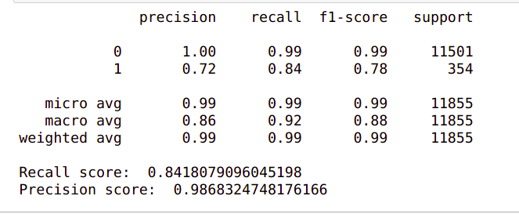
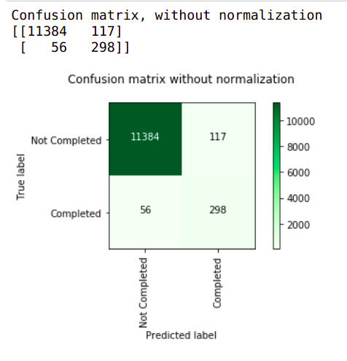
Output Snapshots - Deep Learning

Slide 36
Performance Comparison
Models | Precision score for Class 1 | Recall Score for Class 1
Support Vector Machine | 78 | 73
Logistic Regression | 57 | 94
Naive Bayes | 49 | 96
Linear Discriminant Analysis | 67 | 92
Decision Tree | 63 | 92
Neural Network | 72 | 84

Slide 37
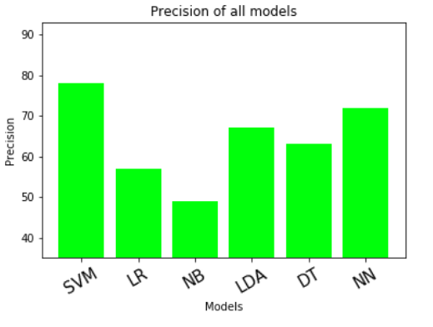
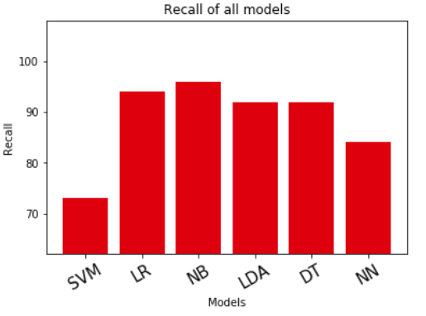
Precision vs Recall

Slide 38
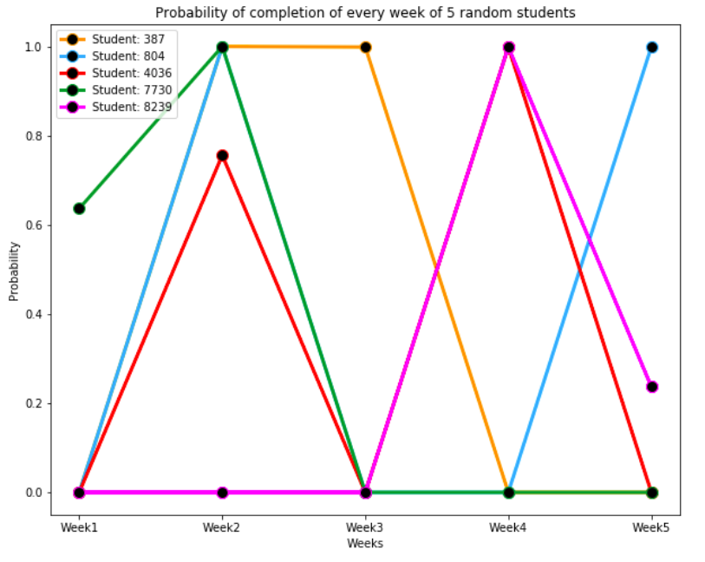
Course Provider Interventions

Slide 39
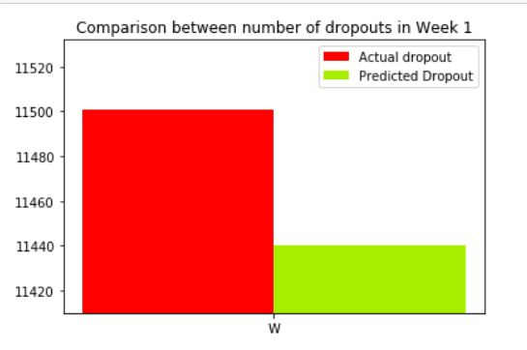
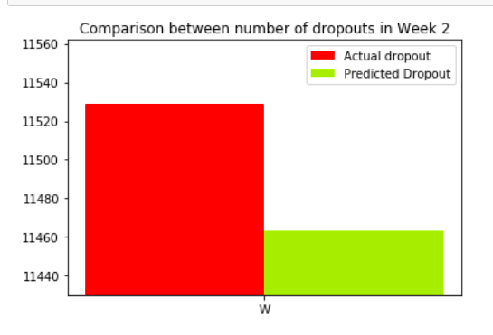
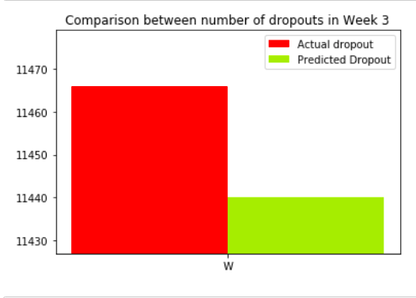
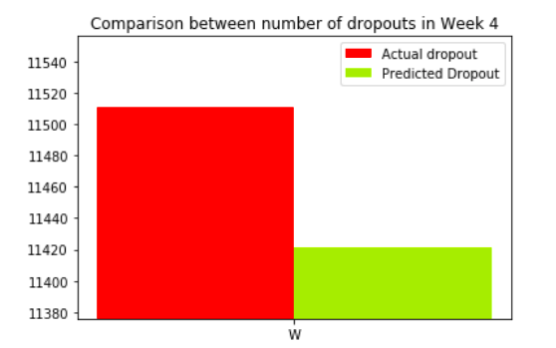
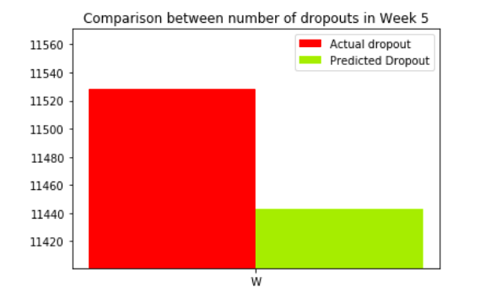
Expected vs Actual dropout over weeks

Slide 40
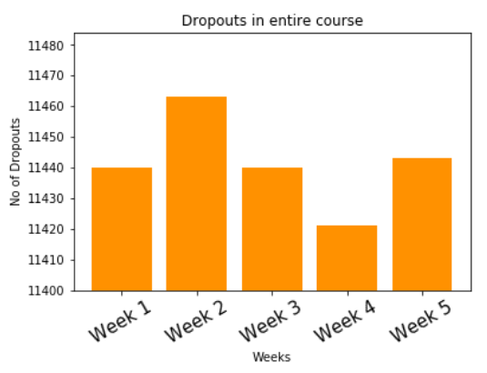
Dropout in Entire course

Slide 41
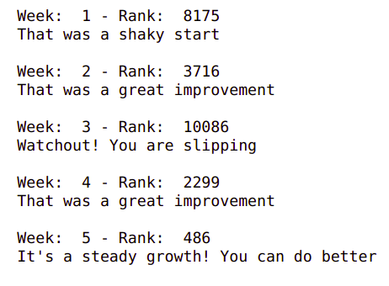
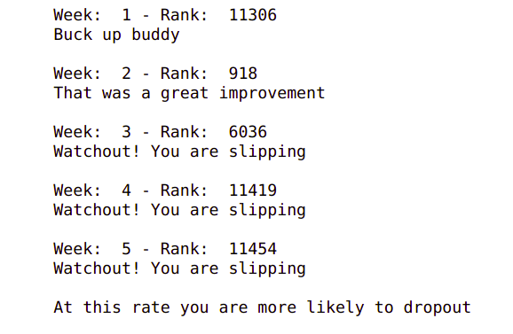
Suggestions for Students
Student 1
Student 2

Slide 42
Challenges
Non uniform behavior of students in taking video lectures, which is primarily dependent on difficulty of the content published, makes it tough to assess the student’s performance in a continuous manner.
Intention of students again poses a problem.
The dataset available is highly imbalanced because out of all the students who enroll, 90% of them tend to drop out halfway or skip in between weeks because of various reasons. Hence the classes are really skewed and it is very difficult to obtain a good recall.
Clickstream data obtained was of lesser quality. Unwanted clicks were taken into consideration, in turn affecting the whole quality. For example, refreshing the web page due to network errors were counted as legitimate clicks.

Slide 43
Advantages
By predicting the dropout rates, the system can act as a warning system for the course providers.
Depending upon the dropout predictions, the structure of the course can be changed to benefit more number of participants.

Slide 44
Conclusion
This project focuses on providing a system which optimizes the dropout prediction models to focus on personalizing and prioritizing intervention for academically at-risk students in MOOCs.
We tested with various algorithms out of which MLF-NN was suitable for building the system.
Significant variance in data was an important factor as to why some predictions were out of class.
Another important factor was the inability to reflect the mental thinking process of the student regarding the content and materials of the course.
All these issues were addressed in this system.

Slide 45
Future Work
Currently, the personalization and prioritization only show statistical validity. Researchers can further examine their validity by implementing the proposed model of prediction and intervention personalization method in actual MOOC courses to evaluate whether this approach can reduce the dropout of students.
Similar experiments on more general online courses can be carried out to examine whether deep learning can be useful in other educational contexts.
Future studies can explore methods to further improve the performance of deep learning predictions in MOOCs, such as increasing the network's hidden layers.
Take forum posts and perform sentiment analysis on that to provide an end to end model.
Efforts to obtain more detailed information about clickstream features can be made so that content wise interventions can also be given. Understand the factors for dropping the course.
Personalization of prediction models based on student needs and motivation. Some may take up for certification, some take up for knowledge etc.

Slide 46
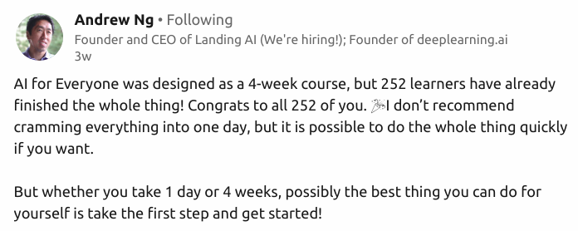
Fun Fact

Slide 47
References
A. D. Ho et al., ―HarvardX and MITx: The First Year of Open Online Courses, Fall 2012-Summer 2013, SSRN Electron. J., no. 1, pp. 1–33, 2014.
Abidi, S.M.R.; Hussain, M.; Xu, Y.; Zhang, W. ―Prediction of Confusion Attempting Algebra Homework in an Intelligent Tutoring System through Machine Learning Techniques for Educational Sustainable Development. Sustainability 2019, 11, 105.
Al-Shabandar, R., Hussain, A, Laws, A., Keight, R., & Lunn, J. (2017). ―Machine learning approaches to predict learning outcomes in massive open online courses. Paper presented at the 2017 international joint conference on neural networks (IJCNN 2017), Anchorage, Alaska, USA.
C. Peng, K. Lee, and G. M. Ingersoll, ―An introduction to logistic regression analysis and reporting, J. Educ. Res., vol. 96, pp. 3–14, 2002.
D. S. Chaplot, E. Rhim, and J. Kim, ―Predicting student attrition in MOOCs using sentiment analysis and neural networks, Work. 17th Int. Conf. Artif. Intell. Educ. AIED-WS 2015, vol. 1432, pp. 7–12, 2015.
D. S. Chaplot, E. Rhim, and J. Kim, ―Predicting student attrition in MOOCs using sentiment analysis and neural networks,‖ in Fourth Workshop on Intelligent Support for Learning in Groups, Madrid, Spain, June 2015.

Slide 48
References
7. Halawa, S.; Greene, D.; and Mitchell, J. 2014. ―Dropout prediction in MOOCs using learner activity features. In Proceedings of the European MOOC Summit.
8. M. Kloft, F. Stiehler, Z. Zheng, and N. Pinkwart, ―Predicting MOOC dropout over weeks using machine learning methods, in Conference on Empirical Methods in Natural Language Processing (EMNLP), Doha, Qatar, October 2014.
9. Mongkhonavit, K., Kanopa, K. and Lang, D. (2019). ―Deep Knowledge Tracing and Engagement with MOOCs. Proceedings of the 9th International Conference on Learning Analytics & Knowledge. Pp. 340-342, Tempe, AZ, USA — March 04 - 08, 2019.
10. P. Viszlay, M. Lojka and J. Juhár, ―Class-dependent two dimensional linear discriminant analysis using two-pass recognition strategy, in: Proceedings of the 22nd European Signal Processing Conference (EUSIPCO), IEEE, 2014, pp. 1796– 1800.
11. R. F. Kizilcec, C. Piech, and E. Schneider, ―Deconstructing Disengagement: Analyzing Learner Subpopulations in Massive Open Online Courses, Lak ‘13, p. 10, 2013.
12. R. R. Kabra and R. S. Bichkar, ―Performance prediction of engineering students using decision trees, Int. J. Comput. Appl., vol. 36, no. 11, pp. 8–12, 2011.

Slide 49
Thank You

