Slide 1
EFFECTIVE IRRIGATION MANAGEMENT USING CYBER PHYSICAL SYSTEM
BY
VIGNESH M
RAGHUL S
PREM HARISH S
GUIDED BY
Dr. N.BHALAJI
AP/IT

Slide 2
MOTIVATION
Uneven watering patterns cause major crop failures.
Excessive usage of water leading to wastage of resources.
Perform irrigation using predicted values rather than estimated values.

Slide 3
OBJECTIVES
To design a Farmers Guidance System to assist them in irrigation.
To measure the temperature and moisture content in the soil using sensors.
To determine the quantity of water needed to irrigate the plants based on the real-time values of the above mentioned physical parameters.
To use machine learning algorithms to perform accurate analysis for optimized irrigation.
To enable web/mobile application services to notify the farmers with text to voice conversion facility.

Slide 4
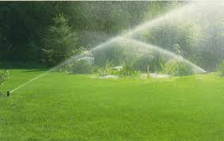
ISSUES IN EXISTING SYSTEM
In many places, old water delivery systems designed decades ago to service much smaller populations are inflexible for irrigation system.
Lawn size and landscape restrictions. Placement of sensors.
Poor Spacing/ Out-dated Technology.
No close-in watering, poor distribution
Uniformity.

Slide 5
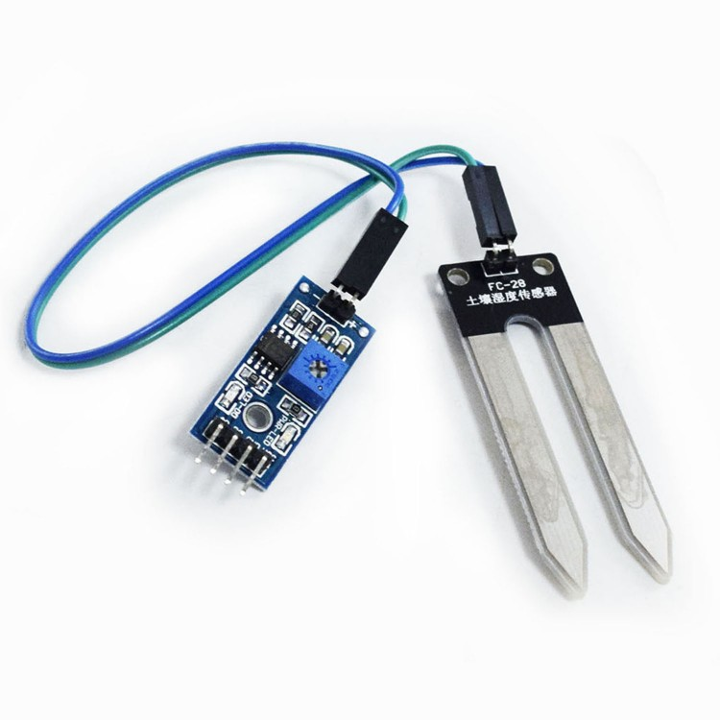
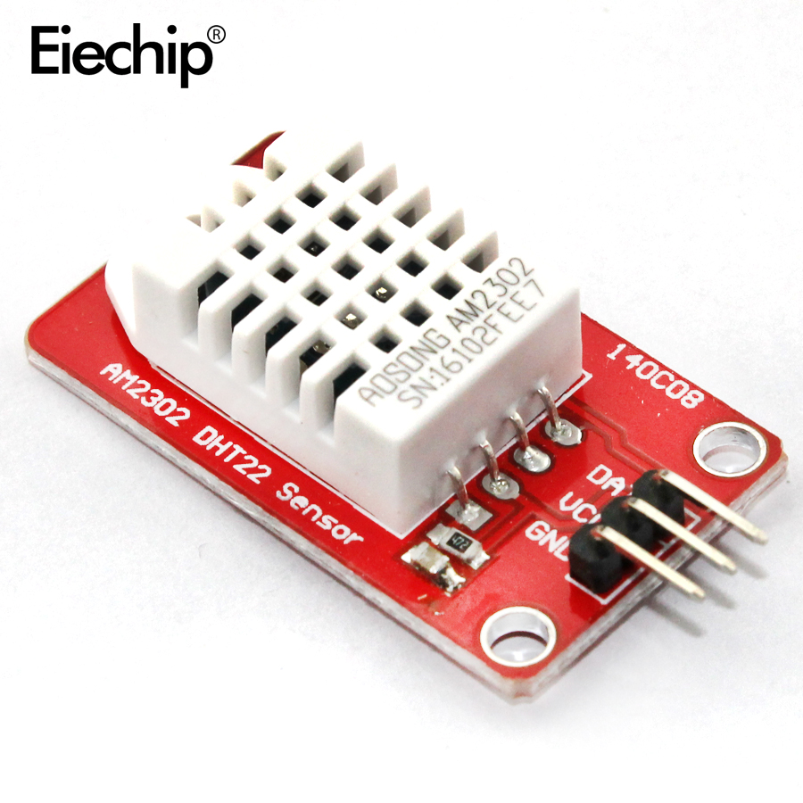
SENSORS EMPLOYED
Soil Moisture sensor measures the volumetric water content in soil.
DHT 22- Temperature and Humidity sensor measures the temperature and humidity existing in the air.

Slide 6
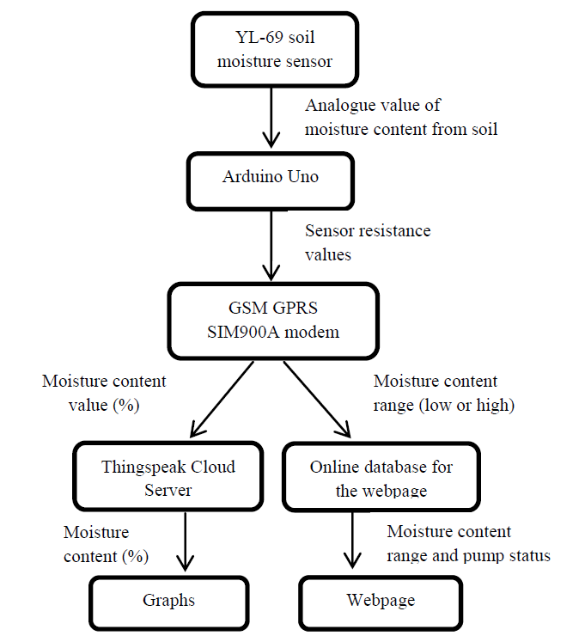
WORKING

Slide 7
WORK PLAN

Slide 8
BUDGET
S No | Components | Expenditure(in Rs)
1 | Arduino Board With Wifi Integrated (Uno)Type | 6000
2 | 1x Node | 800
3 | 1x DHT22 (temperature + humidity) | 270
4 | 1x Soil Moisture sensor | 200
5 | 2x LDR (embedded in each board) | 240
6 | 1x Electro-valve | 300
7 | 1x 12V Power Supply | 280
8 | 1x Battery 3.7V 2300mAh | 100
9 | 1x Breadboard | 150
10 | 1x Arduino jumper cables | 200
11 | 1x Breakout Board for microUSB | 180
12 | 1x microUSB cable | 200
13 | Soil Testing Unit Tools | 2000
 | TOTAL | 10,200

Slide 9
REFERENCES
Liu Hui,Wang Mao-hua,Wang Yue-xuan, Development of farmland soil moisture and temperature monitoring system based on Wireless Sensor Network
F.J. Pierce and T.V.Elliott, Regional and on-farm wireless sensor networks for agricultural systems in eastern Washington
J Hwang C Shin, Study on an agricultural environment monitoring server system using Wireless Sensor
N Wang, N Zhang, M Wang, Wireless sensors in agriculture and food industry—Recent development and future perspective
N. Sakthipriya, An Effective Method for Crop Monitoring Using Wireless Sensor Network, Middle-East Journal of Scientific Research
C.H Chavan, Wireless Monitoring soil moisture, temperature & humidity using zigbee in agriculture, International Journal of Engineering Trends and Technology (IJETT), May 2014
Anjum Awasthi & S.R.N Reddy, Monitoring for Precision Agriculture using Wireless Sensor Network, Global Journal of Computer Science and Technology, Network, Web and Securitya

Slide 10
THANK YOU

