Slide 1

Earthquakes. Event Magnitude relationship occurrence and Location.

Slide 2
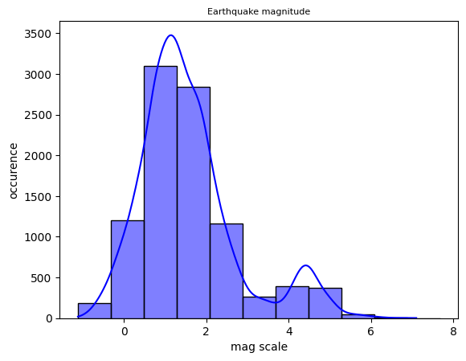
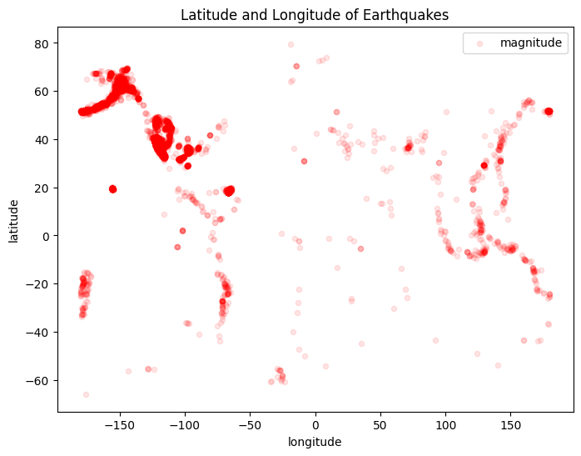
FINDINGS
This shows that fewer events occurred at higher magnitudes.
Geographical alpha to visualize places with high density data points

Slide 3
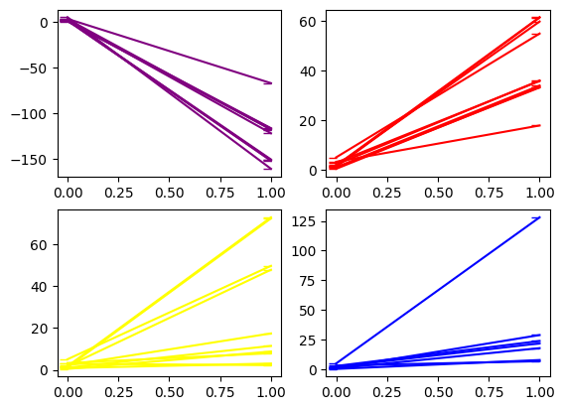
purple = longitude red = latitude depth = yellow blue = magNst From the observation, both the longitude and latitude tends have regress downwards below ‘ 0’ showing that magnitude increases while latitude and longitude decreases. The Magnitude also increases with depth. Notes. -ve value for latitude points down to south -ve value for longitude points to west
purple = longitude red = latitude depth = yellow blue = magNst From the observation, both the longitude and latitude tends have negative coefficient below 0 showing that mag increases while lat and long decreases. -ve value for latitude points down to south -ve value for longitude points to west

Slide 4
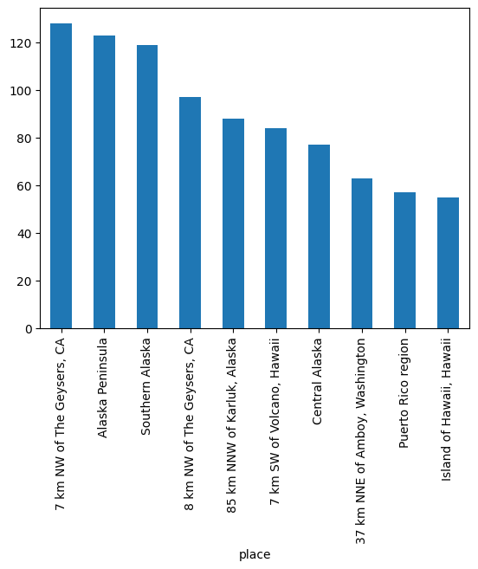
Conclusion
The Geysers, located at Sonoma and Lake counties California, United States recorded the highest occurrence of Earthquake.
Earthquake with high magnitudes are rare, the data also showed most of the earthquakes are micro earthquakes.
Earthquake Magnitude increases with depth.
Longitude and latitude
The 10 places with highest occurence

