Slide 1

FINDING SIMILARITY QUOTIENT OF TWO LOCATIONS

Slide 2
Finding how similar or dissimilar two location is useful
This project is useful to recommend a place for tourist based on his/her previous feedbacks and preferences.
This project finds its use to suggest a place for shifting residence to a new locality.
This project can be used to relate the demographics with its interest and further predicting a new business opportunity in a location

Slide 3
Data Sources
Using Web Scrapping on https://en.wikipedia.org/wiki/List_of_postal_codes_of_Canada:_M link , collected PostCode, Borough and Neighbourhood information.
Geospatial_Coordinates file for the longitude and latitude information of the locations of our interests.
FourSquare API results having details of nearby venues to a given neighbourhood based on its coordinates within a given distance.

Slide 4
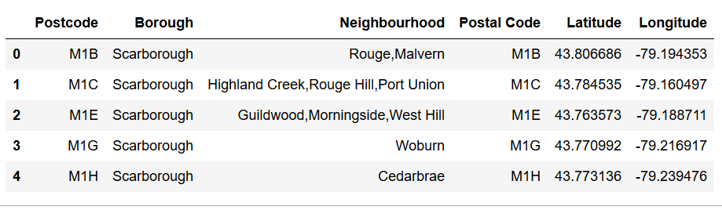
Data Cleaning
Extracted the tabular data from Wikipedia page by web scraping method in python
Removed the row where value of Borough was 'Not assigned’
Grouped the data to create a single record for a particular Borough and PostCode by combining all the neighbourhoods in that single record.

Slide 5
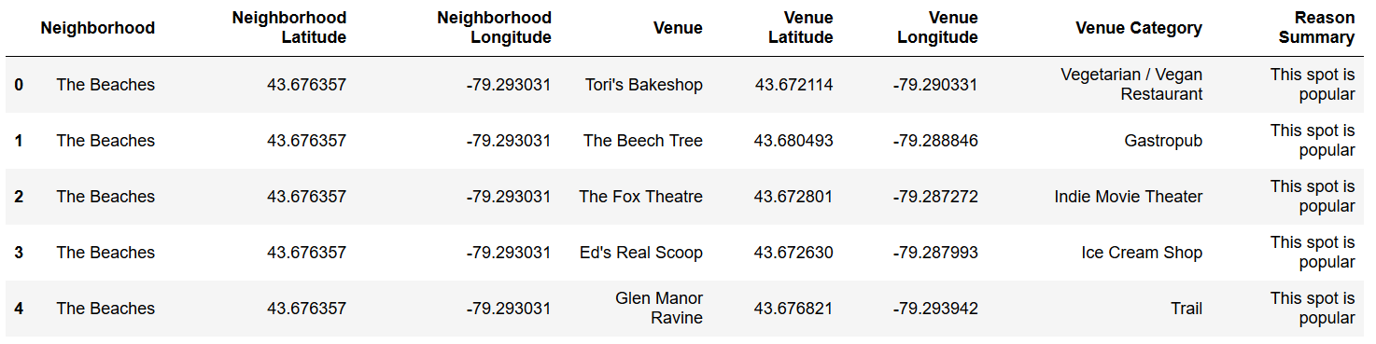
Data cleaning – 2..
Filtered the data to have 3 sets of data – 1) Toronto data 2) North York data 3) Combined data of Toronto and North York
Call FourSquare API with a LIMIT 500 and the above 3 sets of data to get the returned json data with popular venues details
Read the returned data to collect the relevant information in below format –

Slide 6
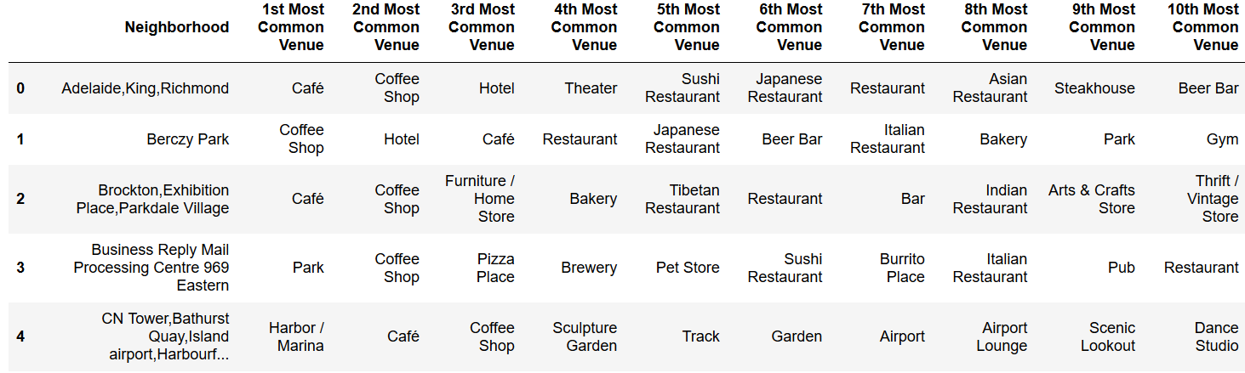
Data preparation- one hot encoding form
Prepare the data appropriate for Machine Learning algorithms as input
Tranformed the data in previous slide to One hot encoding form as below –

Slide 7
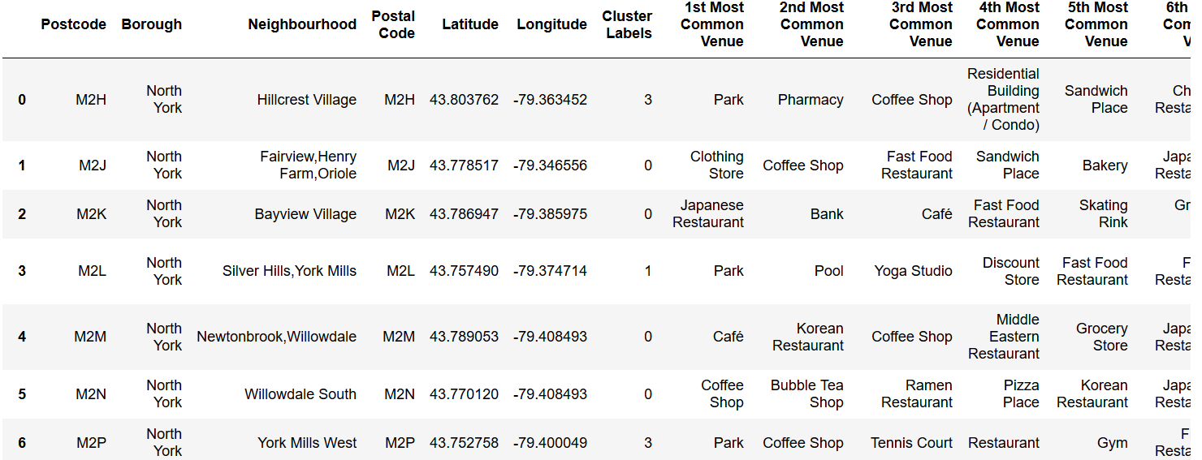
K-means clustering
Choose 5 number of clusters and apply k-means clustering algorithm on all the 3 sets of data.
Column 7 below is the assigned cluster to each location after applying K-means clustering algo.

Slide 8
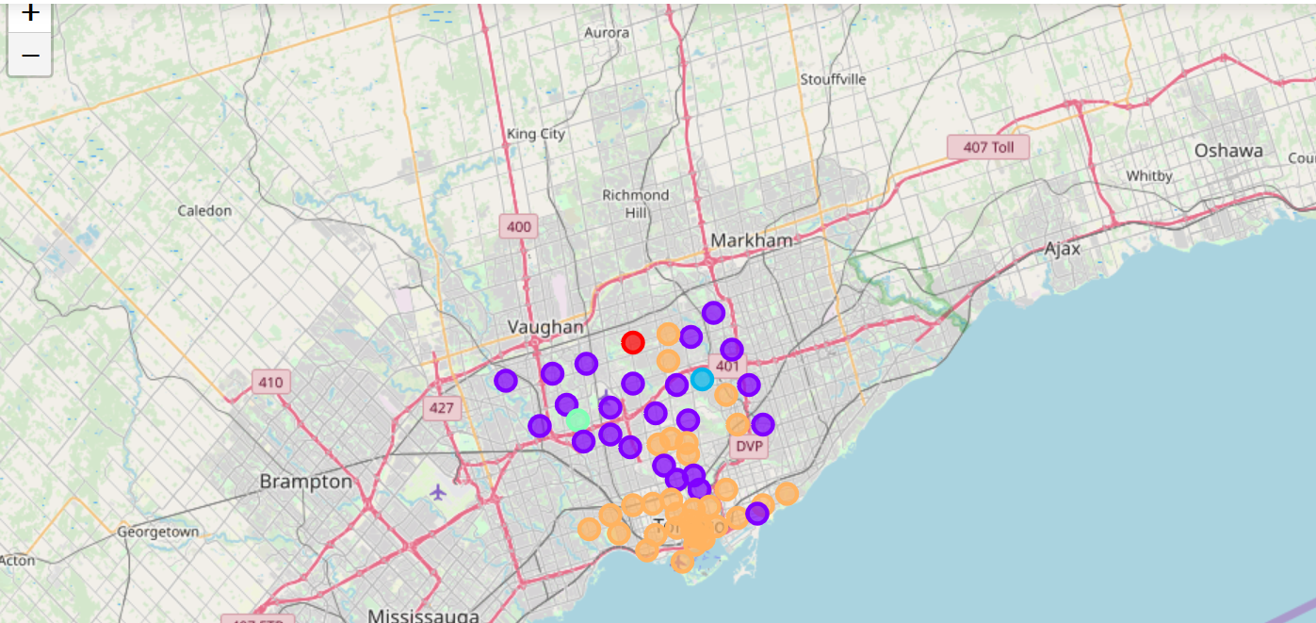
Visualize thru folium maps
Generate Folium map with the clustered data created in previous step
There are 5 clusters denoted by different color in the location map.

Slide 9
Results
Below 3 neighbourhoods has no similar location found
-Downsview Central Cluster 4 -Willowdale West Cluster 1 -Silver Hills,York Mills Cluster 3
Other 89 neighbourhood found a similar location
Similarity quotient is around 0.95
There are 95% chances that a location will find a similar location in another borough .

Slide 10
discussion
Willowdale west is a neighbourhood in North York borough. When we clustered only North York data then there were 7 neighbourhoods in cluster 3 and Willowdale west was one of those 7. When we clustered the north york and toronto data combined then Willowdale West was found to be the only neighbourhood in its cluster 1. There is no other neighbourhood in cluster 1. On digging deep into the data. We noticed that this is because of the results returned from FourSquare API are not consistent.

Slide 11
Conclusion/ending remarks
Not necessarily a similar neighbourhood will be found in single attempt by following the approach given in this project. There are 95% chance of finding a similar neighbourhood following the approach given in this project. Similarity Quotient is 0.95 which is quiet high between Toronto and North York.
THANK YOU

