Slide 1
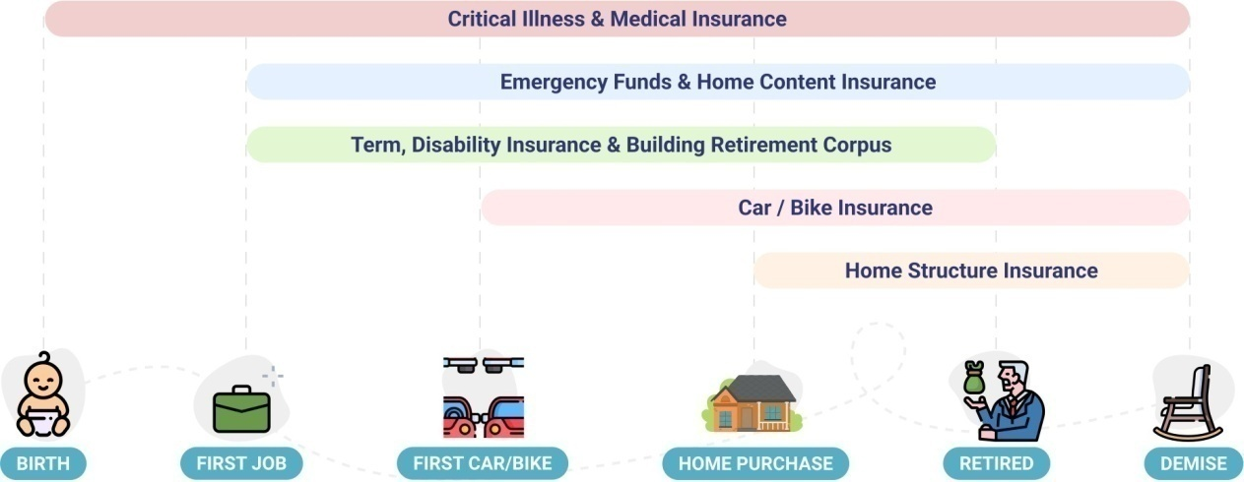

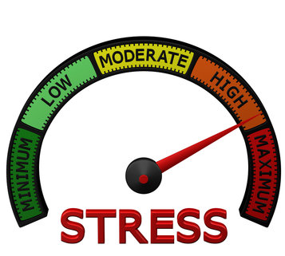



Recommendation for
Anonymous
StressO Meter
790
Personal StressO Meter
Child StressO Meter
Retirement StressO Meter
810
760
850

Slide 2
STRESS LEVELS AT DIFFERET AGES 30 – 690 35 - 720 40 - 790 45 - 870 * Age at which probably your son/Daughter will go to college 50 - 790 55 - 810 * Age at which probably your son/Daughter will get married 60 - 790 65 - 790 …………

Slide 3
Insurance recommendation for
Anonymous
Term Insurance Plan
Retirement Corpus
Size of Cover
₹1.5 Crores
Duration of Cover
20 Years
Total Retirement Corpus Required
₹12.6 Crores
Monthly Investment to achieve Retirement Corpus
₹212,500
Purpose : Ensure a similar lifestyle of dependents in case of an untimely demise
Pro Tip : Term insurance would be redundant if there are no dependents, zero income, and/or no other liabilities
Annual Investment
255% of your current annual household income
Purpose : Ensure similar lifestyle post-retirement
Pro Tip : Earlier retirement planning could substantially reduce the requirement for monthly investment towards retirement
Critical Illness Plan
Size of Cover
₹1.5 Crores
Duration of Cover
20 Years
Medical Insurance
Purpose : Ensure minimal ﬁnancial impact due to critical illness. The current average treatment cost is around INR 20 Lakhs. This when combined with increasing cost of treatment and loss in income during recovery and treatment would require a sizeable cover.
Pro Tip : The critical illness cover is required for the entire lifetime. The duration and the size of the cover bought could be decided based on availability and aﬀordability.
Pro Tip : It is also alright to start with a smaller cover now and increase gradually. However, the approach might have practical limitations
Size of Cover
₹25 Lakhs
Duration of Cover
1 Year
Purpose : Ensure minimal ﬁnancial impact due to a medical situation (other than critical illness).
Pro Tip : The medical insurance is required for the lifetime and needs to be renewed and revised every year.
Pro Tip : For practical reasons, it might be helpful to buy higher cover than recommended as increasing the size of cover might be diﬃcult with progressing age and changing medical situations.
ADD A REMINDER

Slide 4





Insurance recommendation for
Anonymous
Emergency Corpus
Disability Insurance
Size of Emergency Corpus
₹20 Lakhs
To be reviewed in
6 Months
Size of Cover
₹3 Crores
Duration of Cover
20 Years
Purpose : Ensure minimal ﬁnancial impact due to loss of income (like job loss) in the short term. Also, acts as a catch-all corpus for risks not covered by insurance policies
Pro Tip : The fund should be liquid can be split between cash, savings bank account, liquid mutual funds, etc
Pro Tip : The size of the fund is dynamic and closely linked to expenses. It is best to review it half-yearly
Purpose : Ensure minimal ﬁnancial impact due to loss of income resulting in total/partial disability of permanent/temporary in nature
Pro Tip : The disability insurance can be bought as an add-on to term insurance or a standalone cover (which will have to be renewed every year)
Pro Tip : In the Indian context, standalone covers are comprehensive and are recommended
Home Building Insurance
Home Content Insurance
Size of Cover
₹35 Lakhs
Duration of Cover
10 Years
Size of Cover
₹7 Lakhs
Duration of Cover
1 Years
Purpose : Ensure minimal ﬁnancial impact due to damage of home structure resulting from natural/man-made disasters like ﬂoods, cyclones, and ﬁre
Pro Tip : Most Home Building Insurance oﬀers escalation of Sum Assured on a yearly basis to account for inﬂation. So the Sum Assured should be reﬂective of the cost of the reconstruction as of the date of policy purchase
Pro Tip : The cover is best suited for homeowner, who should buy Home Content Insurance as well
Purpose : Ensure minimal ﬁnancial impact due to damage/theft of home belongings from natural/man-made disasters including ﬂoods, cyclones, ﬁre, and theft.
Pro Tip : The Home content insurance when bought along with Home Building insurance generally results in a better deal.
Pro Tip : The estimated cover is for General Contents and doesn’t account for Valuable Contents such as jewelry, silverware, paintings, works of art, etc. It is recommended to further increase the cover for Valuable Contents based on their value.
Car Insurance
Bike Insurance
Size of Cover
Insured Declared
Value
Duration of Cover
1 Year
Size of Cover
Insured Declared Value
Duration of Cover
1 Year
Purpose : Ensure minimal impact due to damage/theft of car and liabilities arising from damage to a third party arising from accidents
Pro Tip : Car Insurance has two components – Own Damage and Third Party Liability insurance. Only Third Party Liability insurance is mandatory but both are recommended
Pro Tip : The Add On covers like Zero Depreciation, Return to Invoice, and Road Side Assitance are useful and are recommended
Purpose : Ensure minimal impact due to damage/theft of bike and liabilities arising from damage to third-party arising from accidents
Pro Tip : Bike Insurance has two components – Own Damage and Third-Party Liability insurance. Only Third- Party Liability insurance is mandatory but both are recommended
Pro Tip : The Add On covers like Zero Depreciation, Return to Invoice, and Road Side Assistance are useful and are recommended

Slide 5




Anonymous
1 Crores
89%
₹74,000
Congratulations on planning to buy a home. It's an exciting and signiﬁcant investment !
We hope you have considered the additional expenses while deciding the size of the goal. These additional expenses include Stamp Duty and Registration Charges, Brokerage Fees, Parking Costs, Interior Designs, Goods and Service Tax, Preferential Locality Charge (PLC), Maintenance Cost Deposit, and Home Insurance premiums on planning to buy a home.
2030
Proportion in Debt
70%
30%
50 Lakhs
25%
₹21,201
Congratulations on planning to save for your kid(s) education! It is a great way to give a headstart to your kid.
This goal tends to have a lot of uncertainty as preferences around the nature of the career, location of the university (India/Overseas), and duration of courses. The best way to address this is by having an additional margin in the goal.
2033
Proportion in Debt
60%
40%
60 Lakhs
15%
₹12,101
Congratulations on planning to save for your kid(s) wedding! It is a great gift for your kid(s) as they start a new phase of their life
While planning it is best to have a budget in mind and ensure that the goal is adjusted for inﬂation. Adding a margin is a good way to be prepared for last-minute surprises.
2038
Proportion in Debt
50%
50%
30 Lakhs
8%
₹6,050
Congratulations on planning to save for your vacation! It is a good idea to take a break once in a while.
Vacations are meant to surprise us in a good way. To ensure the outlays don't surprise us, it might help to account for varying transportation and stay expenses based on the time of the year. Unexpected expenses during the vacation are a norm and budgeting for them generally helps.
2038
Proportion in Debt
50%
50%

