Slide 1
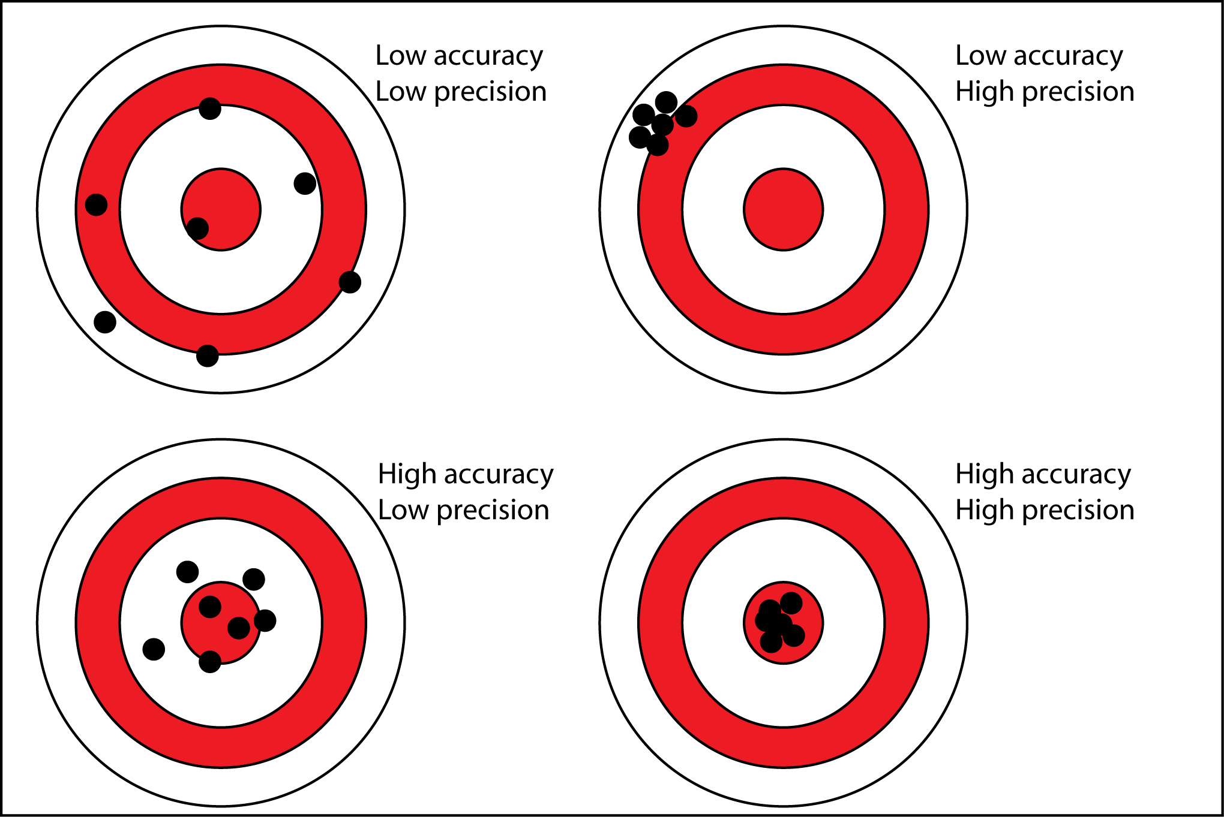
High systematic and random uncertainties
High systematics, low random uncertainties
Low systematics, high random uncertainties
Low systematic and random uncertainties

