Slide 1
Designing tailored software for clients and stakeholders by their requirements is a common strategy in software development. However, in many cases, software engineers would encounter situations where clients and stakeholders are a large group, making it expensive and time consuming to elicit requirements from each of them individually. In such scenarios, performing independent elicitation techniques would become more practical. This presentation will primarily focus on two methods of independent elicitation techniques: system interface analysis and user interface analysis. These methods analyse the interaction between existing software and other entities in system perspective and examine user interfaces to gain a general understanding of system requirements and user expectations in similar software development processes. This demonstration will take the existing communication software LINE as an example to demonstrate how a team can obtain the system platform requirements for development and user expectations through system interface analysis and user interface analysis.

Slide 2
CSSE3012 Presentation
Interface Analysis
Student Name: Wei-Ting, Hong
Student Number: 47523483

Slide 3
Two approaches of Requirements Elicitation
1. Elicitation Techniques
- Interviews
- Workshops
- Focus Groups
- Observations
- Questionnaires
Usually rely on interactions with stakeholders.
Ensure that comprehensive and accurate requirements information is collected.
Aim to create tailored software for stakeholders.
Notes:
The dependent elicitation techniques means U, A. It was well mentioned by lecturer, not diving deep into this.

Slide 4
Two approaches of Requirements Elicitation
2. Independent Elicitation Techniques
- System interface analysis
- User interface analysis
- Document analysis
Techniques without stakeholders, usually for larger scale, more universal systems or software.
Collect requirements and information from existing experience, documentation, analysis, etc.
Notes:
without stakeholders, why? Imaging you want to create an app for maybe 10 billion users, its not possible to do dependent elicitation for every one. Instead Collect requirements and information from existing experience, documentation, analysis, etc.

Slide 5
Interface analysis - methodology
1. System interface analysis
Collect requirements and data exchange methods by analysing the interaction between the system and external entities.
Obtain what functionality should be delivered by analysing the system components.
2. User interface analysis
Gathering user requirement and expectations by analysing a system's user interface.
By reviewing the user interface design, interaction methods, etc. from existing systems to understand how users interact with the system.
What is 10 heuristics for user interface design? -> https://www.nngroup.com/articles/ten-usability-heuristics/
Notes:
Which means you learn what other system would usually go with in this specified type of app, and you can except that you may need to do it in your development processes.
For functionality, you can also gain what functionality you should provide for users by seeing the existing app, if the existing app has this function, then you should also expect that you will need to delivery them as well.
For User interface analysis, it is easier to understand than System interface analysis, you can know the preference UI design that users would be comfortable or like other convention of software design for example 10 heuristics for user interface design.
Not only for UI design, by User interface analysis you can also know how users interact with the system, by knowing this, we can also like improve the accessibility of the app, or try to update like any function to make the app more handy.

Slide 6
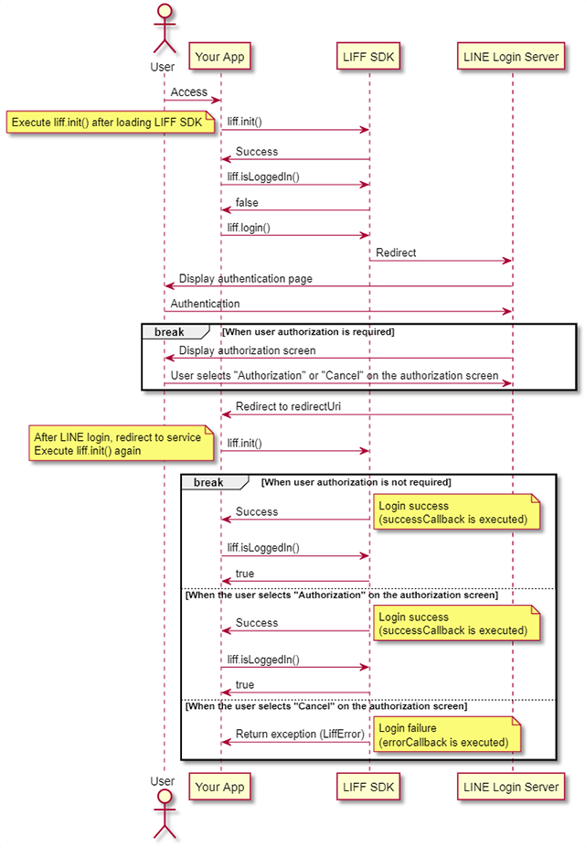
Example of system interface analysis - LINE
Login processes for LINE would involve 2 other systems.
Image 1. Workflow of login processes of LINE.
What is LIFF?
-> https://developers.line.biz/en/docs/liff/overview/
Notes:
I will take the login processes of LINE as an example to do the system interface analysis, in case you dont know, LINE is communicate app that commonly used in Taiwan and Japan. Alright, let look at this picture. You can see that this is how login operation perform in LINE. And LIFF here, LINE login server here. I have a complete introduction of LIFF here, if you are interested in, but easy way to say, LIFF is another app that would be used throughout the LINE, it has many many features to make sure LINE could smoothly run. But in login process, LIFF is used to gain the data from LINE, you need to type your account and password to login, right? Then what you type is your data that would be collected by LIFF. So you can see many arrows that point which steps you are now in login processes, I wont go every details in this picture, but for the most time, we just type our ID and passwords to login, right? Without authorization. So it would be like this. Whats important actually is not the steps you are when you login, the point is that, when you aim to create a communicate app, you should probably also develop some media application to like go with it, cooperate with it, for example LIFF in LINE. And you may also need a server to like storage information of every users. Thats how system interface analysis going, try to find open resources of an existing app, and found out that potential other system you may need for implement your final application.

Slide 7
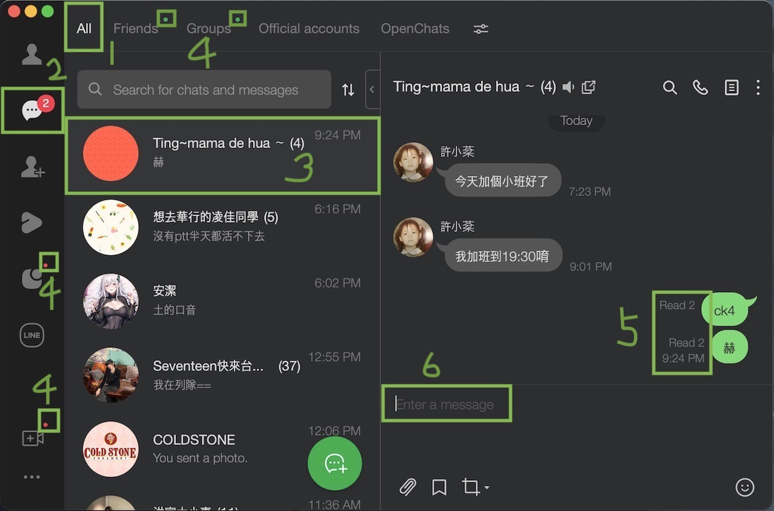
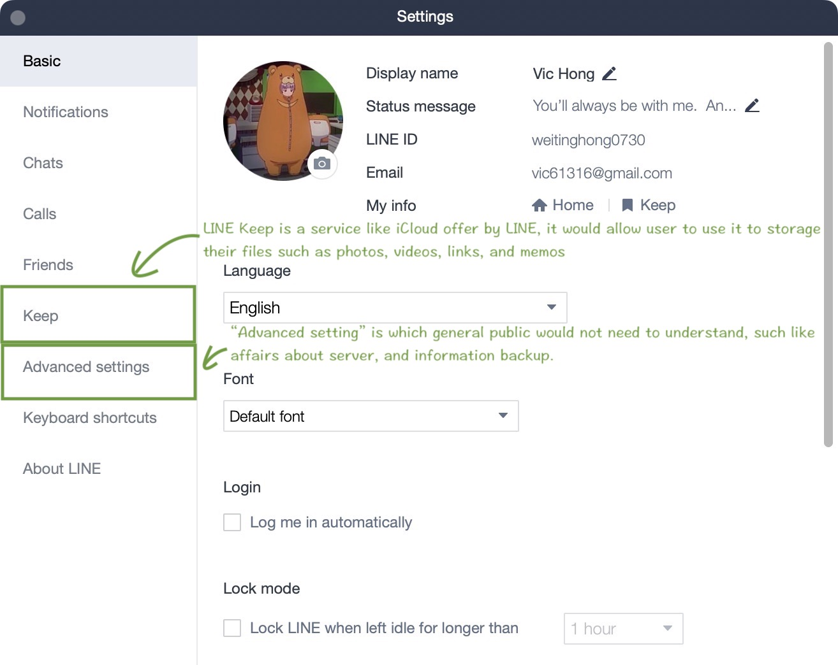
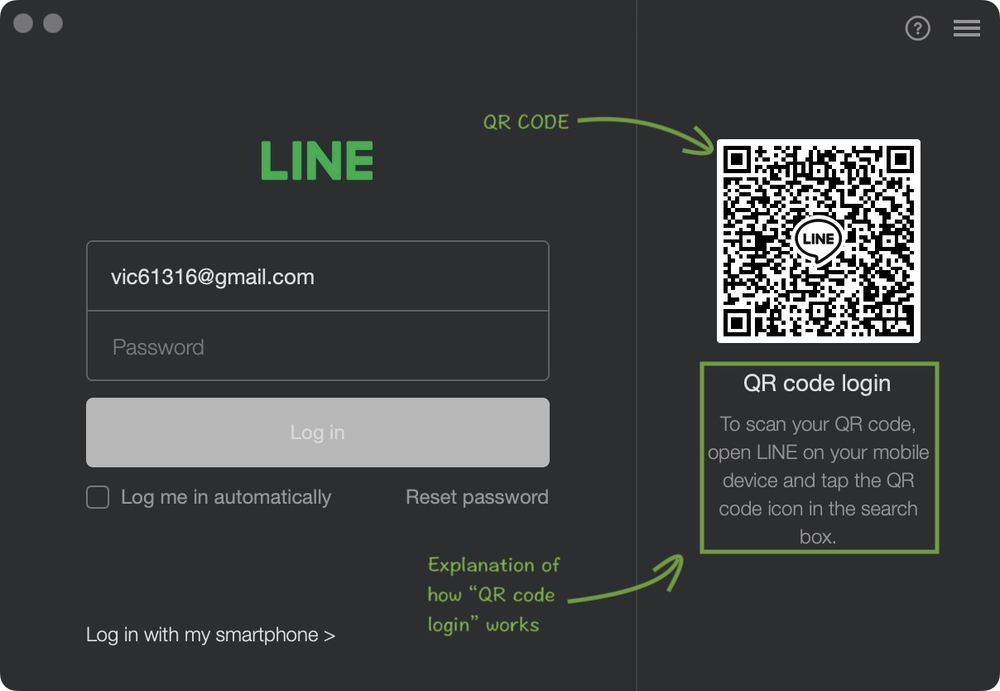
Example of user interface analysis - LINE
Image 2, 3, 4
Several features that could be considered to developed in a new messaging software.

Slide 8
Summary
What, Why, When Interface Analysis?
Two types of interface analysis:
System interface analysis & User interface analysis.
After Independent Elicitation Techniques:
Prioritisation & Estimation (like minimum value product, MVP).
Release and Sprint Planning.
What is MVP? -> https://productplan.com/glossary/minimum-viable-product/

Slide 9
References
Lecture slides
LINE developers -> https://developers.line.biz/en/
My previous assignment.

