Slide 1
Final Year Project Presentation
Blockchain-Based Academic Certificate Issuance and AI-Powered Forgery Detection
Technology Stack
Academic Certificate Verification Portal
Core Value Proposition
A secure end-to-end platform for certificate issuance, blockchain-backed verification, PDF generation, and CNN-supported forgery detection.
Presentation Scope
Academic Certificate Verification Portal
01

Slide 2
Abstract
ABSTRACT
Project summary and academic motivation
The project addresses the problem of insecure and time-consuming certificate verification by combining digital issuance, immutable record keeping, and AI-supported document screening in one integrated platform.
Key Deliverables
1. Admin and student dashboards.
2. JWT-authenticated backend API.
3. PDF certificate generation.
4. Private blockchain ledger with chained hashes.
5. CNN-backed forgery detection pipeline.
6. Verification logs and audit trail.
Institutions issue certificates through a web portal and generate a verifiable PDF document for each student.
A cryptographic fingerprint of each certificate is stored in a private blockchain ledger to provide traceability and integrity.
Verifiers can validate a certificate by ID or upload an image for CNN-based forgery analysis with structural anomaly checks.
The system reduces manual effort, speeds up verification, and improves trust among institutions, students, and recruiters.
Academic Certificate Verification Portal
02

Slide 3
Existing System
CURRENT LANDSCAPE
Conventional certificate issuance and verification workflow
Academic certificates are commonly issued as printed documents or static PDF files maintained by examination cells.
Typical Legacy Flow
Step 1: Certificate Creation
Verification usually depends on manual email, phone, or office-based confirmation from institutional staff.
Certificate is prepared in office software and printed or exported as a PDF.
Student records, issued files, and verification history are often stored in separate spreadsheets or disconnected systems.
Step 2: Student Sharing
Student shares scanned copy or PDF with employers, universities, or agencies.
External verifiers rarely receive machine-verifiable proof that a certificate has not been altered after issuance.
Step 3: Manual Verification
Forgery detection is mostly visual and human-dependent, with no automated screening mechanism.
Verifier contacts the institution and waits for human confirmation.
Step 4: Trust Gap
Any edit to name, grade, or signature is difficult to prove unless the original office record is available.
Academic Certificate Verification Portal
03

Slide 4
Drawbacks of the Existing System
GAP ANALYSIS
Operational, security, and trust limitations
Manual and Slow Verification
Easy Document Manipulation
No Immutable Record
Verification requests depend on staff availability, official working hours, and email response cycles.
Names, grades, seals, and signatures can be edited in image editors without an embedded authenticity check.
Traditional systems do not maintain a tamper-evident chain for issued certificate fingerprints.
Lack of centralized audit logs makes it difficult to review who issued or verified a certificate.
Impact on Stakeholders
Institutions spend time on repetitive validation tasks.
Distributed spreadsheets and offline files increase the risk of duplication and inconsistent records.
Students face delays while proving their credentials.
Recruiters and external agencies cannot perform independent real-time verification.
Employers risk accepting forged or altered certificates.
Manual checking does not scale well when institutions issue certificates in large volumes.
Confidence in digital copies remains low because authenticity depends on trust rather than cryptographic evidence.
Academic Certificate Verification Portal
04

Slide 5
Proposed System
PROPOSED SOLUTION
Secure issuance, verification, and forgery screening platform
Provide a role-based web portal for administrators and students using a unified full-stack architecture.
End-to-End Workflow
01
Admin creates student and certificate data
Generate a certificate PDF and compute a cryptographic document hash at the time of issuance.
Store the hash in a private append-only blockchain ledger to preserve integrity and traceability.
02
System generates PDF and document fingerprint
Allow verifiers to validate a certificate instantly using the certificate ID and the corresponding ledger record.
Private ledger stores the certificate block
03
Analyze uploaded certificate images with a CNN-assisted forgery detector enhanced by crop and edit-region heuristics.
04
Student accesses and shares certificate ID
Maintain verification logs to support auditability, reporting, and institutional accountability.
05
Verifier checks by ID or uploads an image
Academic Certificate Verification Portal
05

Slide 6
Advantages of the Proposed System
BENEFITS
Why the new model is stronger than the conventional process
Fast verification
Tamper evidence
AI assistance
Certificate status can be checked instantly without waiting for manual institutional confirmation.
Any mismatch between the stored fingerprint and the presented document can be detected during validation.
The CNN-based detector screens uploaded images for suspicious cropping, editing, and layout anomalies.
Auditability
Better trust
Scalable deployment
Verification logs and issuance records provide a transparent history for institutional review.
Students, recruiters, and external agencies can rely on a verifiable digital record rather than visual inspection alone.
The project runs on a standard Node.js stack and can be extended with real databases or cloud infrastructure.
Academic Certificate Verification Portal
06

Slide 7
System Architecture Diagram
ARCHITECTURE
Logical view of the implemented end-to-end platform
JSON Data Store
Users, certificates,
verification logs
Express Backend
Stakeholders
React Frontend
Routing, JWT auth, validation,
business logic and service orchestration
Admin
Student
External verifier
Login, dashboards,
issuance forms, verification UI
Private Blockchain Ledger
Hash-chained blocks,
transaction fingerprints
PDF Generation & Storage
Certificate rendering,
downloadable PDF copies
AI Forgery Detection Engine
CNN classifier,
image heuristics and risk scoring
Certificate issuance writes to the data store, PDF storage, and private ledger. Verification requests consult the ledger and AI engine before returning the final authenticity result.
Academic Certificate Verification Portal
07

Slide 8
Proposed Modules
MODULE DESIGN
Functional decomposition of the implemented solution
01. Presentation Layer
02. Authentication and API Layer
Login, admin dashboard, student dashboard, certificate views, and upload-based verification screens.
JWT-based access control, request validation, role handling, and REST endpoints.
03. Certificate Management
04. PDF Document Generator
Student registration, certificate issuance, metadata storage, and verification count updates.
Creates downloadable certificate files with institutional details and verification metadata.
05. Private Blockchain Ledger
06. AI Verification and Audit
Stores immutable certificate fingerprints in chained blocks with transaction identifiers.
Runs CNN-supported forgery detection and stores verification logs for accountability.
Academic Certificate Verification Portal
08

Slide 9
Explanation of Proposed Modules - Part I
MODULE DETAILS
User interaction, API services, and issuance workflow
Presentation Layer
Built with React and Vite. It provides login, role-based navigation, student management, certificate issuance forms, certificate history views, and verification screens. This module ensures a clean user experience for administrators, students, and verifiers.
Authentication and API Layer
Implemented with Express, JWT, and validation utilities. It protects admin-only routes, manages sessions, validates requests, and exposes REST endpoints for students, certificates, verification, and system health.
Certificate Management and PDF Generation
This module issues certificate IDs, binds the certificate to a registered student, computes the document fingerprint, and generates a polished PDF with academic metadata, block number, and verification hash. It supports traceable digital issuance instead of isolated document files.
Academic Certificate Verification Portal
09

Slide 10
Explanation of Proposed Modules - Part II
MODULE DETAILS
Ledger, AI analysis, and verification workflow
Private Blockchain Ledger
A permissioned append-only ledger stores the certificate payload hash, previous block hash, transaction ID, and block hash. This creates an immutable chain of issued credentials and enables integrity checking during verification.
AI Forgery Detection Engine
The AI layer uses a lightweight binary CNN classifier implemented in ConvNetJS. It is trained on synthetic authentic and forged certificate-like samples. The detector is strengthened with border checks, crop detection, row anomaly analysis, tile outlier scoring, and edit-band scoring for suspicious text replacement.
Verification and Audit Logging
Verification by certificate ID checks the stored ledger record, while image upload verification checks the AI engine. Every verification event is logged with timestamp, mode, confidence, and result for auditability.
Academic Certificate Verification Portal
10

Slide 11
Hardware and Software Requirements
DEPLOYMENT
Recommended environment for development and demonstration
Hardware Requirements
Software Requirements
Processor: Intel Core i5 / AMD Ryzen 5 or above recommended; dual-core minimum for basic execution.
Operating System: Windows 10/11, Linux, or macOS.
Memory: 8 GB RAM recommended; 4 GB minimum for classroom demonstration.
Runtime: Node.js 20+ recommended; npm package manager.
Storage: Minimum 10 GB free disk space for project files, generated PDFs, models, and dependencies.
Frontend Stack: React 18, Vite 5, React Router, Axios.
Display: 1366 x 768 resolution or higher for comfortable dashboard usage and presentation display.
Backend Stack: Express 5, JWT, Multer, Zod, PDF-Lib, Jimp.
Network: Internet access recommended for package installation and future deployment extensions.
AI Component: ConvNetJS-based CNN classifier with generated model file.
Development Tools: VS Code or equivalent IDE, modern browser such as Chrome or Edge.
Academic Certificate Verification Portal
11

Slide 12
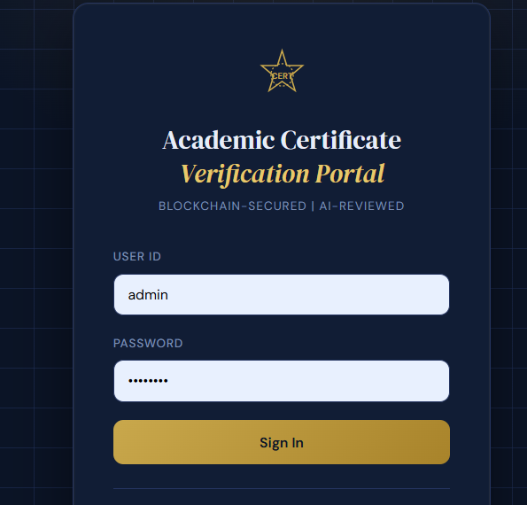
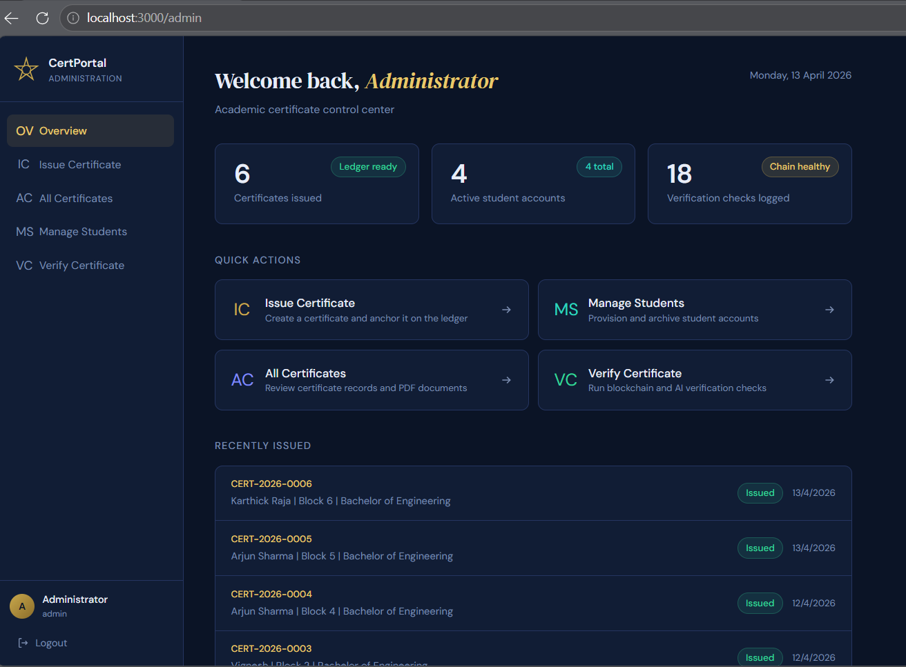
Screenshots
Screenshot
Academic Certificate Verification Portal
11

Slide 13
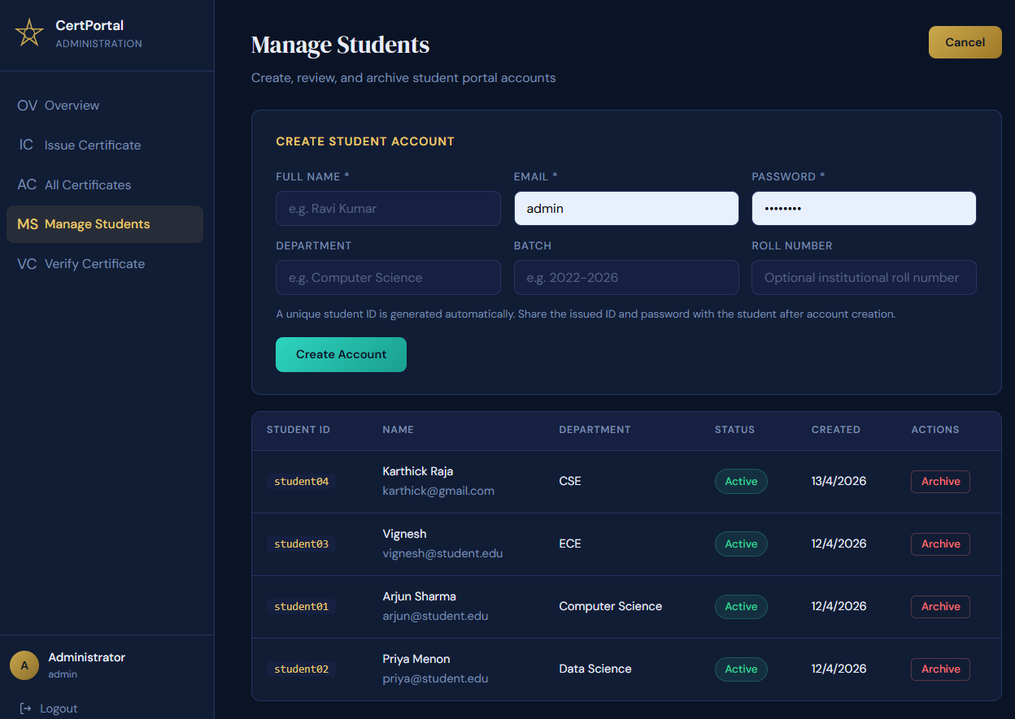
Screenshots
Screenshot
Academic Certificate Verification Portal
11

Slide 14
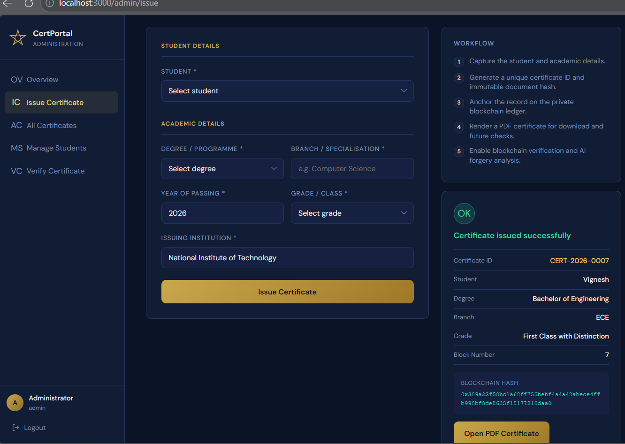
Screenshots
Screenshot
Academic Certificate Verification Portal
11

Slide 15
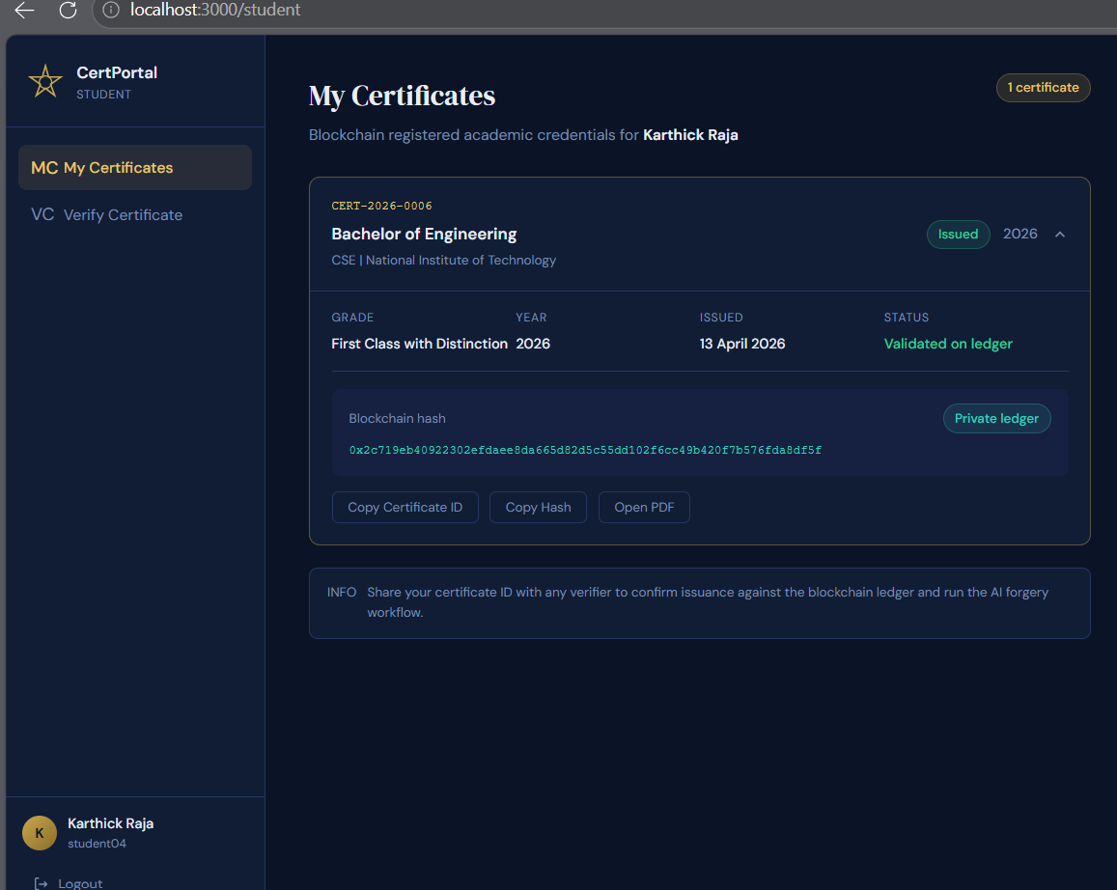
Screenshots
Screenshot
Academic Certificate Verification Portal
11

Slide 16
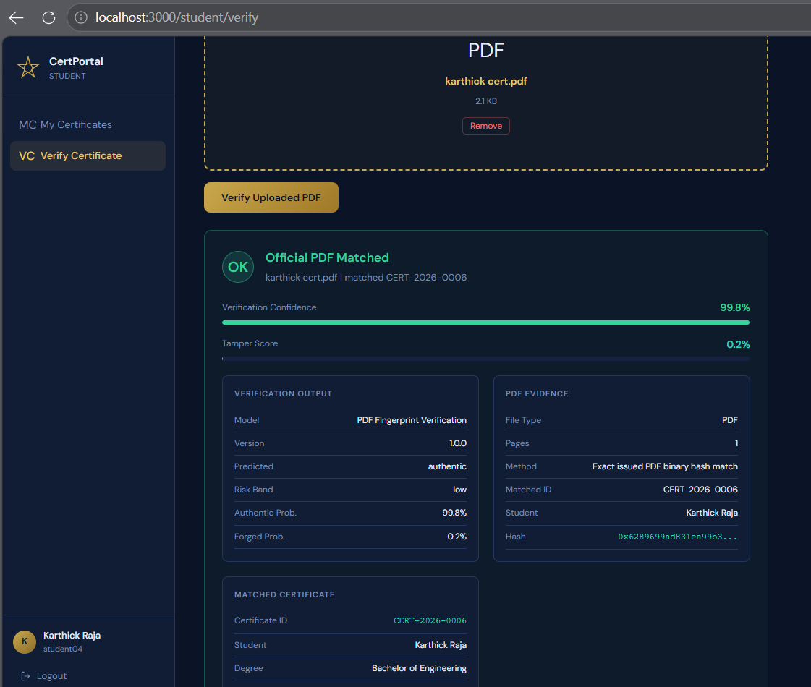
Screenshots
Screenshot
Academic Certificate Verification Portal
11

Slide 17
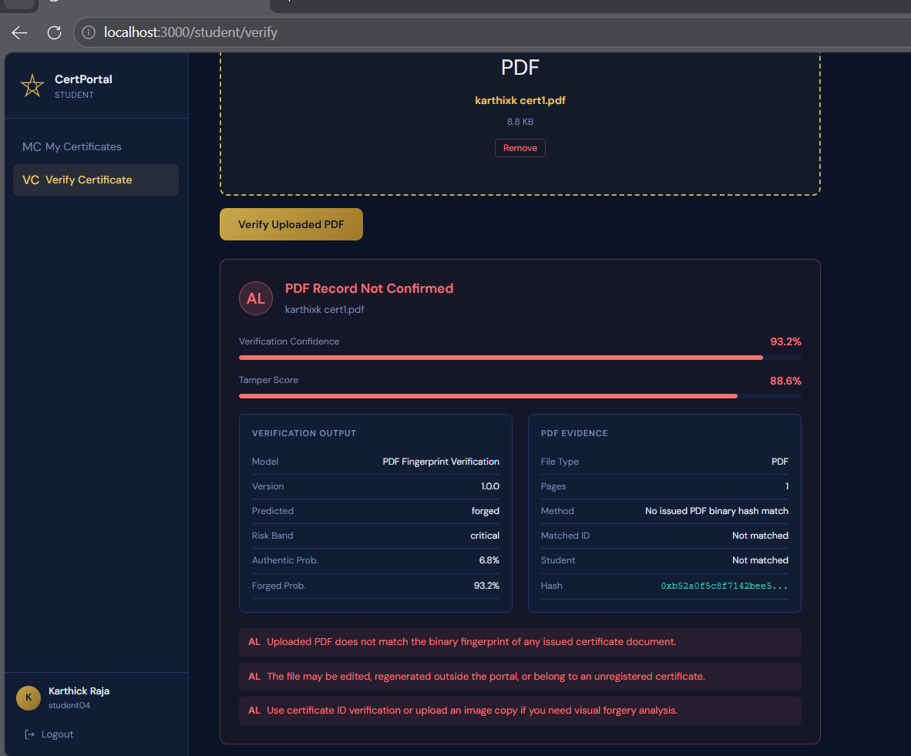
Screenshots
Screenshot
Academic Certificate Verification Portal
11

Slide 18
Conclusion
CONCLUSION
Project outcome and academic significance
The proposed system successfully transforms certificate issuance from a manual trust-based process into a digital, traceable, and verifiable workflow.
The private blockchain ledger provides tamper-evident storage for certificate fingerprints and improves trust in issued records.
Final Takeaway
A certificate becomes more trustworthy when issuance, storage, verification, and forgery screening are designed as one integrated pipeline rather than separate tasks.
The AI layer adds practical value by screening uploaded certificates for suspicious edits, cropping, and structural inconsistencies.
The platform integrates administration, student access, PDF generation, verification, and audit logging in one deployable project.
The solution is suitable for final-year academic demonstration and can be extended with a real dataset, cloud database, or enterprise deployment in future work.
Academic Certificate Verification Portal
12

Slide 19
References
REFERENCES
Standards, frameworks, libraries, and project sources
S. K. Kim and J. H. Lee, “Blockchain smart contract to prevent forgery of degree certificates,” Electronics, vol. 11, no. 14, p. 2112, 2022.
A. J. E. Andrade and F. C. Amate, “A decentralized academic certificate issuance system using smart contracts on the TRON network,” arXiv preprint arXiv:2601.08513, 2026.
M. Aldwairi, M. Badra, and R. Borghol, “DocCert: Document verification and authenticity blockchain solution,” arXiv preprint arXiv:2310.09136, 2023.
X. Zhao and Y.-W. Si, “NFTCert: NFT-based certificates with online payment gateway,” arXiv preprint arXiv:2202.09511, 2022.
A. Farabi, I. Khandaker, N. Jahan, and I. K. Shanto, “ShikkhaChain: A blockchain-powered academic credential verification system,” arXiv preprint arXiv:2508.05334, 2025.
S. Boonkrong, “Design of an academic document forgery detection system,” International Journal of Information Technology, 2025.
L. Selvam, J. R. F. Raj, and S. Krishnan, “Forgery detection in academic certificates using hybrid deep learning framework,” ResearchGate Conference Paper, 2026.
K. Ankit, D. Bhandari, R. Priyadarshini, and P. K. Meher, “Detection of fake physical certificates using blockchain-based certificate verification,” Conference Proceedings, 2024.
“Blockchain-based academic certificate fraud detection: A comparative review and combined framework,” ResearchGate, 2026.
“Certificate verification and counterfeit detection using blockchain,” IJRASET, 2023.
“Detection of fake certificate using blockchain and issuer validation system,” IARJSET, vol. 12, no. 5, 2025.
“Digital certificate fraud detection using blockchain technology,” IJERT, 2024.
Y. LeCun, Y. Bengio, and G. Hinton, “Deep learning,” Nature, vol. 521, no. 7553, pp. 436–444, 2015.
A. Krizhevsky, I. Sutskever, and G. E. Hinton, “ImageNet classification with deep convolutional neural networks,” Communications of the ACM, vol. 60, no. 6, pp. 84–90, 2017.
K. Simonyan and A. Zisserman, “Very deep convolutional networks for large-scale image recognition,” arXiv preprint arXiv:1409.1556, 2014.
K. He, X. Zhang, S. Ren, and J. Sun, “Deep residual learning for image recognition,” in Proc. IEEE CVPR, 2016, pp. 770–778.
O. Ronneberger, P. Fischer, and T. Brox, “U-Net: Convolutional networks for biomedical image segmentation,” in MICCAI, 2015, pp. 234–241.
I. Goodfellow, Y. Bengio, and A. Courville, Deep Learning. MIT Press, 2016.
S. Nakamoto, “Bitcoin: A peer-to-peer electronic cash system,” 2008.
M. Crosby, P. Pattanayak, S. Verma, and V. Kalyanaraman, “Blockchain technology: Beyond bitcoin,” Applied Innovation Review, no. 2, pp. 6–19, 2016.
Academic Certificate Verification Portal
13

Slide 20
References
REFERENCES
Standards, frameworks, libraries, and project sources
React Documentation. React Team. https://react.dev/
Express.js Documentation. OpenJS Foundation. https://expressjs.com/
Karpathy, A. ConvNetJS: Deep Learning in JavaScript. https://cs.stanford.edu/people/karpathy/convnetjs/
Jones, M., Bradley, J., and Sakimura, N. JSON Web Token (JWT), RFC 7519, IETF, 2015.
PDF-Lib Documentation. https://pdf-lib.js.org/
Jimp Documentation. https://jimp-dev.github.io/jimp/
PptxGenJS Documentation. Brent Ely. https://gitbrent.github.io/PptxGenJS/
Academic Certificate Verification Portal, project source code and generated technical artifacts, 2026.
Academic Certificate Verification Portal
13

