Slide 1



KEYLOGGER
Presented By:
VIGNESH PV–Anjalai Ammal Mahalingam Engineering College- Koyilvenni, Thiruvarur.

Slide 2

OUTLINE :
Problem Statement
Proposed Solution
System Development Approach
Algorithm & Deployment
Result
Conclusion
Future Scope
References

Slide 3

PROBLEM STATEMENT:
In today's digital age, where cybersecurity threats loom large, one of the significant concerns is the proliferation of keyloggers, stealthy software tools designed to monitor and record keystrokes on a user's computer without their knowledge.
Keyloggers pose a severe threat to individuals and organizations as they can capture sensitive information such as passwords, credit card details, and other personal data, leading to identity theft, financial loss, and privacy breaches.

Slide 4
PROPOSED SOLUTION:
Antivirus and Anti-Malware Software: Encourage individuals and organizations
to use reputable antivirus and anti-malware software that includes features
specifically designed to detect and remove keyloggers.
Regular Software Updates: Emphasize the importance of keeping operating systems,
applications, and security software up to date to patch vulnerabilities that keyloggers may
Exploit.
Firewalls and Intrusion Detection Systems: Implement robust firewall configurations and
intrusion detection systems to monitor network traffic for signs of keylogger activity and block
suspicious connections.
Behavioral Awareness: Educate users about the risks of clicking on suspicious links or
downloading files from unknown sources, as keyloggers are often distributed through phishing emails or malicious
websites.
Endpoint Security Solutions: Deploy endpoint security solutions that include features such as application
whitelisting, which only allows approved applications to run, and privilege management to restrict access to sensitive system
functions.

Slide 5

SYSTEM DEVELOPMENT APPROACH :
Choose Platform and Programming Language: Decide on the platform and programming language for developing the keylogger. Common choices Include C/C++, Python, or Java, depending on the target operating system and specific requirements.
Design Architecture: Design the architecture of the keylogger system, considering factors such as stealthiness, logging mechanism, data storage, and remote access (if applicable). Ensure that the keylogger operates discreetly to avoid detection by users.
Implement Keylogging Functionality: Develop the core functionality of the keylogger to capture keystrokes entered by the user. This may involve intercepting keyboard events at a low level, hooking into the operating system, or using platform-specific APIs.
Ensure Security and Encryption: Implement security measures to protect the logged data from unauthorized access. If sensitive information is being captured, consider encrypting the logs using strong encryption algorithms to prevent data breaches.
Testing and Debugging: Thoroughly test the keylogger system to ensure functionality, reliability, and compatibility across different operating systems and environments. Debug any issues that arise during testing.

Slide 6

ALGORITHM AND DEPLOYMENT
Initialization
Compile/Package the Application
Distribution
Installation and Execution
Configuration
Monitoring and Maintenance
Legal and Ethical Considerations

Slide 7
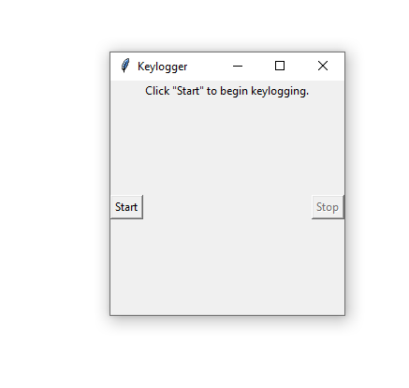
RESULT

Slide 8

CONCLUSION:
In conclusion, the keylogger project emphasizes technical precision, ethical responsibility, and legal compliance. Its deployment must prioritize transparency, consent, and respect for privacy rights. Overall, adherence to these principles ensures responsible usage and ethical integrity.

Slide 9

FUTURE SCOPE
The future scope for keylogger projects lies in enhancing cybersecurity measures, improving parental control solutions, and advancing employee monitoring systems. Additionally, integrating machine learning algorithms for anomaly detection and behavior analysis could provide valuable insights for threat detection and prevention. Furthermore, emphasizing ethical usage guidelines and implementing robust encryption methods will be crucial for maintaining user trust and privacy protection.

