Slide 1
Float Lecture Series
Intro to Web Design and Development

Slide 2
Day 1: The Basics
Introductions
Get a Good Text Editor and Web Browser
HTML/CSS Overview
Make your own basic site from scratch!

Slide 3
Introductions

Slide 4

Meet the Instructors!
Christine Hong
Junior, Trumbull
CS/Econ major
SDE at LinkedIn this summer
Loves going to the zoo (the rea1 one, not AKW)

Slide 5

Torie Nielsen
Sophomore, Branford
CS major
Loves California
Hates broken bones

Slide 6
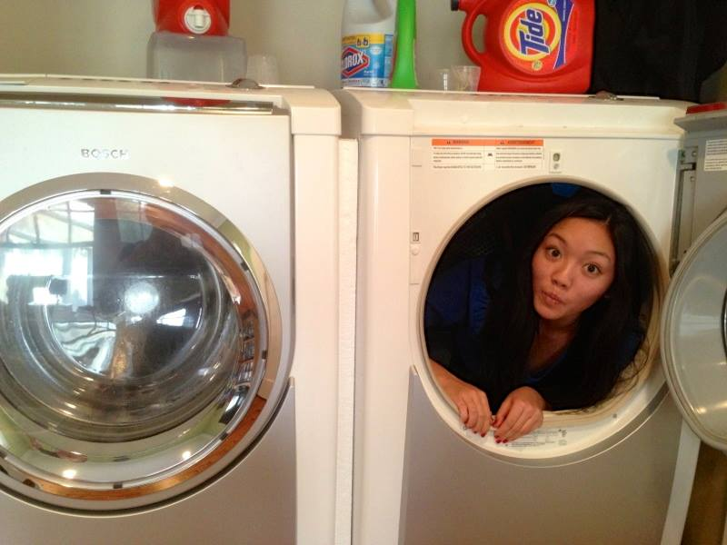
Brianna Loo
Sophomore, Morse
EECS major
Photo editor at the YDN
Loves to sleep

Slide 7

Annie Cook
Sophomore, Morse
CS major

Slide 8


Moriah Rahamim
Junior, Silliman
NELC major
Knows how to ride a motorcycle
Patronus takes the form of
a narwhal

Slide 9

Sophia Normark
Sophomore, Calhoun
E&EB major
Birdwatches
Misses her chum
Paddington

Slide 10
If you have any questions/trouble, just raise your hand and a TA will come help you out
Don’t bother taking notes! Lecture slides are available at floatyale.com/lectures

Slide 11
What is Float?
We think that Yale should have more girls interested in tech and business
What we do:
free workshops
big sib program for anyone interested in coding
forum for any questions about CS classes and looking for a job at a tech startup/company
send members to conferences/hackathons

Slide 12
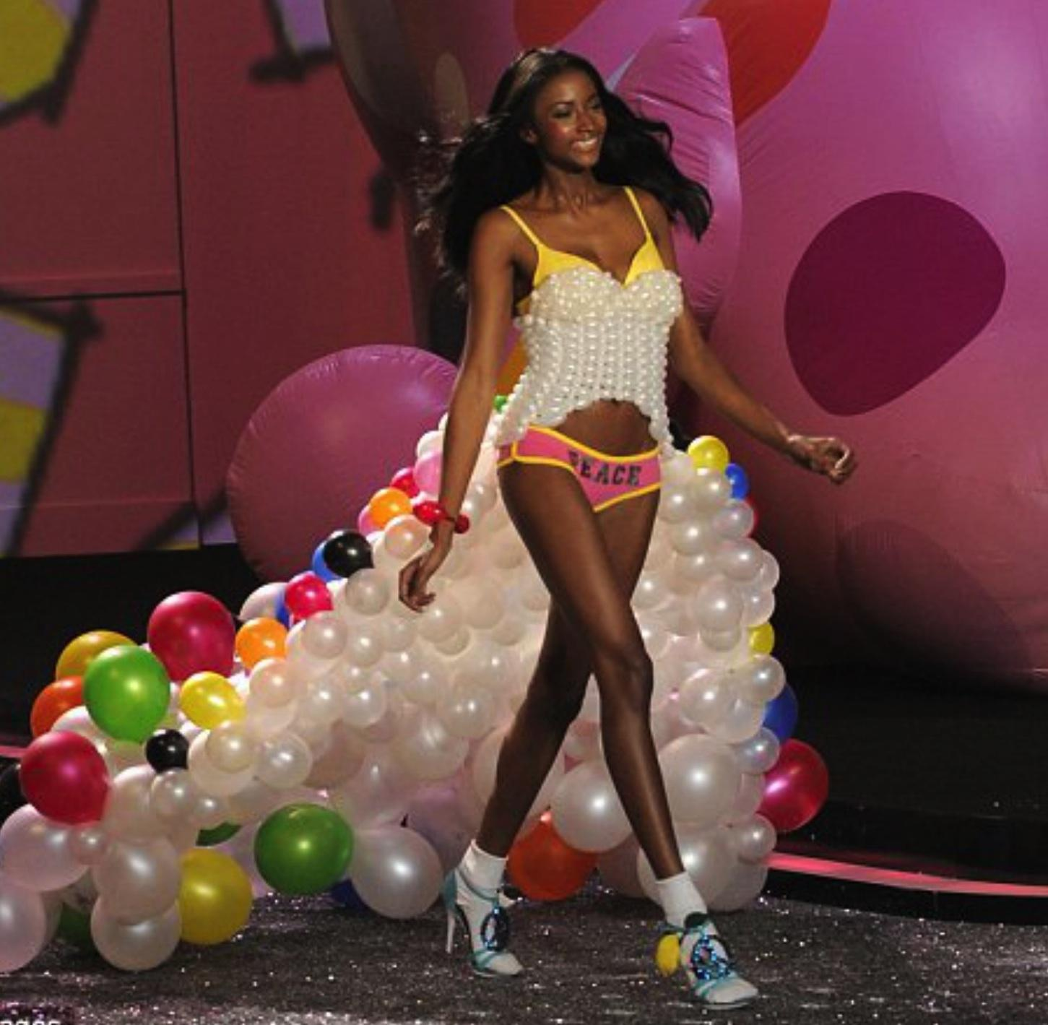
Speaking of Speakers...
Make sure to go see Lyndsey Scott!
Victoria’s Secret model and avid programmer
4:30 pm today in Phelps 407
Src: http://www.businessinsider.com/lyndsey-scott-model-and-coder-2014-1

Slide 13
Future Classes Offered
Making Websites Part 2 (learning Javascript)
Creating scripts (learn Python!)
Building iPhone apps
Acing the Coding Interview

Slide 14
Get a Good Text Editor and Web Browser

Slide 15


Download These Now
Sublime Text
(sublimetext.com)
Google Chrome
(google.com/chrome)

Slide 16
HTML/CSS Overview

Slide 17
Understanding the Internet
Client-server model
client is you and your browser
server is the machine sending you the data and files which you request
Request-Response Cycle
Client makes a request
Server issues a response of requested content or error (404 not found)
request and response are both textual messages defined by HTTP (hyptertext transfer protocol)

Slide 18
What is a Website Exactly?
A website is really a bunch of folders with files
These files are written in HTML, CSS, Javascript, or a backend language (like PHP, Ruby, Python, etc.)
We are going to concentrate on the look of a website (front-end development)
Notes:
Backend language processes login info
Today HTML, CSS

Slide 19
Front-end Development
Front-end is how to display content from server
Interaction between three languages
HTML (hypertext markup language)
the actual content of web page (“bones”)
CSS (cascading style sheets)
style of web page (“skin”)
Javascript (a programming language, NOT Java)
any animations, moving things (“muscles”)
To be a true front-end web developer, you’ll need to know all 3, but we’re concentrating on HTML/CSS because of time constraints

Slide 20
Let’s see an example of a basic website

Slide 21
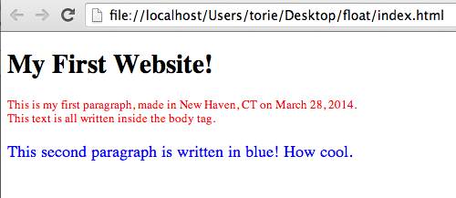
Torie’s first basic website

Slide 22
Torie’s index.html file
<!DOCTYPE html>
<html>
<head>
<link rel="stylesheet" href="./style.css">
</head>
<body>
<h1>My First Website!</h1>
<p class = "red">This is my first paragraph, made in New Haven, CT on March 28, 2014. </br>
This text is all written inside the body tag.</p>
<p class = "blue"> This second paragraph is written in blue! How cool. </p>
</body>
</html>

Slide 23
Torie’s style.css file
p{
font-size: 18px;
font-style: normal;
color: red;
}
.red{
font-size: 14px;
color: red;
}
.blue{
font-size: 20px;
color: blue;
}

Slide 24
Part 1: HTML
(the basic website content)

Slide 25
The Workflow
Create a folder called “float” on your Desktop (or anywhere, doesn’t matter)
Open Sublime Text and open that folder
Create index.html file
Type whatever you want, you can copy Torie’s example code
Locate index.html file
right click -> Open With -> Google Chrome

Slide 26
Structure of HTML
Basic Doc (Source: w3schools.com/html/default.asp):
<!DOCTYPE html>
<html>
<head>
<title>My First Document</title>
</head>
<body>
<h1>My First Heading</h1>
<p>My first paragraph.</p>
</body>
</html>

Slide 27
What are tags?
HTML element that describes the content written between them
gives content certain properties based on tagname
Generally an opening and closing tag surround some code in the program
<tagname> content </tagname>
Think of tags like quotation marks, they come in pairs
All HTML elements are surrounded by tags

Slide 28
Understanding the Doc
<!DOCTYPE html>
need this for browser to recognize file as HTML
<html>
content in this bracket is html
<head> and <body>
content for head and body of doc
<h1> through <h6>
header 1, makes words big (h1 to h6 are decreasing in size)
<p>
paragraph, puts words in section and new line

Slide 29
Let’s see that doc again
Basic Doc (Source: w3schools.com/html/default.asp)
<!DOCTYPE html>
<html>
<head>
<title>My First Document</title>
</head>
<body>
<h1>My First Heading</h1>
<p>My first paragraph.</p>
</body>
</html>

Slide 30
More Popular Tags
<div>(“division”) empty shell for content blocks of HTML
What’s the point then? Assign them class/id
<div class=”style1”> content </div>
You can use CSS to make any div with class “style1” be however you want it (e.g. red background, size 14 font)
<li>(“list”) list elements with bullets or numbers
inside <ul>(“unordered list”) or <ol>(“ordered list”)
<a>(“anchor”) links to other web pages
<a href=”floatyale.com/about”>About Float</a>
<img>(“image”) shows image of link provided
<img src=”floatyale.com/logo.png”/>
No words inside image, so just 1 tag instead of 2
</br>(“break”) empty new line
Also just 1 tag

Slide 31
Comments
Good practice because you WILL forget what the code you wrote represents sometimes (also allows others to read your code more easily)
put anywhere in html file:
<!-- Hi, I’m a comment that won’t show up in the browser at all because I’m awesome. -->

Slide 32
5 minutes: play with tags in your index.html and see what happens

Slide 33
Part 2: CSS
(making your site pretty)

Slide 34
How to link CSS to HTML?
write all CSS in a separate file, the “stylesheet”
make one a blank one now, call it “style.css”
Link to it within the head of your index.html:
<html>
<head>
<link rel=“stylesheet” href=“./style.css”>
<title>My First Document</title>
</head>
Since we said style.css is in the same working directory as index.html, make sure to save the two files in the same folder!
“./” means current working directory

Slide 35
CSS Syntax
Selector
p{
font-size: 14px;
color: red;
}
This means every time you use the <p> tag in your HTML, content will be font-size 14px and color red.
Property
Value
Definition Block

Slide 36
What are CSS Selectors?
CSS links with HTML
Tags in HTML correspond to certain CSS selectors
The style you write for a CSS selector will affect what’s inside the tags in HTML
p{
font-size: 14px;
color: red;
}

Slide 37
Ways to Select HTML Elements
By tag name
just use p, img, div, or whatever element name is in tag
usually used for global feel of site (ex. make all images have a border, make all text of site a certain font size)
By class or id
classes are custom attributes given to one or more HTML elements, rather than every paragraph or every image
id is an attribute given to only one element
The CSS style you apply will affect all elements chosen by these selectors.

Slide 38
Classes and ID Selectors
Classes are for reusable info
You can use the same class on multiple elements and multiple classes on the same element
name begins with “.” in CSS
IDs are for unique info
Each element can have only one ID and each page can have only one element with that ID.
name begins with “#” in CSS
Elements can have both an id and classes
Classes and IDs basically have the same functionality

Slide 39
Let’s See it in Action
HTML:
<p> Hi </p>
<div class=”blue big”> from Float</div>
<div id=”style1”></div>
CSS:
.blue{
color: blue;
}
.big{
font-size: 250%;
}
#style1{
background-color: #000000;
}
Multiple classes,
just separate with spaces!
Remember:
ID = “#”
Class = “.”

Slide 40
CSS Selector Recap
Tag name (p, div, img etc)
use to define global styles
Class (“.”)
can use on multiple elements
most commonly used
ID (“#”)
unique
many people discourage using this
Top 20 selectors you should know: http://code.tutsplus.com/tutorials/the-30-css-selectors-you-must-memorize--net-16048

Slide 41
More Complex CSS Selectors
Multiple Selector
.style1,.style2 {} = all elements with class style1 and/or class style2
Contextual Selector
style1 .style2{} = all elements with class style2 INSIDE element with id style1
Parent-child Selector
div > a{} = all links that are direct children of divs (not grandchildren)
Attribute Selector
div[class=”style1”]{} = all divs with class style1
Need more? => Google what selector you want!

Slide 42
Common CSS Styles
color, background-color
use name (ex. red.) or hex value (ex. #FFFFFF)
width, height, font-size
use percentage (50%) or pixel value (20px)
percentage is compared to current font
border (size, style, color)
ex. border: 1px double red;
Google is your friend to find the CSS style you want

Slide 43
10 min: play with CSS code in your style.css and see what happens
To find hex color codes:
http://html-color-codes.info/#HTML_Color_Picker

Slide 44
Part 3: The Box Model

Slide 45
What is the Box Model?
Each HTML element is a nested box
CSS box model allows us to place a border around elements in relation to other elements

Slide 46
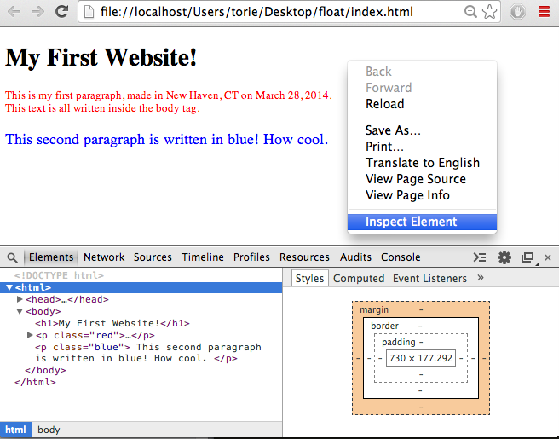

Slide 47
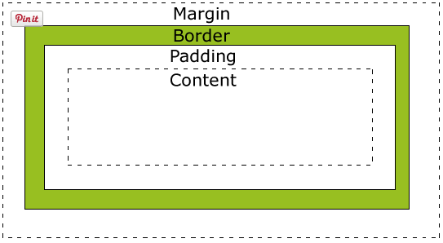
Margin:
no background color
Border:
inherited from color property of box
Padding:
affected by background color of box
Content:
text and images here
source: http://www.w3schools.com/

Slide 48
What’s the point?
Understanding the box model is the only way to set the width/height and position of elements in a browser
It’s how we do things like create multiple columns, a floating navigation bar, etc.

Slide 49
Example CSS:
height: 40px;
width: 250px;
padding: 10px;
border: 5px solid gray;
margin: 10px;
height and width ONLY describe Content
total width of element is 300px
Remember! Padding, border, and margin have two sides:
300 = (250)+(10*2)+(5*2)+(10*2)
source: http://www.w3schools.com/

Slide 50
How to manipulate boxes?
Display, Position and Float!!
Display: type of box used for HTML element
Position: position of HTML element
Float: whether HTML element can “float” (be wrapped around)

Slide 51
What is parent/sibling/child?
The child of an element is one bracket within its tags (tabbed in)
The outer element is the parent
A sibling is an element at the same level, within the tags of the same parent
Parent
Child of <body>
Sibling of <p>
<body>
<h1>My First Heading</h1>
<p>My first paragraph.
</p>
</body>
Child of <body>
Sibling of <h1>

Slide 52
Display:
type of box used for HTML element

Slide 53
Display Types
block:
element takes up full width of doc
on new line
inline:
element takes up only width of its content
no new line
inline-block:
like inline, but can set properties like width, height, and padding/margin
none:
element is removed from doc completely

Slide 54
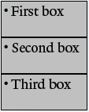

Display examples
<ul id=”my-boxes”>
<li>First box</li>
<li>Second box</li>
<li>Third box</li>
</ul>
#my-boxes li{
display: ??????;
width: 175px;
height: 75px;
background: gray;
border: 1px solid black;
}
display:block;
new line for each block
display:inline;
no new line,
no definable width and height (so they get ignored)
display:inline-block;
like inline, but definable width and height
source: HackYale

Slide 55
Display Defaults
No need to declare for some things, because block/inline are already built in to the following:
block
div, p, ul, etc.
inline
a, em, img, most text modifiers

Slide 56
Position:
position of HTML element

Slide 57
Position Types
static (the default):
render element relative to neighbors with no offset
fixed:
set element at a fixed location in browser window (regardless of page scrolling)
use top, left, bottom, right from browser window
absolute:
set element at specific location in parent element
use top, left, bottom, right from first parent element whose position is NOT static
relative:
sets element position relative to sibling elements (neighboring elements with same parent)
use top, left, bottom right to position element relative to where it would normally be

Slide 58
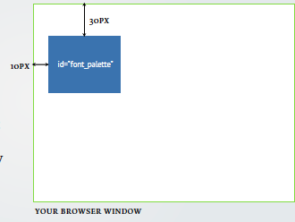
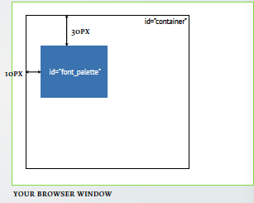
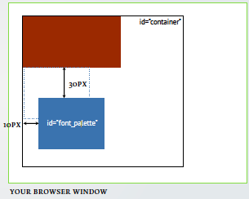
Position examples
#font_palette{
top: 30px;
left: 10px;
}
position: fixed;
from browser window
position: absolute;
from parent element
position: relative;
from sibling element
source: HackYale

Slide 59
Float:
whether HTML element can “float” (be wrapped around)

Slide 60
Float and Clear types
Float: left, right, none, inherit
floating element moves as far left/right as it can
elements after floating element wrap around it (does not affect elements before)
Clear: left, right, both, none, inherit
decides which sides of an element other floating elements are not allowed to float around

Slide 61
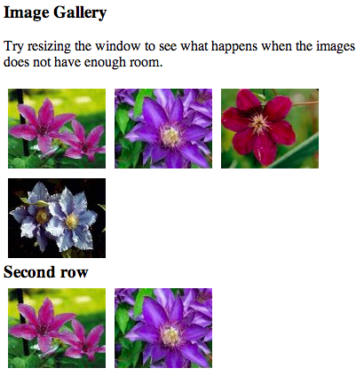
Float/Clear Examples
<h3>Image Gallery</h3>
<p>Try resizing the window to see what happens when the images does not have enough room.</p>
<img src="klematis_small.jpg" >
<img src="klematis2_small.jpg">
<img src="klematis3_small.jpg" >
<img src="klematis4_small.jpg" >
<h3 class="text_line">Second row</h3>
<img src="klematis_small.jpg">
<img src="klematis2_small.jpg">
img {
float:left;
}
.text_line{
clear:both;
}
source: http://www.w3schools.com/
Notes:
Clear the space on either side

Slide 62
Make Your Own “About Me” Site from Scratch

Slide 63
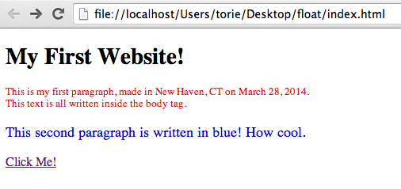
Making Linked Pages:
Updating Torie’s Site

Slide 64
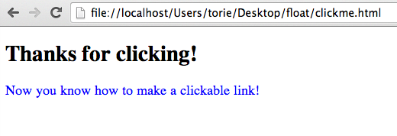
Making Linked Pages

Slide 65
How to do this:
Create a new html file and save it in the same folder as index.html and style.css
Link this new html file to style.css as we did before
Write whatever you’d like in the body
add <a href="./clickme.html">Click Me!</a>
to your index.html file in the location that you want your link to appear

Slide 66
Torie’s updated index.html file
<!DOCTYPE html>
<html>
<head>
<link rel="stylesheet" href="./style.css">
</head>
<body>
<h1>My First Website!</h1>
<p class = "red">This is my first paragraph, made in New Haven, CT on March 28, 2014. </br> This text is all written inside the body tag.</p>
<p class = "blue"> This second paragraph is written in blue! How cool. </p>
<p> <a href="./clickme.html">Click Me!</a> </p>
</body>
</html>

Slide 67
Torie’s clickme.html file
<!DOCTYPE html>
<html>
<head>
<link rel="stylesheet" href="./style.css">
</head>
<body>
<h1>Thanks for clicking!</h1>
<p class = "blue"> Now you know how to make a clickable link! </p>
</body>
</html>

Slide 68
Example Time
Check out the original personal site I made for HackYale at http://christine-hong.com/personalwebsite/
Made that in around 2 hours
Right click->”View Page Source” to view the code of each page

Slide 69
Time to Make Your Own!
make a simple profile website with linked pages
All instructors are here until 4pm
floatyale.com/lectures as reference
Still struggling on HTML/CSS?
Try http://learn.shayhowe.com/
Design inspiration:
Try http://www.thebestdesigns.com/

Slide 70
Survey
Be awesome and fill out this survey of what you think of the class so far!
https://docs.google.com/forms/d/1yovjpgr2XbNQkavfXM0ppd4Nka9DXVmyXljnHvJyC2k/viewform

