Slide 1
CarePortal: Modern Patient Administration System (PAS)
Lead Developer & PAS Core Team
Technical Presentation & Demonstration
July 2026

Slide 2
Problem Statement
CarePortal PAS solves key operational challenges in clinical workflows
by eliminating double-navigation confusion and patient context loss
to deliver a production-ready, high-performance HIS console.

Slide 3
Solution Overview
CarePortal PAS is a minimal, professional hospital console.
Main Objective: Accelerate clinical intake, prevent context errors, and manage patient status.
Features a responsive, high-performance front-end built using Zoneless Angular 19.
Provides complete multi-tab navigation with isolated patient states.
Powered by a robust C# .NET 9 Web API and Marten event-sourcing database.
Designed with clean aesthetics matching Epic, Cerner, and Dedalus.
SOAP Standard
Warnings
Signals
Marten DB
Admissions
Discharge
Bed Board
Occupancy
intent
intent
Clinical Intake
MRSA Flag
Demographics
GP Referrals
Pathway
KPI Reports
Notes
Zoneless

Slide 4
CarePortal Workspace Core Features
Patient Search & Registry: Master directory lookup with national demographics checksum validation.
Patient Registration: Intuitive inpatient/outpatient admission form with Next of Kin auditing.
Referrals & Waitlist: e-RS digital referral intake and 18-week RTT clock tracking pathways.
Clinic Booking & Wards: Consultant appointment slots scheduling and visual interactive bed boards.
Documents & Notes: Categorized progress logs and SOAP formatted clinical case documents.
  Modular
  Console
  Workspace
  Components:
  consists of:
Clinical Alerts: Infection warning banners, high fall risk flags, and isolation warnings.
Multi-Tab Core: Multiple open patient workspaces without context overlap.
Operational Reports: Live hospital KPI charts and ward occupancy indicators.
Demographics Checksum: English NHS, Scottish CHI, and Irish IHI validation check digits.

Slide 5
AI-Assisted Development (Antigravity AI)
  Using Antigravity AI allowed us to accelerate our enterprise development lifecycle by over 80% with high-fidelity output.
UI Prototyping
Developed 12 fully custom healthcare modules using CSS in a fraction of typical front-end delivery times.
Validation
Generated and implemented complex NHS, CHI, and IHI modulus 11 check digit checksum logic.
Seeder Automation
Programmed a seeder mapping 110+ patients, 35 doctors, and hundreds of clinic records.
Interactive State
Simulated ward transfer, cleaning, and discharge state workflows without needing an active backing API.
Define & Assess Situation
Determine & Initiate Actions
Communicate
Monitor & Report
Walkthroughs
Generated structured walkthroughs and project documentations.
Verification
Automated tests and compilation verification to ensure zero runtime issues.
Tab Management
Created client-side tab state preservation and context switching for multiple patients.

Slide 6
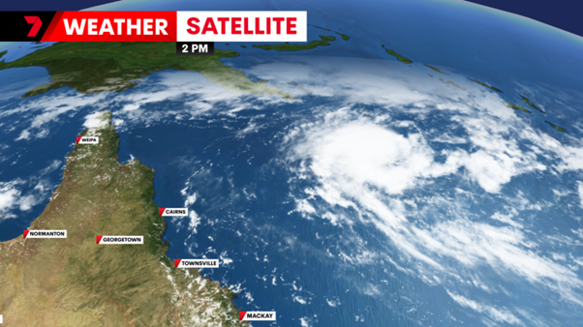



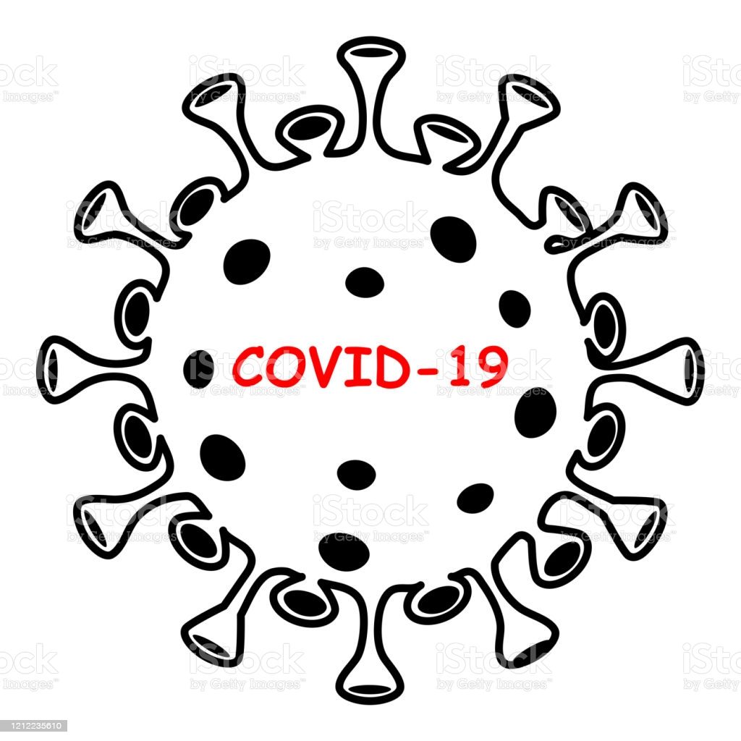
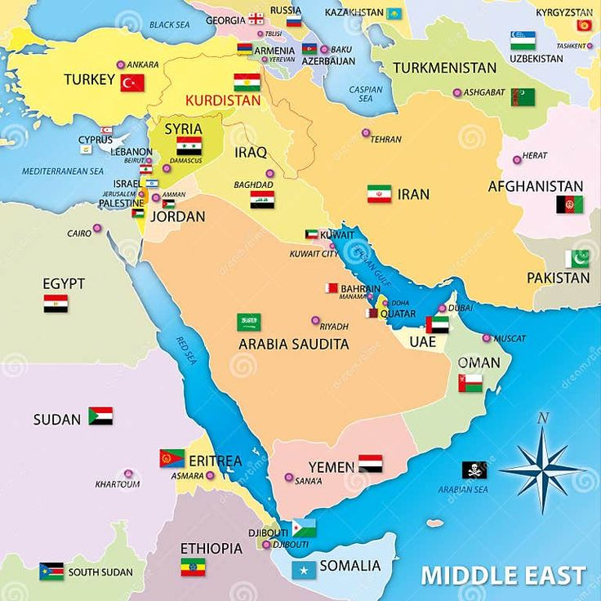



Ward Management Board
Book Clinic Slot
Multi-Tab
Context Isolation
Sign Out Screen
Login Portal
Demo Users Grid
Save Note & Redirect
Patient Search
Context Locking
Create Referral
Create Waitlist
Interactive Beds
Reports & KPIs
Clinical Console Dashboard

Slide 7
Technical Highlights
  A modern, reactive, modular technical stack built for healthcare scalability.
  Core features include Zoneless change detection, event-sourced CQRS, and rich data persistence.
  Key Architecture Pillars:
    Zoneless Angular 19: Signals-driven repainting for sub-millisecond dashboard updates.
    CQRS & Marten: Event sourcing via PostgreSQL mt_events for immutable clinical logging.
    Client-Side Contexts: Independent tab state storage for simultaneous patient encounters.
    Decoupled Navigation: Event-driven redirections between modules to eliminate circular imports.
    Demographics Checksum: Client-side modulus 11 algorithms validating NHS, CHI, and IHI formats.
    Rich Local Seeding: Zero-dependency failover to programmatically seeder arrays when API is offline.

Slide 8
Clinical Roles & User Directory
HIS Access Role | Assigned User Group | HIS Access Role | Assigned User Group
Chief Medical Officer | Clinical Directors | Consultant Doctor | Senior Registrars
Admitting Clinicians | Ward Charge Nurse | Consultant Doctor | Ward Charge Nurse
Inpatient Wards Coordination | Registered Nurses | Emergency Admitter | Joerg Kirsten
Alt. Crisis Coordinator | Abhishek Kumar | HR | Annis Banu Shanavaz Khan
Alt. Crisis Coordinator | Inder Jeet Singh | Communication | Radhika Natraj
Engagements Delivery Manager | Chittaranjan Mohanty | Facilities | Sarfuddin A
Technical Coordinator | Harinam Prasad | Finance | Sachin Upadhyay
Consultant Doctor | Senthilnathan Ranganathan | Supply Chain | Akshay P
Consultant Doctor | Suresh Babu
Crisis Management Plan is the document that guides the Crisis Response Team on activation and managing an incident.

Slide 9
Key Business & Operational Benefits
Operational BenefitsCarePortal PAS increases staff productivity, simplifies onboarding, and guarantees demographic security.
✔ KPI Dashboard
✔ High Productivity
✔ Zero Click Confusion
Using Antigravity AI allowed us to build and verify these features rapidly with zero compilation errors.
This HIS dashboard conforms to Dedalus standards of operational clinical safety and ease of use.
✔ Direct Routing
✔ Context Locker
✔ Interactive Beds
✔ National Checksums
Business process or activity | Location where this is conducted | Delivery Manager | How CarePortal PAS optimizes hospital administration and clinical efficiency: Impact and types to consider: - Loss of staff member, - Loss of site, - Loss of comms, - Loss of equipment |  | Level 1 | Level 2 | Level 3 | Level 4 | Level 5 | Total | Impact Rating
 |  |  |  |  | Quantify the impact if this business process or activity is suspended for periods up to:-
 |  |  |  |  | Up to 4 hours | Up to 8 hours | Up to 1 day | Up to 7 days | Up to 28 days | Total Score | High / Medium / Low
Team name | Noida - hybrid working | Managers name | Reduced Click Fatigue | Single-page direct routing removes double-menu wrapping, saving practitioners critical time. | 0 | 0 | 0 | 3 | 5 | 8 | low
 |  |  | Patient Safety Focus | Rigid patient context isolation prevents cross-record typing errors and medication logging slip-ups. | 0 | 0 | 0 | 2 | 4 | 6 | low
 |  |  | Enhanced Ward Flow | Visual occupancy bar graphs and color-coded bed board cards accelerate discharges and cleanings. | 1 | 1 | 1 | 4 | 6 | 13 | Medium
 |  |  | National Standard Compliant | Built-in modulus 11 checksum algorithms prevent registration input errors on NHS/CHI/IHI numbers. Replacement laptops would need to be sourced. Team are hybrid working not all team in the office, could utilise other team members. If loss of laptop can use personal PCs to connect via virtual machine to Denmark, India DC. If loss of virtual machine connection would be high impact, if 1 person loss of connection can use other team members, high impact if whole team lost connection. Testing purposes only can use company mobiles phones | 3 | 4 | 4 | 6 | 6 | 23 | High
 |  |  | Executive Level Visibility | Real-time reports track admissions, waiting lists, and RTT clock breaches for operational audits. | 3 | 4 | 4 | 6 | 6 | 23 | High

Slide 10

CarePortal Future Development Roadmap
Future Features planned for subsequent release phases: | Planned features will extend auditing and expand interface capability: | Role-Based Access Control | Establish active LDAP/Active Directory bindings for granular clinical permissions. | National Event Hub Interfacing
Yes or No | Yes or No | Yes or No | Implement FHIR and HL7 messaging interfaces to broadcast admission and discharge events. | Admissions Audit Logging Maintain comprehensive historical logs of bed transfers and demographic changes.
No | No | Yes | Regional critical | 2
Introduce high-contrast clinical dark mode to reduce practitioner eye strain.
Clinical safety compliance
HL7 event messaging
Audit compliance
LDAP bindings
Role settings
Security permissions
Audit tracking
Direct connectivity
LDAP bindings
Role settings
Clinical alerts
Infection warnings
Specialty services
Establish active LDAP/Active Directory bindings for granular clinical permissions.
Key areas of clinical expansion:
Granular permissions
FHIR integration
Direct e-RS Integration | Establish active WebService connections to standard national referral portals. (MTPD) | Universal Dark Theme (minimum requirements staff, tools - laptop, detail any cross skill, detail any backup support)
4 hours | 1 day | 2 developers and 2 testers to be available Tools/dependencies; laptop, internet, VPN
Audit logs
e-RS integration
Dark theme
Mobile layouts
FHIR API
Historical tracking
Smartcard login integration
Enhanced logs

Slide 13


Slide 19
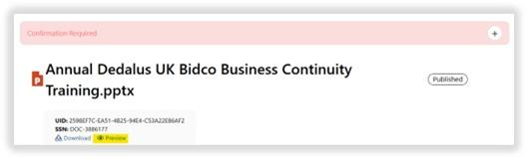
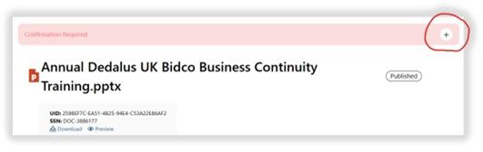

Slide 23
Thank You

