Slide 1
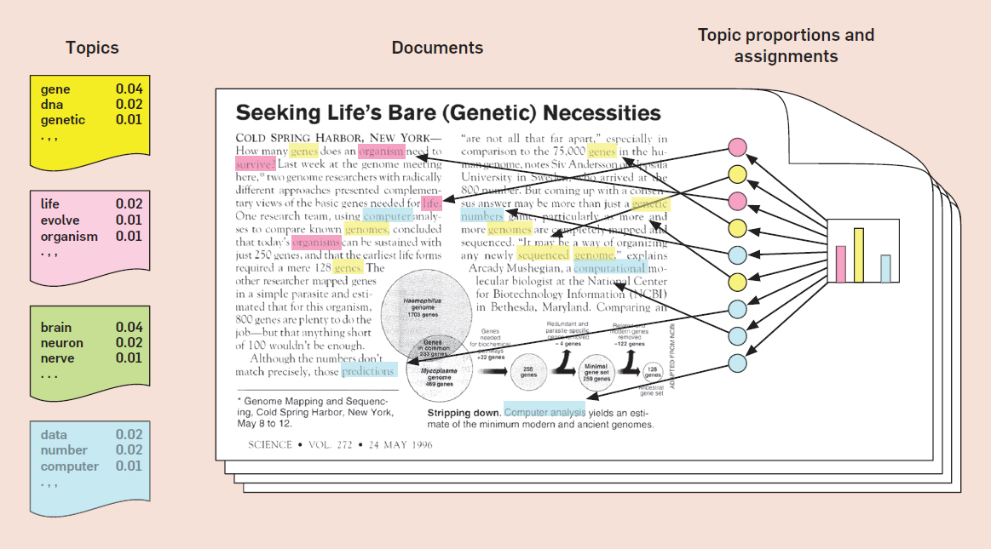
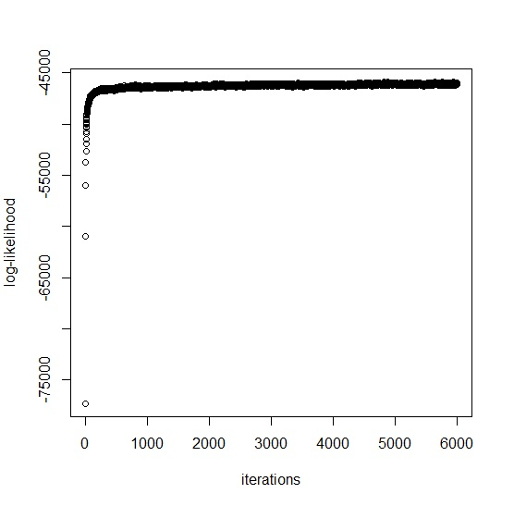
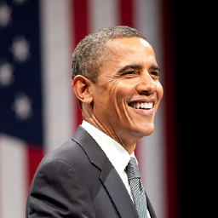
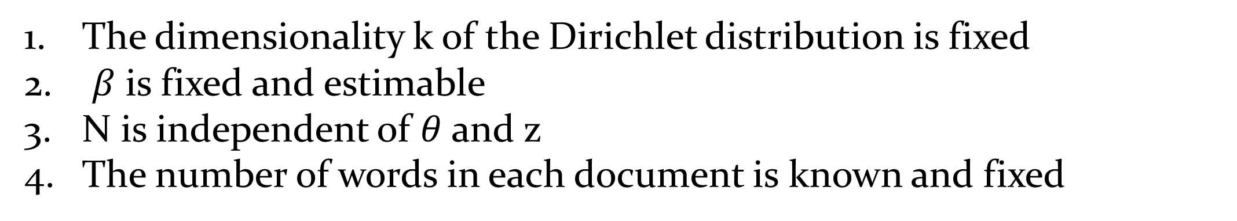
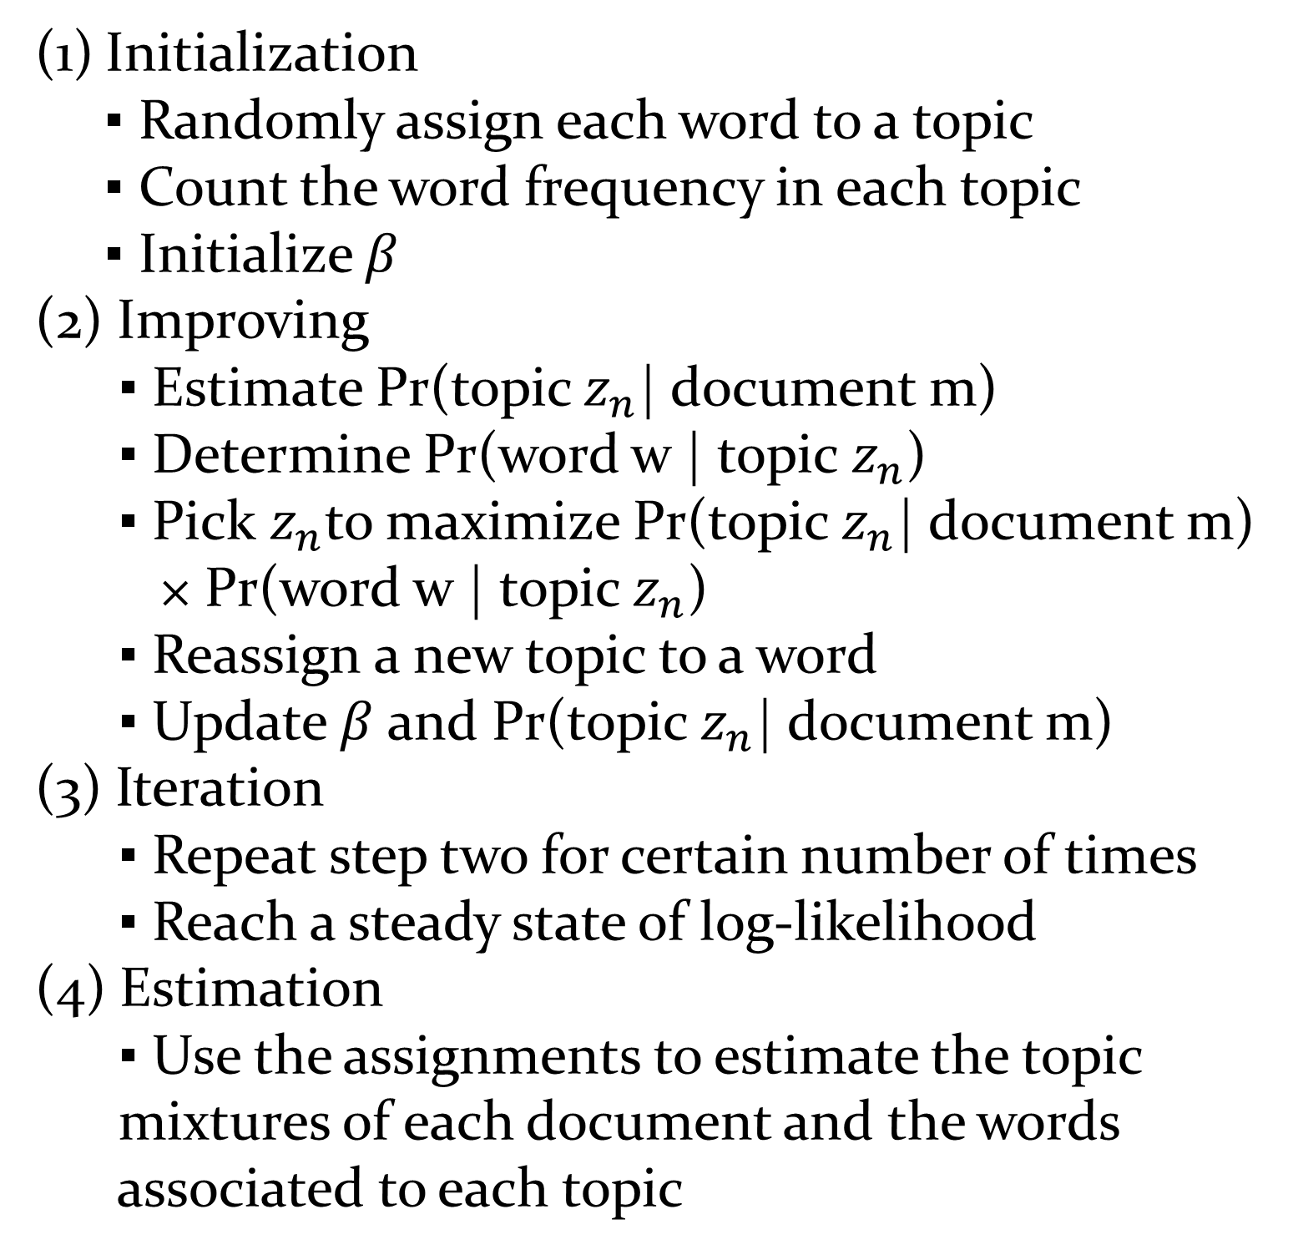
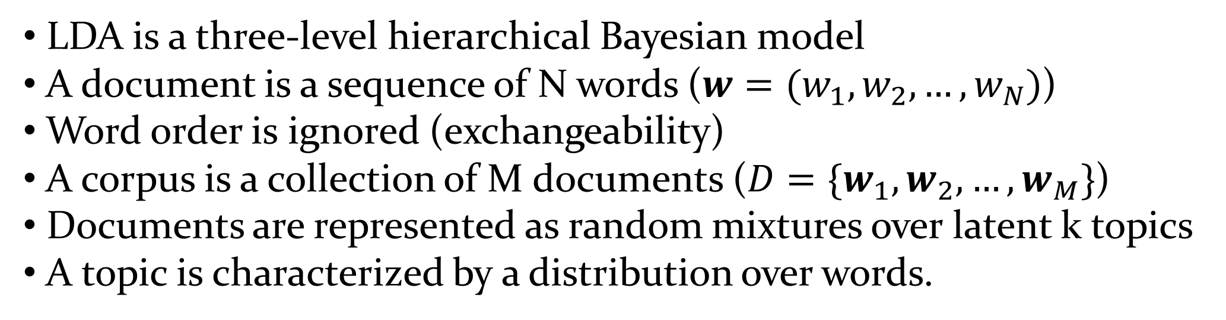
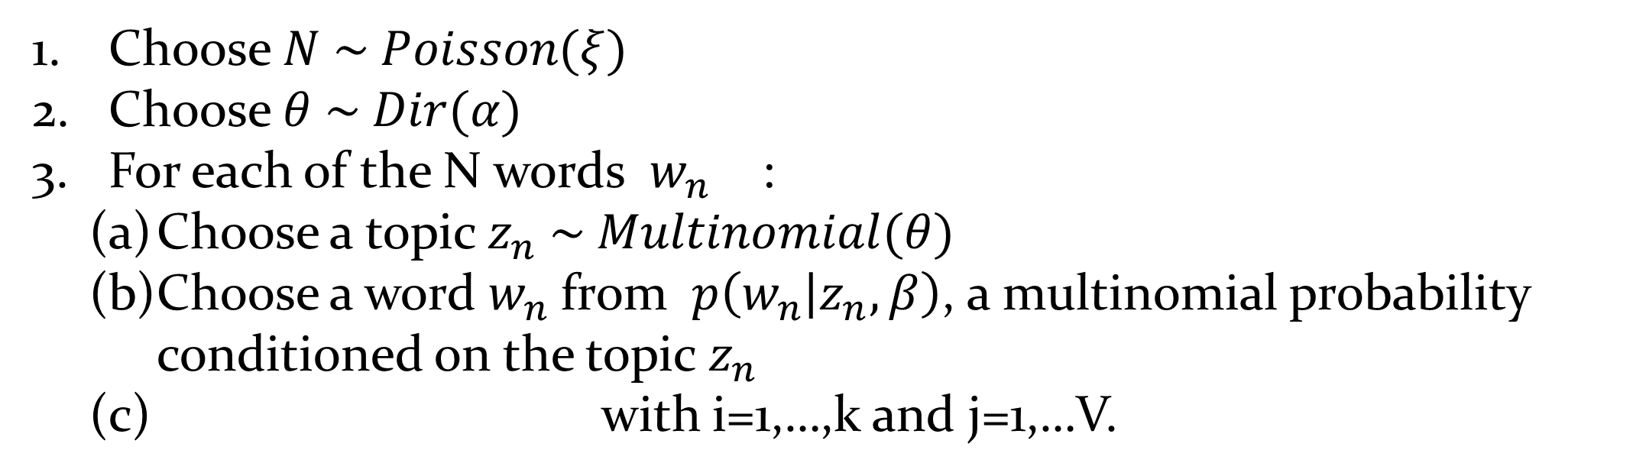
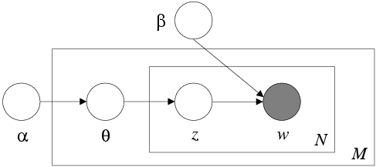
Probabilistic Modeling of Tweets
Chong Wang
North Carolina State University, Department of Statistics
Abstract
Results
In this project we apply the collapsed Gibbs sampling method for the widely used latent Dirichlet allocation (LDA) model, which is a generative probabilistic model that was first proposed
by Blei et al. (2003) to discover topics in text documents. LDA is a three-level hierarchical Bayesian model, in which each
item of a collection is modeled as a finite mixture over an underlying set of topics. Each topic is, in turn, modeled as an infinite mixture over an underlying set of topic probabilities. In the context of text modeling, the topic probabilities provide an explicit representation of a document. In year 2003, Blei, Ng, and Jordan employed an EM algorithm to maximize the likelihood numerically . In this project, we build a LDA model based on 1000 tweets made by president Obama and fit this model via another method called Gibbs sampling or Collapse Gibbs sampling. Further diagnostics of the Gibbs sampling are conducted. We report results of the topics discovered and compare them with a user self-provided benchmark.
The Graphical Model
Table 1: The top 10 most frequent hash-tag keywords
# Tag keyword | Count | # Tag keyword | Count
Obamacare | 70 | MakeCollegeAordable | 22
EnoughAlready | 46 | EndThisNow | 19
immigration | 43 | GetTalking | 18
ActOnReform | 31 | climate | 16
ABetterBargain | 28 | ActOnClimate | 15
The boxes are “plates” representing replicates
The outer plate represents documents
The inner plate represents the repeated choice of topics and words
The LDA equations
Table 2: Top 5 keywords among 9 topics
Topic 1 | president | obama | health | care | people
Topic 2 | health | insurance | care | new | affordable
Topic 3 | shutdown | government | republicans | tell | congress
Topic 4 | watch | obama | middle | class | live
Topic 5 | change | climate | congress | heard | today
Topic 6 | president | obama | america | jobs | county
Topic 7 | president | obama | wage | work | minimum
Topic 8 | house | time | congress | immigration | pass
Topic 9 | obama | predident | day | see | happy
Motivation
Classification and novelty detection with text corpora
Description of the data in a text corpora
Introduction
Methods
Collapse Gibbs Sampling
Figure 1: The log-likelihood trace plot
Initialization
▪ Randomly assign each word to a topic
▪ Count the word frequency in each topic
▪ Initialize $β$
(2) Improving
▪ Estimate Pr(topic $z_{n}$| document m)
▪ Determine Pr(word w | topic $z_{n}$)
▪ Pick $z_{n}$to maximize Pr(topic $z_{n}$| document m)
× Pr(word w | topic $z_{n}$)
▪ Reassign a new topic to a word
▪ Update $β$ and Pr(topic $z_{n}$| document m)
(3) Iteration
▪ Repeat step two for certain number of times
▪ Reach a steady state of log-likelihood
(4) Estimation
▪ Use the assignments to estimate the topic
mixtures of each document and the words
associated to each topic
LDA is a three-level hierarchical Bayesian model
A document is a sequence of N words ($w=(w_{1}, w_{2},…, w_{N})$)
Word order is ignored (exchangeability)
A corpus is a collection of M documents ($D=\{w_{1},w_{2}, …,w_{M}\}$)
Documents are represented as random mixtures over latent k topics
A topic is characterized by a distribution over words.
LDA – Generative Process of Documents
Choose $N \sim Poisson(ξ)$
Choose $θ \sim Dir(α)$
For each of the N words $w_{n}$ :
Choose a topic $z_{n} \sim Multinomial(θ)$
Choose a word $w_{n}$from $p\left(w_{n} | z_{n}, β\right)$, a multinomial probability conditioned on the topic $z_{n}$
with i=1,…,k and j=1,…V.
Conclusions
Real-World Data
We can uncover almost all the topics including health care, immigration reform, climate change, and middle class in America except the education.
The iteration needed in the twitter dataset is much higher than the typical text data analyzed by LDA.
A more efficient method for analyzing Tweets’ topics could utilize their special structure (being brief). A good start would be the hash-tag keywords.
Assumptions
1000 most recent tweets made by President Obama on twitter
The dimensionality k of the Dirichlet distribution is fixed
$β$ is fixed and estimable
N is independent of $θ$ and z
The number of words in each document is known and fixed
Barack Obama ‏@BarackObama 28 Nov
"On behalf of the Obama family, I want to wish everybody a very happy Thanksgiving." —President Obama

