Slide 1
GitHub Technical Exercise

Slide 2
Main Identified Requirements
Requirement | Quality Attribute
“Our security team is asking for help ensuring proper reviews are being done to code being added into our repositories.” | Main Functional Requirement
“We have hundreds of repositories in our organization. What is the best way we can achieve at scale?” | Scalability
“We are new to some of the out-of-the-box settings and the GitHub API” | Serviceability

Slide 3
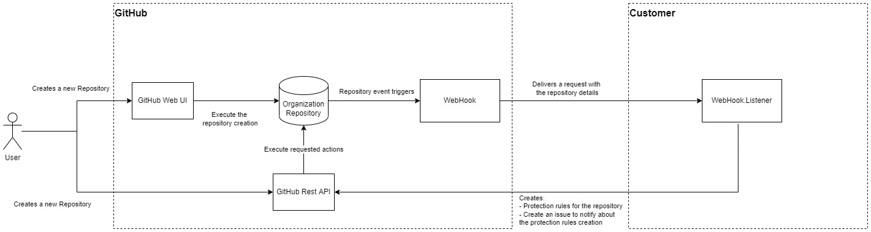
Main Solution - Diagram

Slide 4
Main Solution - Description
WebHook configured in GitHub to trigger an event every time a new repository is created.
A WebHook.Listener software component to receive the WebHook event data, then create Protection Rules and a notification Issue via GitHub Rest API.
Every time a new repository is created (via the GitHub UI or the GitHub Rest API), the WebHook sends a request to the WebHook.Listener, so the Protection Rules and Issue are created automatically.

Slide 5
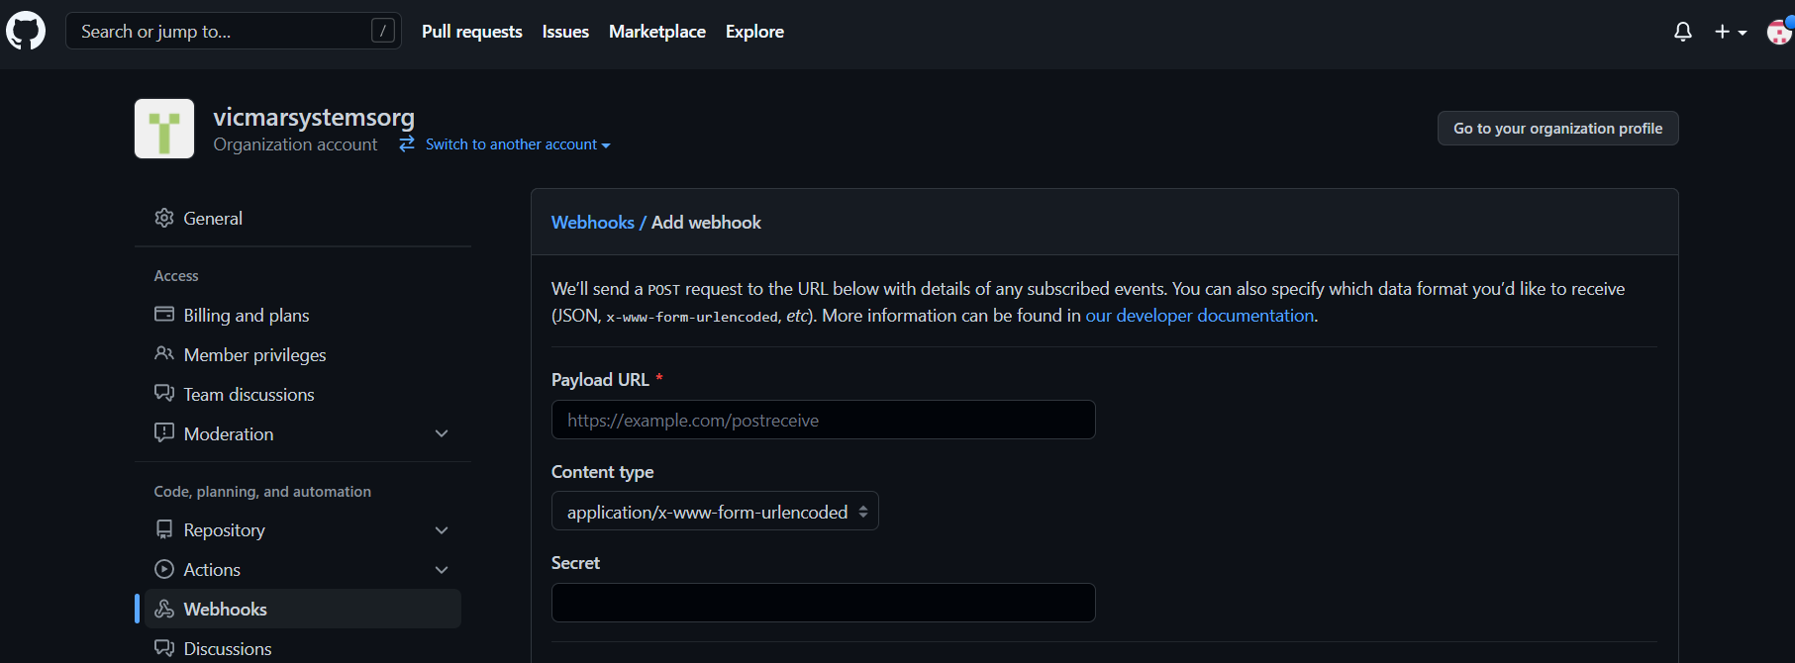
Configuration of a WebHook - 1

Slide 6
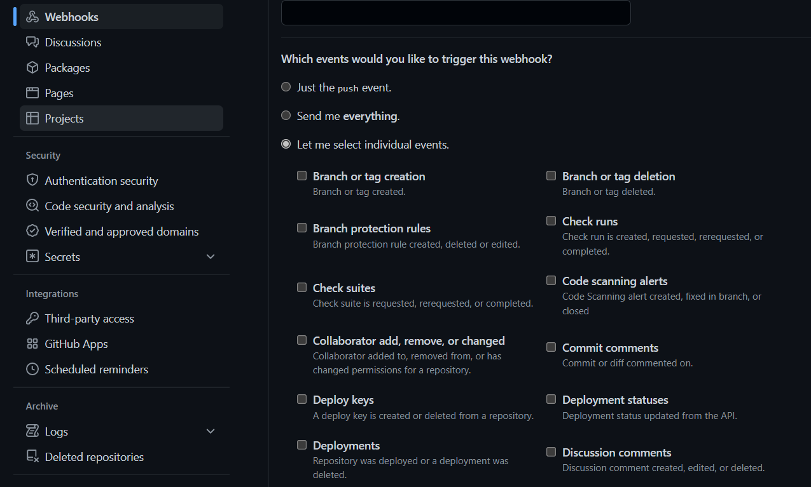
Configuration of a WebHook - 2

Slide 7
Which events would you like to trigger this webhook?
Branch or tag creation
Branch protection rules
Forks
Pull request review threads
Repositories
Releases
Pushes
Workflow Jobs
And much more… For a complete list of available webhook events and their payloads, see "Webhook events and payloads."

Slide 8
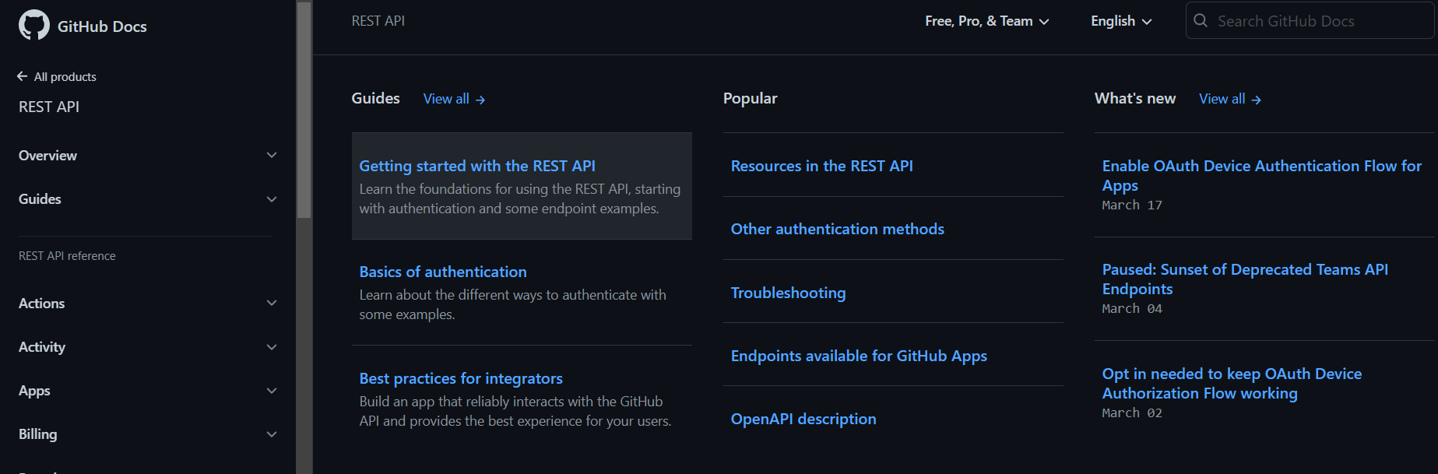
GitHub Rest API
Create integration
Retrieve data
Automate workflows
GitHub REST API home site → GitHub REST API - GitHub Docs

Slide 9
GitHub Rest API – Main Characteristics
All API access is over HTTPS, and accessed from https://api.github.com. All data is sent and received as JSON.
Two ways of authentication: Basic and OAuth2 token
Use GitHub Apps and GitHub Actions to perform requests.
Official library available – Octokit (only available for Ruby, .NET and JavaScript
OpenAPI description. The GitHub REST API is fully described in an OpenAPI 3.0 compliant document.

Slide 10
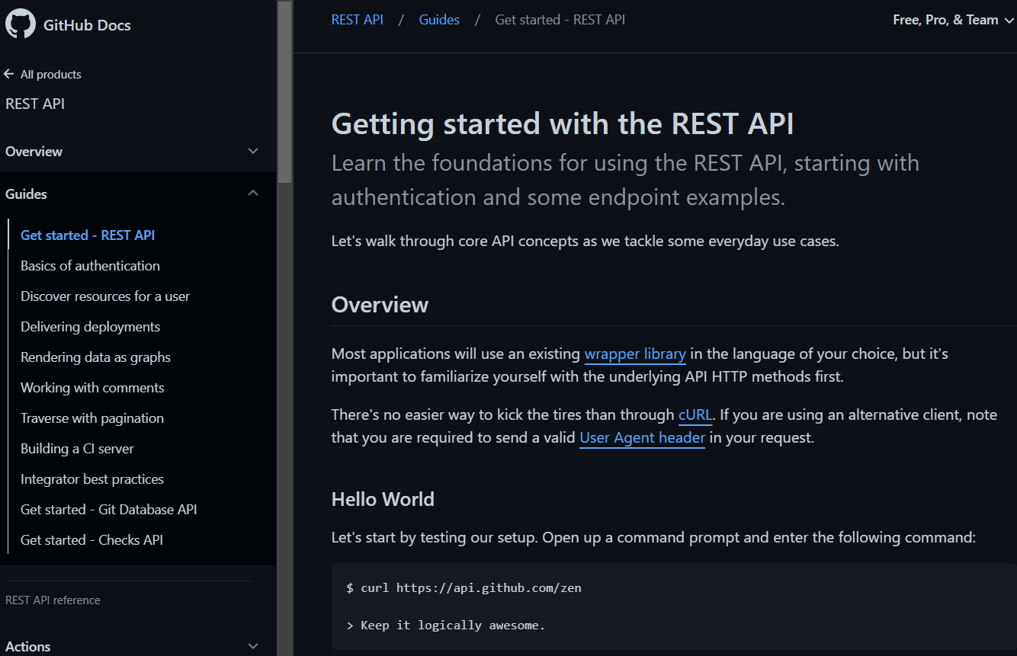
GitHub Rest API – Full helper documentation
GitHub REST API home site → GitHub REST API - GitHub Docs

Slide 11
Main Solution - Demo

Slide 12
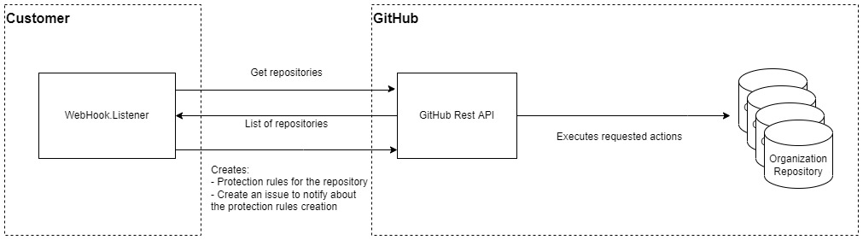
How to apply rules to all current repositories?

Slide 13
Description
The “WebHook.Listener” gets all current repositories within the organization.
The GitHub Rest API returns all available repos.
The “WebHook.Listener” sets the Protection Rules to all the repositories.
Protection Rules are applied to all the organization repositories.

Slide 14
Q&A

