Slide 1
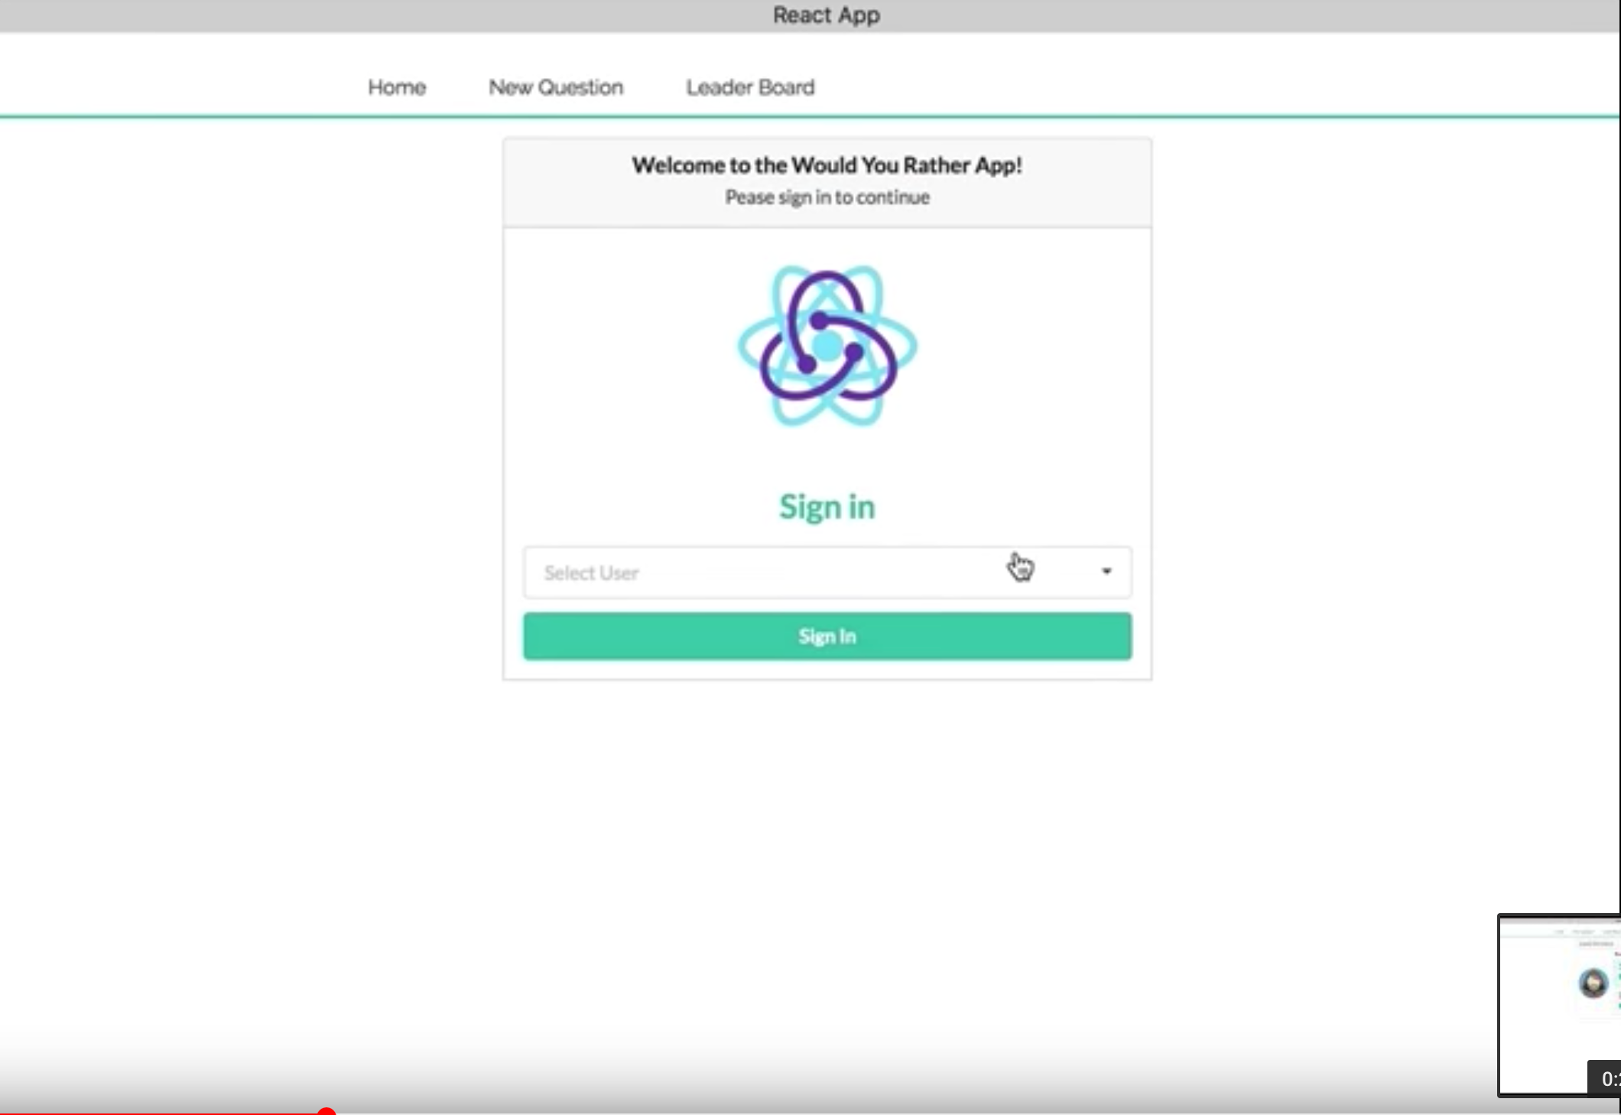
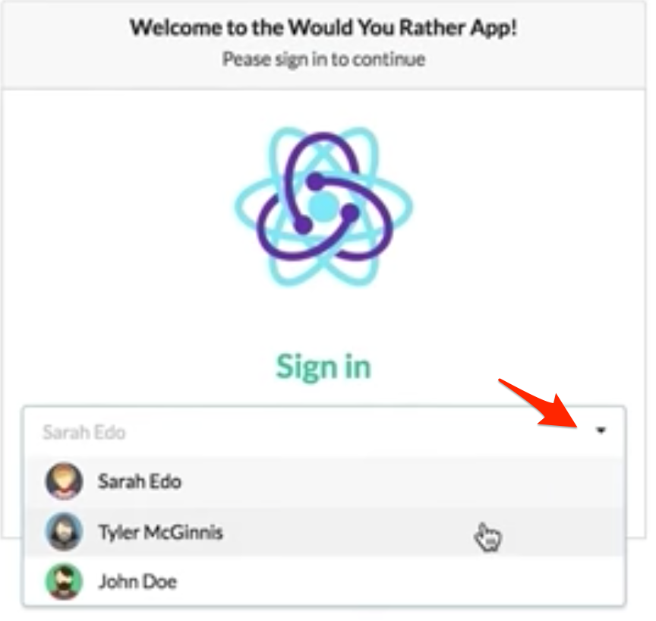
Login component
Initial list of users loaded

Slide 2
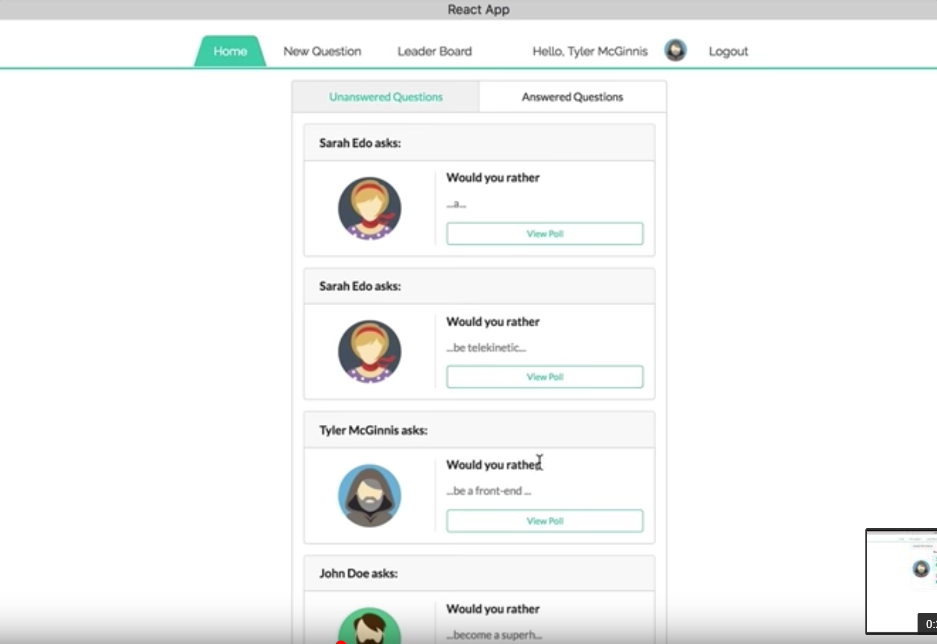
QuestionsBoard component
Click to show 3rd slide
Question component
Picture component

Slide 3
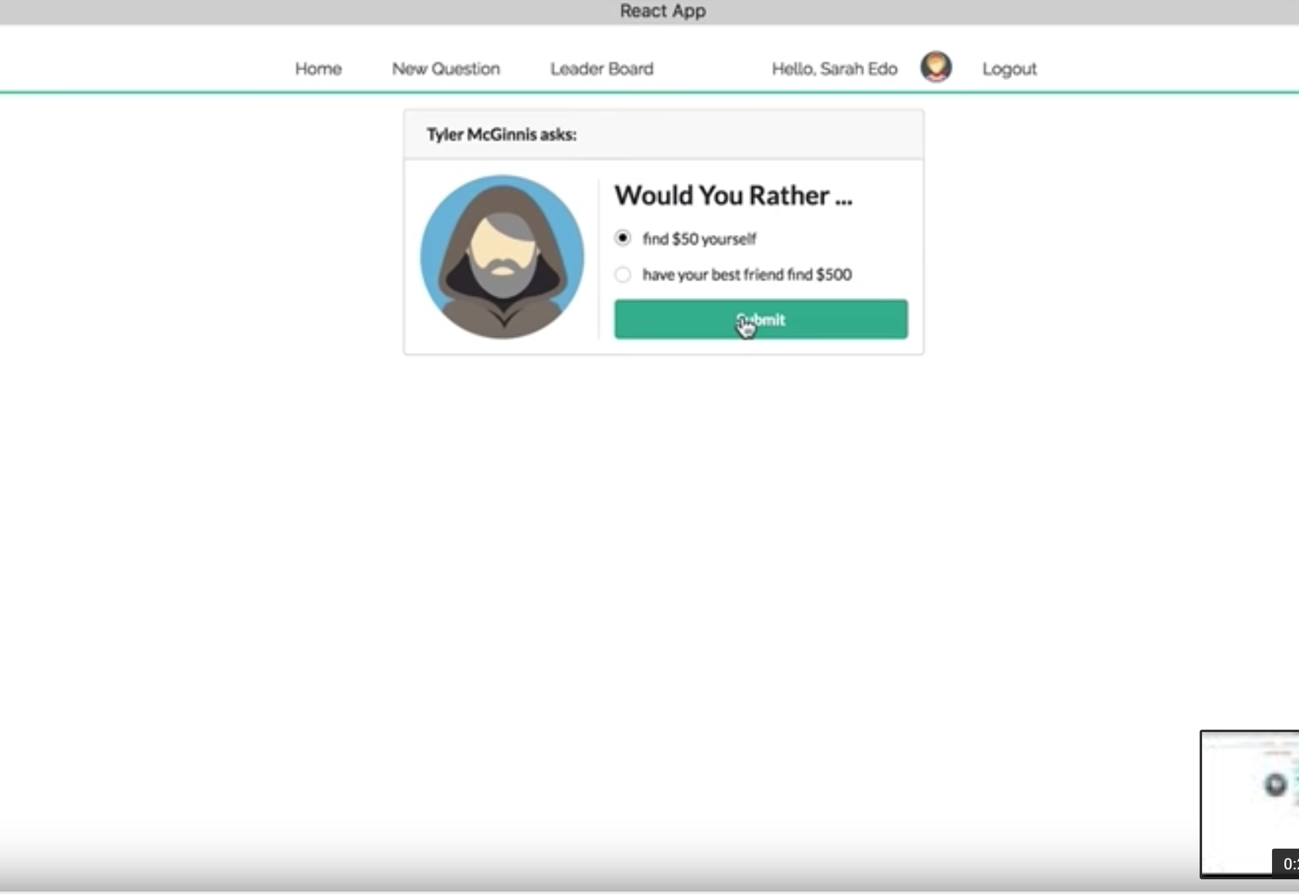
Poll
component
PollForm
component
This view is shown when click on “View Poll” button from Home view
Click to show 4th slide (PollDetails component)

Slide 4
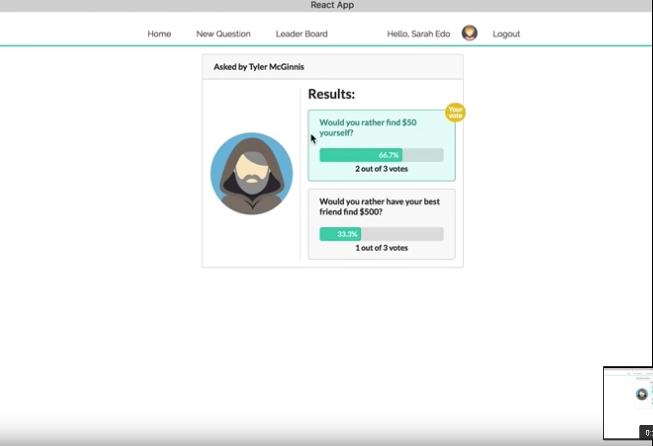
Poll
component
PollDetails
component
This view is shown when click on “Submit” button from previous slide (if question is not answered yet) or when click on “View poll” button from 3rd slide (if question is already answered)

Slide 5
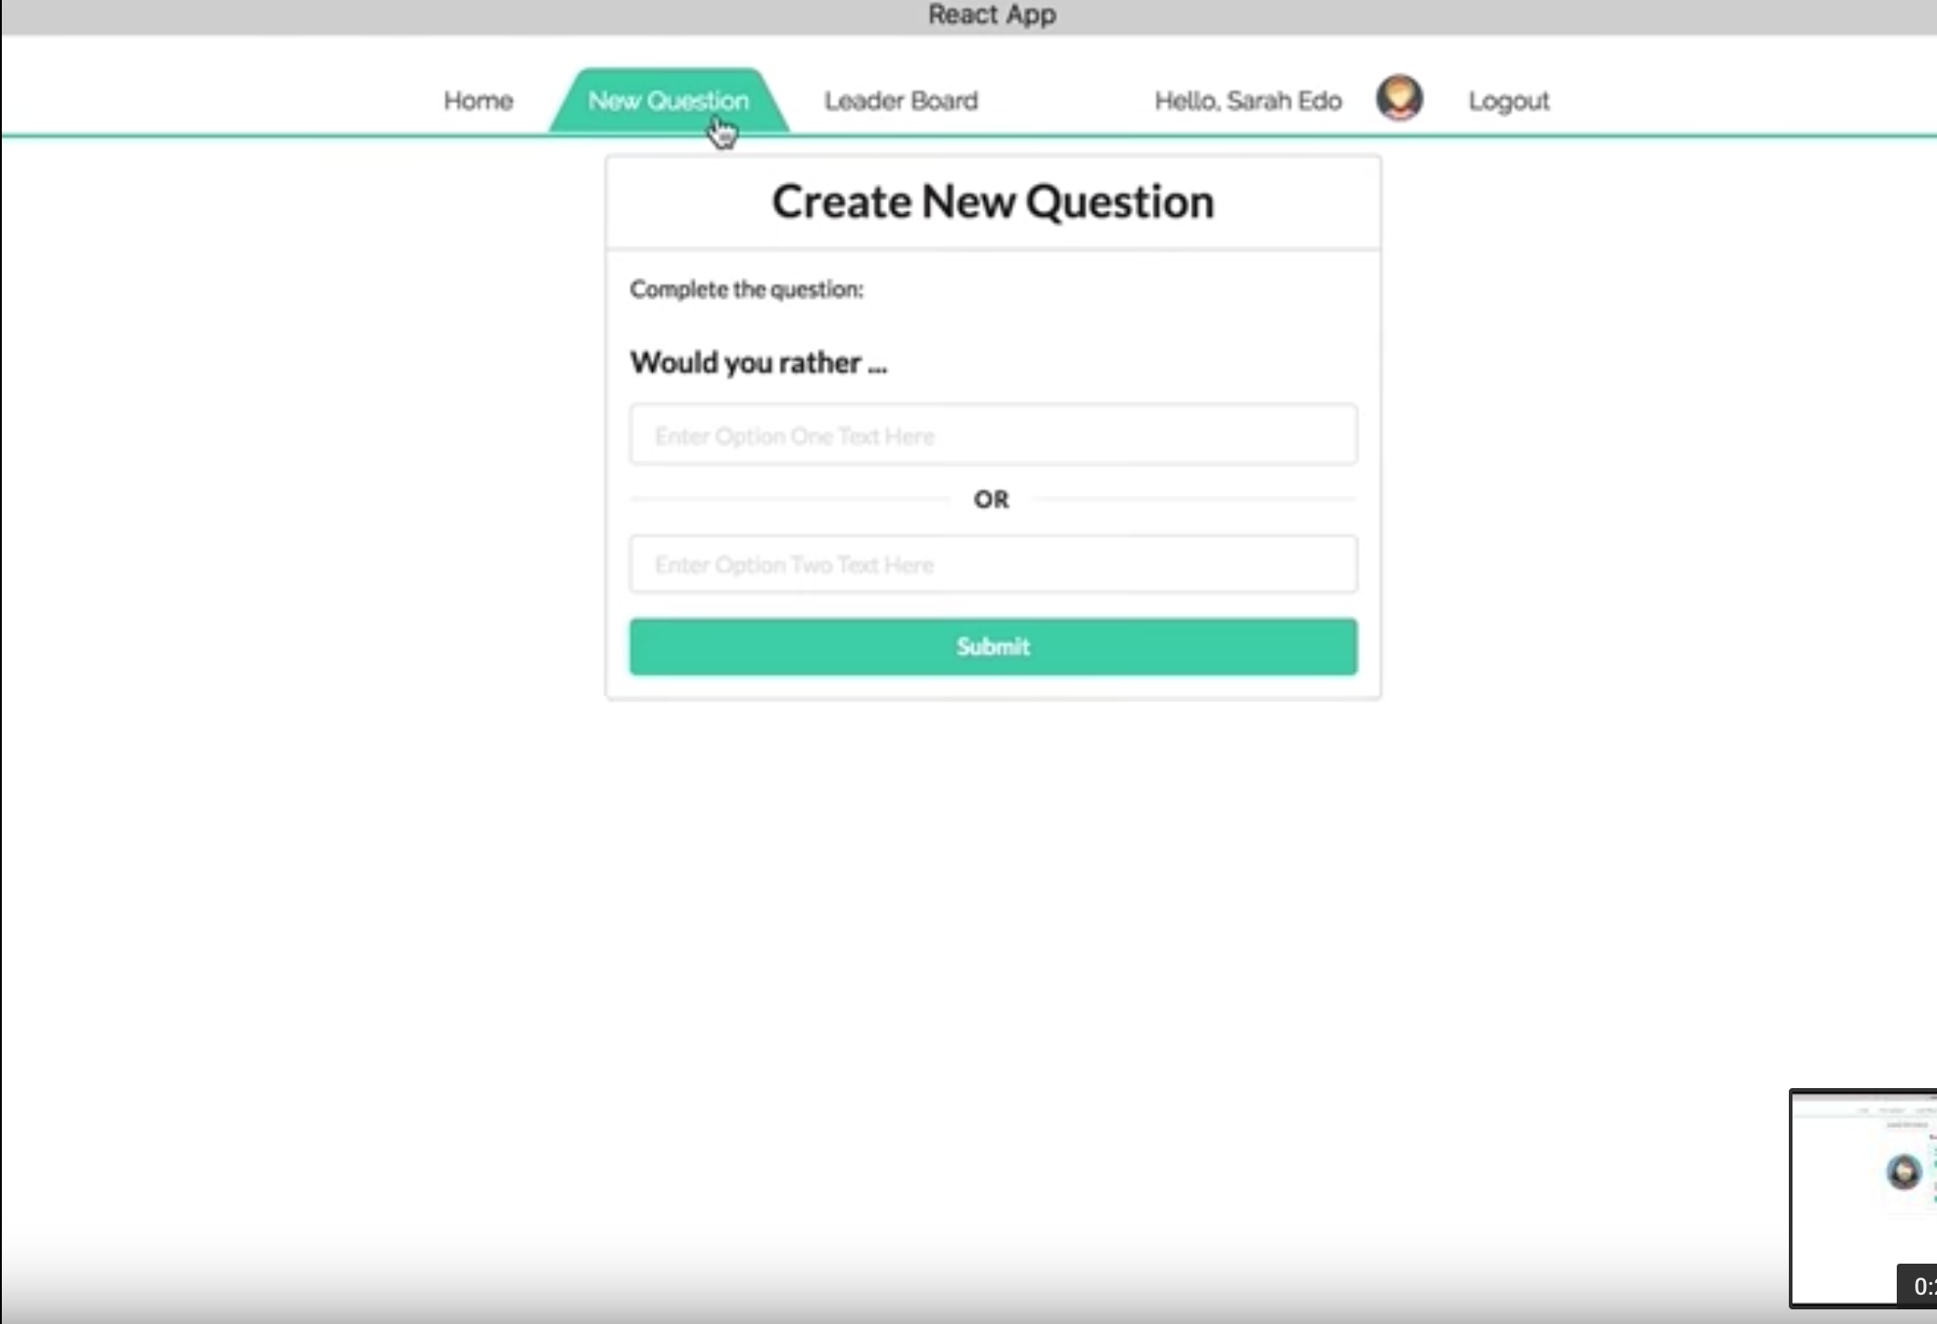
NewQuestion component

Slide 6
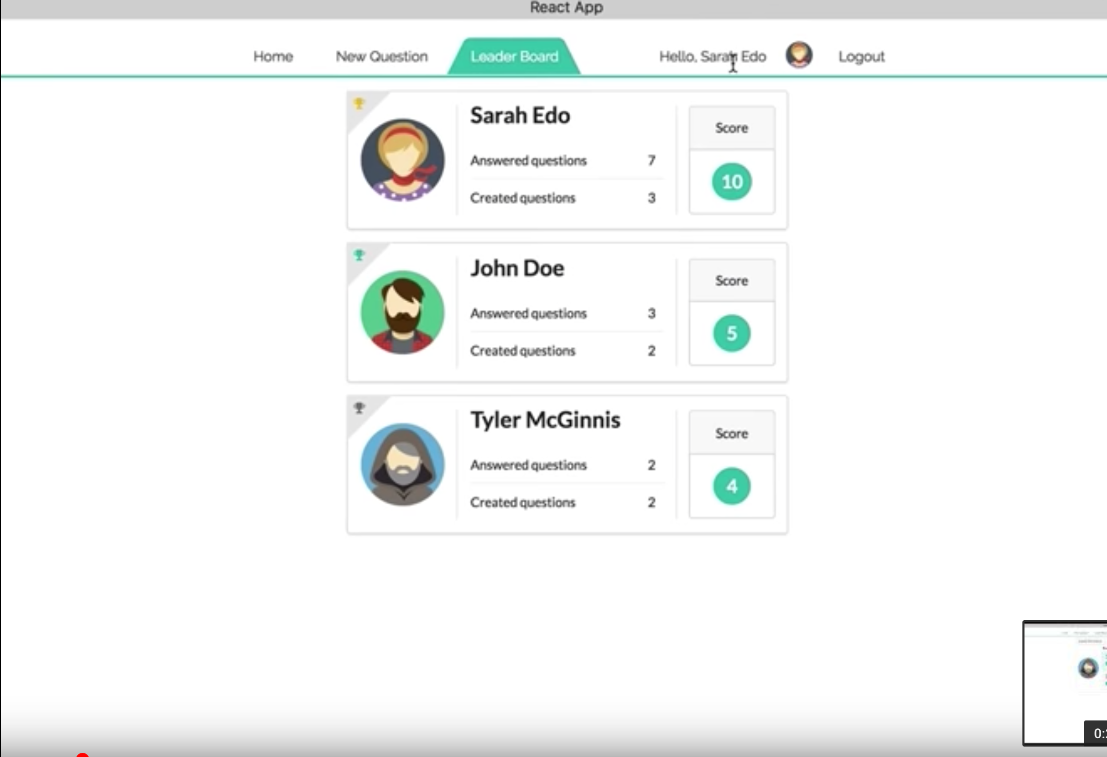
CardBoard component

Slide 7
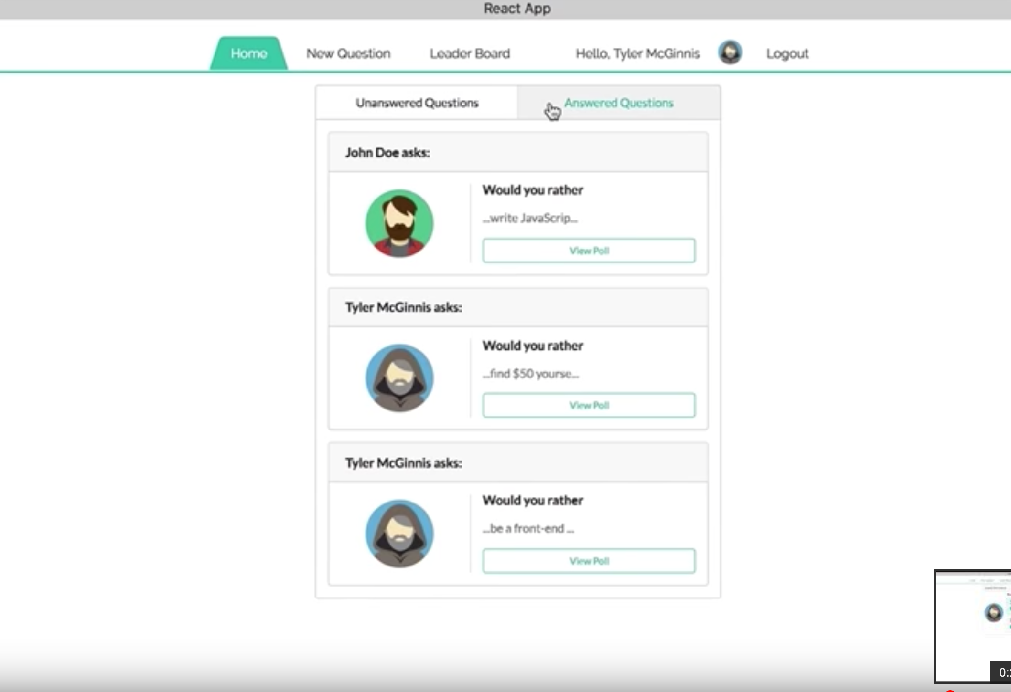
QuestionList component

Slide 8
Paths
‘/’
‘/home’
‘/poll’
‘/newquestion’
‘/results’
‘/leaderboard’
Components
Nav
Login
CreateQuestion
Results
Home
LeaderBoard
CardBoard
NewQuestion
Question
QuestionBoard
QuestionList
Score
Poll
Picture

Slide 9
Actions and Events
LOGIN (SET_AUTHED_USER)
ADD_QUESTION
ANSWER_QUESTION
RECEIVE_USERS
RECEIVE_QUESTIONS
Components
Nav
Login
CreateQuestion
Results
Home
LeaderBoard
CardBoard
NewQuestion
Question
QuestionBoard
QuestionList
Score
Poll
Picture

