Slide 1
SQL for QA Engineers
Portnov Computer School
marina@portnov.com
Installation instruction
https://www.portnov.com/oracle11g.pdf
‹#›
Notes:
‹#›

Slide 2
Relational Database
The relational model was invented by Ted Codd as a general model of data, and subsequently maintained and developed by Chris Date. It is based on predicate logic (true and false conditions). IBM's original implementation of Codd's ideas was System R in mid-1970s
‹#›

Slide 3
DBMS and RDBMS
RDBMS (Relational Database Management System) is a software that controls the organization, storage, retrieval, security and integrity of data in a database.
RDBMS accepts requests from the application and
instructs the operating system to transfer the
appropriate data.
RDBMS vendors are: Oracle, IBM, Microsoft, and Sybase
‹#›

Slide 4
SQL
Structured Query Language
‹#›

Slide 5
SQL Class Objectives
• Understand how data is stored in a database and retrieved with SQL
• Be able to execute SQL queries (practical SQL)
• Learn SQL and database operations basics and terminology.
Apply SQL skills for Project study application
‹#›

Slide 6
What is SQL?
SQL is a database computer language designed to:
Create, modify, and relate the database objects within relational databases
Select and manipulate data
‹#›
Notes:
‹#›

Slide 7
Where a tester can use SQL
Creating data for testing
Saving data generated during testing activity
Data verifications in a database
to find data
to ensure data integrity (quality)
to manipulate test data for specific tests
Gray box testing
‹#›

Slide 8
Databases terminology
Schema – logical container for database objects (tables, views, index, triggers). It is identified by user ID and Password.
Table – container for data elements and relations
Table COLUMN may be called FIELD or ATTRIBUTE
Data definitions (column names, data format, etc) are stored within database dictionaries .
Table ROW may be called RECORD
Data records are stored in the database files on the disks.
‹#›

Slide 9
Databases terminology
Query – a request to retrieve the data from one or multiple DB tables.
Result Set – a number of retrieved records
‹#›

Slide 10
Databases. Basics.
First Name | Last Name | Gender
Anna | Razgul | F
Boris | Gurich | M
Sri | Joshi | M
……..
‹#›
Notes:
‹#›

Slide 11
Databases. Basics.
What happens when a new record, having exactly the same field values of an existing record, needs to be added to the table?
Is this a problem?
If yes, how do we solve it?
‹#›

Slide 12
Table with duplicate records
First Name | Last Name | Gender
Anna | Razgul | F
Boris | Gurich | M
Sri | Joshi | M
Anna | Razgul | F
‹#›
Notes:
‹#›

Slide 13
Table with uniquely identified records
User ID | First Name | Last Name | Gender
1 | Anna | Razgul | F
2 | Boris | Gurich | M
3 | Sri | Joshi | M
4 | Anna | Razgul | F
‹#›

Slide 14
What happened?
We added uniqueness to the records!
We can now uniquely identify each record in the table by a number, ID.
In database terminology – we added a PRIMARY KEY to the table.
‹#›

Slide 15
Primary Key
A table column (or a combination of columns), which uniquely identifies each record of the table is a primary key.
Examples of Primary Keys:
Social Security Number (SSN)
Drivers License ID
‹#›

Slide 16
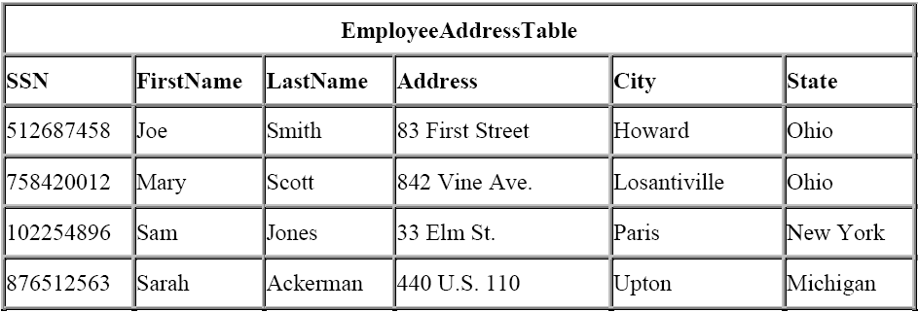
Primary Key
‹#›

Slide 17
Adding Data attribute (column) to a Table
What needs to be done to add a telephone number for a person?
What if a person has more than one telephone number?
‹#›

Slide 18
Table becomes more complicated
ID | First Name | Last Name | Gender | Phone
1 | Anna | Razgul | F | (111)111-1111
2 | Boris | Gurich | M | (222) 222- 2222
3 | Sri | Joshi | M | (333) 333-3333
4 | Anna | Razgul | F | (444) 444-4444
‹#›

Slide 19
Atomic value rule: One value per Field in a row
We cannot have multiple phone numbers listed for a given person (Row/Record) in the same Field (Column)
or multiple credit/debit card numbers , and etc.
Even if we manage it by adding data elements to the existing Field, the database will still regard multiple numbers as a single value.
‹#›
Notes:
‹#›

Slide 20
User Table becomes non-normalized
User ID | First Name | Last Name | Gender | PhoneH | PhoneW
1 | Anna | Razgul | F | (111)111-1111 | (432) 555- 4444
2 | Boris | Gurich | M | (222) 222- 2222
3 | Sri | Joshi | M | (333) 333-3333
4 | Anna | Razgul | F | (444)444-4444 | (432) 666-7777
‹#›

Slide 21
Normalization
Solution is normalization by creating two related tables, each serving specific purpose and balance the data and relations across the tables.
Normalization is a systematic way of database design that is suitable for general-purpose querying and free of certain undesirable characteristics—data redundancy and relational anomalies—that could lead to a loss of data integrity and impact performance.
‹#›

Slide 22
Second Table (User_Phone)
Iser ID | Phone Number | Phone type
1 | (111) 111 1111 | home
2 | (222) 222 2222 | home
3 | (333) 333-3333 | home
4 | (444)444-4444 | office
1 | (432) 555-4444 | work
4 | (432) 666-7777 | work
‹#›

Slide 23

Table Relationship
USER
User ID | First Name | Last Name | Gender
1 | Anna | Razgul | F
2 | Boris | Gurich | M
3 | Sri | Joshi | M
4 | Anna | Razgul | F
USER_PHONE
User ID | Phone Number | Phone type
1 | (111) 111 1111 | home
2 | (222) 222 2222 | home
3 | (333) 333-3333 | home
4 | (444)444-4444 | office
1 | (432) 555-4444 | work
4 | (432) 666-7777 | work
‹#›

Slide 24
Primary and Foreign Keys
“User ID” is a PRIMARY KEY in “USER” table.
Primary key must be unique within a table.
“User ID” is a FOREIGN KEY in “USER_PHONE” table.
Foreign key (FK) is a column (or combination of columns) that is used to establish a relationship (a.k.a. referential integrity) between the tables.
Foreign key is usually not unique (one-to-many relation) and shall always point to a primary key.
‹#›

Slide 25
Foreign Key
Definitions:
Foreign key is a table column (or columns) that links the table row(s) to another table’s primary key.
Foreign key enforces relationship between two tables via primary key of the parent table and foreign key of the dependent child table.
‹#›

Slide 26
Database Design (Modeling)
We have successfully designed two normalized tables: USER_ID uniquely identified by PK within the USER table and USER_ID defined as FK of the USER_PHOHE relate the two tables :
Next steps are:
create database tables,
populate table with the data
query the table(s) data
‹#›

Slide 27
SQL Statement Types
DDL – Data Definition Language
Is used to create, modify, and remove the DB object definition and data:
CREATE
DROP
ALTER
TRUNCATE
‹#›
Notes:
‹#›

Slide 28
SQL Statement Types
DML – Data Manipulation Language
Is used for data management:
INSERT
UPDATE
SELECT
DELETE
‹#›
Notes:
‹#›

Slide 29
SQL Statement Types
DCL – Data Control Language
Is used for data management:
COMMIT
ROLLBACK
GRANT
REVOKE
‹#›
Notes:
‹#›

Slide 30
Practical SQL
ORACLE database.
The only way we can communicate with ORACLE database is using SQL.
‹#›

Slide 31
ORACLE
User needs an account (user login and password) to connect to ORACLE database.
Database administrator decides which roles/privileges user has.
When user logs on, user session starts.
User activity can be tracked
Connection string to log in using SQL+
(ORACLE client):
Connect user_ID/PW@database_name
‹#›

Slide 32
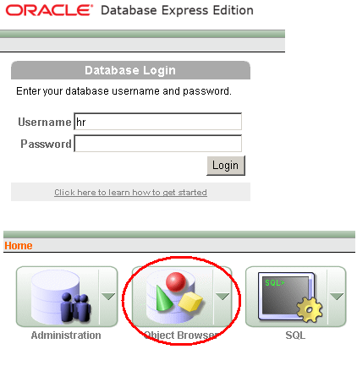
ORACLE Database
‹#›

Slide 33
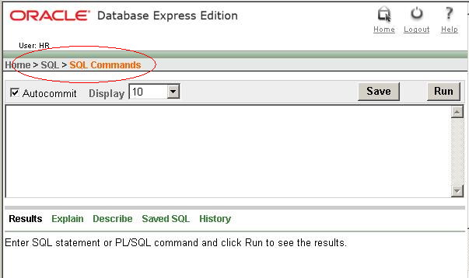
SQL Command page
‹#›

Slide 34
CREATE – DDL Statement Is used to create a DB object
To create a table in a database:
CREATE TABLE table_name ( column_name1 data_type, column_name2 data_type, ....)
Data Types Examples:
CHAR( ) A fixed section from 0 to 255 characters long
VARCHAR( ) A variable section from 0 to 255 characters long
INT( ) -2147483648 to 2147483647 normal unsigned
FLOAT A small number with a floating decimal point
NUMERIC( , ) Number stored as a string, with fixed decimal point
DATE YYYY-MM-DD
‹#›

Slide 35
drop table user_phone;
drop table test_user;
CREATE TABLE TEST_USER
( USER_ID NUMBER Primary Key,
FIRST_NAME VARCHAR2(20) NOT NULL,
LAST_NAME VARCHAR2(32) NOT NULL,
GENDER VARCHAR2(2) ) ;
CREATE TABLE USER_PHONE
( USER_ID NUMBER,
PHONE_NUM VARCHAR2(20) NOT NULL,
PHONE_TYPE VARCHAR2(32) ,
CONSTRAINT USER_FK FOREIGN KEY (USER_ID)
REFERENCES TEST_USER (USER_ID)) ;
SQL+ command to retrieve object definition
DESCRIBE <object type> <object name> ;
describe table user_phone;
‹#›
Notes:
‹#›

Slide 36
ALTER - DDL Statement Is used to modify a DB object and data
ALTER table test_user
ADD dob date;
‹#›

Slide 37
INSERT – DML Statement
INSERT statement allows to insert record into a table.
Syntax:
INSERT into <Table Name> VALUES (value1, value2, etc.)
insert into test_user values(12, 'Marry', 'White',null,'17-FEB-80');
String values shall be encapsulated in single quotes.
If Autocommit is checked, record will be permanently added.
‹#›
Notes:
What needs to do if Autocommit is not checked
‹#›

Slide 38
INSERT – DML Statement
Populate TEST_USER and USER_PHONE related tables
insert into test_user values(12, 'Anna','Razgul', 'F', '5/23/1991');
insert into test_user values(20, 'Boris','Gurich', 'M', '5/23/1987');
insert into test_user values(21, 'Sri','Joshi', 'M', '5/23/1981');
insert into user_phone values(20, '408-123-4455', 'H');
insert into user_phone values(21, '650-425-6736', 'W');
insert into user_phone values(20, '415-987-4532', 'M');
insert into user_phone values(12, '650-678-5632', 'W');
insert into user_phone values(12, '510-678-5632', 'M');
‹#›
Notes:
What needs to do if Autocommit is not checked
‹#›

Slide 39
DROP – DDL Statement Is used to delete a DB object definition and data
DROP table USER_PHONE;
DROP table TEST_USER;
TRUNCATE – DDL Statement
Is used to delete all data from the table
TRUNCATE table USER_PHONE;
TRUNCATE table TEST_USER;
DROP or TRUNCATE dependant (child) tables first to avoid Foreign Key violation.
‹#›

Slide 40
INSERT (Constraints violation)
INSERT into EMPLOYEES
VALUES (207, ‘Test’, ‘Tester’, ‘TTESTER’, ‘408.555.5555’, ’17-FEB-08’, ‘IT_PROG’, 12000, NULL, 103, 60);
Constrains (PK) shall not be violated.
E.g. if we specify existing EMPLOYEE_ID (106 or 55) INSERT operation will fail. We violated primary key uniqueness.
Corrected statement:
INSERT into EMPLOYEES VALUES
((SELECT MAX(EMPLOYEE_ID)+1 FROM EMPLOYEES), ‘Test’, ‘Tester’, ‘TTESTER’, ‘408.555.5555’, ’17-FEB-08’, ‘IT_PROG’, 12000, NULL, 103, 60);
‹#›

Slide 41
DELETE
DELETE statement deletes rows/data record(s) from Table.
SYNTAX:
DELETE FROM [Table Name]
WHERE [predicate];
If we do not specify WHERE, all records of the ‘EMPLOYEES’ table will be erased.
So be careful!
‹#›

Slide 42
DELETE
DELETE FROM EMPLOYEES where EMPLOYEE_ID = 207;
or
DELETE FROM EMPLOYEES where EMAIL = ‘TTESTER’;
Both statements will delete employee with EMPLOYEE_ID 207 only. Which one to use?
Answer: Use primary key (in this example EMPLOYEE_ID) in predicate!
DELETE FROM EMPLOYEES where EMPLOYEE_ID BETWEEN 107 AND 127;
‹#›

Slide 43
DDL (DROP, TRUNCATE) vs DML (DELETE)
Use DROP to delete the table definition and data.
Use TRUNCATE to delete all data from the table.
Remember:
You cannot ROLLBACK DROP and TRUNCATE!
Use DELETE to delete the data from the table according the WHERE clause and/or ROLLBACK may be needed.

Slide 44
EXERCISE 1
Create, Alter and Drop Test_User and User_Phone tables.
Re-Create and Test_User and User_Phone tables.
Insert 5 records into Test_User and 8 records into User_Phone.
‹#›

Slide 45
Part 2
Select Statement
‹#›

Slide 46
SELECT statement
To retrieve data from database (Tables) we use SELECT statement.
Syntax:
SELECT <Column names>
FROM <Table name(s)>
WHERE <conditions>
The SQL Keywords are case-insensitive (SELECT, FROM, WHERE, etc), but are often written in all caps.
DESCRIBE <object type> <object name>
is a SQL+ command to retrieve object definition/description
‹#›

Slide 47
SELECT statement
Execute following statements (one at a time) and see the results.
The asterisk (*) is a quick way of selecting all columns!
( highlight statement(s) to get it executed)
SELECT * FROM EMPLOYEES;
SELECT * FROM DEPARTMENTS;
SELECT * FROM JOB_HISTORY;
‹#›

Slide 48
SELECT statement
Selecting specific columns from Tables. Execute following statements (one at a time)
SELECT FIRST_NAME, LAST_NAME FROM EMPLOYEES;
SELECT DEPARTMENT_ID, DEPARTMENT_NAME FROM DEPARTMENTS;
SELECT EMPLOYEE_ID, START_DATE FROM JOB_HISTORY;
Use DESCRIBE <TABLE NAME> to retrieve the attribute name;
‹#›

Slide 49
SELECT statement
SELECT statement in all examples retrieved whole table’s records.
In most cases it is not what we want.
We want to retrieve particular information which meets given criteria.
Hence, we have to introduce PREDICATES, or condition, which can be TRUE, FALSE or UNKNOWN. If predicate is specified, only those records, for which predicate is TRUE are retrieved.
SELECT * FROM EMPLOYEES WHERE SALARY > 5000;
SELECT DEPARTMENT_ID
FROM DEPARTMENTS
WHERE DEPARTMENT_NAME = ‘Marketing’
SELECT EMPLOYEE_ID
FROM JOB_HISTORY
WHERE DEPARTMENT_ID = 80
Keyword WHERE allows us to specify a predicate (condition)
‹#›

Slide 50
SELECT statement
SQL uses single quotes around text values
Numeric values should not be enclosed in quotes
‹#›

Slide 51
Operators
Operators:
=
>
<
>=
<=
!=
<>
‹#›

Slide 52
Operators
Boolean operators can be used in conditions.
Execute following statement:
SELECT * FROM EMPLOYEES
WHERE DEPARTMENT_ID = 60 AND SALARY >3000
BOOLEAN operator “AND “connects two conditions.
DEPARTMENT_ID = 60
SALARY >3000
SQL returns ONLY rows for which both conditions are true
‹#›

Slide 53
Operators
BOOLEAN Operator “OR”
SELECT * FROM EMPLOYEES WHERE DEPARTMENT_ID = 60 OR SALARY >3000
DEPARTMENT_ID = 60
SALARY >3000
SQL returns records for which either condition is true – either employees from department 60 OR employees with salary > 3000 or both.
‹#›

Slide 54
Operators
Negative conditions
SELECT FIRST_NAME, LAST_NAME
FROM EMPLOYEES
WHERE DEPARTMENT_ID <> 60 AND SALARY > 3000
This statement makes president feel great:
SELECT FIRST_NAME, LAST_NAME FROM EMPLOYEES
WHERE SALARY >= 24000 AND NOT JOB_ID = ‘AD_PRES’;
SELECT FIRST_NAME, LAST_NAME, salary
FROM EMPLOYEES
WHERE SALARY >= 14000 AND job_id NOT IN
(select job_id from EMPLOYEES where JOB_ID = 'AD_PRES')
or
SELECT FIRST_NAME, LAST_NAME, salary
FROM EMPLOYEES
WHERE SALARY >= ALL (SELECT SALARY FROM EMPLOYEES)
‹#›

Slide 55
EXERCISE 1
Accomplish following tasks (table Employees):
Get list of people names who report to manager with ID 103
Find out how much Luis Popp is making a month
Find Kee Gee phone number
Find first and last names of user RMATOS (email address)
Find people who work on commission basis.
Find phone number of employee #123
‹#›
Notes:
Select first_name, last_name from employees where manager_id=103 (4 empl)
Select salary from employees where first_name ='Luis' and last_name ='Popp' (6900)
Select phone_number from employees where first_name =‘Kee’ and Last_name='Gee' (Ki Gee)
select last_name, first_name from employees where email_address='RMATOS' (Matos Randall)
select last_name, first_name from employees where commission_pct is not null (35 empl)
Select phone_number from employees where employee_id=123 (650.123.4234)
‹#›

Slide 56
EXERCISE 2
Accomplish following tasks:
7. Retrieve complete user information whose phone number is 011.44.1644.429263
8. Front desk clerk needs to know if there is an employee with name Donald O’Connell
9 How long employee Renske Ladwig works for the company?
10. Advanced (few searches are needed) – find out where physically HR department is located (country, city).
11. Find out what is salary range for Shipping Clerk position
‹#›
Notes:
9. 1 select end_date, start_date, (end_date-start_date)/365 from job_history, employees
where employees.employee_id=job_history.employee_id and First_name ='Renske' and last_name='Ladwig‘;
9.2. select * from employees where First_name ='Renske' and last_name='Ladwig‘;
select * from job_history where employee_id=137 ;
11.
select min(salary), max(salary) from employees e, jobs j where e.job_id=j.job_id and job_title='Shipping Clerk'
select min_salary, max_salary from jobs where job_title='Shipping Clerk'
‹#›

Slide 57
SORTING RESULTS
Results of SELECT statement execution can be presented in sorted order.
Use predicate ORDER BY <column name>.
SELECT first_name, last_name FROM
EMPLOYEES ;
ORDER BY FIRST_NAME DESC
Will produce list of all employees in descending order.
If you do not list sort order, it will be sorted in ascending (default) order.
‹#›

Slide 58
MORE OPERATORS
IN, BETWEEN, LIKE, IS NULL, IS NOT NULL
What if we want to retrieve data not only for one department, but from list of departments? Say, Marketing, Accounting and IT Engineering.
‹#›

Slide 59
IN OPERATOR
SELECT EMPLOYEE_ID
FROM EMPLOYEES
WHERE DEPARTMENT_ID IN (20, 60, 100)
‹#›

Slide 60
BETWEEN OPERATOR
To get list of employees hired between 1998 and 2000:
SELECT * FROM EMPLOYEES
WHERE HIRE_DATE BETWEEN ’01-JAN-1998’ AND ’01-JAN-2001’
SELECT * FROM EMPLOYEES
WHERE DEPARTMENT_ID BETWEEN 20 AND 80
‹#›
Notes:
SELECT * FROM EMPLOYEES WHERE HIRE_DATE BETWEEN '01-JAN-98' AND '01-JAN-01'
‹#›

Slide 61
LIKE OPERATOR
SELECT EMPLOYEE_ID
FROM EMPLOYEE S
WHERE FIRST_NAME LIKE ‘Nan%’
% stands for any sequence of characters (incl. zero)
_ (underscore) stands for one character only
SELECT EMPLOYEE_ID
FROM EMPLOYEE S
WHERE FIRST_NAME LIKE ‘Nan_n’;
Statement may retrieve Nancy, Nannette, Nana, but not NANA, NANETTE.
Exercise – retrieve all employees whose first name starts with ‘Dav’
‹#›

Slide 62
IS NULL OPERATOR
SELECT EMPLOYEE_ID
FROM EMPLOYEES
WHERE COMMISSION_PCT IS NOT NULL
Returns all commission-based paid employees
‹#›

Slide 63
AGGREGATE FUNCTIONS
Aggregate functions are:
COUNT, SUM, AVG, MAX, MIN
Briefly, let database make some calculations rather than me to sit and write code to extract values from database and make calculations.
‹#›

Slide 64
AGGREGATE FUNCTIONS
COUNT – produces number of records for which predicate (conditions) is true. E.g. to know how many people are employed by the company:
SELECT COUNT(*) FROM EMPLOYEES
Number of employees at IT department:
SELECT COUNT(*) FROM EMPLOYEES
WHERE DEPARTMENT_ID = 60
‹#›

Slide 65
AGGREGATE FUNCTIONS
Company costs for employees salaries:
SELECT SUM(SALARY) FROM EMPLOYEES
Average salary in IT department:
SELECT AVG(SALARY) FROM EMPLOYEES WHERE DEPARTMENT_ID = 60
Minimal salary:
SELECT MIN(SALARY) FROM EMPLOYEES
‹#›

Slide 66
AGGREGATE FUNCTIONS
AVG and SUM function work ONLY with numeric VALUES!
The MIN, MAX functions work with any character, numeric, or date data type.
‹#›

Slide 67
DISTINCT
Returns each value once.
Retrieves only unique data entries
Select distinct department_id
From employees;
‹#›

Slide 68
GROUPING
We need to find out how many people work in each department.
Using GROUP BY clause allowing to group results by some criteria.
SELECT DEPARTMENT_ID, COUNT(*)
FROM EMPLOYEES
GROUP BY DEPARTMENT_ID
‹#›

Slide 69
EXERCISE 3
Find out how many employees work outside of US
Find out which departments are located outside US
Find out how many employees work in Bay area
Find out employees who do not report to a manager
Find out who is getting highest commission
Find out who is employee #1 (hired first)
Advanced: find out how many people work in each department
‹#›
Notes:
create table simon as select max(salary) salary, department_id from employees group by department_id order by department_id;
select first_name, last_name, simon.salary, simon.department_id from employees, simon
where employees.salary=simon.salary
order by simon.department_id;
‹#›

Slide 70
Exercise 3 DISTINCT
select first_name, last_name, DEPARTMENT_ID
from employees
where department_id in (select department_id from DEPARTMENTS WHERE LOCATION_ID IN (select location_id from locations where COUNTRY_ID <> 'US'));
select DISTINCT DEPARTMENTS.department_id
from DEPARTMENTS
WHERE location_id IN (SELECT distinct Location_id FROM LOCATIONS WHERE COUNTRY_ID <> 'US')
‹#›

Slide 71
Exercise GROUPING
Find out who (First name, Last name) gets the top salary in each Department.
‹#›
Notes:
create table simon as select max(salary) salary, department_id from employees group by department_id order by department_id;
select first_name, last_name, simon.salary, simon.department_id from employees, simon
where employees.salary=simon.salary
order by simon.department_id;
‹#›

Slide 72
INSERT, DELETE, UPDATE
INSERT statement allows to insert record into a table.
Syntax:
INSERT into <Table Name> VALUES (value1, value2, etc.)
INSERT into EMPLOYEES VALUES (207, ‘Test’, ‘Tester’, ‘TTESTER’, ‘408.555.5555’, ’17-FEB-08’, ‘IT_PROG’, 12000, NULL, 103, 60);
If Autocommit is checked, record will be permanently added.
‹#›
Notes:
What needs to do if Autocommit is not checked
‹#›

Slide 73
INSERT, DELETE, UPDATE
INSERT statement allows to insert record into a table.
Syntax:
INSERT into <Table Name> VALUES (value1, value2, etc.)
INSERT into EMPLOYEES VALUES (207, ‘Test’, ‘Tester’, ‘TTESTER’, ‘408.555.5555’, ’17-FEB-08’, ‘IT_PROG’, 12000, NULL, 103, 60);
If Autocommit is checked, record will be permanently added.
‹#›
Notes:
What needs to do if Autocommit is not checked
‹#›

Slide 74
INSERT
String values shall be encapsulated in single quotes.
Constrains (PK) shall not be violated. E.g. if we specify existing EMPLOYEE_ID (106 or 55) INSERT operation will fail. We violated primary key uniqueness.
Corrected statement:
INSERT into EMPLOYEES VALUES ((SELECT MAX(EMPLOYEE_ID)+1 FROM EMPLOYEES), ‘Test’, ‘Tester’, ‘TTESTER’, ‘408.555.5555’, ’17-FEB-08’, ‘IT_PROG’, 12000, NULL, 103, 60);
‹#›

Slide 75
DELETE
DELETE statement deletes rows/data record(s) from Table.
SYNTAX:
DELETE FROM [Table Name]
WHERE [predicate];
Predicate is optional; if we do not specify it, all records of the ‘EMPLOYEES’ table will be erased. So be careful!
‹#›

Slide 76
DELETE
DELETE FROM EMPLOYEES where EMPLOYEE_ID = 207;
or
DELETE FROM EMPLOYEES
where EMAIL = ‘TTESTER’;
Both statements will delete employee with EMPLOYEE_ID 207 only. Which one to use?
Answer: Use primary key (in this example EMPLOYEE_ID) in predicate!
DELETE FROM EMPLOYEES
where EMPLOYEE_ID BETWEEN 107 AND 127;
‹#›

Slide 77
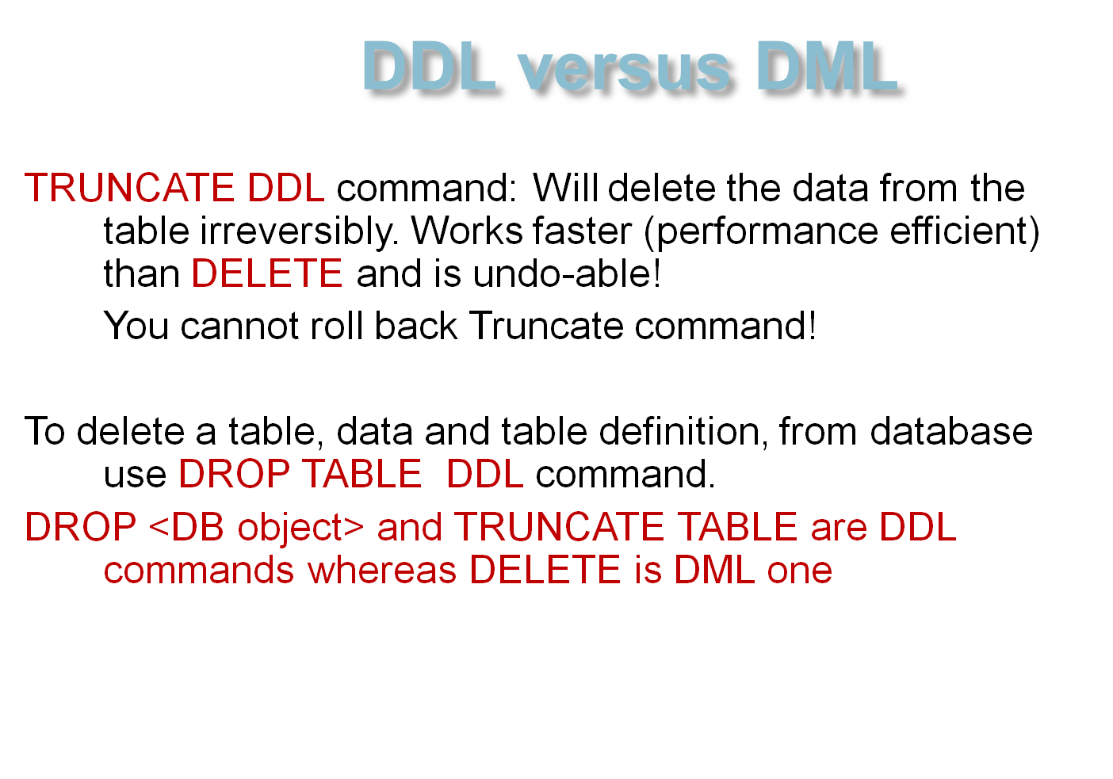
‹#›

Slide 78
UPDATE
UPDATE statement modifies records in Table.
SYNTAX:
UPDATE <TABLE>
SET <Column name>= <new value>
WHERE <conditions>
Example:
UPDATE EMPLOYEES
SET SALARY=1000000
WHERE EMPLOYEE_ID = 106
‹#›

Slide 79
UPDATE
UPDATE EMPLOYEES
SET SALARY=1000000
WHERE JOB_ID = ‘AD_PRES’
Updating multiple columns at once:
‹#›

Slide 80
EXERCISE 4
Employee Diana Lorentz got married and changed her last name. Her new name is Diana Goetz.
Your task is to update EMPLOYEE table accordingly.
‹#›

Slide 81
Answer
UPDATE EMPLOYEES
SET LAST_NAME=‘Goetz’
WHERE EMPLOYEE_ID = 107;
UPDATE EMPLOYEES
SET EMAIL=‘DGOETZ’
WHERE EMPLOYEE_ID = 107;
Or as one SQL statement:
UPDATE EMPLOYEES
SET LAST_NAME=‘Goetz’, EMAIL=‘DGOETZ’
WHERE EMPLOYEE_ID = 107
‹#›

Slide 82
FAMOUS JOIN
Getting information from related tables is called JOIN operation. It is one of the most powerful operations in SQL language.
‹#›

Slide 83
Table Relationship
USER
ID | First Name | Last Name | Gender
1 | Anna | Razgul | F
2 | Boris | Gurich | M
3 | Sri | Joshi | M
4 | Anna | Razgul | F
USER_PHONE
UserID | Phone Number | Phone type
1 | (111) 111 1111 | home
2 | (222) 222 2222 | home
3 | (333) 333-3333 | home
4 | (444)444-4444 | home
1 | (432) 555-4444 | work
4 | (432) 666-7777 | work
‹#›

Slide 84
FAMOUS JOIN
Another example. We need a list of people and their department names, not department id’s. However, people names and department names are stored in different table.
So we have to get one piece of information from one table, and another – from the second table.
‹#›

Slide 85
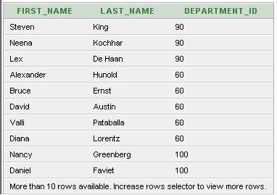
JOIN
EMPLOYEES Table.
‹#›

Slide 86
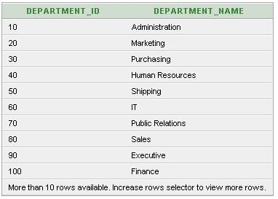
JOIN
DEPARTMENTS Table.
‹#›

Slide 87
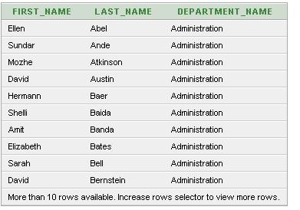
JOIN
Information I would like to retrieve (using join):
‹#›

Slide 88
Writing join statement
1. We start with the fields which we need in our result set (this is not a complete SQL statement!)
SELECT EMPLOYEES.FIRST_NAME, EMPLOYEES.LAST_NAME, EMPLOYEES.PHONE_NUMBER, DEPARTMENTS.DEPARTMENT_NAME
SELECT EMPLOYEES.FIRST_NAME, EMPLOYEES.LAST_NAME, EMPLOYEES.PHONE_NUMBER, DEPARTMENTS.DEPARTMENT_NAME
‹#›

Slide 89
Writing a join statement
Then we specify where from we like to retrieve the information (specifying several tables)
SELECT EMPLOYEES.FIRST_NAME, EMPLOYEES.LAST_NAME, EMPLOYEES.PHONE_NUMBER, DEPARTMENTS.DEPARTMENT_NAME
FROM EMPLOYEES, DEPARTMENTS ;
Warning : Gigantic result set (Cartesian product - each row of EMPLOYEES table joins with each row of DEPARTMENTS, cross-join ) will be generated if WHERE clause condition is missing!
‹#›

Slide 90
JOIN
Final SQL statement to be executed:
SSSELECT EMPLOYEES.FIRST_NAME, EMPLOYEES.LAST_NAME, EMPLOYEES.PHONE_NUMBER, DEPARTMENTS.DEPARTMENT_NAME
FROM EMPLOYEES, DEPARTMENTS
WHERE DEPARTMENTS.department_ID =
EMPLOYEES.department_ID
The fully qualified fields names are used. Data is retrieved from the columns of the different tables (Employees and Departments) .
‹#›

Slide 91

Quiz Foreign Key relation
SP_USER
SP_ALBUM
User_ID Primary Key | ……..
123
167
198
Album_ID | User_ID Foreign Key | ……
211 | 123
214 | 198
256 | 123
SP_USER has 100 records; SP_ALBUM has 1000 records
SP_USER has 1000 records; SP_ALBUM has 100 records
Select sp_user.user_id, album_id
from sp_user, sp_album
where sp_user.user_id=sp_album.user_id
Number of records retrieved:
a) 100 b) 1000 c) 1100 1000
a) 100 b) 1000 c) 1100 100
Notes:
Quiz Results:
1.
2.
‹#›

Slide 92
INNER JOIN
An inner join is the most common join operation and is regarded as the default join-type.
It joins every record in table A with a record in table B, which satisfy the join predicate (conditions).
Equi-join
Natural join
Cross join (Cartesian)
‹#›

Slide 93
INNER JOIN
The "explicit join notation" uses the JOIN keyword to specify the table to join, and the ON keyword to specify the predicates for the join.
SELECT * FROM employees
INNER JOIN departments
ON employees.Department_ID = departments.Department_ID;
Compare :
SELECT * FROM employees, departments
Where employees.Department_ID = departments.Department_ID;
‹#›

Slide 94
OUTER JOIN
An outer join does not require each record in the two joined tables to have a matching record. The joined table retains each record—even if no other matching record exists.
Left outer join
Right outer joins
Full outer joins
depending on which table(s) one retains the rows from (left, right, or both). Left and right refer to the two sides of the JOIN keyword
‹#›

Slide 95
OUTER JOIN
SELECT * FROM employees RIGHT OUTER JOIN departments
ON employees.Department_ID=departments.Department_ID;
SELECT * FROM employees LEFT OUTER JOIN departments
ON employees.Department_ID=departments.Department_ID;
SELECT * FROM employees FULL OUTER JOIN departments
ON employees.Department_ID=departments.Department_ID;
‹#›

Slide 96
Statement using join – to complete!
select first_name, last_name, DEPARTMENT_ID
from EMPLOYEES, DEPARTMENTS, LOCATIONS
where employees.department_id = Departments.department_id
and
LOCATIONS.location_id = DEPARTMENTS.location_id
and
EMPLOYEES.department_id = DEPARTMENTS.department_id
and
LOCATIONS. COUNTRY_ID <> ‘US’
‹#›

Slide 97
Exercise 5
Create join statements to retrieve following information:
What is the top salary which employee #101 can earn?
Office street address where employee RMATOS (email) is working
Where IT department is located (country, city, address)
How much in salary employees working in GB are making combined?
‹#›

Slide 98
VIEWS
VIEW is a virtual table which is created during execution time.
Essentially it is an abbreviation of SELECT statement.
Example: Statement
SELECT FIRST_NAME, LAST_NAME from EMPLOYEES WHERE PHONE_NUMBER LIKE '650.%'
retrieves all employee names living in bay area. We can have this statement stored as a view ‘local_employees_v’. The following statement is equivalent to the first one:
SELECT * FROM local_employees_v
‹#›

Slide 99
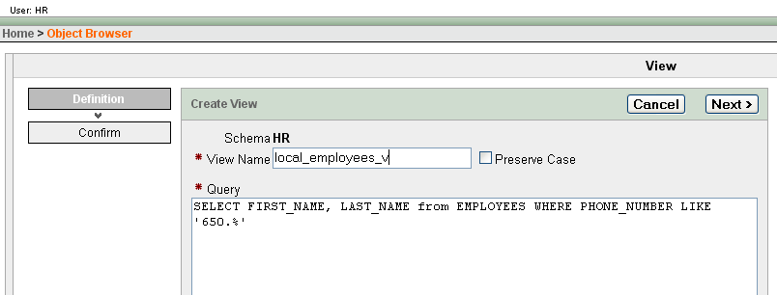
Creating VIEW
‹#›

Slide 100
VIEWS
A view can be updated with UPDATE statement, however it is underlying table which is updated, not a view itself.
It is also important to note that view does not bring performance gain. It makes referral to SQL statements more simple.
‹#›

Slide 101
VIEWS
Compare two statements, which retrieve all Bay area stock managers:
SELECT FIRST_NAME, LAST_NAME,
from EMPLOYEES
WHERE PHONE_NUMBER LIKE ‘650.%’ AND JOB_ID = ‘ST_MAN’;
CREATE OR REPLACE VIEW V_EMPLOYEES_650 ("FIRST_NAME", "LAST_NAME", "JOB_ID")
AS SELECT FIRST_NAME, LAST_NAME, JOB_ID
from EMPLOYEES WHERE PHONE_NUMBER LIKE '650.%' ;
SELECT * FROM V_EMPLOYEES_650 WHERE JOB_ID = 'ST_MAN';
‹#›

Slide 102
MATERIALIZED VIEWS
A view does not contain data. Data is retrieved only if a view is executed.
In contrast materialized view does contain physical data. Regard materialized view as a table - we may have Bay area employees stored in materialized view, mv_local_employees.
‹#›

Slide 103
MATERIALIZED VIEW MV_EMPLOYEES_650
CREATE MATERIALIZED VIEW MV_EMPLOYEES_650
ORGANIZATION HEAP PCTFREE 10 PCTUSED 40 INITRANS 1 MAXTRANS 255 NOCOMPRESS LOGGING
STORAGE(INITIAL 65536 NEXT 1048576 MINEXTENTS 1 MAXEXTENTS 2147483645
PCTINCREASE 0 FREELISTS 1 FREELIST GROUPS 1 BUFFER_POOL DEFAULT)
TABLESPACE "USERS"
BUILD IMMEDIATE
USING INDEX
REFRESH FORCE ON DEMAND
USING DEFAULT LOCAL ROLLBACK SEGMENT
DISABLE QUERY REWRITE
AS SELECT FIRST_NAME, LAST_NAME, JOB_ID
from EMPLOYEES WHERE PHONE_NUMBER LIKE '650.%'
‹#›

Slide 104
MATERIALIZED VIEWS
Materialized view, unlike DB view, allows to achieve performance gain. If underlying table is big and we frequently query only specific data (like information about local employees) then queering a subset of the table will be executed faster.
Materialized view shall be periodically synchronized with underlying table since it contains the source data (REFRESH FORCE ON DEMAND).
‹#›

Slide 105
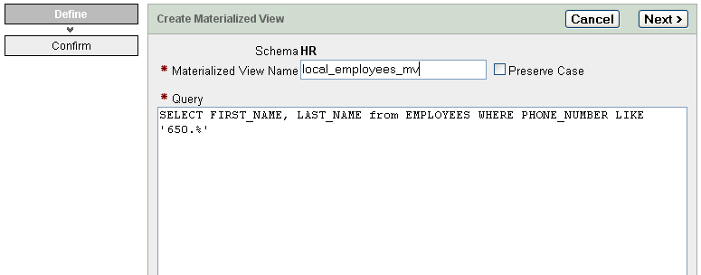
Create MATERIALIZED VIEW
‹#›

Slide 106
VIEW CREATION FAILURE
Error Creating view. ORA-01031: insufficient privileges
It means that
User HR does not have enough privileges to create materialized view/table.
DBAdmin did not give enough privileges to user HR.
Why?
‹#›

Slide 107
TRANSACTIONS
A transaction is a logical block of SQL statements that succeed or fail as a unit.
If all statements in the unit succeed,
COMMIT; statement makes final changes in the table(s).
Otherwise, ROLL BACK; statement is executed.
‹#›

Slide 108
TRANSACTIONS
A good example is an on-line purchase. Before merchandize is shipped to customer following actions take place:
Credit card is validated
Credit card is authorized for the purchase amount (purchase amount is reserved)
Credit card is charged
If any of the above actions fail, on-line purchase fails.
‹#›

Slide 109
TRANSACTIONS
When all conditions of an operation are met a COMMIT statement is executed. Changes in the database are made.
If transaction fails, then ROLLBACK statement is executed, effectively undoing all changes made.
Credit card is authorized for the purchase amount (purchase amount is reserved)
Credit card is charged
If any of the above actions fail, on-line purchase fails.
‹#›

Slide 110
SQL and PL/SQL
PL stands for Procedural Language
In Oracle database, PL/SQL is a procedural language extension to Structured Query Language (SQL).
The purpose of PL/SQL is to combine database language and procedural language.
PL/SQL allows to mix SQL statements with procedural constructs
‹#›

Slide 111
Stored procedure and Trigger
A PL/SQL program that is stored in a database in compiled form and can be called by name is referred to as a stored procedure.
A PL/SQL stored procedure that is implicitly started when an INSERT, UPDATE or DELETE statement is issued against an associated table is called a trigger.
‹#›

Slide 112
TRIGGERS
For example, if a new employee joined the company (added to the EMPLOYEES table) email is sent to manager, IT Department (to prepare his office space), and payroll department.
‹#›

Slide 113
INDEXES
Indexes are optional structures associated with tables, created to improve query performance. Just as the index in a book helps you to quickly locate specific information, an Oracle index provides a quick access path to table data.
Indexes can be created on one or more columns of a table; it is automatically maintained and used by Oracle: changes to a table's data or structure, such as adding new rows, updating rows, or deleting rows, are automatically incorporated into all relevant indexes with complete transparency to the user.
‹#›

Slide 114
INDEXES
Some indexes are created implicitly through constraints that are placed on a table.
For example, for the PK column Oracle creates unique key index.
Indexes are generally of value to queries and to SQL statements, however, too many indexes can increase the processing overhead for statements that add, modify, or delete rows.
‹#›

Slide 115
Index Types
Standard (B-tree)
Bitmap (used primarily for data warehouse environments)
‹#›

Slide 116
INTERVIEW QUESTIONS 1
Q. What does SQL stand for?
A. Structured Query Language
. Q. How do you select all records from the table?
Select * from table_name;
Q. What is a join?
Join is a process of retrieving data from a table (self-join) or multiple related tables. Relation is defined by identical attribute values (EMPLOYEES.department_id = DEPARTMENTS.department_id ).
‹#›

Slide 117
INTERVIEW QUESTIONS 2
Q. How do you add record to a table? A. INSERT into table_name VALUES (‘ALEX’, 33 , ‘M’);
Q. How do you add a column to a table?
ALTER TABLE Department ADD (AGE, NUMBER);
Q. How do you change value of the field?
A. UPDATE EMP_table set number = 200 where item_munber = ‘CD’;
update name_table set status = 'enable' where phone = '4161112222';
update SERVICE_table set REQUEST_DATE = to_date ('2006-03-04 09:29', 'yyyy-mm-dd hh24:MM') where phone = '4161112222';
‹#›

Slide 118
INTERVIEW QUESTIONS 3
Q. What does COMMIT do?
A. Saving all changes made by DML statements
Q. What is a primary key?
A. The column (columns) that has completely unique data throughout the table is known as the primary key field.
Q. What are foreign keys?
A. Foreign key field is a field that links one table to another table’s primary key.
Q. What is the main role of a primary key in a table?
A. The main role of a primary key is to uniquely identify a data row in a table.
‹#›

Slide 119
INTERVIEW QUESTIONS 4
Q. Can a table have more than one foreign key defined?
A table can have any number of foreign keys defined. It can have only one primary key defined.
Q. List all the possible values that can be stored in a BOOLEAN data field.
There are only two values that can be stored in a BOOLEAN data field: -1(true) and 0(false).
Q. What is the highest value that can be stored in a BYTE data field?
A. The highest value that can be stored in a BYTE field is 255. or from -128 to 127. Byte is a set of Bits that represent a single character. Usually there are 8 Bits in a Byte, sometimes more, depending on how the measurement is being made. Each Char requires one byte of memory and can have a value from 0 to 255 (or 0 to 11111111 in binary).
‹#›

Slide 120
INTERVIEW QUESTIONS 5
Q. Describe how NULLs work in SQL?
The NULL is how SQL handles missing values. Arithmetic operation with NULL in SQL will return a NULL.
Q. What is Normalization? A. The process of table design is called normalization.
Q. What is a Trigger?
A. Trigger will execute a block of procedural code against the database when a table event occurs, UPDATE, INSERT,DELETE. A2. A trigger defines a set of actions that are performed in response to an insert, update, or delete operation on a specified table. When such an SQL operation is executed the trigger is activated/executed.
‹#›

Slide 121
INTERVIEW QUESTIONS 6
Can one select a random collection of rows from a table?
Yes. Using SAMPLE clause. Example:
SELECT * FROM EMPLOYEES SAMPLE(10);
10% of rows selected randomly will be returned.
‹#›

Slide 122
INTERVIEW QUESTIONS 7
Q. You issue the following query:
SELECT FirstName FROM StaffList
WHERE FirstName LIKE '_A%’;
Which names would be returned by this query? Choose all that apply.
Allen
CLARK
JACKSON
David
‹#›

Slide 123
INTERVIEW QUESTIONS 8
Q. Write a SQL SELECT query that only returns each city only once from Students table?
Do you need to order this list with an ORDER BY clause?
A. SELECT DISTINCT City FROM Students;
‹#›

Slide 124
INTERVIEW QUESTIONS 9
Q. What is DML and DDL?
DML and DDL are subsets of SQL. DML stands for Data Manipulation Language and DDL – Data Definition Language.
DML consist of INSERT, UPDATE and DELETE
‹#›

Slide 125
INTERVIEW QUESTIONS 10
DDL commands
CREATE TABLE, ALTER TABLE, DROP TABLE, RENAME TABLE, CREATE INDEX, ALTER INDEX, DROP INDEX.
CREATE/ALTER/DROP VIEW
‹#›

Slide 126
INTERVIEW QUESTIONS 11
Q. Write SQL SELECT query that returns the first and last name of each instructor, the Salary, and gives each of them a number.
A. SELECT FirstName, LastName, Salary, ROWNUM FROM Instructors;
‹#›

Slide 127
INTERVIEW QUESTIONS 12
Q. Is the WHERE clause must appear always before the GROUP BY clause in SQL SELECT ?
A. Yes. The proper order for SQL SELECT clauses is: SELECT, FROM, WHERE, GROUP BY, HAVING, ORDER BY. Only the SELECT and FROM clause are mandatory.
‹#›

Slide 128
INTERVIEW QUESTIONS 13
Q. Which of the following statements are Data Manipulation Language commands?
INSERT
UPDATE
GRANT
TRUNCATE
CREATE
A. A and B. The INSERT and UPDATE statements are Data Manipulation Language (DML) commands. GRANT is a Data Control Language (DCL) command. TRUNCATE and CREATE are Data Definition Language (DDL) commands
‹#›

Slide 129
INTERVIEW QUESTIONS 14
Question: Describe SQL comments.
A. SQL comments are introduced by two consecutive hyphens (--) and ended by the end of the line.
‹#›

Slide 130
INTERVIEW QUESTIONS 15
Difference between TRUNCATE, DELETE and DROP commands?
The DELETE command is used to remove 'some or all rows from a table.
TRUNCATE removes ALL rows from a table. The operation cannot be rolled back
The DROP command removes a table from the database. All the tables' rows, indexes and privileges will also be removed.
‹#›

Slide 131
INTERVIEW QUESTIONS 16
Q: How to SELECT nine records from a table?
A: select * from employees where rownum< 10;

Slide 132
SQL
SELECT ‘THE END’ FROM DUAL;
‹#›

Slide 133
Misc
“Mastering SQL” by Martin Gruber
Oracle Database 11g Express Edition (free) is available from http://www.oracle.com/technology/software/products/database/xe/index.html
http://oracle-base.com/articles/misc/all-any-some-comparison-conditions-in-sql.php
SQL FAQ:
http://www.orafaq.com/wiki/SQL_FAQ
‹#›

