Slide 1
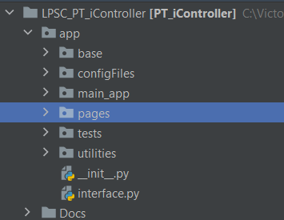
File structure

Slide 2
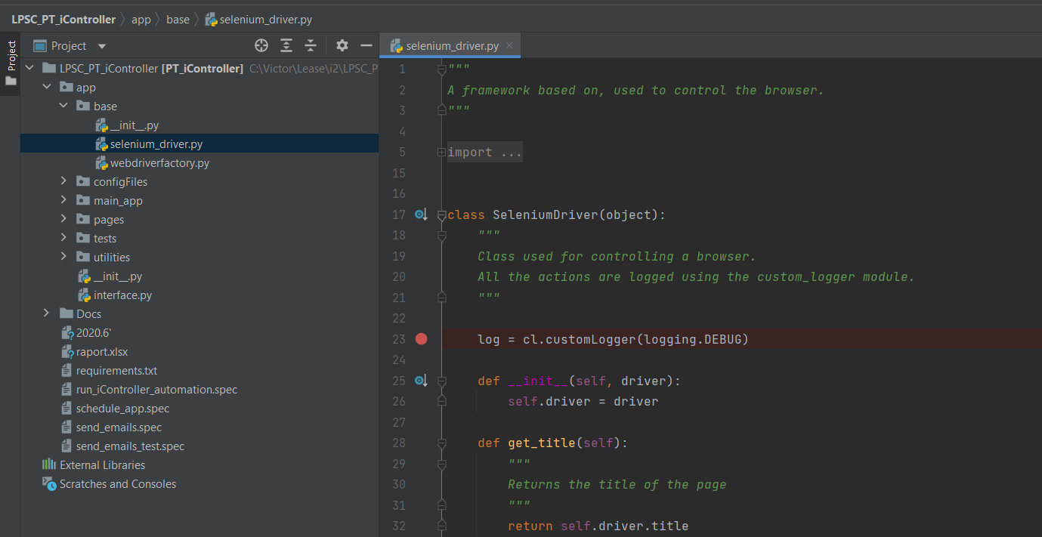
Selenium driver is the class that contains the main methods used to interact to a web page

Slide 3
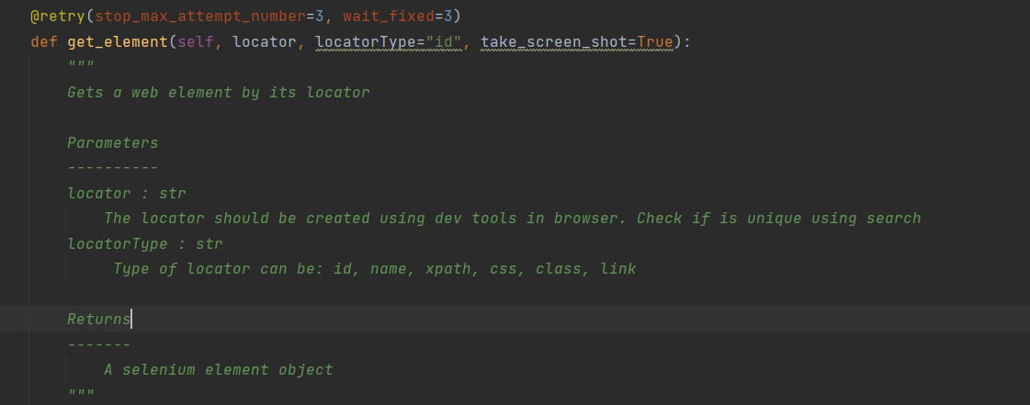
Get element
Is used to capture an element
Selector type can be: id, name, xpath, css, class, link

Slide 4
Other methods
element_click
get_text
is_element_present
send_Keys
wait_for_element

