Slide 1

Vi Luu – AxS Modeling 11/2015

Slide 2
agenda
what is odoo?
odoo overview
how strong odoo?
license
develop with odoo
component
architecture
demo

Slide 3
what is odoo?

Slide 4
odoo overview

Slide 5
how strong odoo?

Slide 6
license

Slide 7
develop with odoo

Slide 8
component

Slide 9
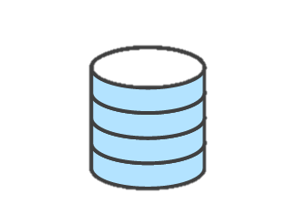
architecture
__init__.py
model.py
API
module
Brower
__openerp__.py
view.xml
deploy
controllers.py
PostgreSQL

Slide 10
mvc

Slide 11
__init__.py

Slide 12
__openerp__.py

Slide 13
model.py

Slide 14
controller.py

Slide 15
view.xml

