Slide 1
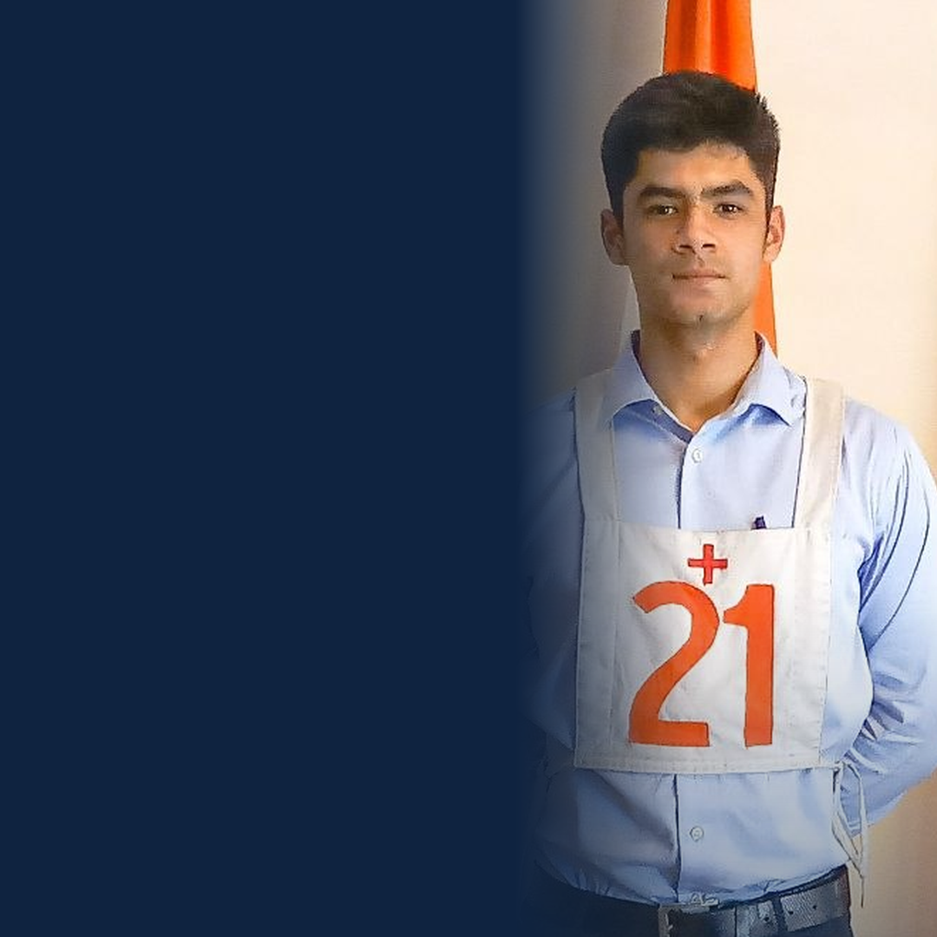

CDS Result out. If GK pulled your score down, your next attempt can be different.
90 Days is all it takes.
Anmol Sharma
AIR 32 · UPSC CDS 2018

