Slide 1
File Topic Routing
Progress update: synthetic data + ML proof of concept (v0)
Binary routing: target vs other from article text
Internal progress readout
Yao Qin 07/24/2026

Slide 2
Outline
What we will cover in this update
1. Problem & goal
2. Why an ML PoC on synthetic data first
3. Synthetic data & domain understanding
4. Dataset V4 (context, snapshot, EDA)
5. ML task (v0) — flowchart
6. Results vs label-only baselines
7. What the model learned (coefficients)
8. Next steps — data & model

Slide 3
1. Problem & goal
What we are trying to prove
Business problem: route articles as target vs other from article text
Current configurable routing rule (example):
target if topic in {telecommunications, cloud_computing}, else other
PoC goal (v0): show a text classifier can beat naive label-only baselines
This update covers:
Synthetic article dataset (current generation: V4)
Minimal ML baseline: TF-IDF + logistic regression
Evidence: metrics, baseline comparison, feature coefficients

Slide 4
2. Why an ML PoC before real data & production?
De-risk the learning loop early
Before real corpus
Before advanced ML
Before production
Labels, splits, metrics, explainability are free to iterate
Find pipeline bugs without waiting on collection/SME time
Clarify routing definition before expensive labeling
Establish a simple baseline first
Know whether text signal exists at all
Avoid jumping to embeddings/complex stacks without a yardstick
Synth PoC ≠ production readiness
Real ingestion, monitoring, and SME labels come later
Use PoC to decide what to ask of a real knowledge corpus

Slide 5
3. Synthetic data & domain understanding
How we create data — and what that means for domain knowledge
How we create it
Domain honesty
Topic taxonomy (10 topics; 5–10 subtopics each)
Per topic: fictional orgs, customers, metrics, adjacent topics
Vary style, length, difficulty, cross-topic mentions
Keep topic; derive routing_label from a configurable rule
Hard examples share vocabulary across topics on purpose
Encodes structured domain assumptions — not SME-validated knowledge
Great for controlled experiments; not a real corpus substitute
True domain depth needs real articles + SME partnership next

Slide 6
4a. How we got to V4
Four iterations: more realism, same clean supervised labels
V1 — Smoke test
V2 — Diversity
V3 — Richer narrative
V4 — Benchmark corpus
10 balanced topics; simple templates
Validated end-to-end ML pipeline
Too template-driven for realism
Multiple styles; multi-paragraph
Varied titles; cross-topic refs
More overlap; still parameterized
More natural narrative flow
Greater wording diversity
Richer business context
Subtopics, orgs, 6 pub styles
Easy/Med/Hard + metadata
Primary-topic ID, not keywords
Key takeaways
Progressively increased realism while keeping high-quality labels; topic kept separate from routing_label
Semantic overlap added to stress models (esp. future embeddings); V4 is the development benchmark before real labeled data

Slide 7
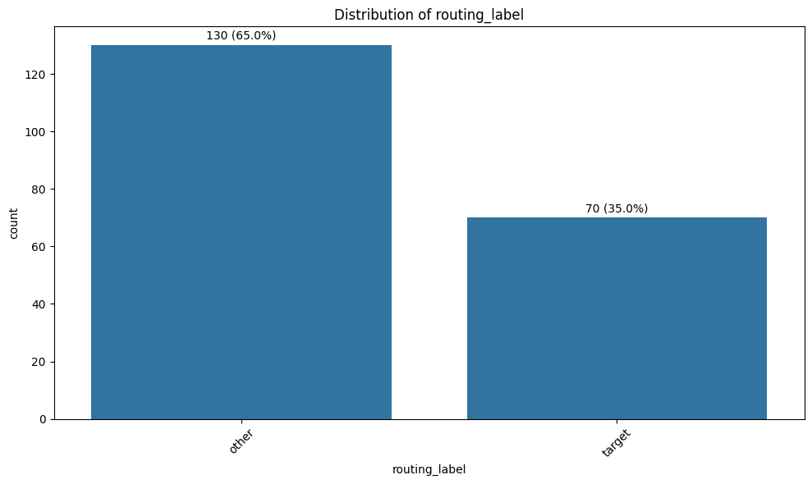
4b. Dataset V4 snapshot
200 articles · 10 topics · 70 target / 130 other
200
10
articles
topics
target / other

Slide 8
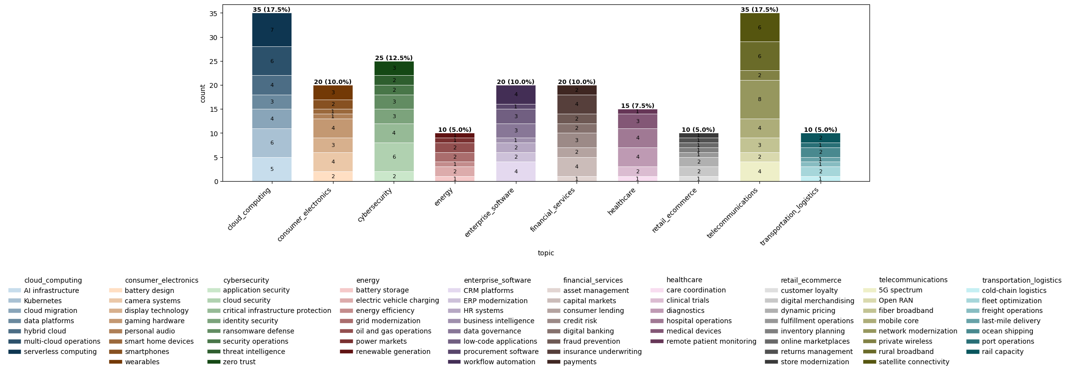
4c. EDA — topic / subtopic structure
Target topic
Target topic

Slide 9
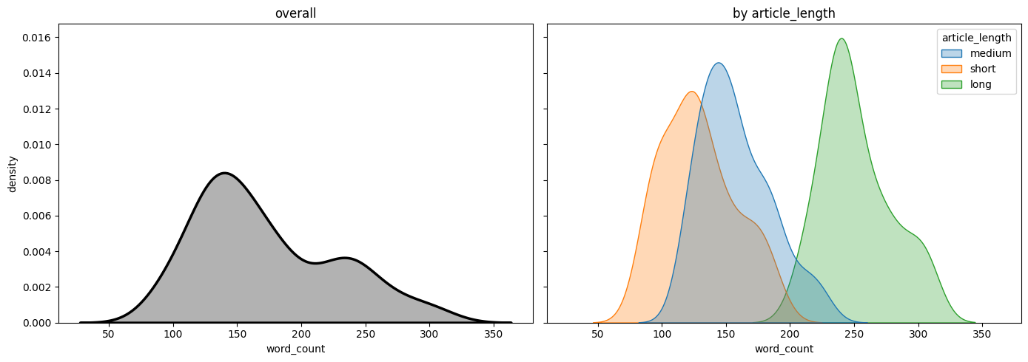
4d. EDA — length

Slide 10
5. ML task (v0) — minimal PoC flow
Fixed TF-IDF + LR · stratified split · threshold 0.5 · no tuning
Load Synthetic Data CSV
Map y target=1
Stratified 80/20 split
Fit TF-IDF + LR
Score test @ 0.5
Baselines + coefs
Input: article_text
Output: target vs other
Success bar for this PoC:
beat label-only baselines on the same test set
sensible coefficients

Slide 11
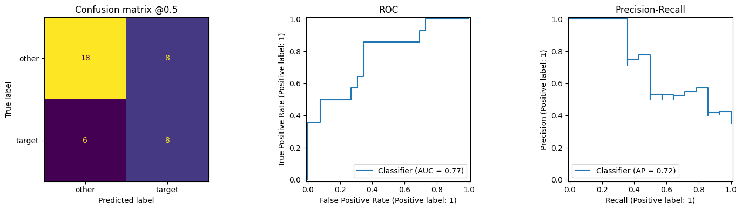
6a. v0 model results @ threshold 0.5
class | precision | recall | f1 | support
other | 0.75 | 0.69 | 0.72 | 26
target | 0.50 | 0.57 | 0.53 | 14
Accuracy = 0.65 (Accuracy alone is easy to misread under imbalance)
Next slide compares against label-only baselines

Slide 12
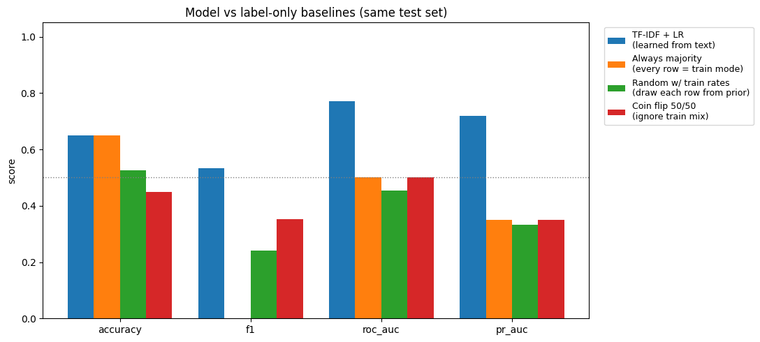
6b. Better than chance? — vs label-only baselines
model | accuracy | precision | recall | f1 | roc_auc | pr_auc
TF-IDF + LR | 0.650 | 0.500 | 0.571 | 0.533 | 0.772 | 0.720
Always majority class | 0.650 | 0.000 | 0.000 | 0.000 | 0.500 | 0.350
Random w/ train rates | 0.525 | 0.273 | 0.214 | 0.240 | 0.453 | 0.333
Coin flip 50/50 | 0.450 | 0.300 | 0.429 | 0.353 | 0.500 | 0.350

Slide 13
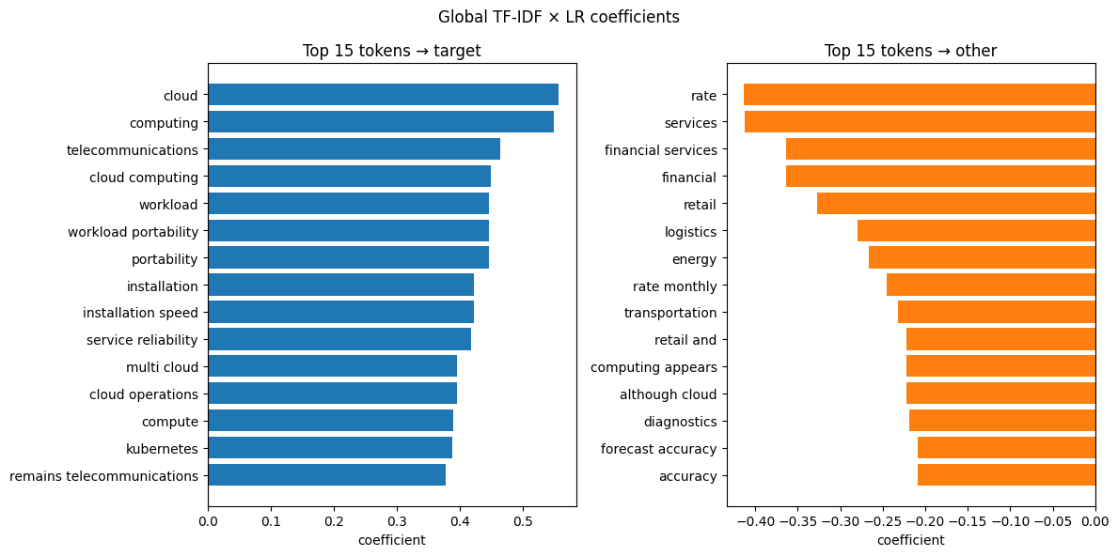
7. What did the model learn?
Global TF-IDF × LR coefficients (explainability)
Target side leans on cloud/telecom language; other side on non-target domains — consistent with the routing rule.

Slide 14
8a. Next steps — improve data
Synthetic scale-up + real knowledge corpus
(1) Synthetic
(2) Real knowledge corpus
Scale beyond 200; raise medium/hard share
Refine taxonomy with feedback
Check generator-template leakage
Optional BoW preprocessing (lemma/stopwords) via CV
Reach out to [Colleague Name] for real articles / SME corpus
Align routing definitions & labeling guidelines
Small gold set; stress-test synth → real
This is how we deepen true domain understanding

Slide 15
8b. Next steps — improve model
Model roadmap after v0 (data track is on 8a)
Build stronger signal
Decide, evaluate, explain, ship
1. Representations: embed text with a pretrained model, then train a small linear (or MLP) classifier head — keep the embedder frozen at first
Meanwhile on BoW/TF-IDF (current path): try lemma/stopwords, char n-grams, SVD via CV until embeddings replace it
2. Features: add title + selected metadata (leakage checks); combine with text features
3. Models: compare several classifiers + hyperparameter tuning; refine grids from CV diagnostics (train only)
Stacking only when data supports a clean meta-holdout
4. Decisioning: tune thresholds / abstain bands on train only; calibrate probabilities so P(target) matches real frequencies (needed for trustworthy confidence-based routing)
5. Evaluation: score by subgroup (topic/length/difficulty); learning curves (does more data help?); nested CV when tuning (avoids overly optimistic scores); cost-sensitive metrics if FP/FN costs differ
6. Explainability & errors: richer local explanations; build a named catalog of failure modes (e.g. cross-topic bleed, short text, label ambiguity) from FP/FN reviews to drive data and feature fixes
7. Productization: versioned model artifacts; batch/API inference; monitor score & abstain-rate drift; human-in-the-loop on abstains (uncertain cases go to people for labeling → feed back into training)

Slide 16
Update 2 — ML v1 methodology
Cross-validation, tuning, confidence banding, richer evaluation
07/28/2026
Appended to the v0 progress readout — same V4 data; stronger methodology on the classifier side

Slide 17
What v1 adds vs v0
Same task & data — more rigorous ML workflow
Still true from v0
New in v1
Input: article_text → target vs other
V4 synthetic corpus; stratified 80/20
TF-IDF + Logistic Regression family
Default operating point remains 0.5 for headline metrics
Stratified 5-fold GridSearchCV on train (optimize F1)
CV diagnostics (ranked configs)
Layer A threshold analytics (explored, not adopted)
Layer B abstain band (illustrative confidence routing)
Stronger held-out metrics after tuning

Slide 18
v1 training workflow
What we added on top of v0 — and why
Train texts
TF-IDF vectorizer
LogReg classifier
GridSearch + Stratified 5-fold CV
Best params refit on full train
Evaluate once on test
GridSearch wraps TF-IDF + LogReg as one Pipeline so vectorizer stats never leak across CV folds.
What's new vs v0 | Purpose / benefit
Pipeline(TF-IDF → LogReg) inside GridSearchCV | Tunes features + model together without test leakage
Stratified 5-fold CV on train (score = F1) | Stable selection under class imbalance
Hyperparameter grid (C, n-grams, min_df, max_features) | Find a stronger config than fixed v0 defaults
Refit best estimator on full train | Use all labeled train data after selection
Hold out test for final report only | Honest estimate of generalization

Slide 19
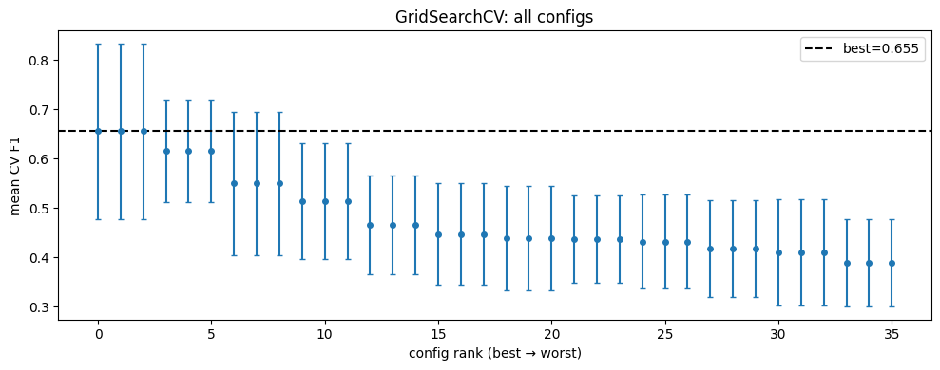
Hyperparameter search (train CV)
36 configs × 5 folds · scoring = F1 · refit best on full train
item | value
Best CV F1 | 0.655
clf__C | 10.0
tfidf__ngram_range | (1, 1)
tfidf__min_df | 1
tfidf__max_features | 5000
Search stays on train only;
test used once late
ranked CV plot

Slide 20
Two evaluation layers (before results)
Why v1 separates model quality from confidence routing
Layer A — always predict
Layer B — abstain band
Every test row gets Target or Other (default @ 0.5)
Answers: is the classifier any good?
Report: class P/R/F1, confusion matrix, ROC / PR
Threshold analytics (F1/Youden/top-left) are diagnostics only
Only auto-route when P(target) is clearly high or low
Middle band → abstain / human review
Answers: if we require confidence, what's coverage vs quality?
Metrics computed on auto-routed rows only
Why explore both: a strong Layer A model can still be wrong on borderline scores — Layer B shows the ops tradeoff (precision/coverage) without changing the headline @0.5 report
In this update the abstain band is illustrative (not yet tuned on train/val)

Slide 21
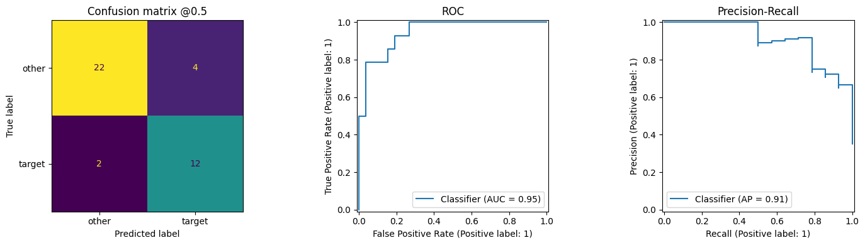
Layer A results @ 0.5 (tuned model)
Always predict · headline quality metrics
class | precision | recall | f1 | support
other | 0.92 | 0.85 | 0.88 | 26
target | 0.75 | 0.86 | 0.80 | 14
Accuracy = 0.85
(easy to misread under imbalance — use with F1 / curves)
ROC-AUC = 0.945
PR-AUC = 0.911
vs v0 fixed defaults: F1 ~0.53 → 0.80; ROC ~0.77 → 0.95

Slide 22
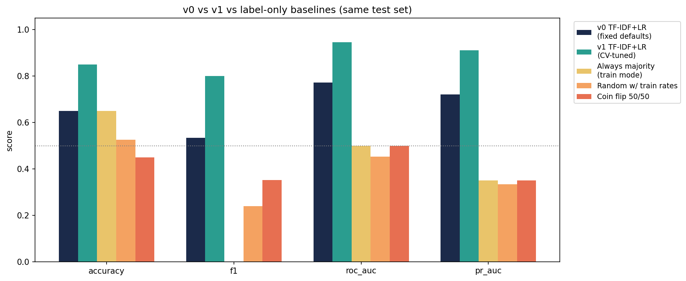
v0 vs v1 vs label-only baselines
model | accuracy | precision | recall | f1 | roc_auc | pr_auc
v0 TF-IDF+LR (fixed) | 0.650 | 0.500 | 0.571 | 0.533 | 0.772 | 0.720
v1 TF-IDF+LR (tuned) | 0.850 | 0.750 | 0.857 | 0.800 | 0.945 | 0.911
Always majority class | 0.650 | 0.000 | 0.000 | 0.000 | 0.500 | 0.350
Random w/ train rates | 0.525 | 0.273 | 0.214 | 0.240 | 0.453 | 0.333
Coin flip 50/50 | 0.450 | 0.300 | 0.429 | 0.353 | 0.500 | 0.350

Slide 23
Threshold analytics (not a production change)
Explored on train; headline default stays 0.5
method | threshold | role | test precision | test recall | test f1
(1) default 0.5 | 0.500 | default | 0.750 | 0.857 | 0.800
(2) train F1 sweep | 0.440 | analytics | 0.667 | 1.000 | 0.800
(3) Youden J | 0.496 | analytics | 0.750 | 0.857 | 0.800
(4) closest top-left | 0.496 | analytics | 0.750 | 0.857 | 0.800
F1 sweep / Youden / top-left are diagnostics — they can change precision/recall tradeoffs
We do not pick the cutoff from test; default Layer A report remains @ 0.5
Proper threshold tuning (train/val or nested CV) stays on the roadmap

Slide 24
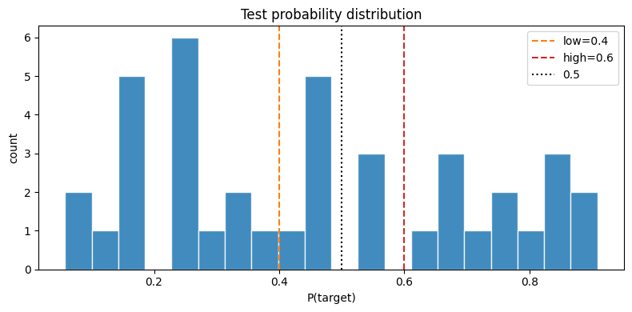
Layer B — abstain band (illustrative)
Auto-route only when confident; middle band → review
Rule used here: low=0.4, high=0.6 (symmetric ±0.1; not tuned)
P ≥ 0.6 → Target · P ≤ 0.4 → Other · else abstain
Coverage 77.5% (31/40) · abstain 22.5% (9/40)
mode | coverage | precision | recall | f1
Layer A @0.5 (all rows) | 100% | 0.75 | 0.86 | 0.80
Layer B routed only | 77.5% | 0.85 | 1.00 | 0.92
Higher F1 on auto-routed subset — at the cost of coverage
Band values remain illustrative until tuned on train/val

Slide 25
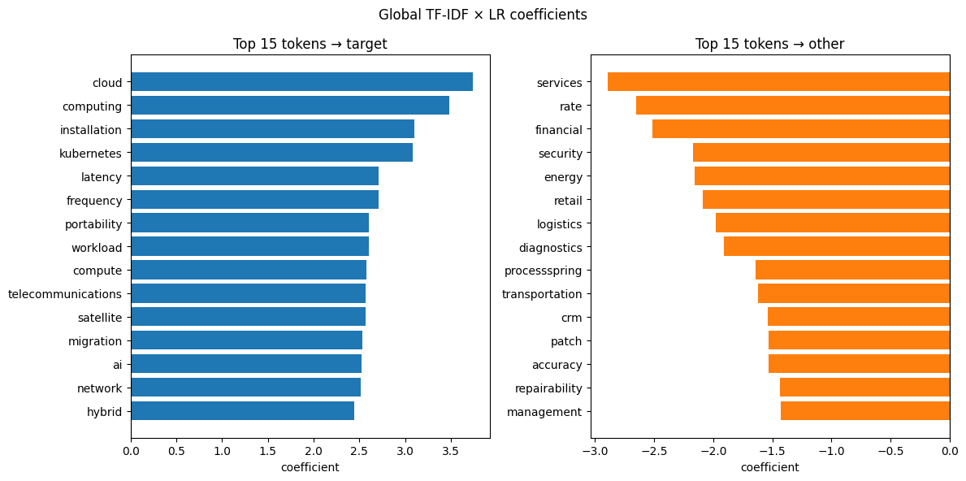
What the tuned model leans on
Global coefficients after GridSearch (from notebook)
Still cloud/telecom vs other-domain tokens — consistent with the routing rule; local token tables omitted for readout clarity.

Slide 26
Next after v1 — model roadmap status
Same 7 themes as slide 8b · status after this v1 update
[Done] completed in v1
[In progress] partially done
[Open] not started
[New] added to roadmap this update
[Open] 1. Representations
Pretrained embeddings + linear/MLP head; meanwhile BoW lemma/stopwords/char-n-grams/SVD
Not started
[Open] 5. Evaluation
Subgroup metrics; learning curves; nested CV when tuning; cost-sensitive metrics if FP/FN costs differ
Not started (basic CV was for model selection, not these eval upgrades)
[Open] 2. Features
Add title + selected metadata (with leakage checks); combine with text features
Not started
[In progress] 6. Explainability & errors
Richer local explanations; named failure-mode catalog from FP/FN reviews
Done: global coefficients · Open: local explanations + error taxonomy
[In progress] 3. Models
Compare several classifiers + hyperparameter tuning; refine grids from CV diagnostics; stacking later
Done: train CV + GridSearch + ranked diagnostics · Open: multi-classifier comparison / stacking
[Open] 7. Productization
Versioned artifacts; batch/API inference; monitor drift; human-in-the-loop on abstains
Not started
[In progress] 4. Decisioning
Tune thresholds / abstain bands on train only; calibrate probabilities for confidence routing
Done: threshold analytics (default stays 0.5) + illustrative abstain band · Open: proper band/threshold tuning + calibration
Roadmap changes this update: no new themes added. v1 advances existing items 3, 4, and 6 (partial).

