Slide 1
DPR400210 · CAPSTONE FINAL EXAMINATION
BITE & GRILL
An Oracle Database System for Restaurant Ordering & Management
Student: Nadjitiessem Gondje Victoire ID: 31603_2025_Nadjitiessem_Restaurant_DB Instructor: Eric Maniraguha
15 July 2026

Slide 2
INTRODUCTION
What Bite & Grill Is
A complete Oracle 19c database system for a restaurant: menu, customers, orders, auditing, and business-rule enforcement — accessed through a controlled PL/SQL API and demonstrated with a live web ordering interface.
WHY IT MATTERS
Small restaurants track orders on paper — slow, error-prone, and impossible to audit. Bite & Grill replaces that with a normalized schema and rules enforced at the database layer, not just in app code that can be bypassed.
6
Tables — categories, menu_items, customers, orders, order_audit, holidays
6
PL/SQL program units in order_management_pkg
3
Triggers — audit trail + business-rule enforcement
Every write goes through one PL/SQL package — so every write is validated and audited.
2 / 10

Slide 3
THE PROBLEM
Paper Tickets Don't Scale
1
Slow capture
2
No audit trail
Orders taken by phone or in person, then hand-written — every step adds delay and transcription error.
When an order or its status is changed, there is no record of what it used to be, who changed it, or when.
3
No enforced rules
4
No sales visibility
Restaurant policy (e.g. no changes outside opening hours) lives only in staff memory, not in the system.
Owners can't see daily totals or order volume without manually adding up paper tickets.
3 / 10

Slide 4
METHODOLOGY
Eight-Phase Build Process
1
2
3
4
5
6
7
8
Problem
statement
Business
process model
Logical design
(ERD, 3NF)
Database
creation
Table
implementation
PL/SQL
programming
Triggers &
security
Docs &
innovation
Each phase maps directly to the marking scheme, so the deliverables you're reviewing trace 1:1 back to the rubric.
4 / 10

Slide 5
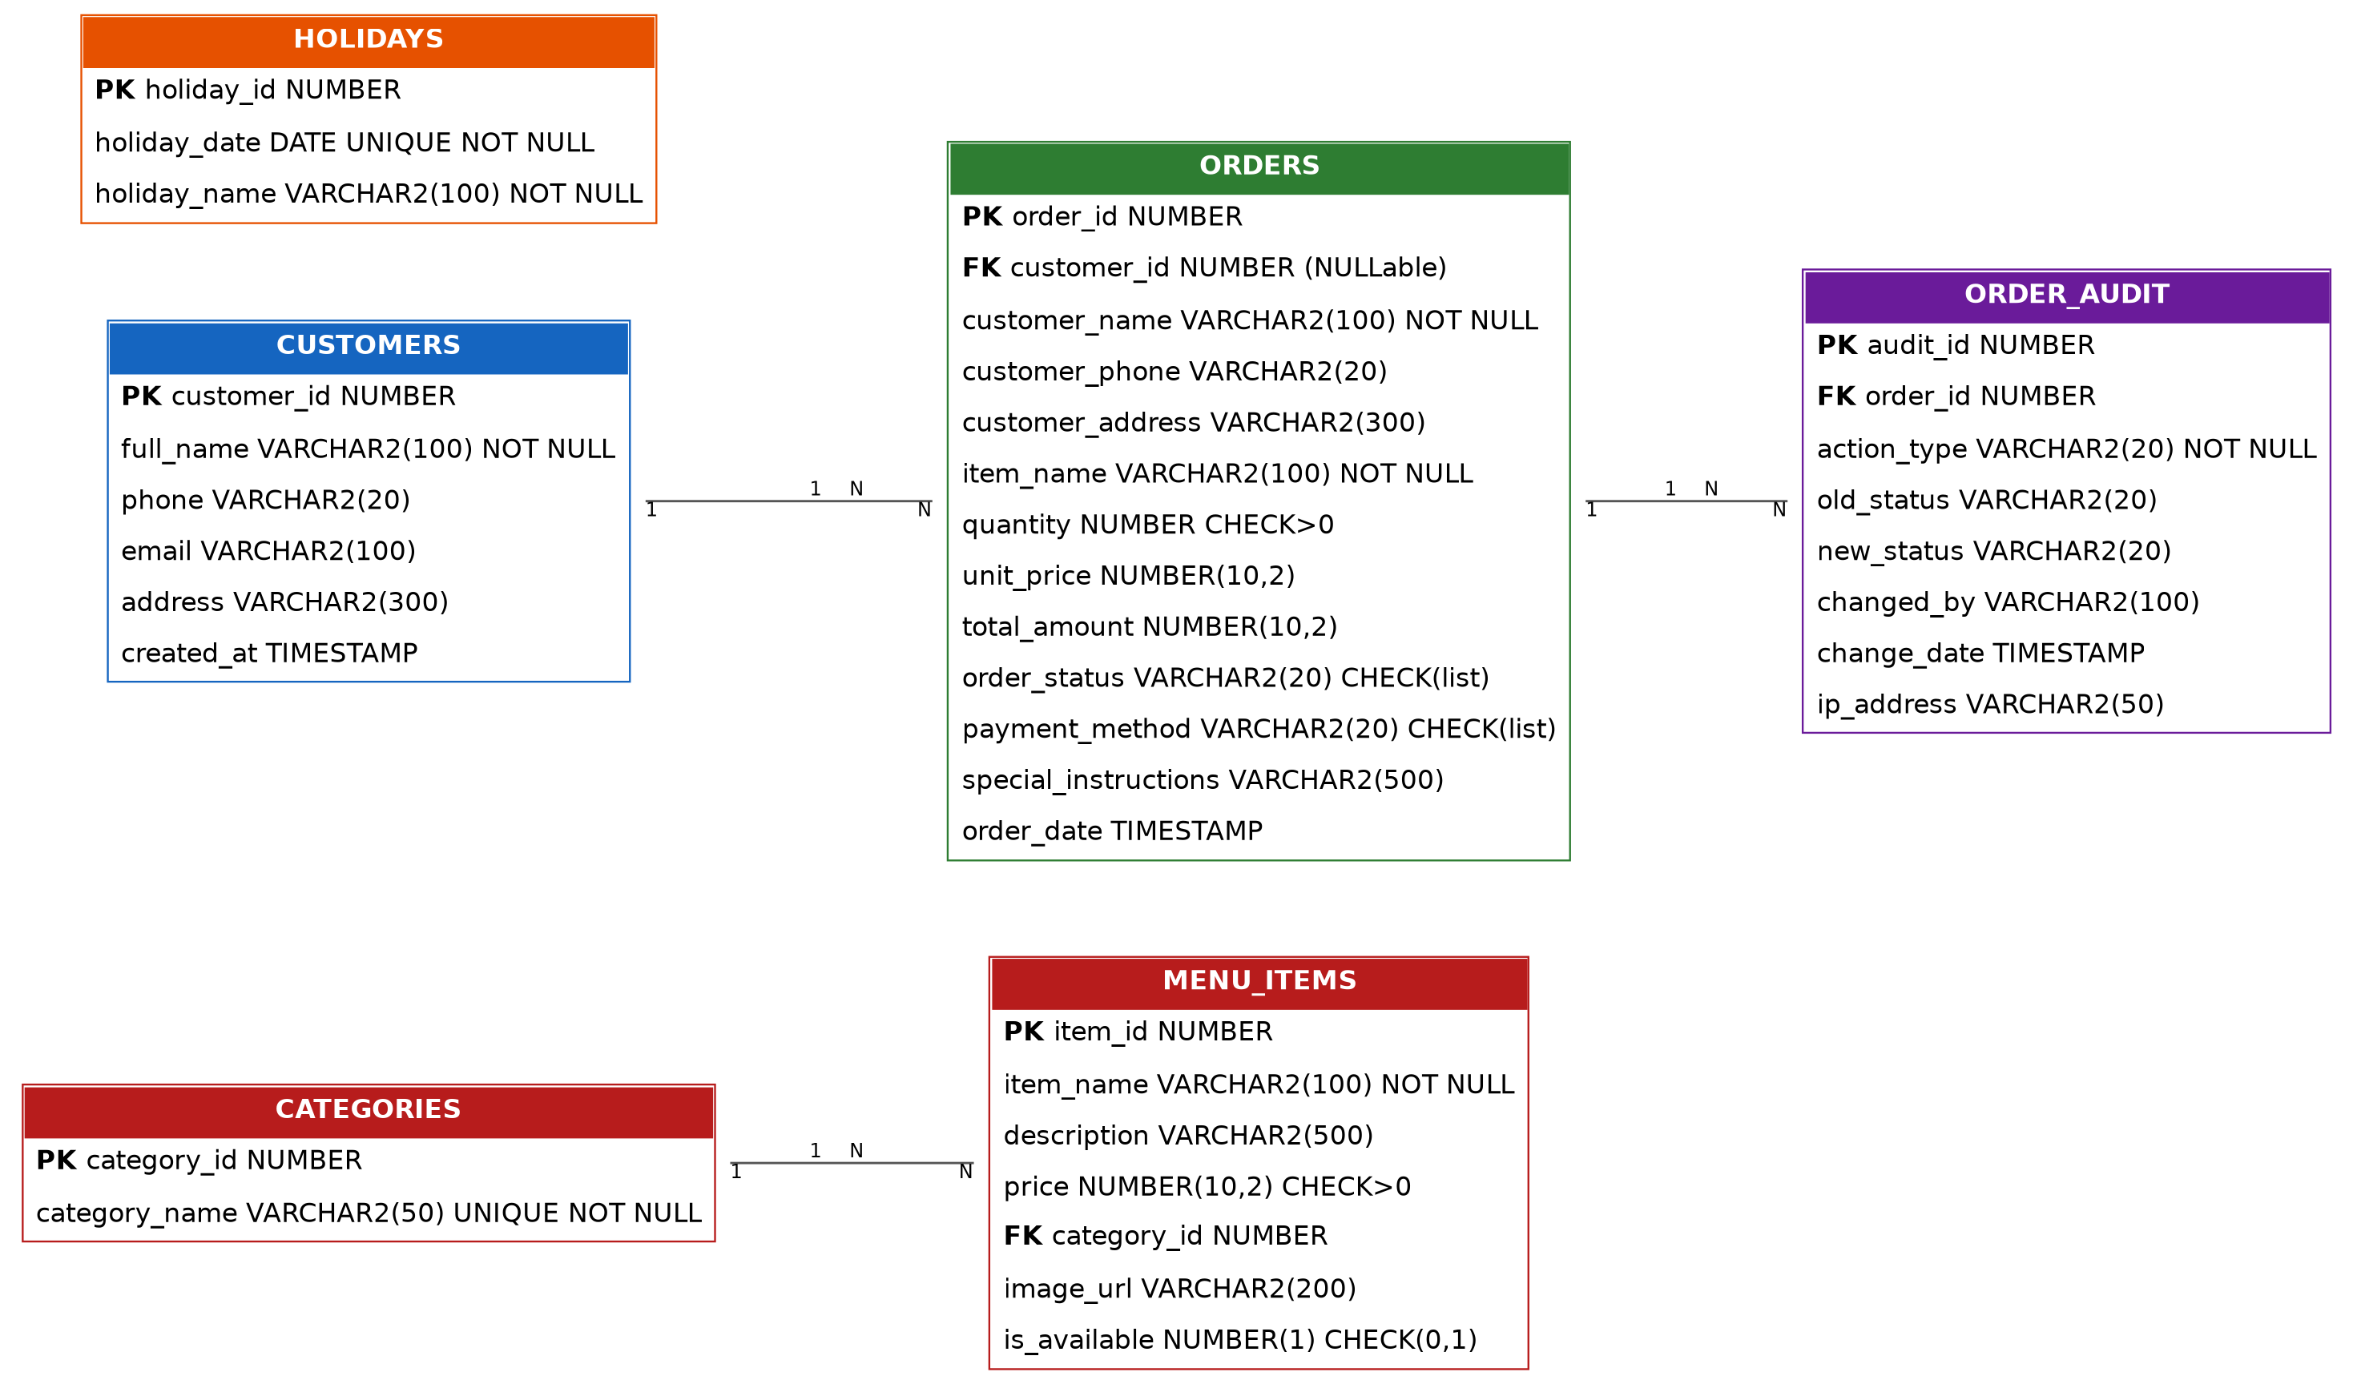
DATABASE DESIGN
Entity–Relationship Model
3NF NORMALIZED
6 entities · single-column surrogate keys · FKs on category, customer, and order.
customer_name/phone/address are intentionally duplicated on orders — a deliberate trade-off to keep a permanent record even for walk-in orders.
5 / 10

Slide 6
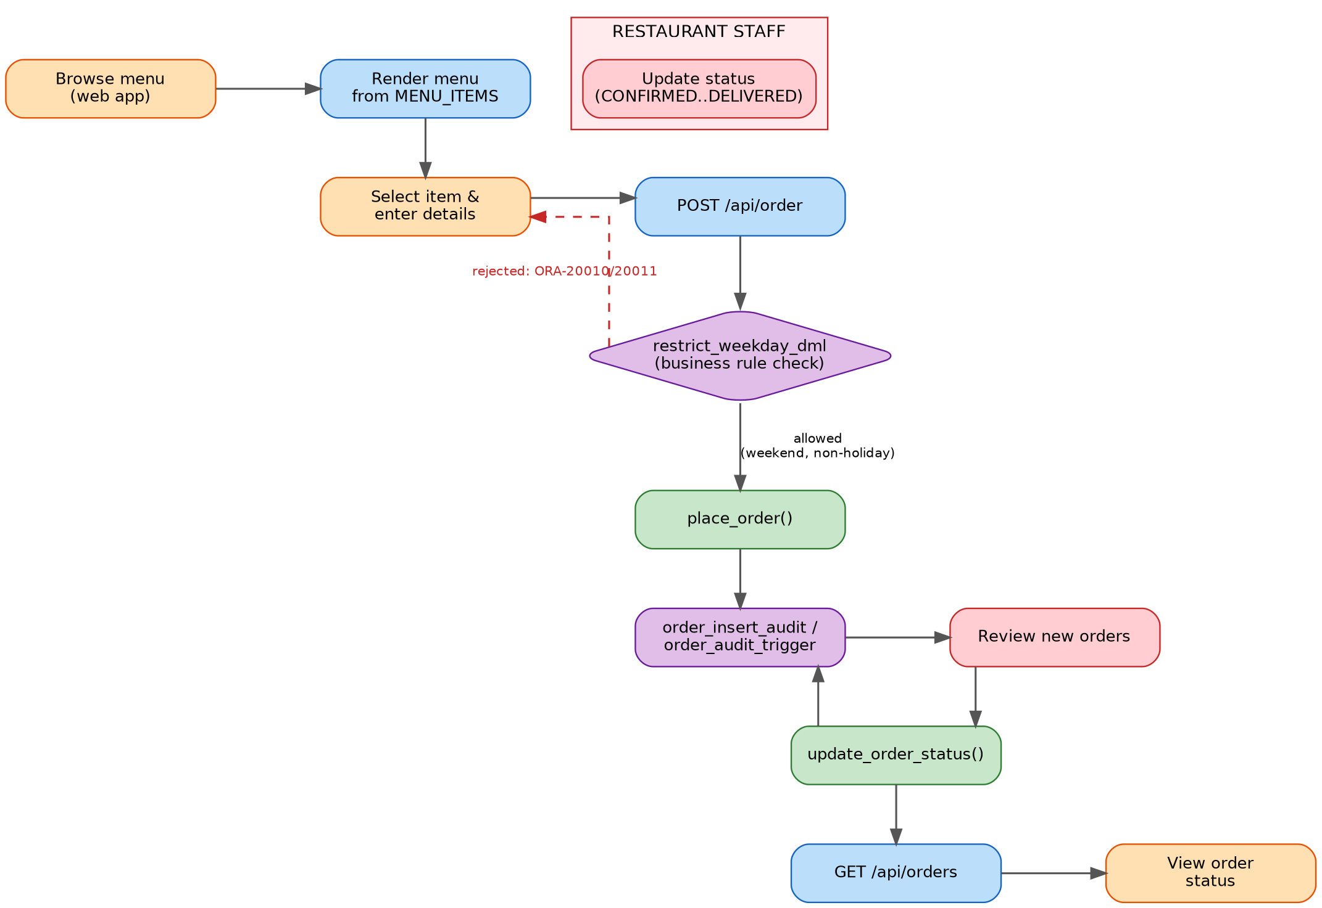
BUSINESS PROCESS
From Order to Delivery
KEY CHECKPOINT
restrict_weekday_dml fires BEFORE every insert, update, or delete on orders. If it's a weekday or a public holiday, the transaction is rejected with ORA-20010 / ORA-20011 — no matter which client tried to write.
Every insert and every status change is captured automatically by AFTER triggers into order_audit.
6 / 10

Slide 7
IMPLEMENTATION
order_management_pkg
Every write to ORDERS happens through this package — the single controlled entry point.
place_order()
Function
Inserts a new order, computes the total, COMMITs, ROLLBACKs on error
update_order_status()
Procedure
Validates the order exists, updates status, NO_DATA_FOUND handling
get_order_details()
Function → REF CURSOR
Full details for one order
get_total_sales()
Function
SUM(total_amount), excludes CANCELLED orders
get_orders_by_status()
Function → REF CURSOR
Orders filtered by status, most recent first
get_daily_orders_report()
Procedure + explicit CURSOR
Loops today's orders, prints a DBMS_OUTPUT summary
7 / 10

Slide 8
AUDITING & SECURITY
Enforced at the Database Layer
AUDIT TRAIL
SECURITY MODEL
✓
order_insert_audit
REVOKE INSERT, UPDATE, DELETE ON orders FROM PUBLIC removes direct write access completely. restaurant_app_role is granted only EXECUTE on order_management_pkg and SELECT on orders. Because the package runs with definer's rights, a session with only that role can still place and update orders — but only through the package, which guarantees the business rule and the audit trail apply to every single write.
AFTER INSERT → logs ORDER_CREATED
✓
order_audit_trigger
AFTER UPDATE OF order_status → logs old/new status + who changed it
restrict_weekday_dml
BEFORE INSERT/UPDATE/DELETE, FOR EACH ROW — blocks writes on weekdays and on dates found in the new HOLIDAYS reference table, raising ORA-20010 / ORA-20011.
8 / 10

Slide 9
RESULTS & INNOVATION
A Live Ordering Interface
A Python web app (app.py) drives the Oracle package live — no ORM, no framework, every call visible.
1
Browse
2
Order
3
Track
Menu renders live from MENU_ITEMS / CATEGORIES
POST /api/order calls place_order() — never a raw INSERT
GET /api/orders shows live status per customer
DEMONSTRATED LIVE
Live demo covers: placing an order, the business-rule trigger rejecting a weekday write, staff progressing an order's status, and the resulting rows in order_audit.
9 / 10

Slide 10
CONCLUSION
A Complete, Enforced
Restaurant Database
3NF-normalized schema across 6 tables
All writes routed through order_management_pkg
Business rule + full audit trail enforced by triggers
Direct table DML revoked — security by grants, not convention
Working Python web interface as the innovation component
Thank you — questions welcome.
10 / 10

