Slide 1
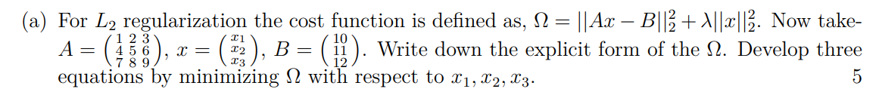
X-ray CT
Problem solve

Slide 2
Image reconstruction means solving system of linear equations
Image reconstruction problem can be presented as a problem of solving a system of linear equations
A- system matrix or model matrix; the interaction of the input beam with each pixel is retained here; it is a large matrix; ill-conditioned matrix; condition number is large
B- is the measurement vector; long vector; it contains noise as well
x- vector containing the unknowns; it can be converted into 2D matrix which is an image- displays spatial map of a property of the tissue that we want to image
Our job is solve this equation and obtain x.

Slide 3
Solution of a system of linear equations
If A is a square matrix (m=n) and |A|≠ 0, then the inverse of A exists. The solution becomes,
This provides the unique solution.
The above condition rarely meets in the experiment. Rather it does not meet at all. Two situations may occur-
m<n, under determined problem
m>n, over determined problem
For both the cases, unique solution does not exist. Therefore, plenty of solutions exist. Now our task is to find out the best solution.

Slide 4
Moore-Penrose inverse method
If A is a not a square matrix. Let us do some trivial steps,
where,
This is known as the Moore-Penrose pseudo inverse.

Slide 5
Least square method
We have to solve the following equation-
………………………………(1)
Let us define a quantity,
………………………………(2)
Now minimize Ω with respect to x. Iteratively change x and then find out the x for which Ω becomes minimum. Let x_{sol} is the solution and then for this x_{sol} the quantity Ω becomes minimum. The x_{sol} can be expressed as,
………………(3)

Slide 6
l_{p} norm of a vector
Consider a vector x. Its components are- x₁, x₂, x₃, x₄, …x_{n} then l_{p} norm of x is defined as ,

Slide 7
Properties of A matrix
A is a large matrix
A is an ill-conditioned matrix
Condition number is large

Slide 8
Calculation of the condition number
Small variation in A or b results in large change in the solution if A is an ill-conditioned matrix.
Definition 1: Cond(A) = ||A||₂ ||A⁻¹||₂
The above definition creates problem when |A|=0, matrix A is not invertible.
The condition number becomes infinity. Then we can use the definition given below.
Definition 2: Cond(A) = ||A||₂ ||A†||₂

Slide 9
A is an ill-conditioned matrix then-
Least square method does not work or does not give a good solution.
You need special method to obtain the solution. This is known as the regularization.

Slide 10
l₂ norm based Tikhonov regularization
We have to solve the following equation-
………………………………(1)
Let us define a quantity,
………………………………(2)
Fidelity term
Penalty term
Regularization parameter (positive definite quantity)
Now minimize Ω with respect to x. Iteratively change x and then find out the x for which Ω becomes minimum. Fortunately analytical solution exists for this.
The solution becomes,
…………………(3)

Slide 11
l₁ norm based Tikhonov regularization
We have to solve the following equation-
………………………………(1)
Let us define a quantity,
………………(2)
Now minimize Ω with respect to x. Iteratively change x and then find out the x for which Ω becomes minimum. Unfortunately analytical solution does not exist for this. This procedure gives sparse solution.
The solution can be obtained using numerical methods. For example, Augmented Lagrangian method can be utilized.

Slide 12
Total variation minimization method
We have to solve the following equation-
………………………………(1)
Let us define a quantity,
………………(2)
Now minimize Ω with respect to x. Iteratively change x and then find out the x for which Ω becomes minimum. Unfortunately analytical solution does not exist for this. This procedure gives solution with less spatial fluctuations.
The solution can be obtained using numerical methods. For example, Augmented Lagrangian method can be utilized.

Slide 14
Regularization refers to the techniques that are used to calibrate machine learning models in order to minimize the adjusted loss function and prevent overfitting or underfitting.

Slide 15
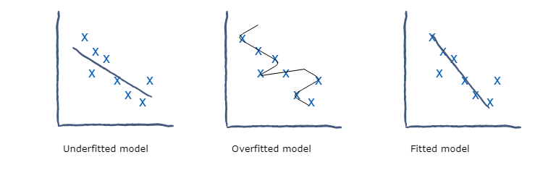

Slide 16
