Slide 1
Axial and lateral resolutions of optical coherence tomography

Slide 2
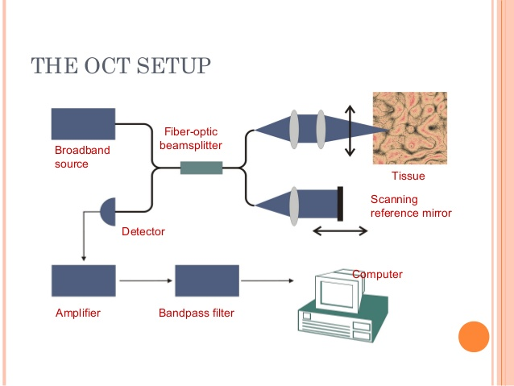
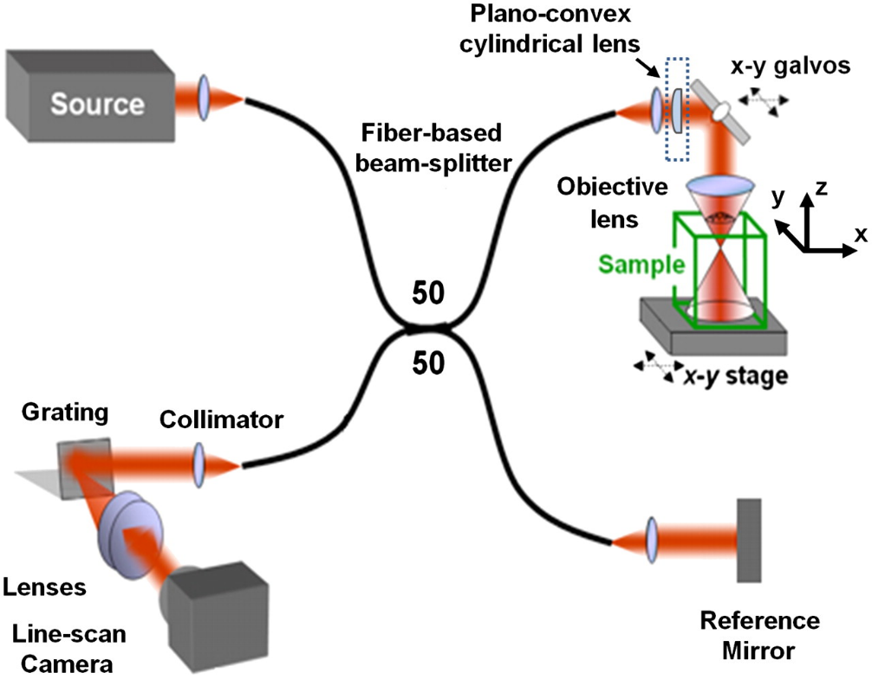
OCT set up with fiber-optic delivery
Lateral resolution depends upon the objective lens.

Slide 3
Lateral resolution calculation

Slide 4
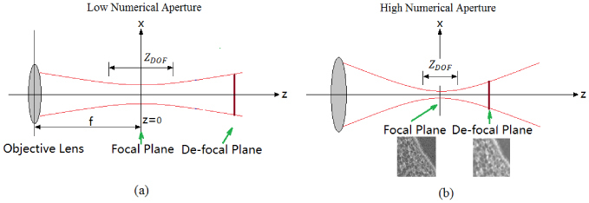

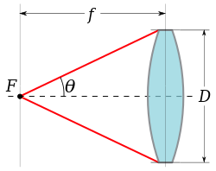
Numerical aperture
Numerical aperture increases, focusing increases but imaging depth decreases.

Slide 5
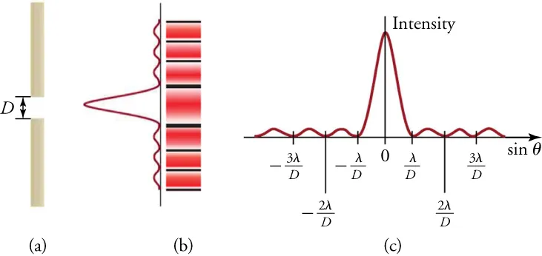
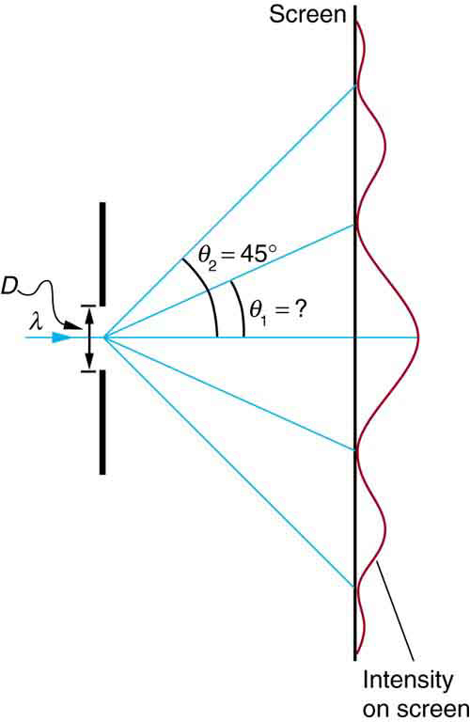
Single slit experiment- Diffraction pattern
Light path is not straight line, light source produces a pattern on the screen. Mathematically it is represented by,

Slide 6
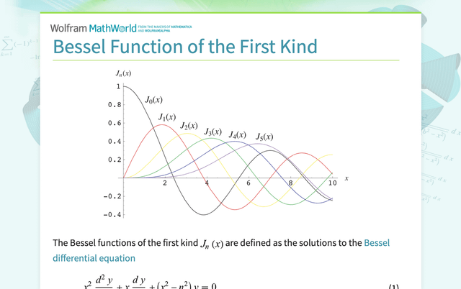
Plots of Bessel function of the first kind

Slide 7
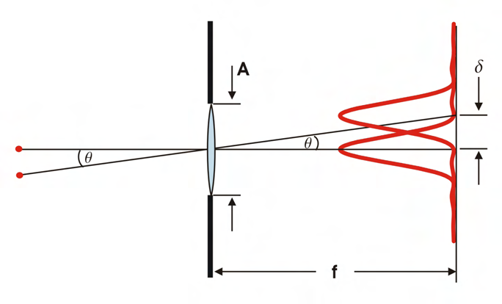

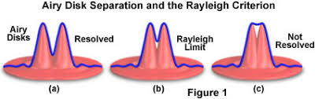
Diffraction pattern- airy disc

Slide 8
Diffraction pattern by a circular aperture light source
To resolve two objects in the lateral direction-
First minimum of Bessel function occurs
To resolve two objects (separated by ∆l) in the lateral direction-
Rayleigh criterion

Slide 9
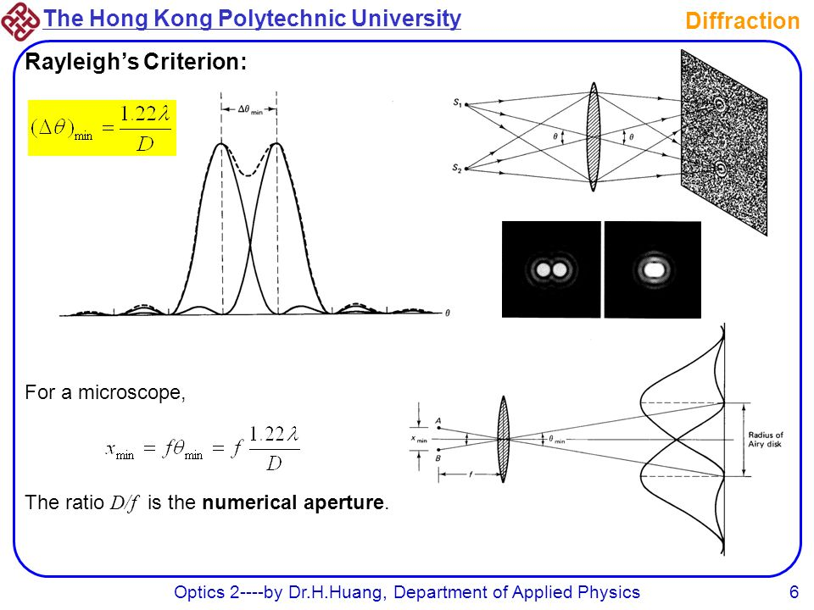
Another illustrative figure

Slide 10
Axial resolution calculation

Slide 11
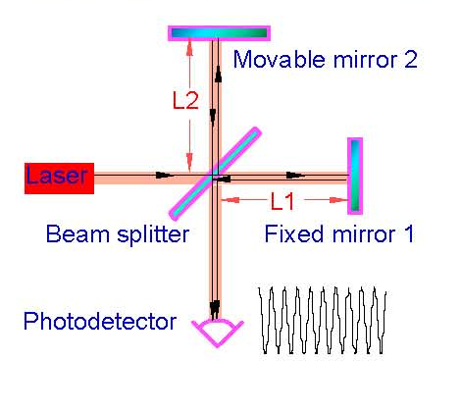


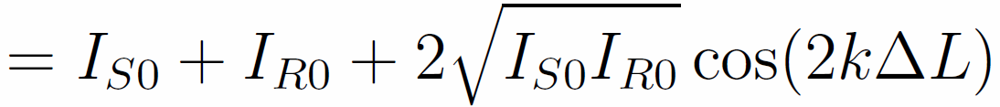
Michelson Morley Experiment- One light source
L_{R}
L_{S}
Constructive interference
Long coherence length
Destructive interference

Slide 12
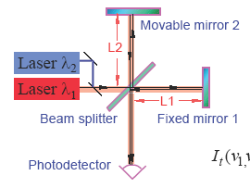
Michelson Morley Experiment- Two light sources

Slide 13
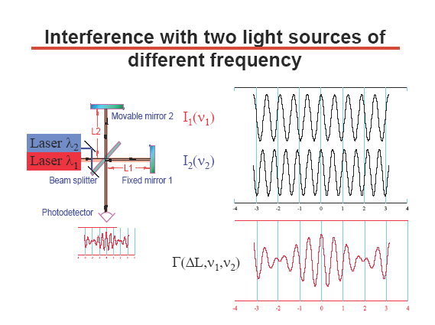

Slide 14
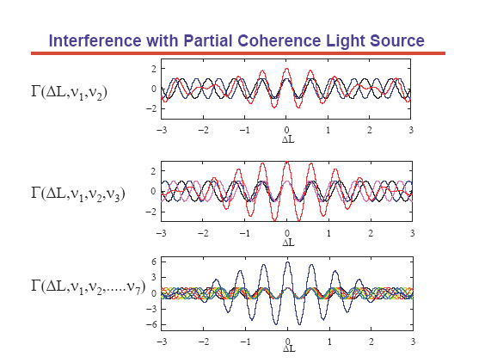

Slide 15
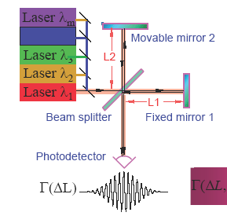

Michelson Morley Experiment- Many light sources
.
.
.
Interference term-

Slide 16
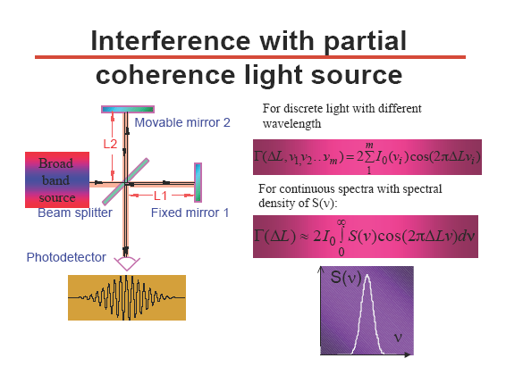
Michelson Morley Experiment- Many light sources
For discrete light with different wavelengths
For continuous spectra with spectral density S(k)-
S(k)
k
Superluminescent diode (SLD)

Slide 17
Resultant intensity at the detector
For continuous spectra with spectral density S(k)-
S(k)
k

Slide 18

Coherence length calculation
l_{c} is the round trip coherence length.
Axial resolution=
OCT is a short coherence technique.

Slide 19
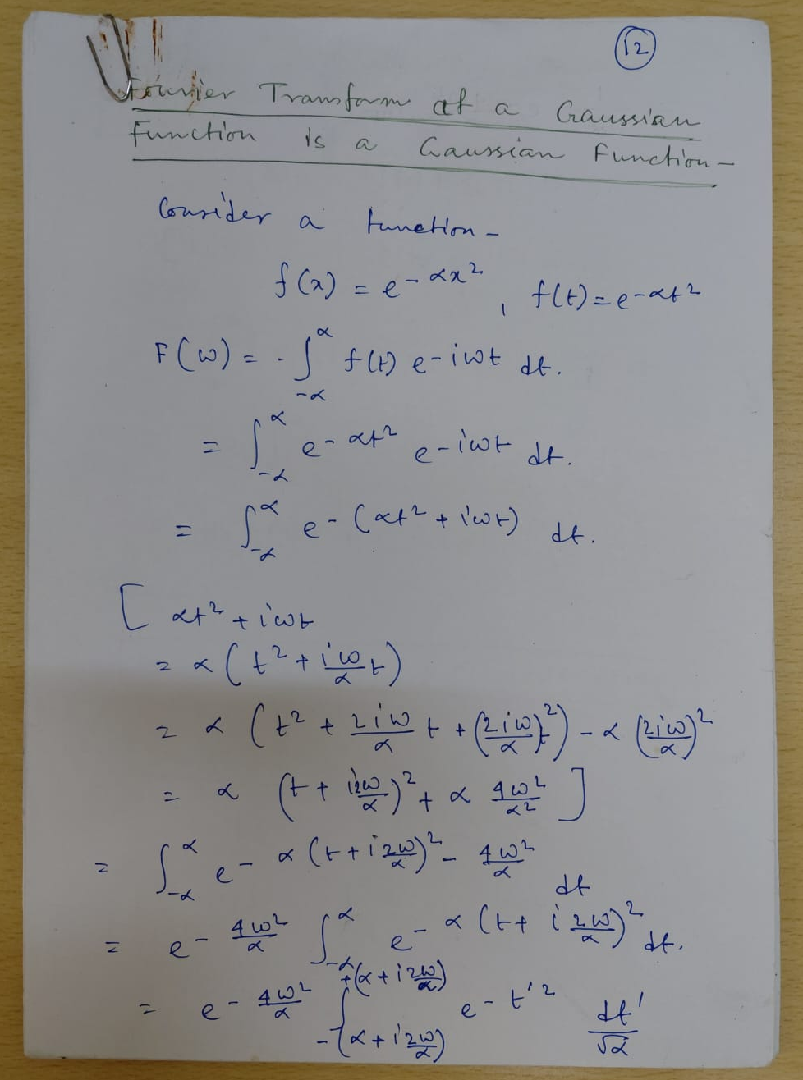
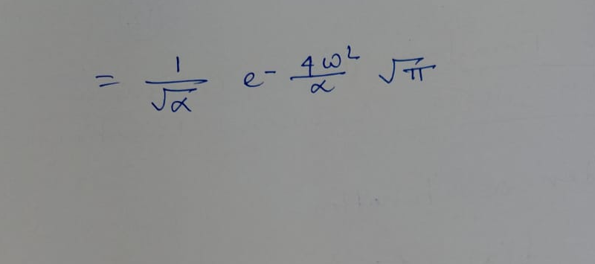

Slide 20
Schematic diagram from literature

