Slide 1
Radioactivity
Heavy nuclei emit radiations and transforms into some other nuclei.
Radiations in the form of α-decay, β-decay and γ-decay.

Slide 2
N/Z ratio
The ratio of number of neutrons to the number of protons is the neutron-proton ratio.
This ratio plays an important role in radioactivity.
For stable nuclei, N/Z =1.
Nuclei become unstable as the N/Z ratio increases. Uranium238, Pluttonium244 the ratio is 1.587, 1.596, respectively.
Radioactivity decay generally proceeds so as to change the N/Z ratio to increase stability.

Slide 3
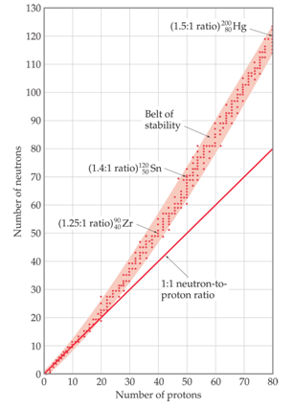
N/Z graph

Slide 4
Radioactive decay equation
N=N₀ exp(- αt)
Where
N₀= number of particles at time t=0
α= is the decay constant
Half life = ln(2)/α
Mean life = 1/α

Slide 5
Radioactive decay
Alpha emission
Beta emission
Gamma emission

Slide 6
α-decay
_{Symbolically-}
_{Z}X^{A} --> _{Z-2}X^{A-4} + ₂He⁴
Example-
₉₂U²³⁸ ---> ₉₂Th²³⁴ + α
₉₂U²³⁸ ---> ₉₂Th²³⁴ + ₂He⁴

Slide 7
β-decay
_{Symbolically-}
_{Z}X^{A} --> _{Z+1}X^{A} + e⁻ + ν* (β⁻ decay)
_{Z}X^{A} --> _{Z-1}X^{A} + e⁺ + ν (β⁺ decay)
_{Z}X^{A} + e⁻ --> _{Z-1}X^{A} + ν* (Electron capture)
_{Examples-}
₅₅Cs¹³⁷ --> ₅₆Ba¹³⁷ + e⁻ + ν*
₁₁Na²² --> ₁₀Ne²² + e⁺ + ν
₁₁Na²² + e⁻ --> ₁₀Ne²² + ν* (Auger effect)

Slide 8
γ-decay
_{Symbolically-}
_{Z}X^{A}* --> _{Z}X^{A} + γ
_{Example-}
₆₆Dy¹⁵² * --> ₆₆Dy¹⁵² + γ

Slide 9
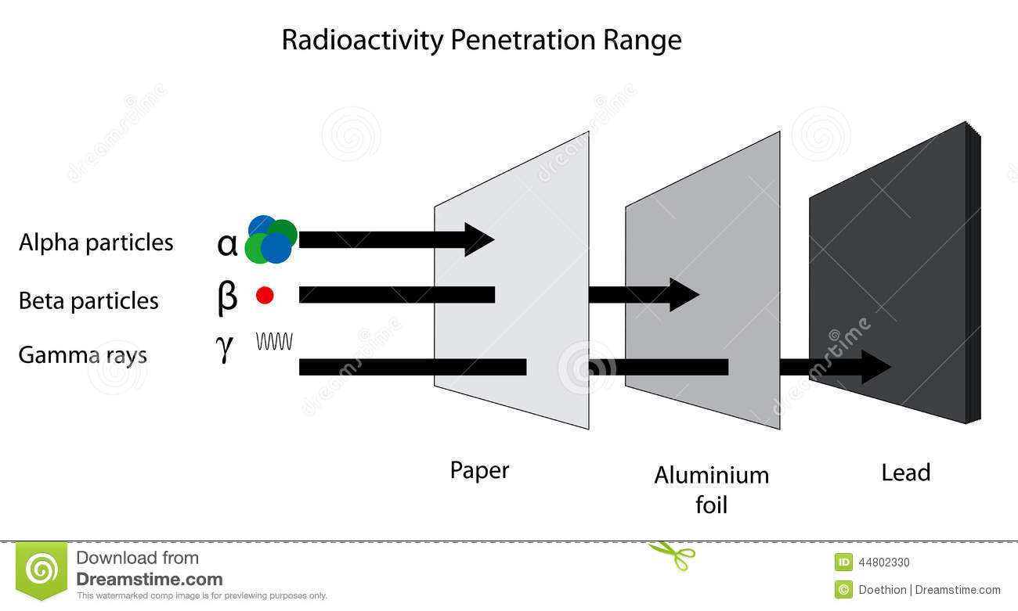
Penetration

Slide 10
Isotope, Isobar, Isotone
Isotope = mass number same, but atomic number different
Isobar = mass number different, but atomic number same
Isotone = same number of neutron

Slide 11
Radioisotope, radiopharmaceuticals
Radioisotopes are atoms that have excess energy so that they undergo radioactive decay.
Some drugs exhibiting radioactivity are known as radiopharmaceuticals.

Slide 12
Difference between isotope and radioisotope
Isotopes are stable but radioisotopes are unstable (demonstrate radioactivity)
₁H¹, ₁H²
₆C¹², ₆C¹⁴
₁₉K³⁹, ₁₉K⁴¹, ₁₉K⁴³, ₁₉K⁴⁸

Slide 13
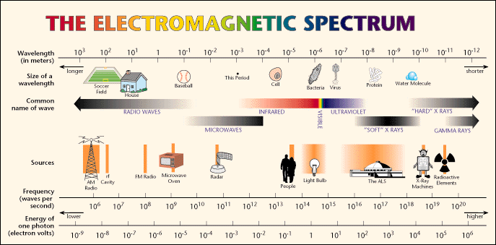

Slide 14
Difference between X-ray and ϒ-ray imaging
X-ray | ϒ-ray
Produced by electrons outside the nucleus | Emitted by nucleus.
Energy 50 keV | Energy 100-300 keV
During imaging X-ray source is outside the object | For imaging ϒ-ray source (radioisotope) is placed inside the object
It is used to image hard tissue (e.g. bone) | It is used to image accumulation/source of radioisotope (in soft tissue)
Emissions of α and β particles don’t take place | Accompanied by emissions of α and β particles

Slide 15
SPECT and PET imaging

Slide 16
Single photon emission computed tomography (SPECT)

Slide 17
Common Radiopharmaceuticals (RaPhs)
Name | T1/2 | Energy of γ radiation | Remarks
²²⁶Ra | 1600 y | 186 keV | is used for highly localized studies
⁶⁷Ga | 78.3 h | 93, 185, 300 keV | is often used as tumor localizing agent (gallium citrate)
¹²³I | 13 h | 159 keV | bonds good with proteins and molecules that can be iodinated.
^{99m}Tc | 6 h | 140 keV
⁸¹Kr | 13 s | 190 keV | is a very short-lived gas used to perform lung ventilation studies, (short half-life limits its application)
Technetium-99m

Slide 18
Features of RaPhs
Short half-lives create a logistical challenge for supply of tracers. On the other hand, long half-lives can lead to an excessively high radiation dose to the patient. The radionuclide should optimally have a photon energy of 100-300 keV; that is, high enough energy to get out of the body without too much attenuation or scattering, yet low enough to be efficiently detected.

Slide 19
RaPhs are tracers
A substance introduced into a biological organism or other system so that its subsequent distribution may be readily followed from its colour, radioactivity, or other distinctive property.

Slide 20
More on RaPhs
The great advantage of nuclear medicine is its ability to image qualitatively and quantitatively dynamic physiological processes of different body organs.
To highlight a particular organ the radioisotope must be administered in the form of a chemical agent (radiopharmaceutical) which addresses preferably a particular organ (e.g. iodine in thyroid) or the physiological function of a particular organ (e.g. blood flow).
Therefore a radiopharmaceutical is typically made of two components, the radionuclide and the chemical compound to which it is bound.
Since radiopharmaceuticals are used to study body functions, it is important that they have no pharmacological or toxicological effects which may interfere with the organ function under study. Therefore the pharmaceutical is administered in extremely small amounts (10⁻⁹ g).

Slide 21
More on RaPhs
Following intravenous injection the tracer is distributed around the body by the circulation. Which organs a tracer will enter depends on physicochemical factors such as the lipophilicity and charge of the tracer. Fat soluble compounds enter the brain, lungs, and liver, while water soluble tracers do not enter the brain and are cleared by the kidneys. As with any drug, tracers are metabolised, largely in the liver, into metabolites which are excreted via the gall bladder and/or kidneys.

Slide 22
Difference between X-ray and ϒ-ray
X-ray | ϒ-ray
Produced by electrons outside the nucleus | Emitted by nucleus.
Energy 50 keV | Energy 100-300 keV
During imaging X-ray source is outside the object | For imaging ϒ-ray source (radioisotope) is placed inside the object
It is used to image hard tissue (e.g. bone) | It is used to image accumulation/source of radioisotope (in soft tissue)
Emissions of α and β particles don’t take place | Accompanied by emissions of α and β particles

Slide 23
Interaction mechanisms of ϒ-ray with tissue
Photoelectric effect
Compton scattering
Pair production

Slide 24
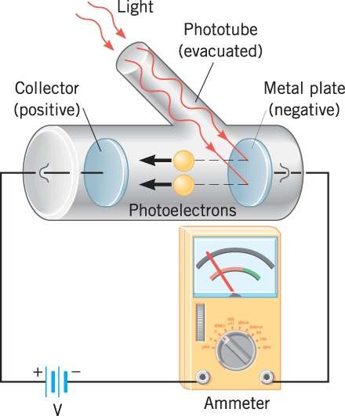
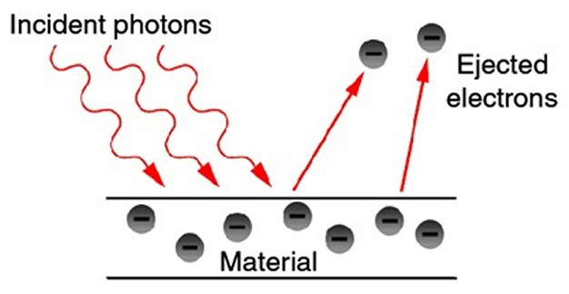
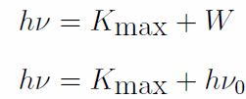

Photoelectric effect
In 1905 Einstein published a paper explaining photoelectric effect using light quanta. He got the Nobel prize in 1923. Kinetic energy of an electron can be written as:
W is the work function, i.e. minimum amount of energy required to release electron from the metallic surface. It is different for different materials.

Slide 25
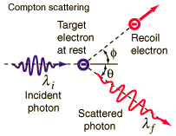
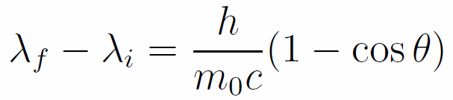
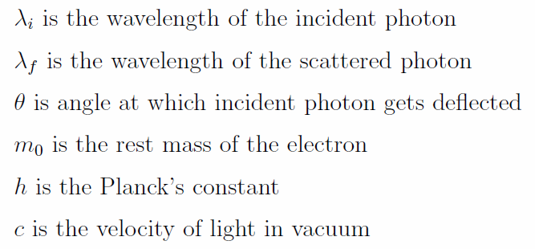
Compton scattering

Slide 26
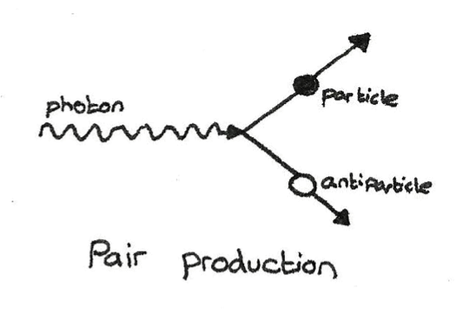
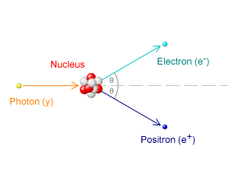
Pair production
Feynman diagram

Slide 27
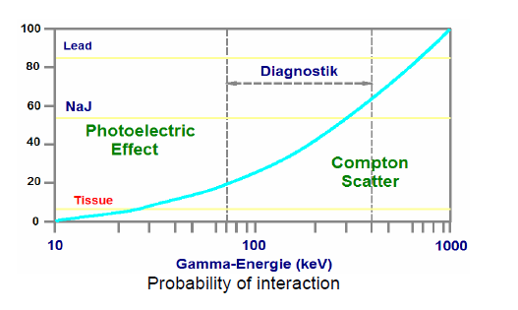
Regimes

Slide 28

Attenuation coefficient (μ)
I=I₀ exp(-μ_{m}x)
The attenuation can be decomposed into-

Slide 29
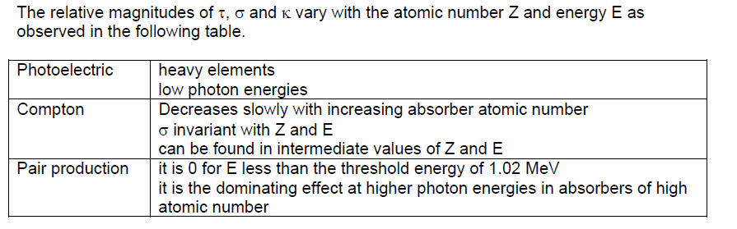
Relative strengths

Slide 30
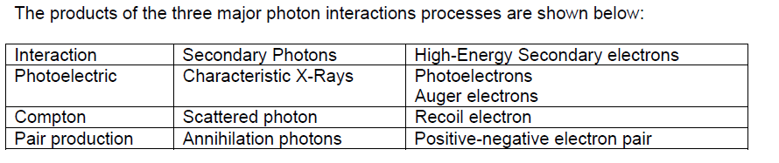
Products of interaction

Slide 31
Detection of ϒ-ray

Slide 32
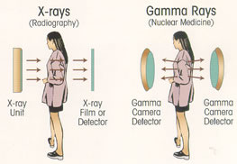

Slide 33
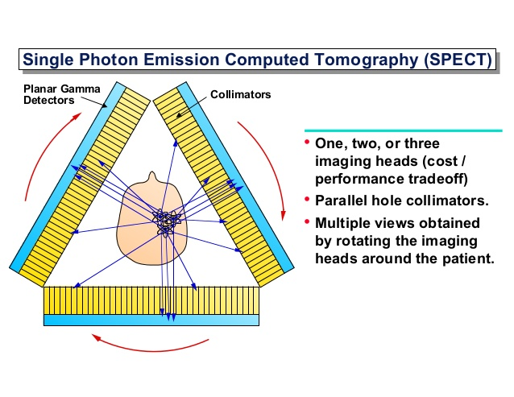
Collimator

Slide 34
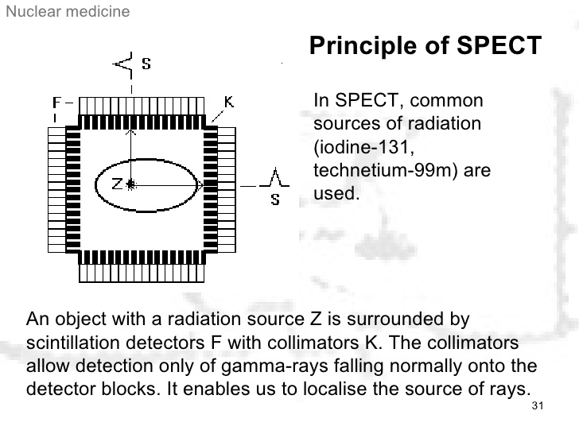
Collimator

Slide 35
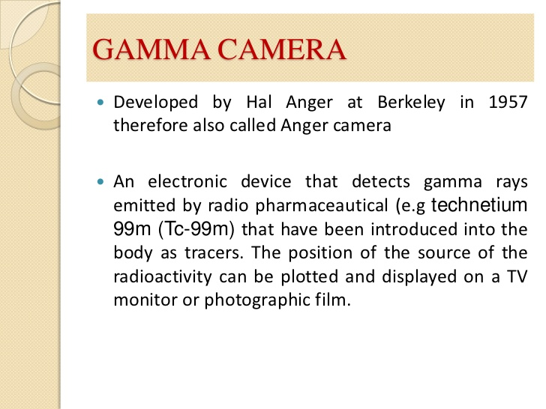
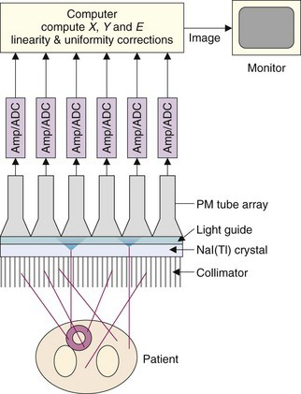
Gamma camera: block diagram

Slide 36
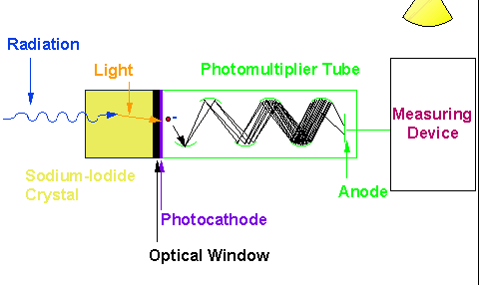
Scintillation

Slide 37
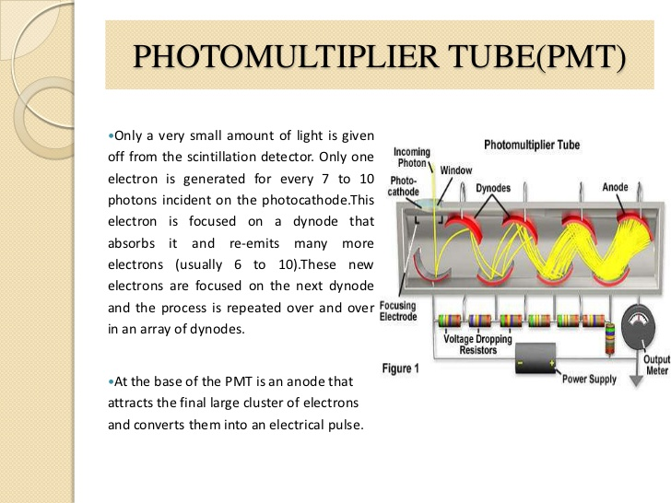

Slide 38
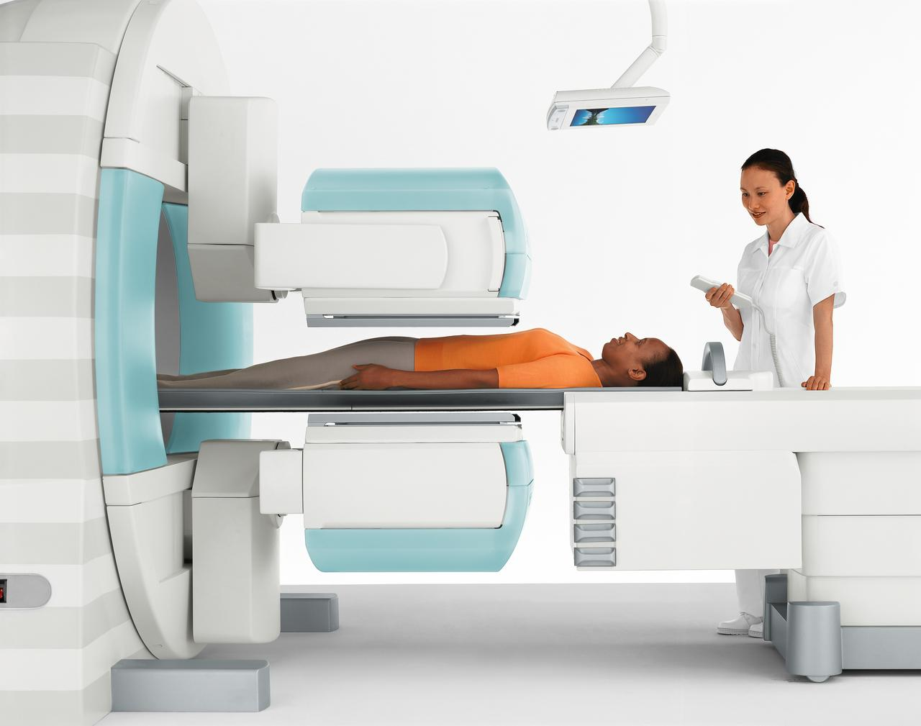
Dual head SPECT

Slide 39
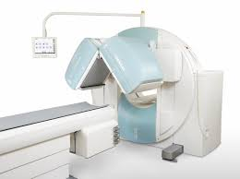
Dual head SPECT

Slide 40
Positron emission tomography (PET)

Slide 41
Positron emission tomography (PET)
Nuclear imaging modality
It is used to see metabolic processes in the body
Detects pairs of gamma-rays emitted by a positron-emitting radionuclide
3D images of tracer concentration within the body are reconstructed using computer analysis

Slide 42
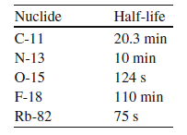
Positron emitting isotopes
The most commonly used isotopes are
C-11, N-13,O-15, F-18, Rb-82
These are relatively short-lived, which enables optimal use of imaging photons while keeping patient radiation dose low. Furthermore, many of these isotopes can be incorporated into biological substrates (glucose, H₂O, NH₃, CO₂, O₂, etc.) and pharmaceuticals, without altering their biological activity.

Slide 43
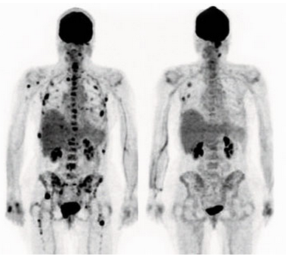
Whole body images

Slide 44
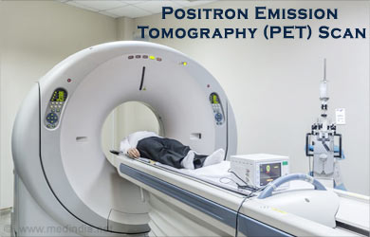
Machine

Slide 45
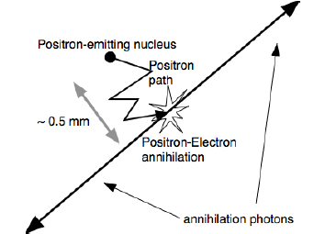
Positron emission
General principle of PET imaging: decay of radionuclide, positron (β+) emission, multiple scatter in tissue, annihilation with electron, and production of two back-to-back 511 keV annihilation photons.

Slide 46
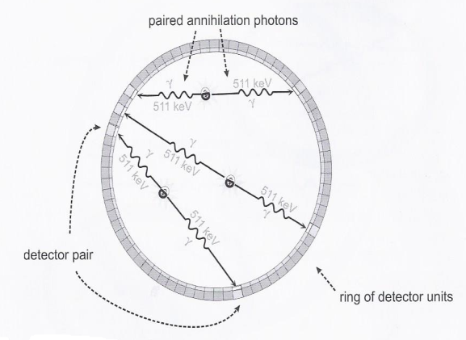
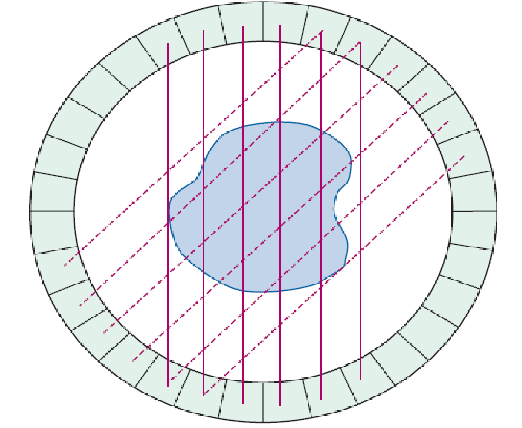
Coincidence detection
Basic principles of annihilation coincidence detection
Simultaneous detection of two annihilation photons allows PET to localize their origin along a line between the two detectors, without the use of absorptive collimators. This mechanism is called annihilation coincidence detection (ACD)
The ability of ACD to localize events on the basic of coincidence timing, without the need for absorptive collimation, is referred to a electronic collimation
Notes:
I have to add some introduction
History of gamma camera and uses

Slide 47
Steps
Basic principles of annihilation coincidence detection
Coincidence logic is employed to analyze the signals from the opposing detectors.
For many PET scanners, this is accomplished by having the electronics attach a digital “time stamp” to the record for each detected event.
The coincidence processor examines the time stamp for each event in comparison to events recorded in the opposing detectors.
A coincidence event is assumed to have occurred when a pair of events are recorded within a specified coincidence timing window , which typically is 6-12 nanoseconds.
LOR- Line of response
Notes:
I have to add some introduction
History of gamma camera and uses

Slide 48
Time window
The annihilation may occur closer to one detector surface than the other, which will result in a slight but measurable delay of one photon, where the photons travel at the speed of light, or 1 m in 3.3 ns. Most important for temporal mismatches is the finite timing resolution of the detector, i.e. its timing uncertainty, which arises from the decay time of the scintillation in the crystal and the processing time of the PMT signals. These effects lead to the use of a coincidence time window on the order of 6-12 ns.

Slide 49
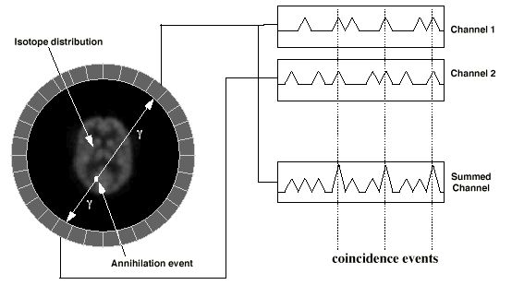
Coincidence circuit (Block diagram)

Slide 50
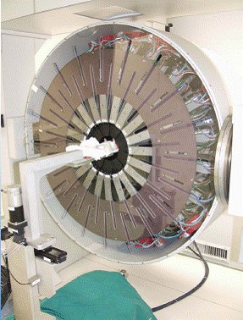
Inside

Slide 51
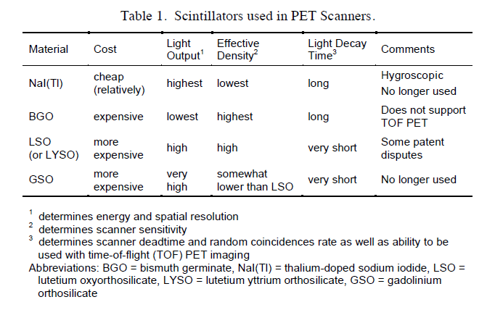
Scintillation detectors
In scintillation crystals, the incident annihilation photon (nominally 511,000 eV energy) interacts and creates tens of thousands visible wavelength photons (about 1 eV energy each) in a very short flash or 'scintillation'. The number of scintillation photons produced in the crystal is proportional to the energy deposited by the annihilation photon.

Slide 52
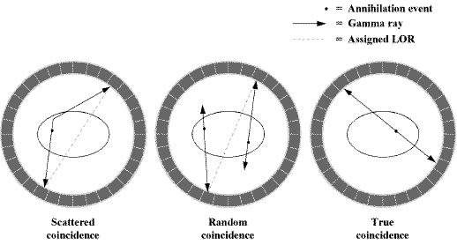
Artifacts
True coincidence: The coincidence arise from a pair of photons produced from the same annihilation event and that the annihilation event occurs somewhere within the coincidence line between the detectors. Theses events are called true coincidence
Random coincidence: Occur when annihilation photons from two unrelated positron annihilation events are detected in two different detectors, within the coincidence timing window, and recorded as a single coincidence event. This can happen if one photon from each annihilation event is detected in each detector element.
Scattered coincidence: These occur when one (or both) of the photons from an annihilation undergoes scattering and is detected in a detector other than the one that would be appropriate for a true coincidence event.

