Slide 1
Radon Transformation and Sinogram
and
Fourier slice theorem or Central slice theorem or Projection slice theorem

Slide 2
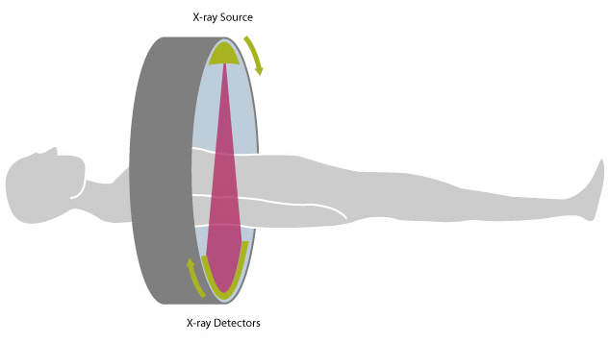
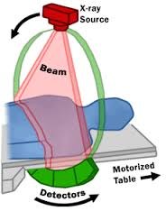
X-ray CT source-detector geometry
Array of detectors
Scintillation detector- convert X-ray photon into visible-light photon and then into electrical signal

Slide 3
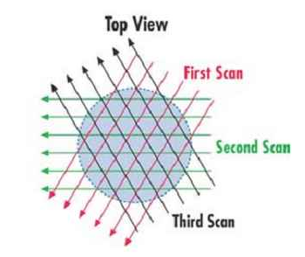
Measurement setup
Array of detectors
What are array detectors?

Slide 4
Equation of a straight line
Equation of AB-
y
P₁
OA = a
OB = b
OQ = s
B
P₂
………………. (1)
Q
s
P₃
φ
P₄
O
A
x
Express a and b in terms of s and φ
s = a cos (φ)
s = b sin (φ)
………………. (2)
Now Eq. (1) becomes
………………. (3)

Slide 5
Radon transformation
y
B
Detector
O
A
x
Detector
g(x, y)

Slide 6
Radon transformation
y
B
O
A
x
Detector
g(x, y)
Detector

Slide 7
Radon transformation
y
B
Q
s
φ
O
A
x
s
Detector
g(x, y)
p(s, φ)
φ
O

Slide 8
Radon transformation
Dirac delta function
Data collected by the detector
2D function or the imaging region
Notation-
The Dirac delta function ensures that all the points of the function g(x, y) along the line AB contributes to the data collected at the detector placed at a distance s from the origin and oriented at an angle φ with respect to the x-y coordinate system.

Slide 9
BP image using all projections
BP algorithm in terms of Radon transformation
y
B
Q
s
BP from a single view angle
φ
O
A
x
s
Detector
g(x, y)
p(s, φ)
φ
Inverse Radon transformation
O
Integrate over 180, the other half doesn’t give extra information

Slide 10
Important points
The Radon transform is a mapping from the Cartesian rectangular coordinates (x, y) to a distance and an angle (s, φ), also known as the polar coordinates.
In 1917, Johann Radon proved that an object can be reconstructed exactly from an infinite number of projections, when taken over 360 degree around the object.
The Backprojection algorithm can be mathematically presented in terms of the inverse Radon transformation. Therefore, it is an analytical method and that is why it is very fast.

Slide 11
Sinogram
P₂
O₂
y
P=point source
φ₂
P
P₁
r
(2)
O₁
O
x
φ₁
(1)
(3)
P₃
O₃
φ₃
P₁O₁=r sin φ₁; P₂O₂=r sin φ₂; P₃O₃=r sin φ₃

Slide 12
Sinogram
S₂
Detectors
y
S₁
N₂
O₂
Detectors
(2)
O
x
N₁
O₁
S₃
(1)
N₃
O₃
Detectors
(3)

Slide 14
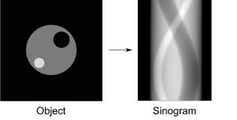
Sinogram
s
φ=0⁰
φ=180⁰
Plot/stack of detector data
Neat and clean version

Slide 15
Sinogram
φ=90⁰
φ=135⁰
φ=45⁰
s
φ=0⁰
φ=180⁰
φ=0⁰
φ=180⁰
Plot/stack of detector data
Contains details but clumsy version

Slide 16
Fourier slice theorem or Central slice theorem or Projection slice theorem

Slide 17
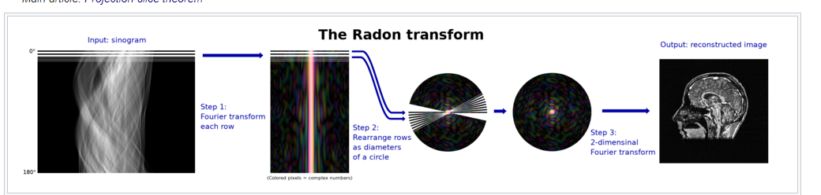
Sinogram to image formation

Slide 18
Illustration

Slide 19
Illustration

Slide 20
Application in image reconstruction
Therefore, collect the projections of a 2D object from different-different angles, take the Fourier transform of the individual projections, arrange them in a 2D grid as shown in the previous slide and then take the 2D inverse Fourier transform which will provide image of the object.

Slide 21
The Fourier slice theorem step by step

Slide 22
Step 1
Place the object and the detectors
(1)
(2)
(3)
(4)

Slide 23
Step 2
Perform the measurements
(1)
(2)
Always one sided because counts are always positive
(3)
(4)

Slide 24
Step 3
Obtain 1D Fourier transforms of individual measured data
(1)
(1)
FT
(2)
(2)
FT
(3)
(3)
FT
(4)
(4)
FT

Slide 25
Step 4
Stack the Fourier transforms properly

Slide 26
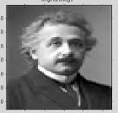
Step 5
Take the inverse Fourier transform in 2D
IFT

Slide 27
Dirac delta function

Slide 28
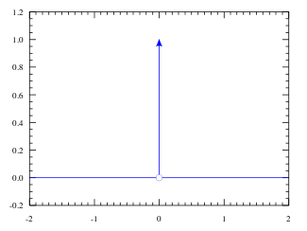
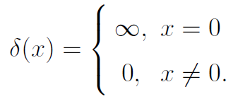
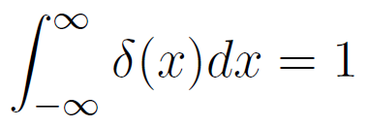
Mathematical representation
Can be thought as a line which is zero everywhere and infinite at the origin
As it is a probability distribution function then-

Slide 29
Common forms of the Dirac delta function

Slide 30
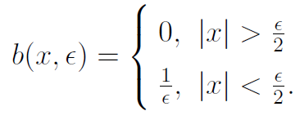
Box function as a delta function
Y
b(x, ε)
ε
1/ε
O
X
x

Slide 31
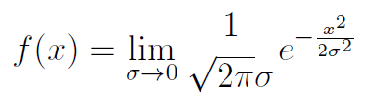
Gaussian function as a delta function

Slide 32
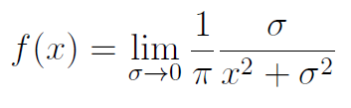
Lorentzian function as a delta function

Slide 33
Triangular function as a delta function
1/ε
2ε
Area under the curve is = 2 x base x height = 2 x 2ε x (1/ε) = 1.
So it satisfies the condition of the delta function.
If we impose ε → 0, the triangular function becomes a delta function.

Slide 34
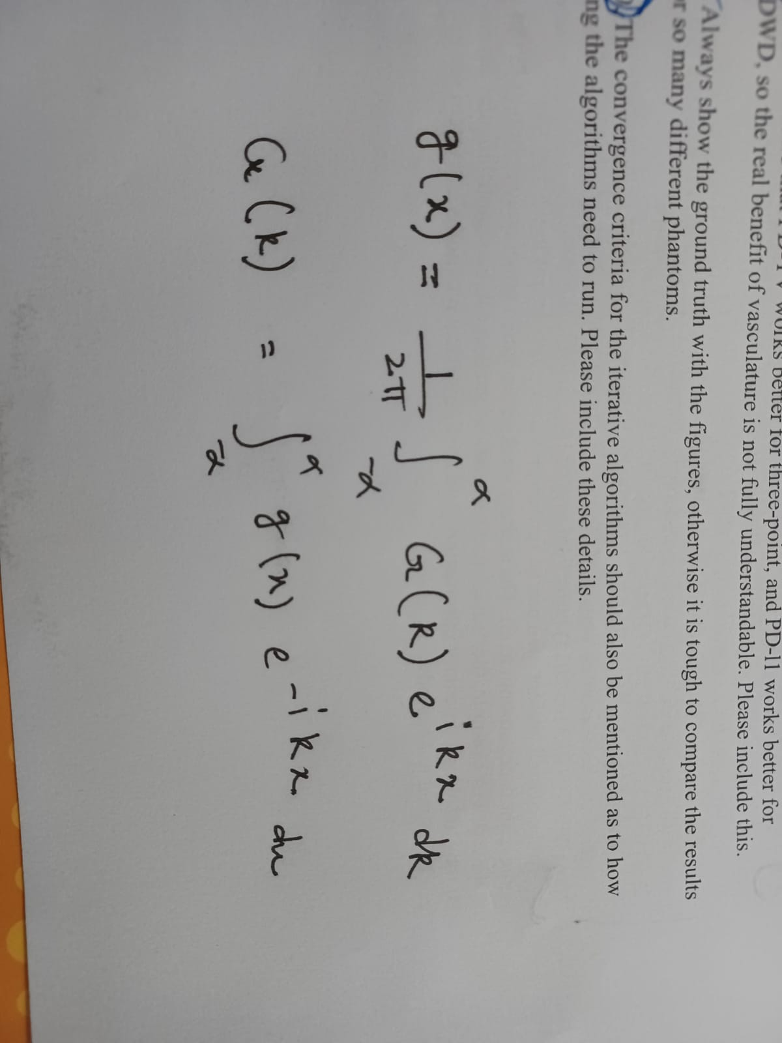
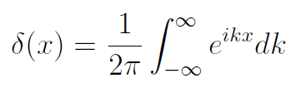
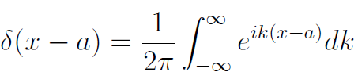
Integral representation of a delta function
Fourier transformation
Inverse Fourier transformation
Integral representation generalization-

Slide 35

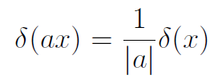
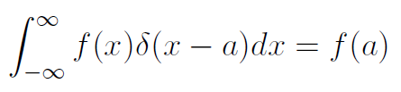
Some properties of the delta function
Even function (symmetric)-
Scaling-
Shifting-

Slide 36
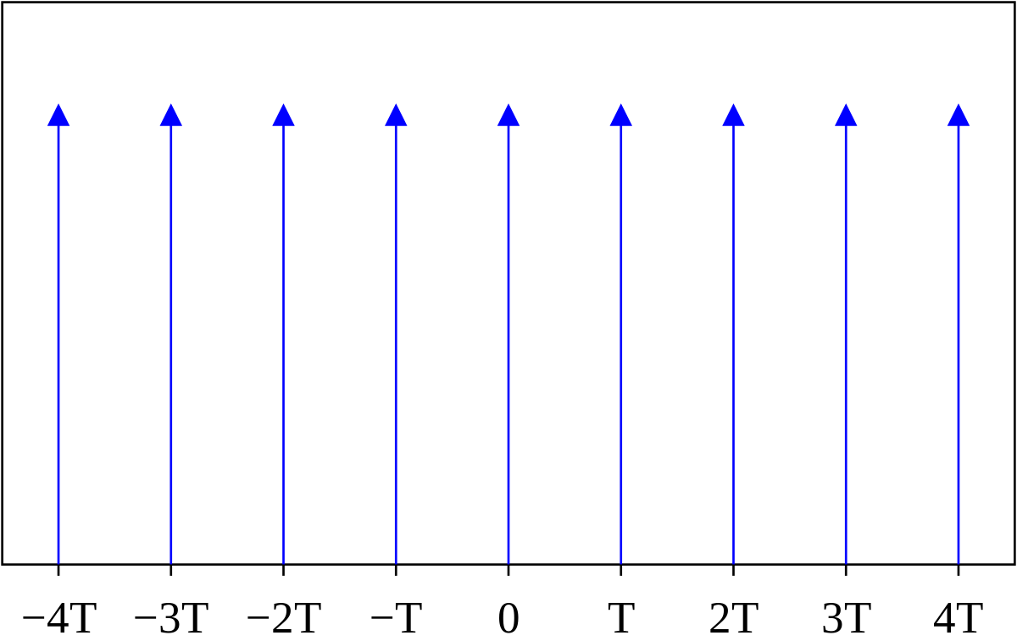

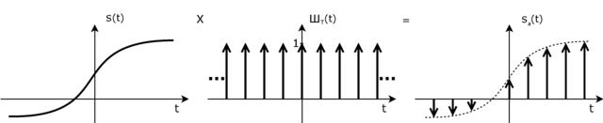
Dirac comb

Slide 37
Introduction to Delta function
It is a generalized function or a distribution
Introduced by Physicist Paul Dirac
Denoted by δ
Very very important and widely used function
In physics it is used to model mass density/charge density of a point object
In signal processing it is used to model impulse
Kroncecker delta function which is a discrete analogue of the Dirac delta function.

