Slide 1
OCT

Slide 2
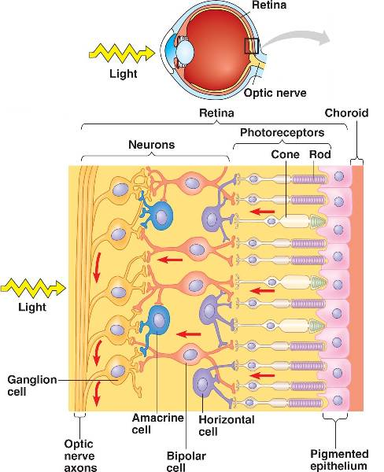
Eye/retina imaging
Retina contains different types of cells arranged as layers.
Rod, cones, ganglion and bipolar cells.
Converts optical signal to neural signal.
Optic nerve carries from retina to brain for processing.

Slide 3
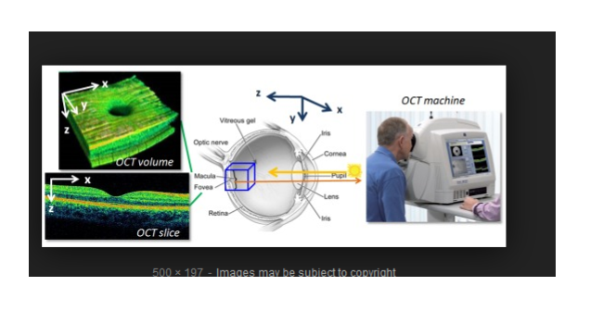

Slide 4
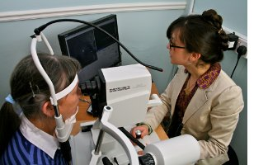
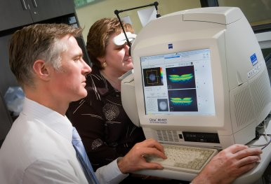
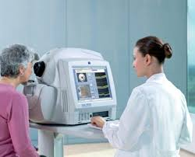
OCT set up

Slide 5
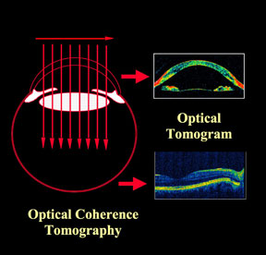
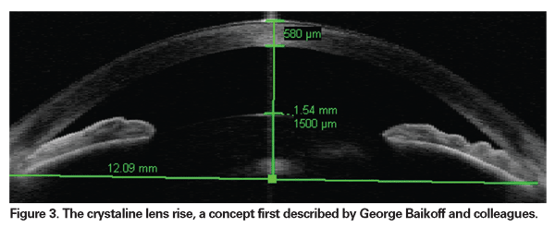
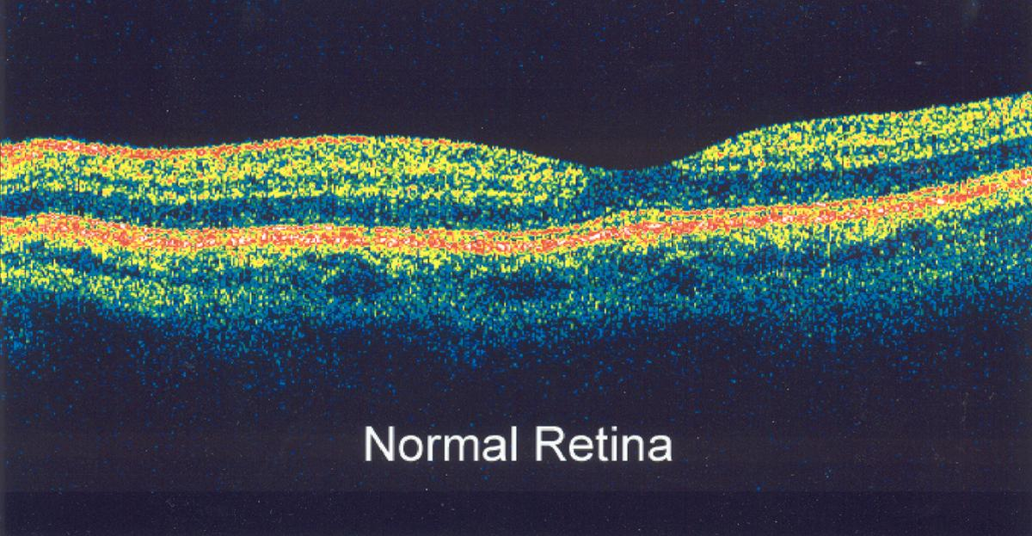
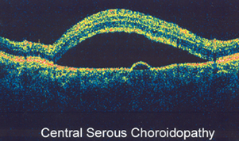
Visualization of tissue layers with OCT

Slide 6
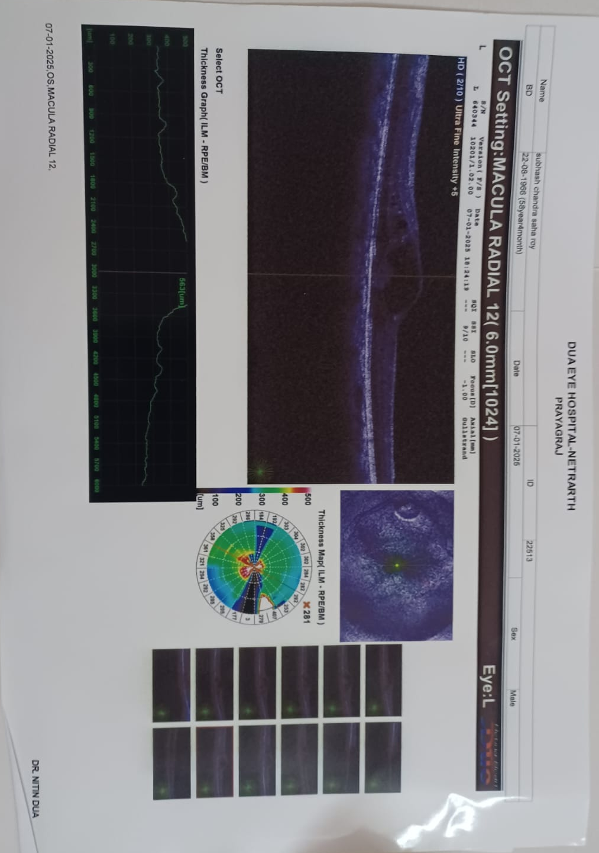
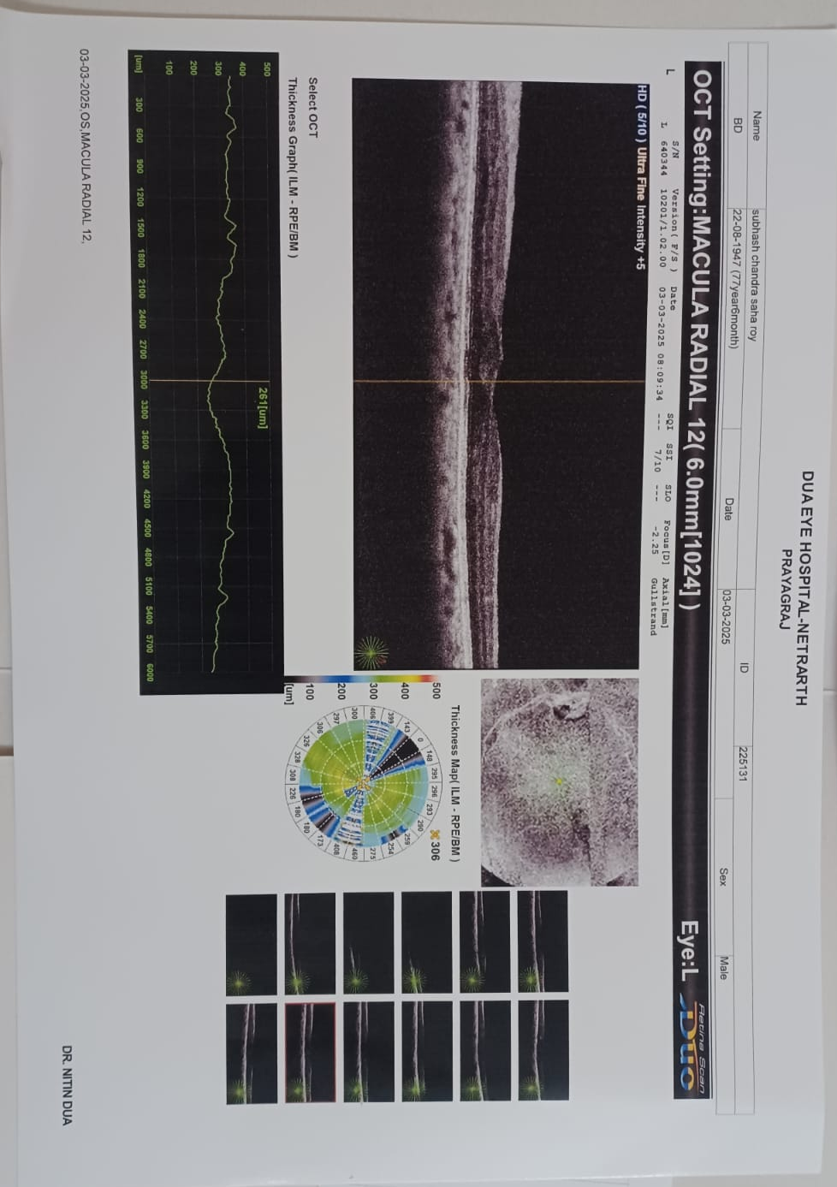

Slide 7
OCT vs. standard imaging
Resolution (log)
1 mm
Standard clinical
Ultrasound
High frequency
100 μm
10 μm
OCT
Confocal microscopy
1 μm
Penetration depth (log)
1 mm
1 cm
10 cm

Slide 8
Time domain optical coherence tomography

Slide 9
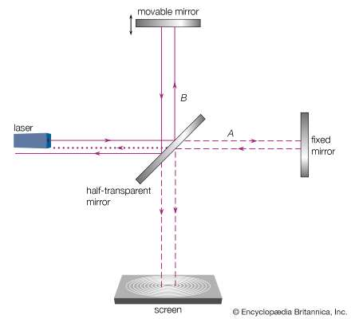
Michelson Morley Experiment Set up 1
It was performed to prove Einstein’s special theory of relativity.
Laser Interferometer
Gravitational-Wave Observatory (LIGO)
Arm length = 4 km

Slide 10
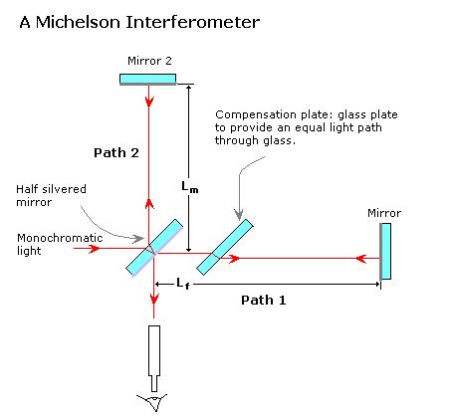
Michelson Morley Experiment Set up 2

Slide 11
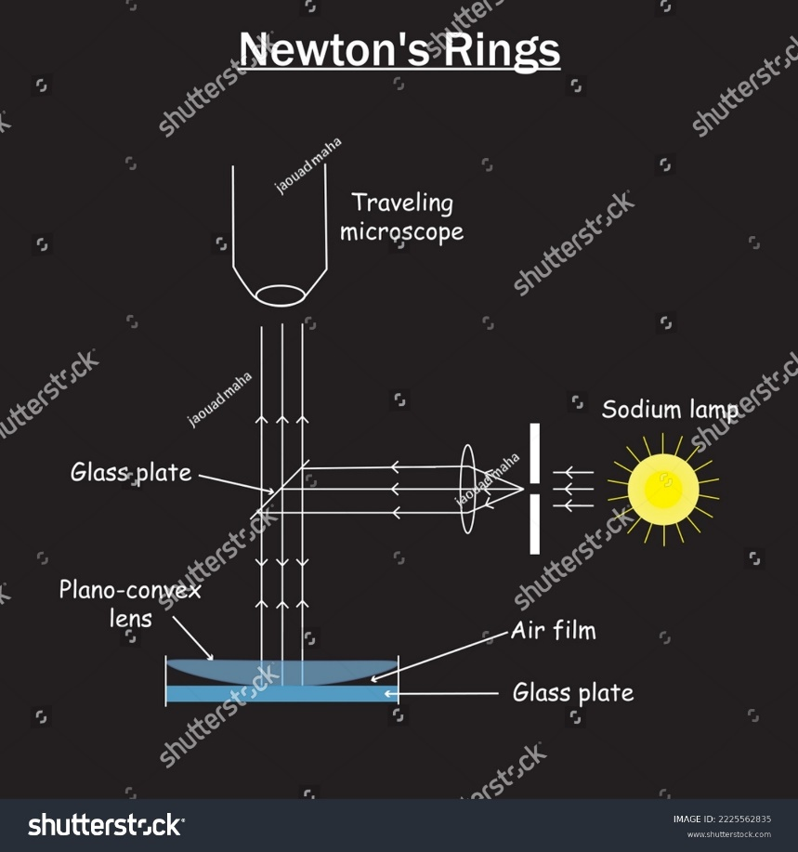
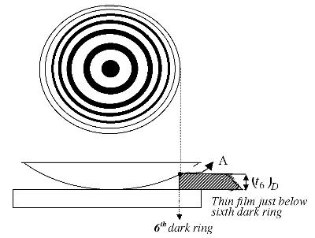
Newton’s ring- Fringe pattern
A thin, varying air film forms between a plano-convex lens and a glass plate. When monochromatic light is shone vertically, light reflecting from the top (air-to-glass) and bottom (glass-to-air) of the air film interferes.

Slide 12
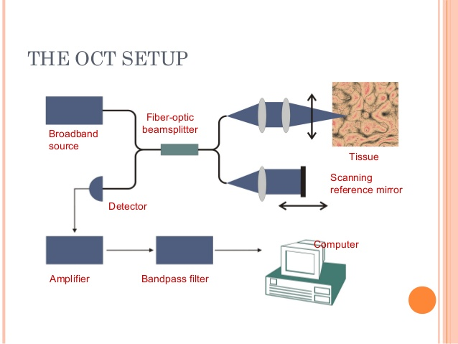
OCT set up with fiber-optic delivery

Slide 13
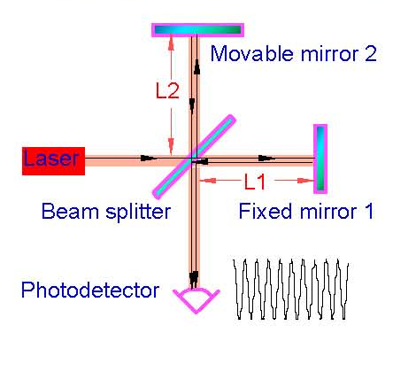
Michelson Morley Experiment
L_{R}
L_{S}

Slide 14


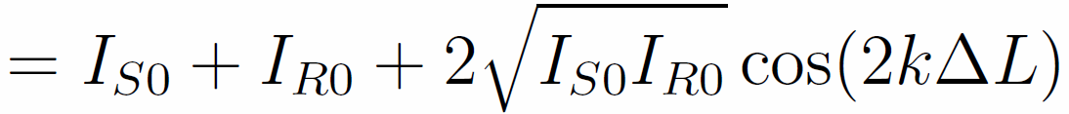
Michelson Morley Experiment
L_{R}
L_{S}
Constructive interference
Long coherence length
Destructive interference

Slide 15
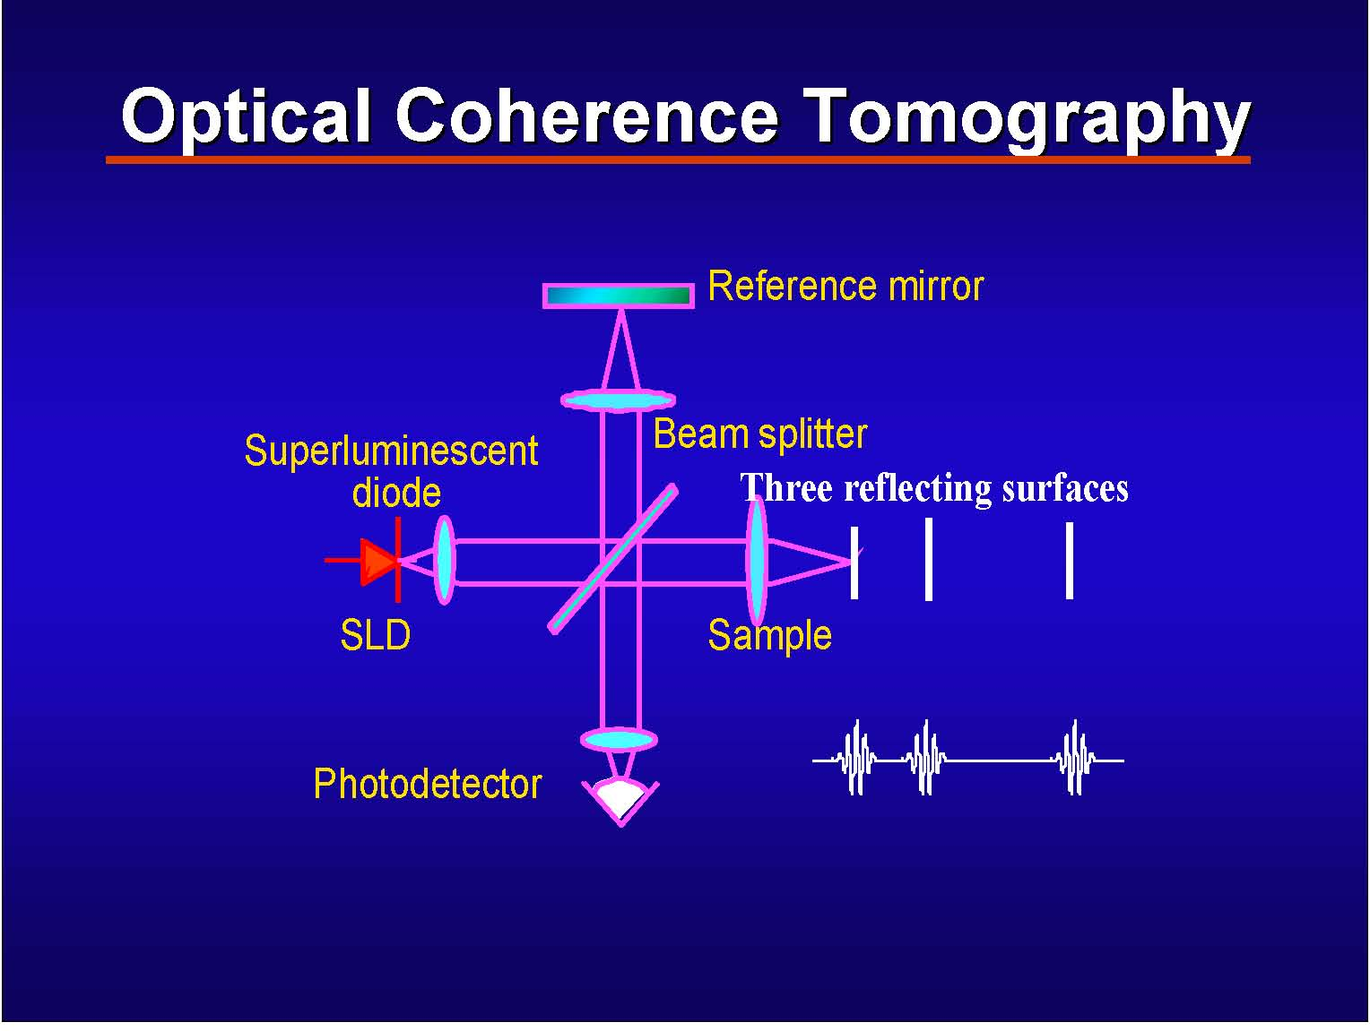
Short coherence length

Slide 16
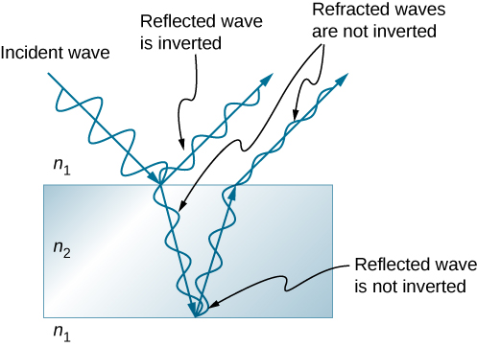
Phase change of light
n₂>n₁

