Slide 1
HOW THE DATA IS COLLECTED, AND WHAT IS NORMAL
Most signals come off one garment, the Bio-Monitor shirt flown on the ISS since 2019; the rest takes two minutes each morning. "Your baseline" is the median of your 14 pre-flight days.
SIGNAL | DEVICE | HOW | HOW OFTEN | NORMAL
Heart rate, HRV | Bio-Monitor shirt | 3-lead ECG woven into the fabric | Continuous | 60-100 bpm (AHA); HRV against your baseline
Breathing rate | Bio-Monitor shirt | Stretch bands on chest and abdomen | Continuous | 12-20 per minute
Blood oxygen | Bio-Monitor headband | Pulse oximeter (red and infrared light) | Continuous | 95-100%; below 90% is low
Skin temp, activity, sleep | Bio-Monitor shirt | Thermistor and accelerometer | Continuous | Fever 38.0 °C+; sleep 7 h+ (8.5 h scheduled)
Blood pressure | Arm cuff | Seated, 5 min rest, two readings | Every morning | <120/80; 130/80 stage 1; 140/90 stage 2
Blood glucose | Finger-stick meter | Fasting, before breakfast | Every morning | 70-99 mg/dL fasting
Body mass | SLAMMD mass device | Spring oscillation (nothing weighs in orbit) | Weekly | Within 5% of your baseline
Radiation dose | Personal dosimeter | Worn on the body, read into the tablet | Daily reading | ~1.8 mSv/day transit, 0.6 Mars; 600 mSv career
Reaction time, lapses | Tablet | 60 s reaction test on the screen | After waking | Your baseline; a lapse is 355 ms or slower
Mood, stress, symptoms | Tablet | Check-in: 1-5 scales and a symptom list | Every morning | Your baseline; red-flag symptoms urgent
Notes:
Where each number comes from. Sources: CSA Bio-Monitor; NASA NTRS 20190000238; ACC/AHA 2017; Cleveland Clinic; Mayo Clinic; CDC; ADA; AASM and Barger 2014; NASA-STD-3001; MSL/RAD; Basner 2011. SLAMMD is NASA's Space Linear Acceleration Mass Measurement Device.

Slide 2
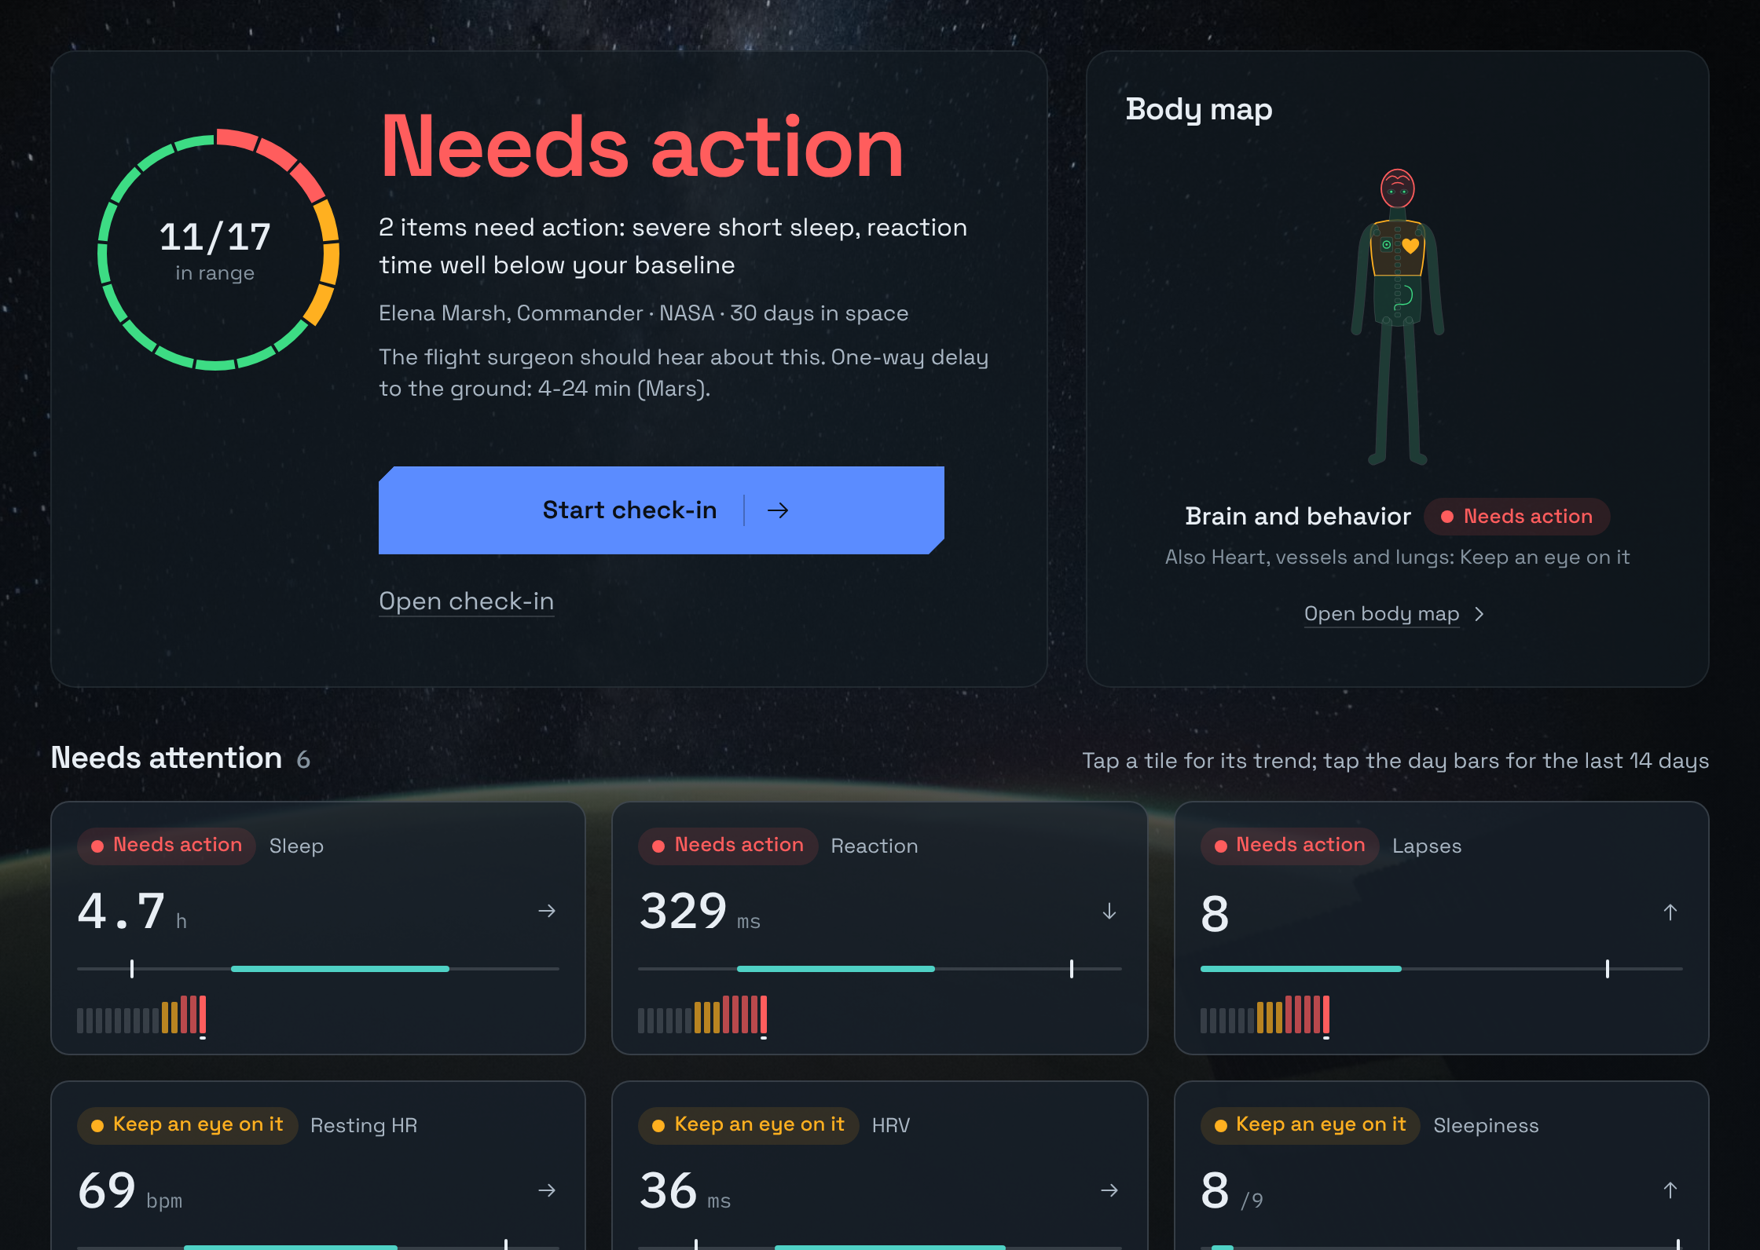
THE RESULT: ONE SCREEN PER ASTRONAUT
WHO
Portrait, name, role, agency and days in space, top left.
HOW AM I TODAY
One ring, green, amber or red, with a plain-language summary.
EVERY SIGNAL
Sixteen tiles in four groups, each with a two-week sparkline over the baseline band.
WHAT TO DO
Alerts explain the rule, cite the source, give a checklist, and draft the surgeon message.
Notes:
The dashboard for Elena Marsh, a simulated commander on mission day 30. All crew data is simulated.

