Slide 1
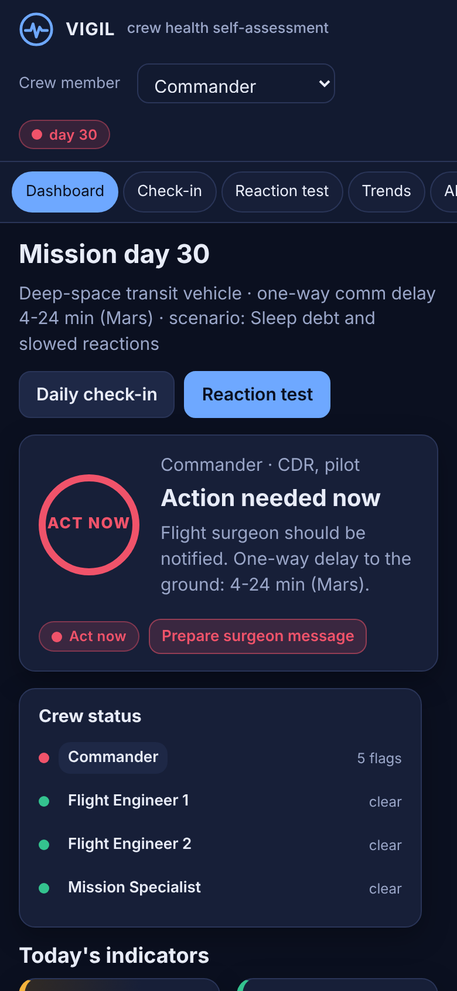
VIGIL
Crew health self-assessment and decision support for long-duration missions
Les Tigres de Bethesda
NASA Space Apps Challenge 2026
Create Health Monitoring Software for Astronauts on Space Missions
Notes:
VIGIL: crew health self-assessment and decision support. Built for the 2026 Space Apps challenge on astronaut health monitoring software.

Slide 2
24 minutes to Mars
On a Mars transit, a question to the flight surgeon takes up to 48 minutes round trip. The crew has to assess and act first; the ground confirms later.
4-24 min
5 hazards
6.1 h
one-way signal delay to Mars (NASA Ames)
radiation, isolation, distance, gravity, closed environment (NASA HRP)
average sleep on ISS against 8.5 h scheduled (Barger 2014)
Each hazard shows up first as a small shift in an everyday number: a slower reaction time, a shorter night, a few extra beats per minute at rest. Crews need software that notices those shifts for them and says what to do.
Notes:
NASA Human Research Program lists five hazards. The distance from Earth means telemedicine in real time is impossible on a Mars transit.

Slide 3
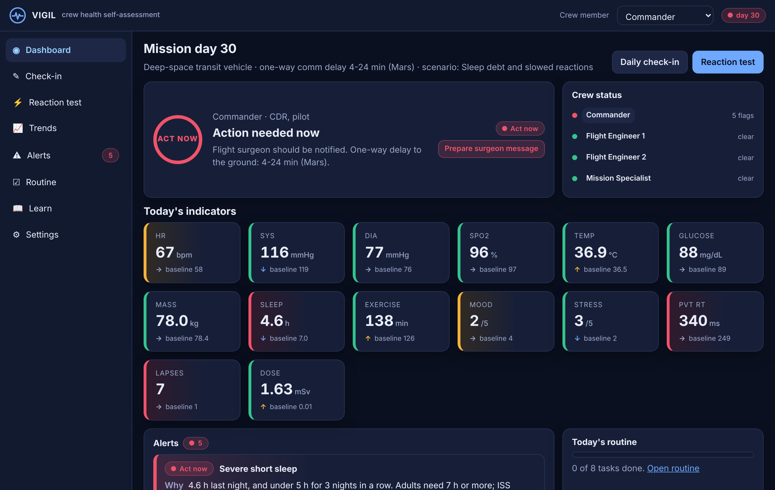
One screen, one answer
14 indicators
Blood pressure, heart rate, glucose, temperature, sleep, mood from the brief, plus SpO2, mass, exercise, stress, reaction time, lapses and radiation dose.
Green, amber, red
Nominal, Watch, Act now. Each tile shows today's value and the person's own baseline.
Whole crew
Four crew members, one status each, one click to switch.
Notes:
Dashboard for the Commander on mission day 30 in the sleep-debt scenario. Red ring means act now and notify the flight surgeon.

Slide 4
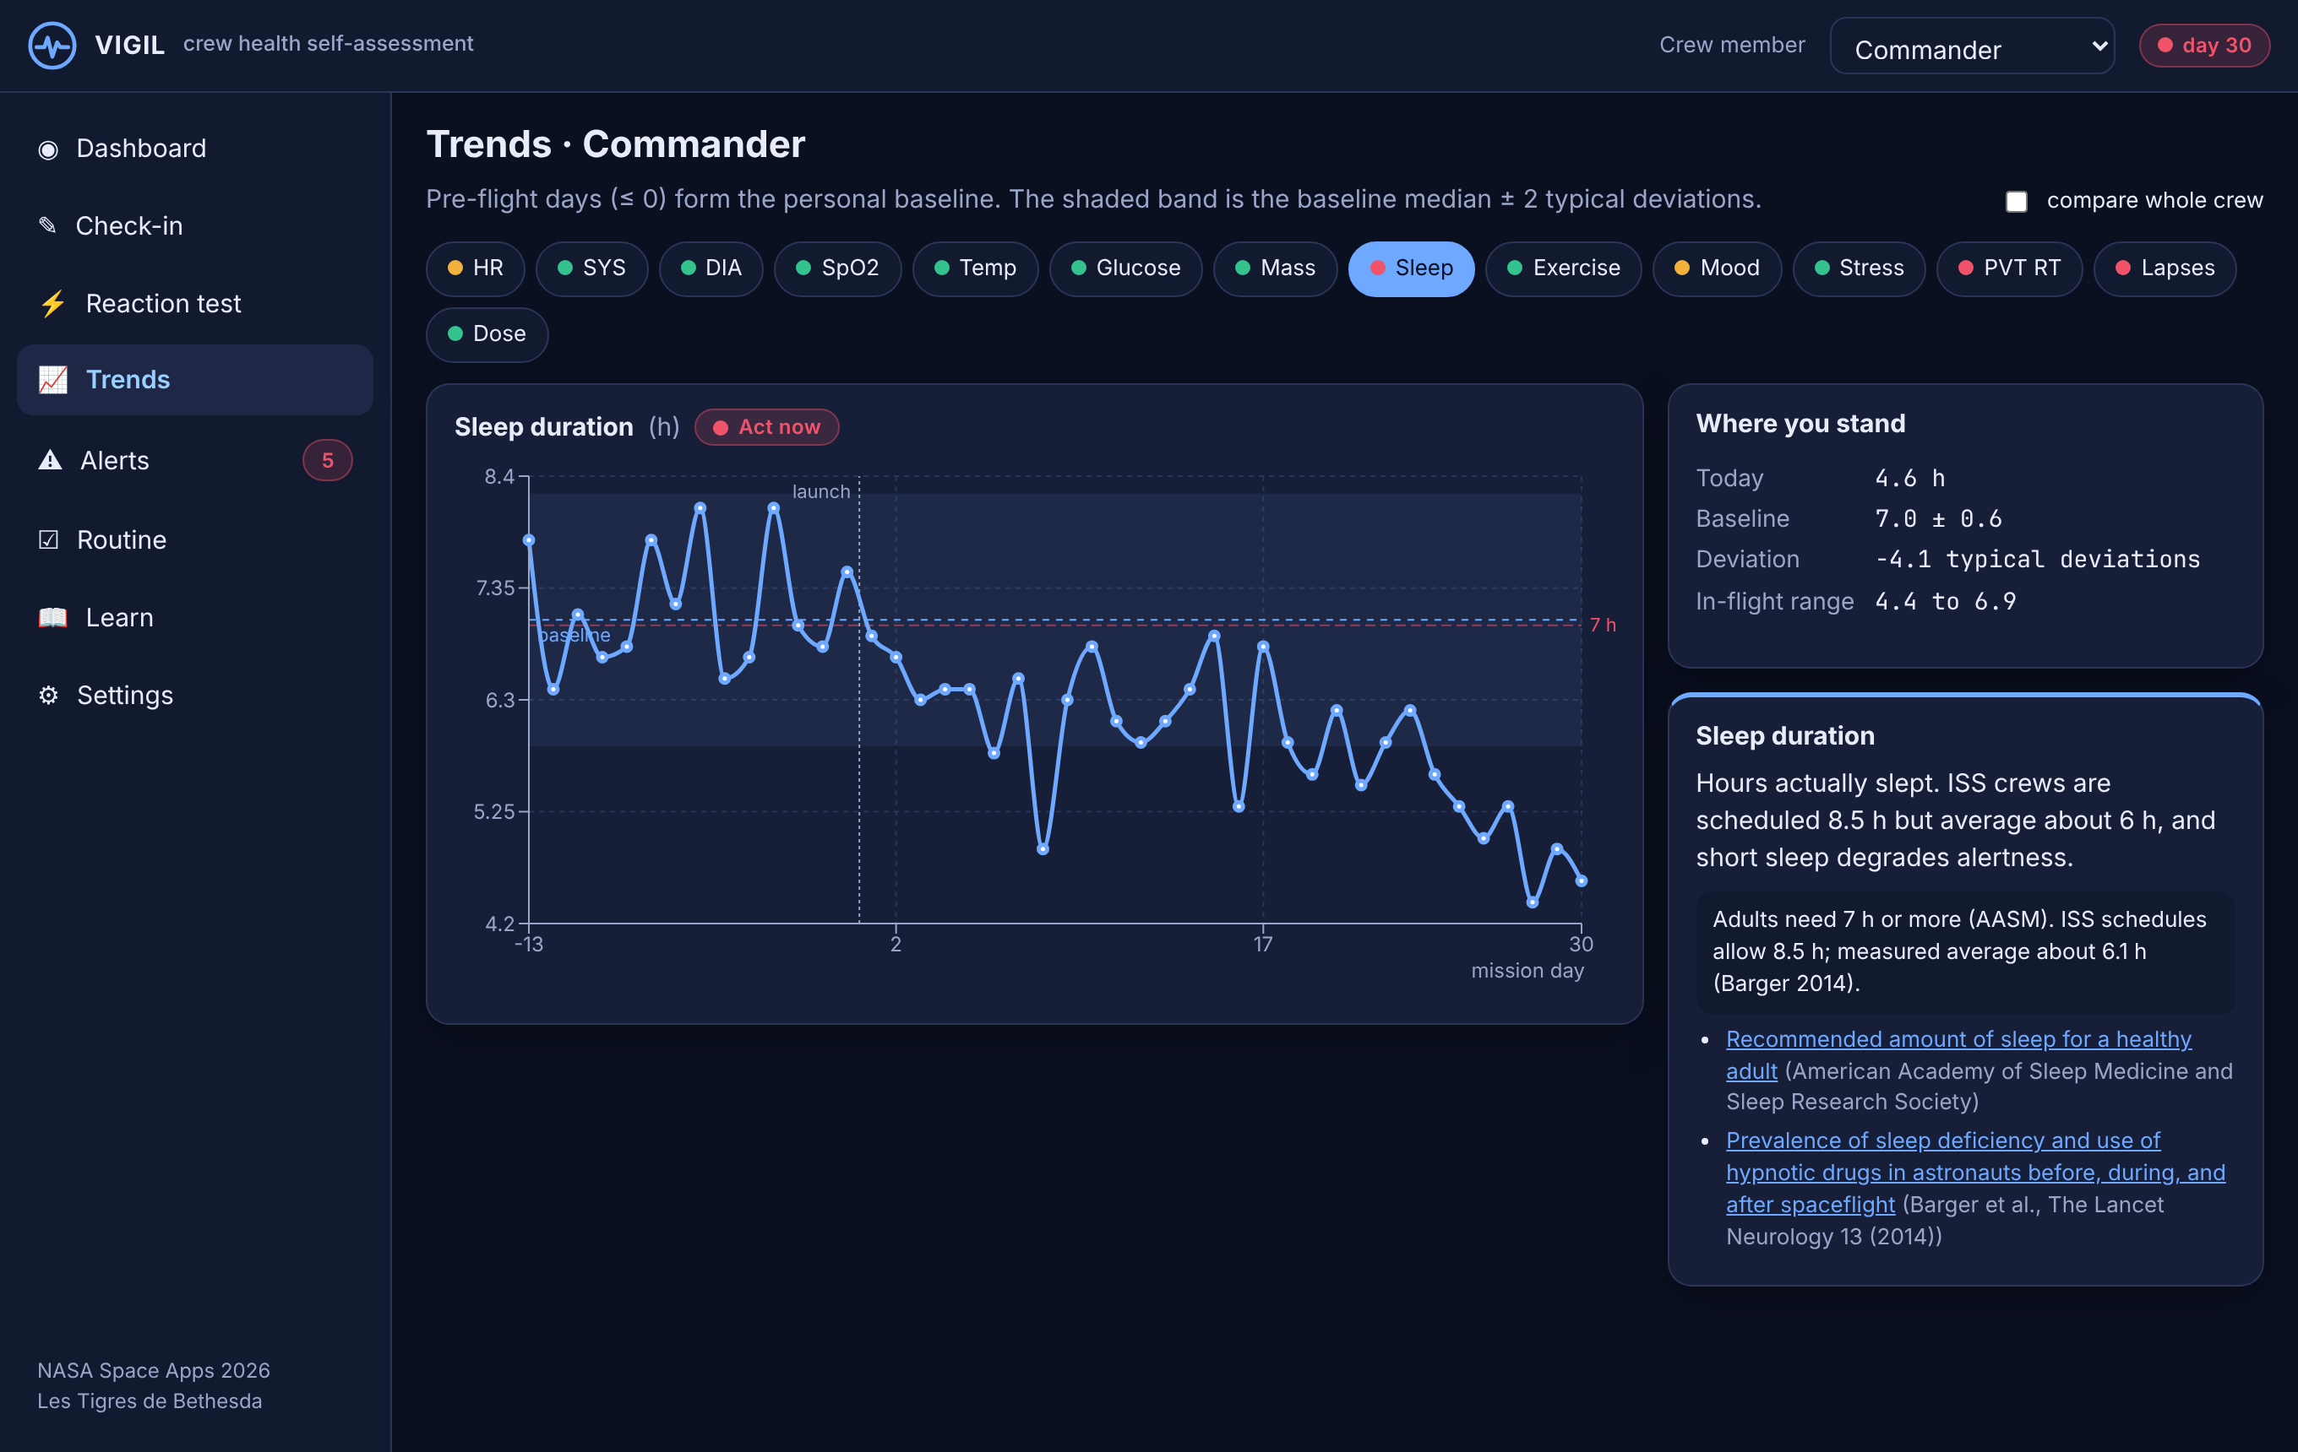
Judged against you, not the average
Personal baseline
14 pre-flight days give a median and a robust spread per indicator. The band on the chart is that baseline.
Published cut-offs
ACC/AHA, CDC, ADA, AASM and NASA-STD-3001 limits are drawn on the same chart.
Why both
A resting heart rate of 95 is normal for most adults and abnormal for someone whose baseline is 55.
Notes:
Sleep trend. Pre-flight days left of the launch line, the amber window is the scenario, the red dashed line is the 7-hour AASM reference.

Slide 5
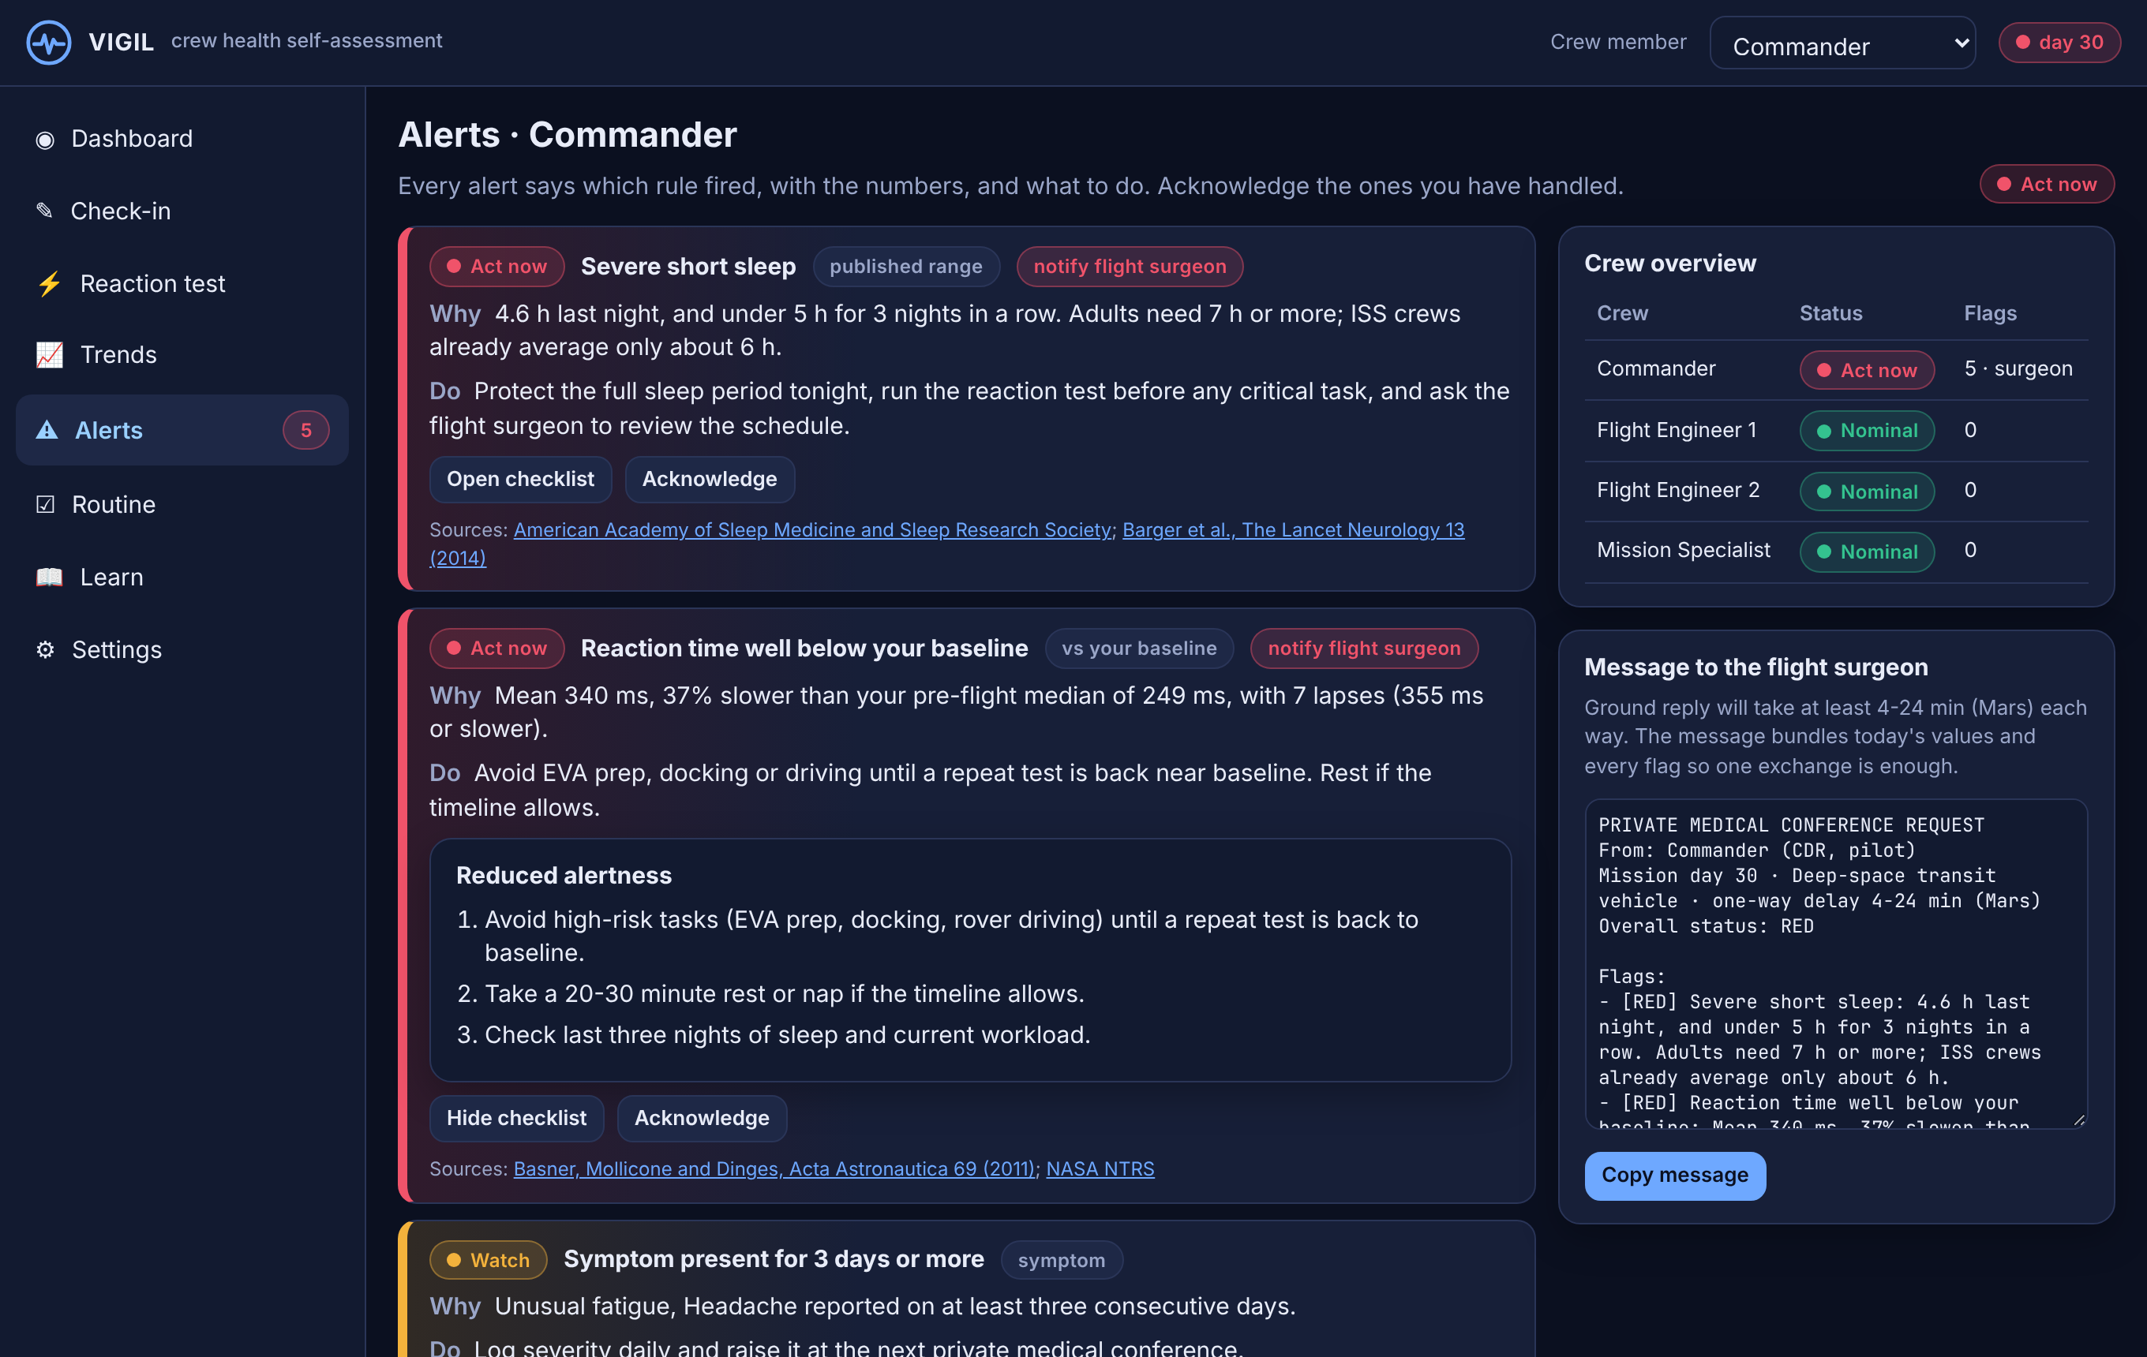
Every alert explains itself
Why
The rule, the numbers and the source behind every flag.
Do
A checklist of concrete next steps. Alerts that need the ground say so.
One message
The day's values and flags packaged for the flight surgeon, so one exchange is enough across a 48-minute round trip.
Notes:
Alerts list with the reaction-time checklist open. The right column holds the crew overview and the generated message to the flight surgeon.

Slide 6
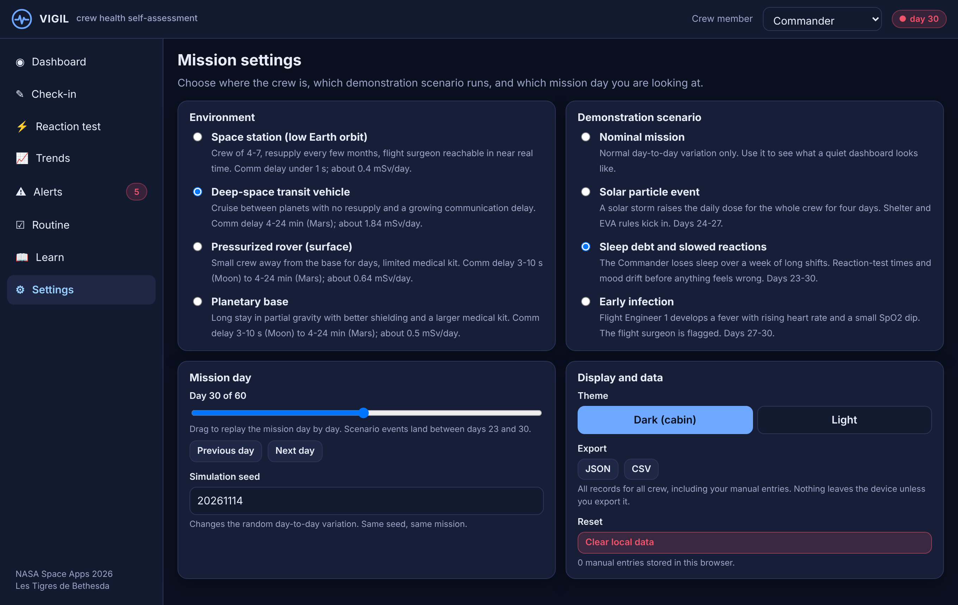
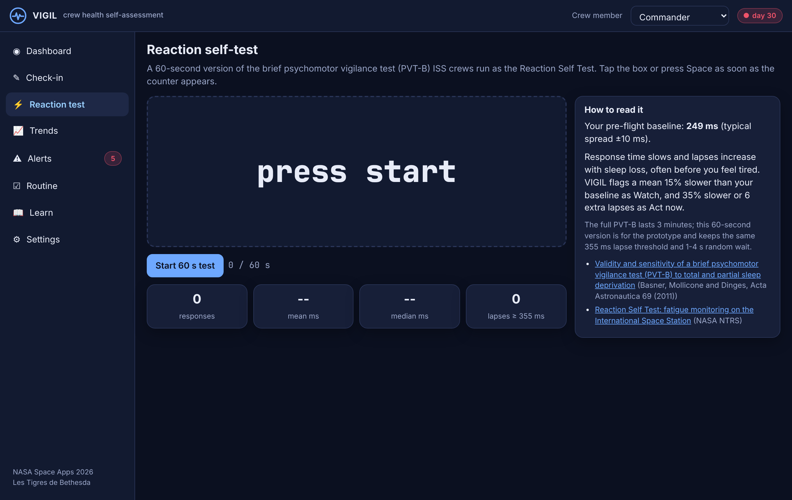
Built for the whole mission
Station, transit, rover or base: comm delay and expected daily dose from measured values.
Four scenarios and a mission-day slider to replay any day.
60-second reaction test, same family as the ISS Reaction Self Test.
Offline, on-device, exportable. Phone, tablet or laptop.
Notes:
Settings: four environments, four scenarios, mission day slider, theme and export. Top right, the reaction test.

Slide 7
What is real, and what is next
Real
Next
Every threshold cites NASA-STD-3001, NASA HRP, NASA NTRS, MSL/RAD, ACC/AHA, CDC, ADA, AASM or a peer-reviewed paper.
Comm delays and daily doses are measured values, not guesses.
Crew data is simulated and labelled as such; no real astronaut records.
Decision support, not diagnosis. Operational limits stay with the flight surgeon.
Bluetooth cuff, oximeter and wearable input.
Ground-side view for the flight surgeon with per-crew limits.
Baselines informed by NASA OSDR human datasets.
Validate the 60-second reaction test against the 3-minute PVT-B.
Live demo: victor-andiazabal.github.io/victor-andiazabal
Notes:
Sources are listed in the app under Learn and in docs/SOURCES.md.

