Slide 1
C++ For the Current Year
By Bismarck

Slide 2
C++ ISO Standards
Year | C++ Standard | Informal name
1998 | ISO/IEC 14882:1998 | C++98
2003 | ISO/IEC 14882:2003 | C++03
2011 | ISO/IEC 14882:2011 | C++11, C++0x
2014 | ISO/IEC 14882:2014 | C++14, C++1y
2017 | ISO/IEC 14882:2017 | C++17, C++1z
Copied from Wikipedia

Slide 3
Myths About C++
C++ is slower than C
You have to first understand C in order to learn C++
C++ is an Object-Oriented Language
Lower-level code ≡ Higher efficiency

Slide 4
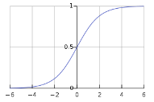
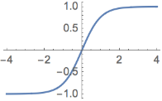
Today’s Example: Making Generic Artificial Neural Network Classes
NeuralNet
NeuronLayer
NeuronLayer
vector<T>
sigmoid
Input1
NeuronLayer
tanh
…
Output
sigmoid
Input2
tanh
sigmoid

Slide 5
Smart Pointers
Clean up after Themselves
Hide raw new-delete/malloc-free
Control the ownership of a pointer
Allow you to override the delete method
Are thread friendly

Slide 6
void FuncMightLeak()
{
std::cout << “Leak Hazard!\n";
MyType* pFirst = new MyType();
if (!process())
{
delete pFirst;
return;
}
MyType* pSecond = new MyType();
if (!processSecond())
{
delete pFirst;
delete pSecond;
return;
}
process();
delete pFirst;
delete pSecond;
}

Slide 7
unique_ptr
void FuncNoLeaks()
{
std::cout << "FuncNoLeaks\n";
auto pFirst = std::make_unique<MyType>();
if (!process())
return;
auto pSecond = std::make_unique<MyType>();
if (!processSecond())
return;
process();
}

Slide 8
shared_ptr: example from cppreference.com
int main()
{
std::shared_ptr<Base> p = std::make_shared<Derived>();
std::cout << p.get()
<< ", p.use_count() = " << p.use_count() << '\n';
std::thread t1(thr, p), t2(thr, p), t3(thr, p);
p.reset(); // release ownership from main
std::cout << "Shared ownership between 3 threads and released\n"
<< "ownership from main:\n"
<< " p.get() = " << p.get()
<< ", p.use_count() = " << p.use_count() << '\n';
t1.join(); t2.join(); t3.join();
std::cout << "All threads completed, the last one deleted Derived\n";
}

Slide 9
shared_ptr
void thr(std::shared_ptr<Base> p)
{
std::this_thread::sleep_for(std::chrono::seconds(1));
std::shared_ptr<Base> lp = p; // thread-safe, even though the
// shared use_count is incremented
{
static std::mutex io_mutex;
std::lock_guard<std::mutex> lk(io_mutex);
std::cout << "local pointer in a thread:\n"
<< " lp.get() = " << lp.get()
<< ", lp.use_count() = " << lp.use_count() << '\n';
}
}

Slide 10
New Algorithms
#include <algorithm>
//C++11 code
//are all of the elements positive?
all_of(first, first+n, ispositive()); //false
//is there at least one positive element?
any_of(first, first+n, ispositive());//true
// are none of the elements positive?
none_of(first, first+n, ispositive()); //false

Slide 11
Unordered Containers
unordered_map : O(1) access hash map
unordered_set: O(1) access hash
unordered_multimap
unordered_multiset

Slide 12
New Algorithms
//Sums all elements
accumulate(begin(vec1),end(vec1),begin(vec2));
//Dot product of vectors
inner_prod(begin(vec1),end(vec1),begin(vec2));
//Custom reducer
reduce(begin(vec1),end(vec1),begin(vec2),reducer);
...

Slide 13
Move Semantics

Slide 14
References
int foo(int input){
input*2;
}
int x=foo(5);
lvalue
rvalue

Slide 15
References
int a = 42;
int b = 43;
// a and b are both l-values:
a = b; // ok
b = a++; // ok
a = a * b; // ok
// a * b is an rvalue:
int c = a * b; // ok, rvalue on right hand side of assignment
a * b = 42; // error, rvalue on left hand side of assignment

Slide 16
References Resolution
& && => &
&& & => &
&& && => &&

Slide 17
Rvalue References
Person(Person const & rhs){//#1 copy constructor
//Very long copy
attr1 = rhs.attr1
...
}
Person(Person&& rhs){
//Inexpensive moves
. attr1 = move(rhs.attr1)
..
} //#2 move constructor
foo(Person p){
...
}
auto bob = Person(); foo(bob) //Calls #1
foo(Person()) //Calls #2
foo(move(bob)) //Calls #1

Slide 18
Auto Variables
auto x=5; //int
auto c='q'; //char
auto pi=3.1459; //double
auto trillion=1000000000000LL;//long long
auto bob = new Person();//Person*

Slide 19
Auto Variables in Range Loops
std::vector<SomeObject> v;
for(std::vector<SomeObject>::iterator it = v.begin(); it != v.end(); ++it) {
it->doSomething();
}
for(auto obj:v) {
obj.doSomething();
}

Slide 20
Range Loops
//Iterating variable
std::array<int, 5> arr{ 1, 2, 3, 4, 5, 6 };
for (int& x : arr) x *= 2;
// a == { 2, 4, 6, 8, 10, 12 }
//Lvalue reference
std::array<int, 5> arr{ 1, 2, 3, 4, 5, 6 };
for (int x : arr) x *= 2;
// a == { 1, 2, 3, 4, 5, 6 }
//Universal reference
std::array<int, 5> arr{ 1, 2, 3, 4, 5, 6 };
for (auto&& x : arr) x *= 2;
// a == { 2, 4, 6, 8, 10, 12 }

Slide 21
decltype: Like typedef but it takes entities
struct A { double x; };
const A* a;
decltype(a->x) y; // y is double (declared type)
template<typename T, typename U>
auto add(T t, U u) -> decltype(t + u) // return type depends on template
// return type can be deduced since C++14
{
return t+u;
}

Slide 22
nullptr
void f(int); //#1
void f(char *);//#2
//C++03
f(0); //which f is called?
//C++11
f(nullptr) //will unambiguously, call #2

Slide 23
Deleted Class Methods
struct CantBeCopied
{
CantBeCopied & operator =( const CantBeCopied & ) = delete;
CantBeCopied ( const NoCopy & ) = delete;
};
CantBeCopied a;
CantBeCopied b(a); //compilation error
CantBeCopied b = a; //compilation error

Slide 24
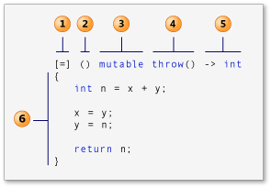
Lamba Expressions (anonymous functions)
capture clause (Also known as the lambda-introducer in the C++ specification.)
parameter list Optional. (Also known as the lambda declarator)
mutable specification Optional.
exception-specification Optional.
trailing-return-type Optional.
lambda body)
Image from https://msdn.microsoft.com/en-us/library/dd293608.aspx?f=255&MSPPError=-2147217396

Slide 25

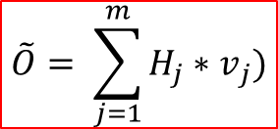

Toy Program: Simple Artificial Neural Network
$$H_{j}=S(\sum_{i=1}^{n}{{i_{i}∗w}_{j,i}})$$
$$S(x)=\frac{1}{1+e^{−x}}$$
where
Target Function
COIN(A,B) = (~A AND ~B) OR (A AND B)
i1*w1,1
H1*v1
i1 | i2 | Output
0 | 0 | 1
0 | 1 | 0
1 | 0 | 0
1 | 1 | 1
Input1
i2* w1,2
i1* w2,1
H2*v2
$$\tilde{O}= \sum_{j=1}^{m}{{H_{j}∗v}_{j}})$$
Output
i2*w2,2
Input2
i1*w3,1
i2*w3,2
H3*v3

Slide 26


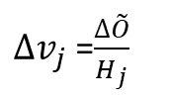


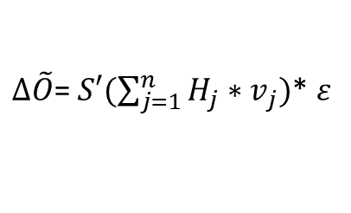


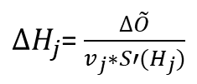
Back Propagation: Gradient Descent
$$S(x)=\frac{1}{1+e^{−x}}$$
$$S^{′}\left(x\right)=\frac{dS(x)}{dx}=\frac{e^{x}}{{(1+e^{x})}^{2}}$$
$ε=$ $O−\tilde{O}$
error
$next w_{i,j}$ =${previous w}_{i,j}+∆w_{i,j}$
$next v_{j}$ =${previous v}_{j}+∆v_{j}$
Input1
Output
Input2
$∆\tilde{O}$= $S′(\sum_{j=1}^{n}{{H_{j}∗v}_{j}})$* $ε$
$∆w_{i,j}$ =$\frac{∆H_{j}}{i_{i}}$
$∆v_{j}$ =$\frac{∆\tilde{O}}{H_{j}}$
$∆H_{j}$= $\frac{∆\tilde{O}}{v_{j}∗S′(H_{j})}$

Slide 27
C11 (ISO/IEC 9899:2011)
Bounds-Checking Functions, e.g.: gets_s,strcat_s() and strncpy_s()
Native multithreading through <threads.h> and <stdatomic.h>
Anonymous structs and unions
Type-Generic Functions, i.e. macro-based template functions
Memory Alignment Control
Static Assertions

Slide 28
Pro tip: Linking C++ functions to C
extern "C" int foo(char *bar)
{
return realFoo(std::string(bar));
}

Slide 29
Pro tip: Linking C functions to C++
#ifdef __cplusplus
extern "C"{
#endif
void c_function_prototype();
#ifdef __cplusplus
}
#endif

Slide 30
FYI: Code Quality Stats from Github

Slide 31
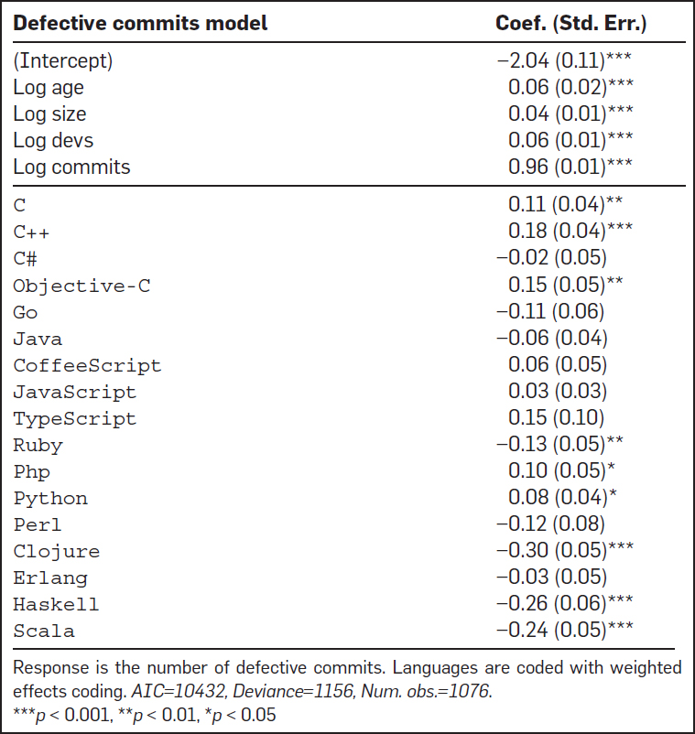
https://cacm.acm.org/magazines/2017/10/221326-a-large-scale-study-of-programming-languages-and-code-quality-in-github/fulltext

Slide 32
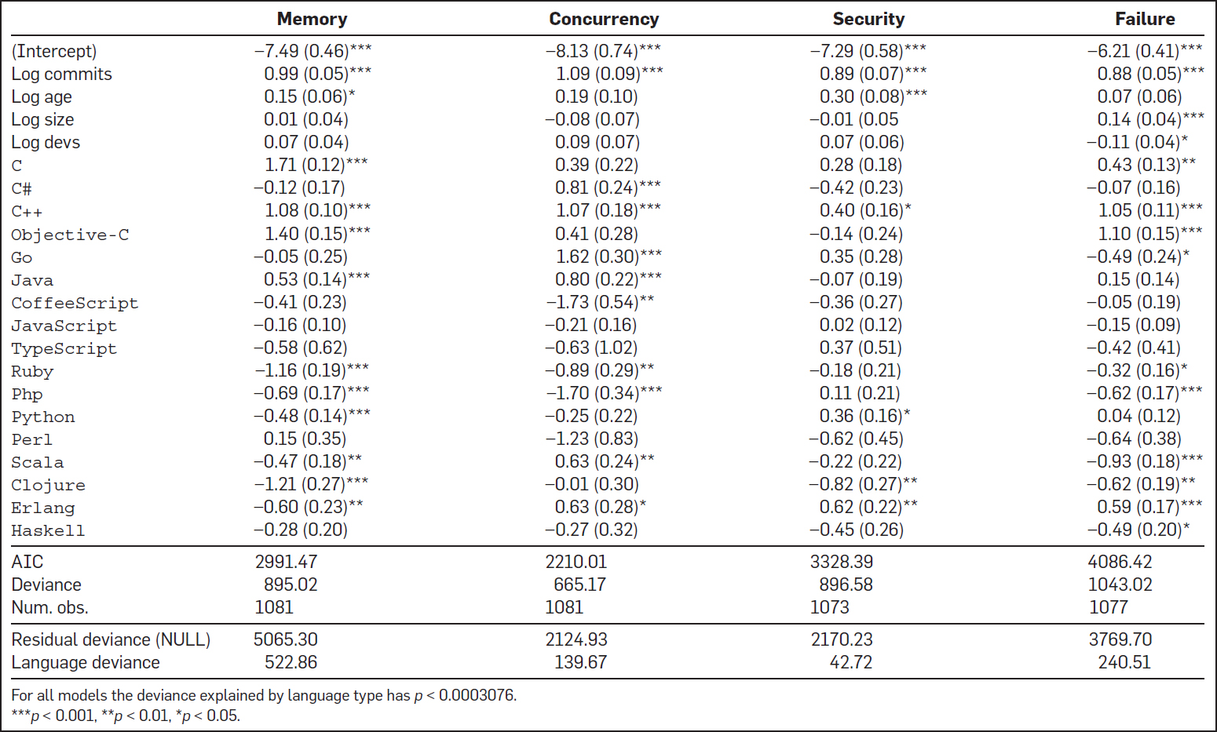

Slide 33
Challenges to: the Audience
Parallelize NeuronLayer
OR
Improve NeuralNet

Slide 34
Resources
CERT C Secure Coding Standard
CERT's C++ Secure Coding Guide
http://en.cppreference.com/w/

