Slide 1
AGROFORESTRY ADVICE FOR MARSHALLS’ WEATHER & CLIMATE
[For daily and weekly weather predictions, tune into *** ]
For more information click http://apdrc.soest.hawaii.edu/dashboard_RMI/ | RECENT | OUTLOOK (forecast)
Rainfall | [selfpopulated dial] | [selfpopulated dial]
Wind/ storms | [selfpopulated dial] | [selfpopulated dial]
Sea level /waves | [selfpopulated dial] | [selfpopulated dial]
THIS YEAR (updated quarterly):
“El Nino Advisory” (click ** for full advisory)
(click [#4] to understand the El Nino-La Nina pattern for agroforestry)
(Click #6) to understand how El Nino affects the calendar fro agroforestry
Wet weather will affect your crops during the El Nino year – care for them! (click #9)
Plan ahead for a drought after the El Nino year! #9
Prepare for possible storms! #9
LONG TERM:
THE LIFETIME OF A TREE OR PERSON
Plant resilient trees and crops that can tolerate drought and salty conditions (click here)
Enjoy traditional foods that keep you healthy with vitamins and fiber (click here)
☺ Recipe/event of the day: ☺
Care for coastal forest that holds the shoreline and protects crops from salt spray (click here)
Learn about the effects of climate change in the Marshalls (click here)
THIS IS NOW
Notes:
HOME PAGE. Simple english with key vocabulary words in Marshallese.
This version of the home page is for an El Nino Advisory. Other versions in next slide(s)
“Recent” should selfpopulate with dials from http://apdrc.soest.hawaii.edu/dashboard_RMI/
Might need notes about different timeframes of “recent” for each dial/dataset
“Outlook” would selfpopulate with basic info from “Marshall Islands Climate Outlook”, and send the reader there for more info.
Call this “Forecast”? Notes about different timeframes? Translate into Marshallese word?
Asked Jim & John to post ENSO status somewhere quarterly (El Nino/La Nino watch/advisory or neutral)
The links under “This Year” all go to the secondary page for topic B (slide #4 of this powerpoint). However if space allows and the material is developed there could be links under the specific topics to more detail in the secondary page for topic B4/E (slides #7? and #8? of this powerpoint).
The links under “Long Term” go to:
Plant resilient… secondary page for topic C1 (slide #9? TBD)
Enjoy foods… secondary page for topic D (slide #5)
Care for coast… secondary page for topic B4/E (slide #?
Learn about… secondary page for topic E (slide #?

Slide 2
AGROFORESTRY ADVICE FOR MARSHALLS’ WEATHER & CLIMATE
[For daily and weekly weather predictions, tune into *** ]
For more information click http://apdrc.soest.hawaii.edu/dashboard_RMI/ | RECENT | OUTLOOK (forecast)
Rainfall | [selfpopulated dial] | [selfpopulated dial]
Wind/ storms | [selfpopulated dial] | [selfpopulated dial]
Sea level /waves | [selfpopulated dial] | [selfpopulated dial]
THIS YEAR (updated quarterly):
“El Nino Watch” (click ** for text)
An El Nino is possible. Listen to the news and continue to check this website to learn what might happen next.
(click [#4] to understand the El Nino-La Nina pattern for agroforestry)
(Click #6) to understand how El Nino affects the calendar fro agroforestry
Wet weather will affect your crops during the El Nino year – care for them! (click #9)
Plan ahead for a drought after the El Nino year! #9
Prepare for possible storms! #9
LONG TERM:
THE LIFETIME OF A TREE OR PERSON
Plant resilient trees and crops that can tolerate drought and salty conditions (click here)
Enjoy traditional foods that keep you healthy with vitamins and fiber (click here)
☺ Recipe/event of the day: ☺
Care for coastal forest that holds the shoreline and protects crops from salt spray (click here)
Learn about the effects of climate change in the Marshalls (click here)
Possible
THIS IS NOW
Notes:
HOME PAGE. Simple english with key vocabulary words in Marshallese.
This version of the home page is for an El Nino WATCH. Other versions in next slide(s)
“Recent” should selfpopulate with dials from http://apdrc.soest.hawaii.edu/dashboard_RMI/
Might need notes about different timeframes of “recent” for each dial/dataset
“Outlook” would selfpopulate with basic info from “Marshall Islands Climate Outlook”, and send the reader there for more info.
Call this “Forecast”? Notes about different timeframes? Translate into Marshallese word?
Asked Jim & John to post ENSO status somewhere quarterly (El Nino/La Nino watch/advisory or neutral)

Slide 3
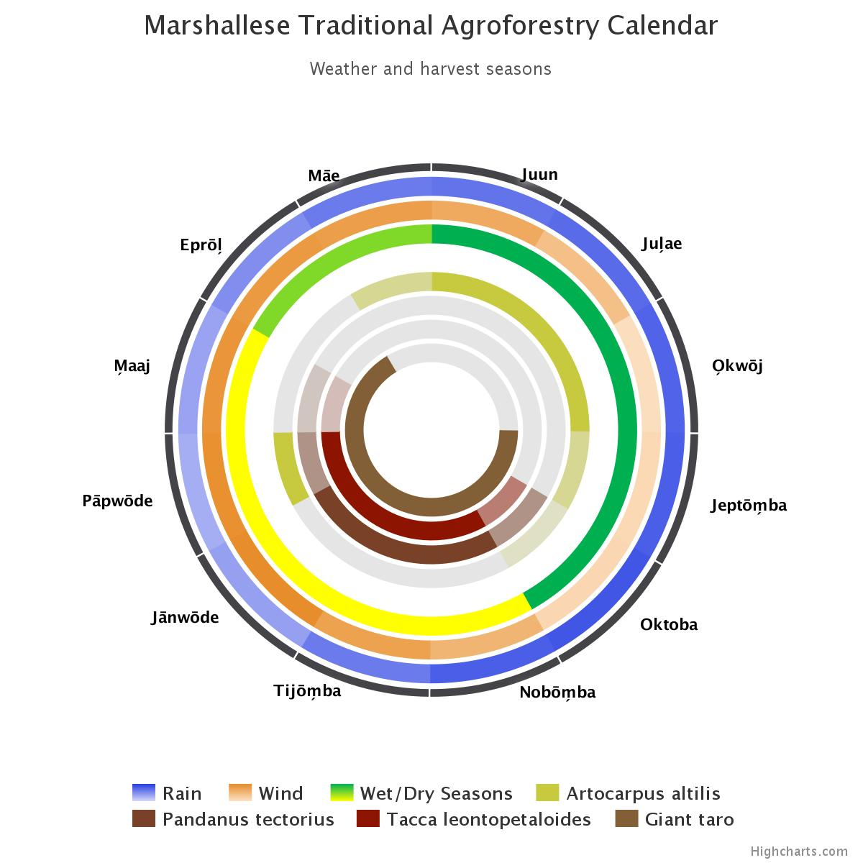
AGROFORESTRY ADVICE FOR MARSHALLS’ WEATHER & CLIMATE
[For daily and weekly weather predictions, tune into *** ]
For more information click http://apdrc.soest.hawaii.edu/dashboard_RMI/ | RECENT | OUTLOOK (forecast)
Rainfall | [selfpopulated dial] | [selfpopulated dial]
Wind/ storms | [selfpopulated dial] | [selfpopulated dial]
Sea level /waves | [selfpopulated dial] | [selfpopulated dial]
THIS YEAR (updated quarterly):
La Nina / Neutral (click ** for text)
(click [#4] to understand the El Nino-La Nina pattern for agroforestry)
Click #5 to learn more about the Marshallese traditional agroforestry calendar.
LONG TERM:
THE LIFETIME OF A TREE OR PERSON
Plant resilient trees and crops that can tolerate drought and salty conditions (click here)
Enjoy traditional foods that keep you healthy with vitamins and fiber (click here)
☺ Recipe/event of the day: ☺
Care for coastal forest that holds the shoreline and protects crops from salt spray (click here)
Learn about the effects of climate change in the Marshalls (click here)
Notes:
HOME PAGE. Simple english with key vocabulary words in Marshallese.
This version of the home page is for Neutral/El Nino. Other versions in previous slide(s)
“Recent” should selfpopulate with dials from http://apdrc.soest.hawaii.edu/dashboard_RMI/
Might need notes about different timeframes of “recent” for each dial/dataset
“Outlook” would selfpopulate with basic info from “Marshall Islands Climate Outlook”, and send the reader there for more info.
Call this “Forecast”? Notes about different timeframes? Translate into Marshallese word?
Asked Jim & John to post ENSO status somewhere quarterly (El Nino/La Nino watch/advisory or neutral)

Slide 4
THIS PAGE POSTED AT
http://sub47-86.uhh.hawaii.edu/rmi-agroforestry/enso.php
Edit layout
This link needs supplementary instruction:
“maps of rainfall and drought across the Marshall islands for different seasons of the El Nino-La Nina pattern
http://developarc.maps.arcgis.com/apps/MapSeries/index.html?appid=411ccedeadb14a2392bf21a4a2ae037e “
Draft:
The home page shows which islands and atolls are wetter (dark blue) and drier (light blue) on average. Click the “+” and drag the map to zoom in to the Marshalls.
To see the effects of a strong El Nino:
Click the circled “2” at the upper left to see how the Year 1 winter (Dec-Feb) will compare to a normal year. Dark brown means less than half the usual amount of rain, as in the far northeast of the Marshalls, but pale blue means a little wetter than the usual winter, as in the far west of the Marshalls.
Click “6” for the Year 1 spring (March-May) – drier.
Click “10” for the Year 1 summer (June-August)
Notes:
Secondary page B – topics B1, B2, B3, B4
Tertiary pages would include:
Simplified user interface for maps of rainfall and drought across the Marshall islands for different seasons of the El Nino-La Nina pattern (or until that’s developed, a link to the atlas) (topic B2)
More detail on agroforestry recommendations (topic B4 – slides #5 and #6 in this powerpoint)
A printable poster that is very similar to this page, but with more detail on AF recommendations, would be available for download and/or requestable. We have some budget for printing and distributing such posters. (topic B3, may include B2)

Slide 5
THIS PAGE POSTED AT
http://sub47-86.uhh.hawaii.edu/rmi-agroforestry/calendar.php
(will also want to enable user to scroll down to table format of same info)

Slide 6

El Nino effect on agroforestry calendar
An El Nino “Watch” might be announced sometime February-June. The rest of the year is wet and stormy, and the following year brings a drought. By the following June the weather might be average again, but crops might still be recovering. After the second year, the cycle probably returns to the “normal” calendar (click #5).
Wet weather will affect your crops during the El Nino year – care for them! (click #9)
Plan ahead for a drought after the El Nino year! (click #9)
Prepare for possible storms! (click #9)
For a more detailed version of this calendar, scroll down. However keep in mind that this is generalized – each atoll and each El Nino is different.
El Nino peak
El Nino onset
Normal
June
Post El Nino
Notes:
DELETE THIS IDEA SINCE WE NOW HAVE 24-MONTH EL NiNO: Simplified/scrunched normal year on the inside, El Nino year on the outside.
Use similar symbols to NOAA graph on page one; duplicate that graph when scroll down.
Scroll down to table format and also graphs of El Nino rainfall. From there provide access to paper, atlas.
Add at end: “The El Nino Southern Oscillation (ENSO) is a weather pattern that affects the Marshalls (and much of the world). For information about ENSO and other reasons why the climate in the Pacific is different from year to year, read http://pcep.prel.org/wp-content/uploads/2015/11/FINAL-Climate-Variability.pdf “
Impact of drought on crops http://www.pacificrisa.org/places/republic-of-the-marshall-islands/

Slide 7
THIS PAGE POSTED AT
http://sub47-86.uhh.hawaii.edu/rmi-agroforestry/el-nino-recommendations.php
Notes:
Secondary page – topic B4, E for EL NINO
https://ethnobiology.org/sites/default/files/pdfs/JoE/14-2/Spennemann.pdf - arrowroot

Slide 8
LONG TERM: THE LIFETIME OF A TREE OR PERSON
ISLAND PLANTS: Ancient traditions, modern adaptability. Keeping people healthy even in climate change.
Traditional plants of the Marshalls were brought by Island people many centuries ago. They are adapted to atoll conditions: sandy soils and occasional inundation, storms and droughts. They are better able to withstand extreme conditions due to El Nino or climate change than almost any recently introduced species. Traditional and local fruits, vegetables and staple crops provide more vitamins and fiber than imported white rice, white bread, sugar, soda, and fatty meats. They help prevent Vitamin A deficiency, obesity, diabetes, heart disease, and even cancer. Local plants support rich traditions: ceremonies, traditional medicine, basketry, and art.
GARDENING: Plant resilient trees and crops that can tolerate drought and salty conditions
Recommended species and characteristics (click here for NRCS Vegetative Guide)
Traditional and modern ways of gardening – mulch, compost, and multistory cropping (click here)
Click here for calendar of crop harvests under normal or La Nina conditions
Enjoy traditional foods that keep you healthy with vitamins and fiber
- Nutrition (click here)
- Storage & preservation (click here)
Recipes (click here)
Policies (click here)
Events/festivals (click here)
Care for coastal forest that holds the shoreline and protects crops from salt spray (link to entire separate powerpoint)
Strand forest
Mangroves
Learn about the long-term effects of climate change in the Marshalls (click here)
[Next few powerpoint slides could be separate pages or could be same page, scroll down, with internal links]
Notes:
Secondary page – topic B4, E for LA NINA. Right hand side is identical.

Slide 9
Plant resilient trees and crops that can tolerate drought and salty conditions
(continuation from previous page)
Recommended species and characteristics
Choose species and varieties that are less susceptible to drought and salinity.
Varieties of pandanus and breadfruit from the northern atolls can tolerate drought and salinity. Look for productive northern varieties; conserve those varieties; try them in southern islands that may be affected by climate change in the future.
Alocasia macrorrhiza is easier to grow and can tolerate drought and salinity better than Colocasia and XX.
Varieties of Alocasia from Fais and other FSM islands might taste better. Ask R&D about introduced varieties!
Garden crops that do not need groundwater can still be grown even if groundwater becomes saline. These crops include: tapioca, sweet potatoes
edible hibiscus (bele, Abelmoschus manihot) and Cnidoscolus chayamansa are nutritious, leafy vegetable shrubs that are fairly tolerant of drier conditions. This species should be replanted by shoots every 2-3 months in semi shade to open sites.
Click here (NRCS vegetative guide) for lists of species and characteristics.
For more information:
National Agroforestry Center brochure
Elevitch publications
Other sources
Notes:
Secondary page for topic C1, provide link to user interface for topic C2

Slide 10
Plant resilient trees and crops that can tolerate drought and salty conditions
(continuation from previous page)
Traditional and modern ways of gardening
Traditional agroforests have many species, varieties and crops (multi-cropping for “biotic diversity”). This reduces risks by not depending on the success of just a few crops. Multicropping, rotating crops and fallowing all help control pests.
Mulch and use compost to enrich the soil and help soil retain moisture. Compost farm wastes instead of burning them.
Ask R&D for assistance chipping materials to turn into mulch or compost. Some crops grow best under the partial shade of trees.
Raised beds can tolerate wet conditions and also avoid problems with salinized groundwater
Improve catchment systems and use irrigation systems.
Find the best possible location. Planting sites on larger islets generally have more groundwater resources. Planting sites that are inland yet at a higher elevation are further from inundations that may occur. Planting sites on the leeward side or where the reef crest is far from the shore are less likely to be inundated by large waves. These locations are better protected from high sea levels under La Nina conditions, and storms during El Nino conditions.
Maintain coastal vegetation to protect gardens and agroforests from wind and salt spray (click here)
Click here for a calendar of crop harvest seasons under normal and La Nina conditions.
For more information:
National Agroforestry Center brochure
Elevitch publications
Other sources
Notes:
Secondary page – topic D
Get Jonathan Deenik’s advice and have WUTMI, Island Foods, etc. take the lead on what will appeal to people here
Link to a variety of existing web pages and downloadable materials

Slide 11
(continuation from previous page)
Enjoy traditional foods that keep you healthy with vitamins and fiber
- Nutrition (click here)
Storage & preservation
Recipes (click here)
Policies. Health and nutrition programs and courses can emphasize cultural pride in traditional food preservation of traditional foods using pandanus, tacca and breadfruit; new methods of processing and storing nutritious foods; and traditional and “starvation” foods such as Crinum and Ixora. Develop new food processing industries that focus on products based on local staples (makmok, breadfruit and pandanus).
Events/festivals (click here)
Notes:
Secondary page for topic C1, provide link to user interface for topic C2

Slide 12
Learn about the long-term effects of climate change in the Marshalls
Continuation of previous page
What changes will affect agroforestry in the Marshalls and when? We still do not know what choices the world will make and exactly how the air and oceans will change in the long term. Let’s think about what the climate will be during the next 40 years, because that is the time period that a coconut is generally considered to be productive. 40 years allows time for coconuts, breadfruit and other trees to provide crops for our children and grandchildren!
The natural cycle of La Nina and El Nino events will continue. The effects of these events (storms, rain and drought, sea level) are temporary (lasting 1-2 years) but strong. Their effects will be more noticeable than climate change for the next 40 years. Scientists are not sure yet whether climate change will affect how La Nina and El Nino events happen. For more information click http://sub47-86.uhh.hawaii.edu/rmi-agroforestry/enso.php
Worldwide sea levels are now rising at least 0.3 inches/year, so they will rise at least 12.6 inches within 40 years. In addition, sea levels may temporarily rise by 12 inches during a La Nina and drop by 5 inches during an El Nino event in the Marshalls. Sea level rise is also added to the effect of each king tide and storm surge, making inundation events more frequent. Generally high sea levels will increase the salinity of groundwater. This makes it important to choose crops that are relatively salt-tolerant (link above). Plant agroforests where inundations are less frequent (link above). For general information on the effects of sea level rise, see http://pcep.prel.org/wp-content/uploads/2014/08/PCEP-Sea-level-final.pdf
Air temperatures will continue to get a little warmer in the Marshalls. Hot days make trees and crops thirsty, so choose trees and crops that can tolerate dry conditions (link above).
Rainfall has been generally decreasing in the Marshalls, but scientists believe it will increase in the future. However, within just the next 40 years, any changes as a result of climate change will not be very noticeable compared to the natural variability of rainfall in the Marshalls, especially as a result of the ENSO cycle. Therefore, choose trees and crops that can tolerate a variety of conditions, and plant a variety of crops (link above).
Any changes in the frequency of droughts and storms in the next 40 years in the Marshalls will also probably be a result of ENSO instead of climate change.
For more reading about Marshall Islands climate and climate change,
see http://pcep.prel.org/wp-content/uploads/2014/08/RMI-Climate-FINAL.pdf
And [link to Australian paper]
Notes:
Secondary page, topic E

