Slide 1
AGROFORESTRY ADVICE FOR MARSHALLS’ WEATHER & CLIMATE
[For daily and weekly weather predictions, tune into *** ]
For more information click http://apdrc.soest.hawaii.edu/dashboard_RMI/ | RECENT | OUTLOOK (forecast)
Rainfall | [selfpopulated dial] | [selfpopulated dial]
Wind/ storms | [selfpopulated dial] | [selfpopulated dial]
Sea level /waves | [selfpopulated dial] | [selfpopulated dial]
THIS YEAR (updated quarterly):
“El Nino Advisory” (click ** for full advisory)
(click [#4] to understand the El Nino-La Nina pattern for agroforestry)
(Click #6) to understand how El Nino affects the calendar fro agroforestry
Wet weather will affect your crops during the El Nino year – care for them! (click #9)
Plan ahead for a drought after the El Nino year! #9
Prepare for possible storms! #9
LONG TERM:
THE LIFETIME OF A TREE OR PERSON
Plant resilient trees and crops that can tolerate drought and salty conditions (click here)
Enjoy traditional foods that keep you healthy with vitamins and fiber (click here)
☺ Recipe/event of the day: ☺
Care for coastal forest that holds the shoreline and protects crops from salt spray (click here)
Learn about the effects of climate change in the Marshalls (click here)
THIS IS NOW
Notes:
HOME PAGE. Simple english with key vocabulary words in Marshallese.
This version of the home page is for an El Nino Advisory. Other versions in next slide(s)
“Recent” should selfpopulate with dials from http://apdrc.soest.hawaii.edu/dashboard_RMI/
Might need notes about different timeframes of “recent” for each dial/dataset
“Outlook” would selfpopulate with basic info from “Marshall Islands Climate Outlook”, and send the reader there for more info.
Call this “Forecast”? Notes about different timeframes? Translate into Marshallese word?
Asked Jim & John to post ENSO status somewhere quarterly (El Nino/La Nino watch/advisory or neutral)
The links under “This Year” all go to the secondary page for topic B (slide #4 of this powerpoint). However if space allows and the material is developed there could be links under the specific topics to more detail in the secondary page for topic B4/E (slides #7? and #8? of this powerpoint).
The links under “Long Term” go to:
Plant resilient… secondary page for topic C1 (slide #9? TBD)
Enjoy foods… secondary page for topic D (slide #5)
Care for coast… secondary page for topic B4/E (slide #?
Learn about… secondary page for topic E (slide #?

Slide 2
AGROFORESTRY ADVICE FOR MARSHALLS’ WEATHER & CLIMATE
[For daily and weekly weather predictions, tune into *** ]
For more information click http://apdrc.soest.hawaii.edu/dashboard_RMI/ | RECENT | OUTLOOK (forecast)
Rainfall | [selfpopulated dial] | [selfpopulated dial]
Wind/ storms | [selfpopulated dial] | [selfpopulated dial]
Sea level /waves | [selfpopulated dial] | [selfpopulated dial]
THIS YEAR (updated quarterly):
“El Nino Watch” (click ** for text)
An El Nino is possible. Listen to the news and continue to check this website to learn what might happen next.
(click [#4] to understand the El Nino-La Nina pattern for agroforestry)
(Click #6) to understand how El Nino affects the calendar fro agroforestry
Wet weather will affect your crops during the El Nino year – care for them! (click #9)
Plan ahead for a drought after the El Nino year! #9
Prepare for possible storms! #9
LONG TERM:
THE LIFETIME OF A TREE OR PERSON
Plant resilient trees and crops that can tolerate drought and salty conditions (click here)
Enjoy traditional foods that keep you healthy with vitamins and fiber (click here)
☺ Recipe/event of the day: ☺
Care for coastal forest that holds the shoreline and protects crops from salt spray (click here)
Learn about the effects of climate change in the Marshalls (click here)
Possible
THIS IS NOW
Notes:
HOME PAGE. Simple english with key vocabulary words in Marshallese.
This version of the home page is for an El Nino WATCH. Other versions in next slide(s)
“Recent” should selfpopulate with dials from http://apdrc.soest.hawaii.edu/dashboard_RMI/
Might need notes about different timeframes of “recent” for each dial/dataset
“Outlook” would selfpopulate with basic info from “Marshall Islands Climate Outlook”, and send the reader there for more info.
Call this “Forecast”? Notes about different timeframes? Translate into Marshallese word?
Asked Jim & John to post ENSO status somewhere quarterly (El Nino/La Nino watch/advisory or neutral)

Slide 3

AGROFORESTRY ADVICE FOR MARSHALLS’ WEATHER & CLIMATE
[For daily and weekly weather predictions, tune into *** ]
For more information click http://apdrc.soest.hawaii.edu/dashboard_RMI/ | RECENT | OUTLOOK (forecast)
Rainfall | [selfpopulated dial] | [selfpopulated dial]
Wind/ storms | [selfpopulated dial] | [selfpopulated dial]
Sea level /waves | [selfpopulated dial] | [selfpopulated dial]
THIS YEAR (updated quarterly):
La Nina / Neutral (click ** for text)
(click [#4] to understand the El Nino-La Nina pattern for agroforestry)
Click #5 to learn more about the Marshallese traditional agroforestry calendar.
LONG TERM:
THE LIFETIME OF A TREE OR PERSON
Plant resilient trees and crops that can tolerate drought and salty conditions (click here)
Enjoy traditional foods that keep you healthy with vitamins and fiber (click here)
☺ Recipe/event of the day: ☺
Care for coastal forest that holds the shoreline and protects crops from salt spray (click here)
Learn about the effects of climate change in the Marshalls (click here)
Notes:
HOME PAGE. Simple english with key vocabulary words in Marshallese.
This version of the home page is for Neutral/El Nino. Other versions in previous slide(s)
“Recent” should selfpopulate with dials from http://apdrc.soest.hawaii.edu/dashboard_RMI/
Might need notes about different timeframes of “recent” for each dial/dataset
“Outlook” would selfpopulate with basic info from “Marshall Islands Climate Outlook”, and send the reader there for more info.
Call this “Forecast”? Notes about different timeframes? Translate into Marshallese word?
Asked Jim & John to post ENSO status somewhere quarterly (El Nino/La Nino watch/advisory or neutral)

Slide 4
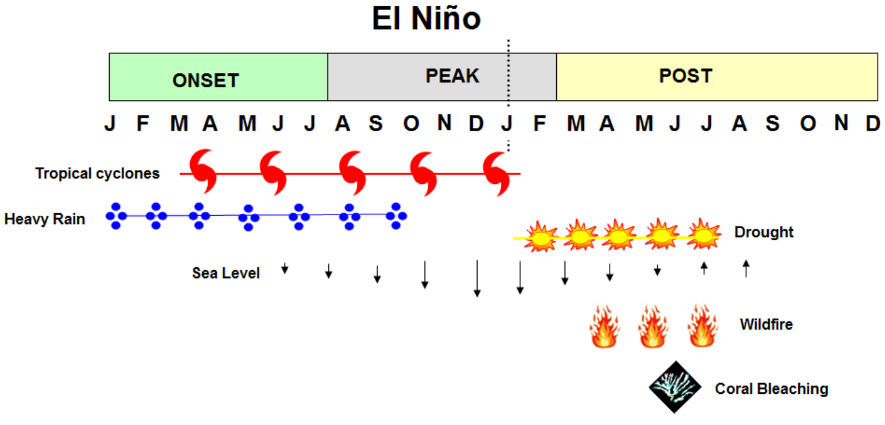
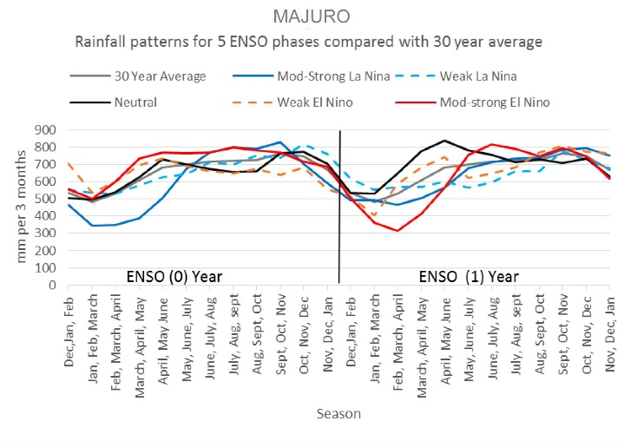
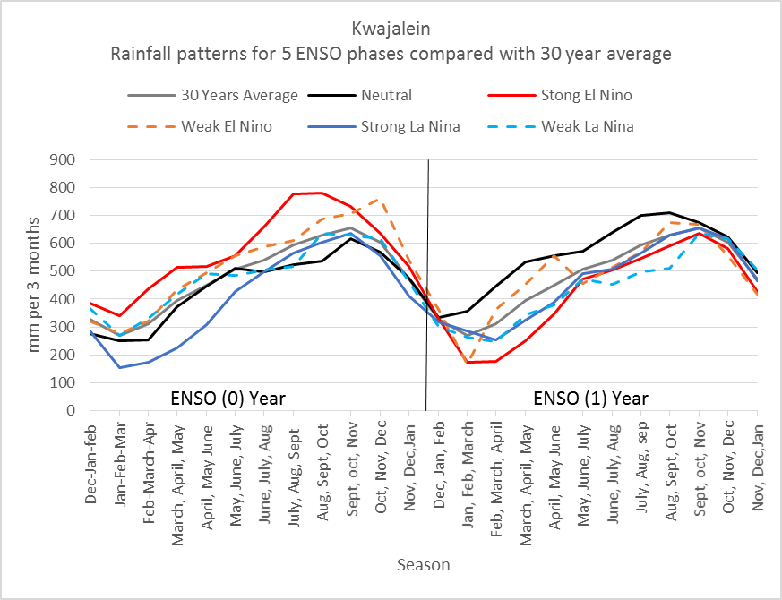
The El Nino Southern Oscillation (ENSO) is a weather pattern that affects the Marshalls (and much of the world).
When the trade winds are normal it is called a neutral year.
When trade winds are weaker than normal, or absent, it is an El Niño year.
When the trade winds are stronger than normal, it is a La Niña year.
The winds and water temperatures affect rain, storms, drought, and sea level.
An El Nino year (“Year 0”) typically has wet and stormy weather. The year following an El Nino Year (“Year 1”) usually has a strong drought in Micronesia. The storms and drought are bad, but because we can recognize the pattern and predict them, farmers can take action.
“Year 0”
WATCH: Sometime around February, if scientists see signs that it MIGHT be the onset (beginning) of an El Nino year, they declare an “El Nino Watch.” Farmers should pay attention for further news.
ADVISORY: Sometime around June, if scientists are sure that it is an El Nino year, they declare an “El Nino Advisory.” Farmers should take action.[click page #6,9]
“Peak:” Around November it becomes apparent whether this is a strong or weak El Nino.
”Year 1”
4. “Post” means “After”: Starting around February of the following year, after-effects like drought begin.
5. A FINAL ADVISORY is issued when El Nino conditions have ended and conditions are normal (“Neutral”).
6. A Watch or Advisory might follow, making this “Year 0” for a La Nina, neutral, or even another “El Nino” year.
Watches and Advisories are also announced in La Nina years. However, after the time a La Nina Advisory is issued (around June of Year 0), there is not a major drought or storm season to predict. For Neutral and La Nina conditions, farmers should care for a variety of crops using good traditional and scientific methods for Marshallese conditions [click page#5,11]
Click here to understand El Nino and its impacts in the Marshalls: http://www.pacificrisa.org/wp-content/uploads/2015/11/Pacific-Region-EL-NINO-Fact-Sheet_RMI_2015-FINAL-v2.pdf)
For information about ENSO and other reasons why the climate in the Pacific is different from year to year, read http://pcep.prel.org/wp-content/uploads/2015/11/FINAL-Climate-Variability.pdf
Click here [Atlas link http://developarc.maps.arcgis.com/apps/MapSeries/index.html?appid=411ccedeadb14a2392bf21a4a2ae037e
] to see maps of rainfall and drought across the Marshall islands for different seasons of the El Nino-La Nina pattern
Notes:
Secondary page B – topics B1, B2, B3, B4
Tertiary pages would include:
Simplified user interface for maps of rainfall and drought across the Marshall islands for different seasons of the El Nino-La Nina pattern (or until that’s developed, a link to the atlas) (topic B2)
More detail on agroforestry recommendations (topic B4 – slides #5 and #6 in this powerpoint)
A printable poster that is very similar to this page, but with more detail on AF recommendations, would be available for download and/or requestable. We have some budget for printing and distributing such posters. (topic B3, may include B2)

Slide 5

Marshallese traditional agroforestry calendar
The Marshallese year is divided into two major seasons, Añōn Rak and Añōneañ.
The calendar focuses on harvest rather than planting times, because traditional crops are perennial.
This calendar shows how wind and rain change through the year – it generally describes these seasonal changes for an “average” year.
This calendar is very general for the Marshalls – each atoll should have its own calendar, since the northern atolls are drier.
For the El Nino version of this calendar, click [#6]
For more detailed information based on this calendar, scroll down.
Normal
Notes:
Scroll down to table format and also graphs of normal/neutral rainfall (from atlas or selfpopulated from blue website). From there provide access to paper, atlas.

Slide 6
El Nino effect on agroforestry calendar
An El Nino “Advisory” is typically announced by June. The rest of the year is wet and stormy, and the following year brings a drought. By the following June the weather might be average again. This simplified calendar shows how the weather might be very different for a year before returning to normal.
Wet weather will affect your crops during the El Nino year – care for them! (click #9)
Plan ahead for a drought after the El Nino year! (click #9)
Prepare for possible storms! (click #9)
For the normal version of the Marshallese calendar, click [#5]
For a more detailed version of this calendar, scroll down.
El Nino peak
El Nino onset
Normal
June
Post El Nino
Notes:
Simplified/scrunched normal year on the inside, El Nino year on the outside.
Use similar symbols to NOAA graph on page one; duplicate that graph when scroll down.
Scroll down to table format and also graphs of El Nino rainfall. From there provide access to paper, atlas.
Add at end: “The El Nino Southern Oscillation (ENSO) is a weather pattern that affects the Marshalls (and much of the world). For information about ENSO and other reasons why the climate in the Pacific is different from year to year, read http://pcep.prel.org/wp-content/uploads/2015/11/FINAL-Climate-Variability.pdf “

Slide 7
ISLAND PLANTS:
Ancient traditions, modern adaptability
Keeping people healthy even if the climate changes
RECIPE/EVENT OF THE DAY
“Canoe” plants of the Marshalls were brought by Island people many centuries ago. They have survived because of their adaptability to atoll conditions: sandy soils and occasional inundation, storms and droughts. The ancient Marshallese developed dozens or even hundreds of cultivars of these plants. These traditional species are better able to withstand extreme conditions due to El Nino or climate change than almost any recently introduced species. Local fruits, vegetables and staple crops provide more vitamins and fiber than imported white rice, white bread, sugar, soda, and fatty meats. Traditional and modern recipes with local foods can help prevent Vitamin A deficiency, obesity, diabetes, heart disease, and even cancer. Local plants support rich traditions: ceremonies, traditional medicine, basketry, and art. Good health and confidence in Marshallese culture will help people sail their “canoes” into the future, no matter where they go!
ISLAND FOODS:
Nutrition
Storage & preservation
Recipes
Gardening
ISLAND CHOICES & CULTURE
Policies
Events (like bob festival)
Ethnobotany
Notes:
Secondary page – topic D
Get Jonathan Deenik’s advice and have WUTMI, Island Foods, etc. take the lead on what will appeal to people here
Link to a variety of existing web pages and downloadable materials
“Gardening” will link to secondary page, topic C

Slide 8
CLIMATE CHANGE IN THE MARSHALLS:
WHAT WE THINK WE KNOW
AND WHAT WE DON’T KNOW
ABOUT THE FUTURE FOR THE MARSHALLS
For more reading about Marshall Islands climate and climate change,
see http://pcep.prel.org/wp-content/uploads/2014/08/RMI-Climate-FINAL.pdf
For more reading about sea level rise, see
Notes:
Secondary page – topic E

Slide 9
EL NINO RECOMMENDATIONS for AGROFORESTRY
Prepare for possible storms!
During the El Nino year, tropical storms and even typhoons may hit the Marshalls.
Prune fruit trees by removing the crossed and unproductive branches. Pruning can improve the shape of the tree and also reduce the chances it will catch wind and be damaged in a storm.
Prune branches and even remove trees that have the greatest chance of falling on a house.
Grow arrowroot and other crops that will not be damaged in storms [check this with Harley]
Wet weather will affect your crops during the El Nino year – care for them!
During the early months of an El Nino year (Jan-June), even before an “advisory” is announced, rainfall is higher than normal. It may continue to be wetter than usual all that year, through November or December.
Grow vegetables in raised beds, for good drainage.
Look at rainfall predictions [link to blue calendar]. Plant short-term crops if there will be enough time for them to grow deep roots or even give harvests before the drought.
Tapioca (manihot)
edible hibiscus (bele)
Abelmoschus ??
Cnidoscolus chayamansa
sweet potato
pumpkin.
Cultivate bele and Cnidoscolus chayamansa as nutritious, leafy vegetable shrubs that are fairly tolerant of drier conditions. This species should be replanted by shoots every 2-3 months in semi shade to open sites.
Plan ahead for a drought after the El Nino year!
During the year following an El Nino year, rainfall is lower than normal. Some crops might fail.
Look at the rainfall predictions [link to blue calendar] – decide whether to postpone planting long-term crops like trees until after the drought.
Repair tanks and catchment systems.
Mulch plants and use compost to retain soil water
Preserve breadfruit and other crops
Learn about emergency/starvation foods (for example, Crinum and Ixora)
Repair tanks (for taro) and catchment systems
Notes:
Secondary page – topic B4, E for EL NINO
Does it make sense to preserve pandanus after a watch/advisory is called? Is that when they’re fruiting?

Slide 10
LONG-TERM RECOMMENDATIONS
Care for coastal forest (link to entire separate powerpoint)
Choose resilient crops
(link to secondary page for topic C, NRCS Vegetative Guide)
Use resilient cropping systems:
Relocate or emphasize agroforestry in less susceptible locations within an atoll or islet (higher elevation, larger islets, leeward side, etc.).
Other…
Notes:
Secondary page – topic B4, E for LA NINA. Right hand side is identical.

Slide 11
RESILIENT SPECIES FOR THE MARSHALL ISLANDS
(rewrite Harley’s recommenations, below;
link to secondary page for topic C,
NRCS Vegetative Guide)
Identify and use species and varieties that are less susceptible to drought and salinity. This particularly applies to pandanus and breadfruit species which are still important staples in the Marshallese diet. Varieties of pandanus and breadfruit that are cultivated in the drier northern atolls may be more resilient to drought and salinity and should therefore be highly considered in experimental trials. A noteworthy crop that is less susceptible to drought and perhaps salinity is Alocasia macrorrhiza which requires less effort to grow.
RMI should introduce edible varieties of Alocasia from Fais and other FSM islands where it is widely cultivated as a preferred aroid. Promote biotic diversity within gardens and agroforests (using multi-cropping, crop rotation, fallowing, etc) which provides various ecological benefits (stability and resilience to perturbations, including natural pest control).
Use species and cropping systems less/not reliant on groundwater resources (which may become saline with increased sea level height and consumption of groundwater resources). Grow vegetables in raised beds. In addition to breadfruit and pandanus other possible crops to grow include tapioca, edible hibiscus (bele, Abelmoschus manihot), Cnidoscolus chayamansa, sweet potatoes, Alocasia taro (wot)s. Cultivate bele and Cnidoscolus chayamansa as nutritious, leafy vegetable shrubs that are fairly tolerant of drier conditions. This species should be replanted by shoots every 2-3 months in semi shade to open sites.
Promote food preservation of traditional foods using pandanus, tacca and breadfruit. Extension to offer courses in breadfruit and pandanus preservation foods. Course can also teach about emergency/starvation foods (for example, Crinum and Ixora). Reinforce the value of traditional knowledge and foods through service programs that also promote nutrition and health.
Develop new food processing industries that focus on products based on local staples (makmok, breadfruit and pandanus).
Increase capacity (and quality) of rooftop water catchment systems in villages, home compounds and urban areas. Increase tank catchment volume. Develop the necessary plans for the greater storage of water for urban and rural systems and for irrigation during drier periods.
Investigate various irrigation methods and systems (i.e., drip, hands, etc). Teach ways to water plants during drought periods. Seek funding for such projects.
Reinforce and support the practice and systems of traditional agroforestry that incorporate multicropping and horizontal and vertical diversity, use of traditional plants and a diversity of species and varieties. Introduce modern practices and technologies where possible and relevant. Plant breadfruit w/traditional knowledge.
Notes:
Secondary page for topic C1, provide link to user interface for topic C2

Slide 12
Sea level rise
For general info re sea level rise, see
http://pcep.prel.org/wp-content/uploads/2014/08/PCEP-Sea-level-final.pdf
Coastal strand forest cf. mangroves
Conserve cf. restore

