Slide 1



校长奖学金答辩
SEU Pattern Classification
Photo-based Attendance Marking System
SOUTHEAST
Team members: 71123329 Jiawen Duan, 71123331 Xirui Yang
ＳＯＵＴＨEＡＳＴ ＵNＩＶＥＲＳＩＴＹ

Slide 2













Research Background and Problem Statement
Traditional attendance time
Classroom environment challenges
Each roll call takes an average of 5-10 minutes, accumulating to about 2 class periods wasted per semester.
Multiplayer overlaps
In the group photo, middle school students have a variety of postures and block each other
Side face and bowed head
Students often face sideways, bow their heads, turn their heads and other non-standard postures
The phenomenon of proxy answers is serious
Uneven lighting
Students commonly engage in "proxy answering" behavior, making it difficult for teachers to accurately determine true attendance.
Complex lighting conditions such as window backlight and projector reflection
Partial occlusion
wearing masks, hair covering eyes, wearing hats and other covering situations
Existing system limitations
Existing open-source facial recognition attendance systems have a recognition rate of less than 70% in complex classroom environments.
Recognition performance of existing systems in real classroom environments:
Legacy system
Recognition rate < 70%

Slide 3


























Overall design of the system
System architecture
Technology stack
Front end layer
Streamlit provides a beautiful and responsive web management interface that supports class selection, student management, photo upload, real-time recognition of progress and result display
Python
OpenCV
Business logic layer
Python core module, responsible for process scheduling, database operation, recognition result merging and deduplication
face_recognition
SQLite
Core strengths
Data persistence layer
SQLite lightweight embedded database with zero configuration and single-file deployment
Zero hardware costs
Only a regular laptop, pure software deployment
High efficiency
Algorithm layer
The processing time for a single lesson is only 8.7 seconds
OpenCV is responsible for image enhancement and preprocessing, face_recognition face detection and 128-dimensional feature extraction
High accuracy
Recognition of F1 score of 88.9%, accuracy of 90.0%

Slide 4












Core algorithm innovation
Triple detection mechanism
The highest similarity deduplication of multiple photos
Dynamic threshold adjustment
First layer: HOG rapid detection
Global highest similarity retention strategy
Reduced the recognition threshold from the default 0.6 to 0.42
The second layer: CNN accurate detection
Completely solve the problem of repeated marking of the same student
Third: Image enhancement + multi-fold upsampling
Optimized for classroom small face and side face scenes
Significantly reduce the false identification rate
face_locations = face_recognition.face_locations(rgb_image, model='hog')
if not face_locations:
face_locations = face_recognition.face_locations(rgb_image, model='cnn')
if not face_locations:
enhanced = cv2.convertScaleAbs(rgb_image, alpha=1.2, beta=30)
Improve the recall rate under the premise of ensuring a very low false identification rate
if best_similarity >= 0.42:
if best_student.id not in recognized_students:
recognized_students[best_student.id] = (best_student.name, best_similarity)
else:
if best_similarity > recognized_students[best_student.id][1]:
recognized_students[best_student.id] = (best_student.name, best_similarity)
Comparison of threshold selection experiments:
0.60 (default): 95.2% accuracy, 72.5% recall
0.42 (this article): Accuracy 87.8%, Recall 90.0%
Performance improvements
68.4%
90.0%
+21.6%
Before optimization
Face detection rate
After optimization
Face detection rate

Slide 5





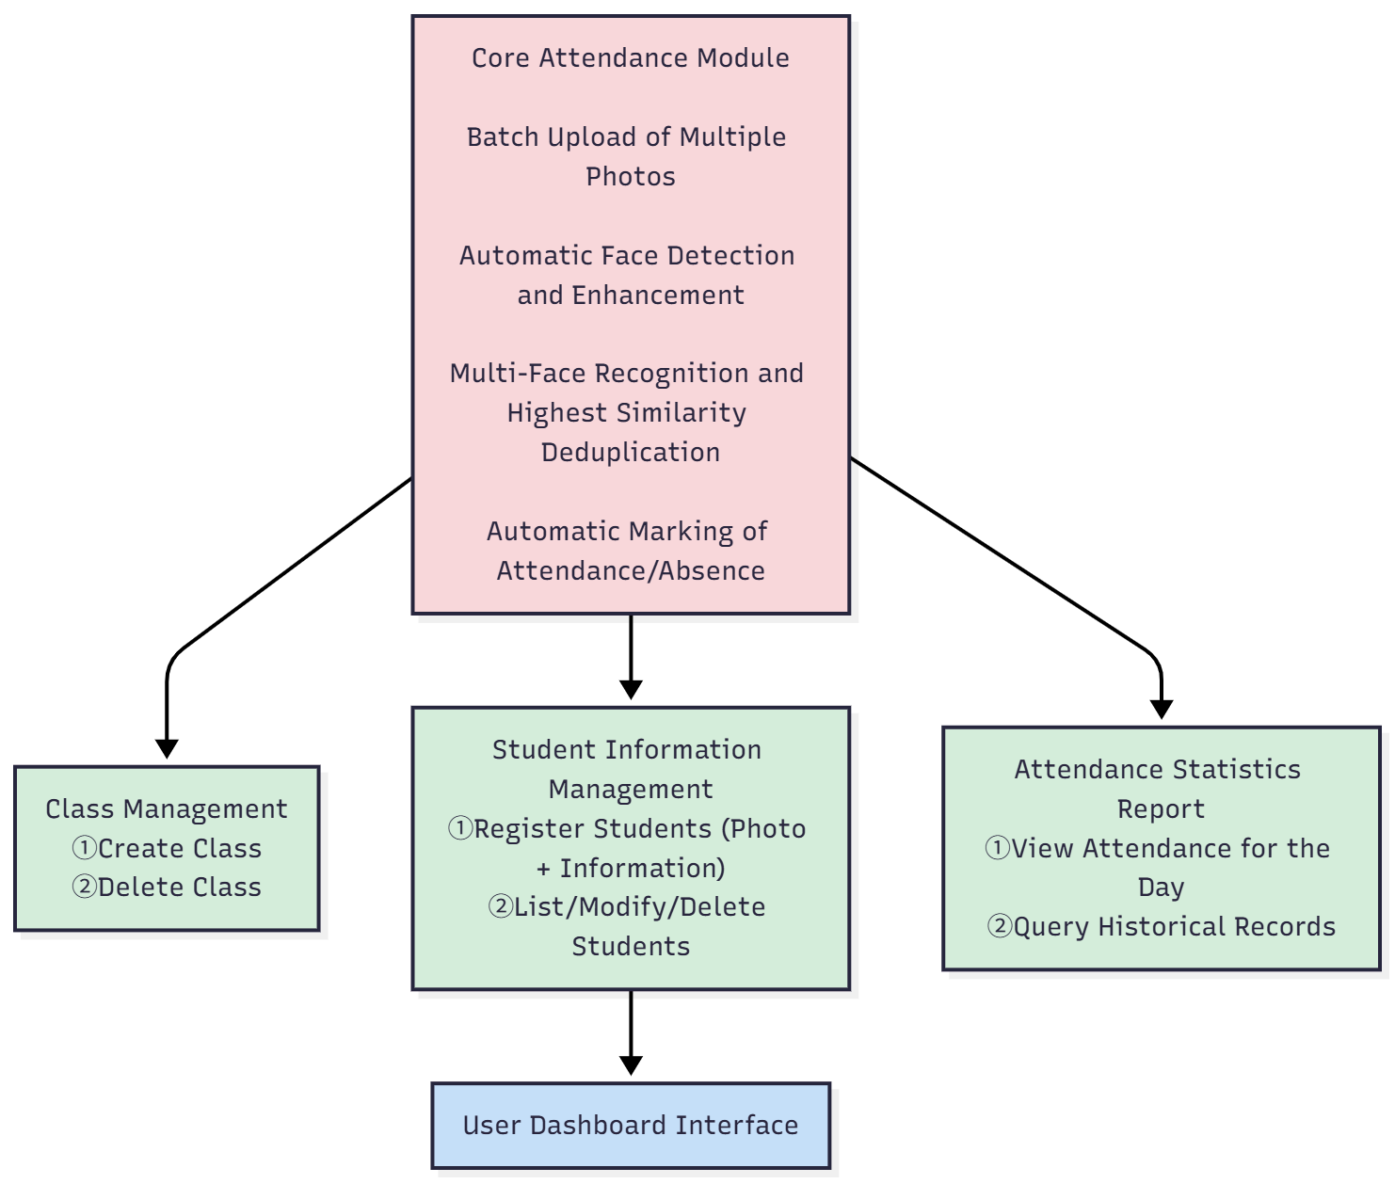













System function module
Student management
Class management
Single front photo registration
Create and delete classes
Information modification and replacement of photos
Batch management of class students
Delete students and history
Student information export
Photo processing
Data management
Multiple classroom photos were uploaded
Attendance record query
Image preprocessing and enhancement
Generate statistical and pivot reports
Large image auto-scaling processing
Database backup and reset

Slide 6































Experimental environment and dataset
Experimental hardware environment
Evaluation methods and indicators
Tencent Cloud Lightweight Application Server (4-core processor)
Assessment tools
4GB RAM, 40GB SSD
Independently developed automated accuracy evaluation tool with the same face detection and recognition logic as the main attendance system
Ubuntu 22.04 LTS, Python 3.10
Evaluation process
face_recognition 1.3.0, OpenCV 4.8
Pre-process and identify each photo, output TP, FP, FN, and calculate various indicators
Core evaluation indicators：
Dataset description
Precision
Recall
The percentage of students who are actually present is identified
The percentage of students who are actually present
Real university classroom with 55 registered students
9 consecutive lessons tested
F1 score
Accuracy
Take multiple class photos from different angles in each class
The harmonized average of accuracy and recall
The proportion of students correctly identified as the actual students present
The assessment covered 40 students who were actually present
Real classroom scenario test coverage:
Front
Side
Submit
Backlight
Partial occlusion
Crowds

Slide 7

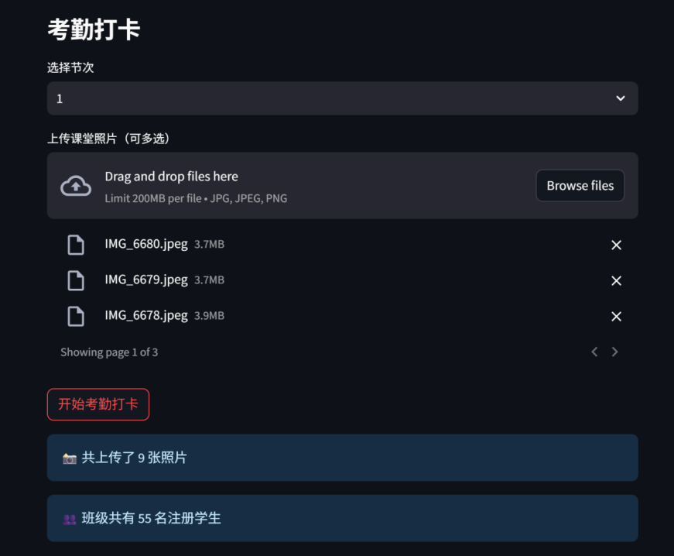

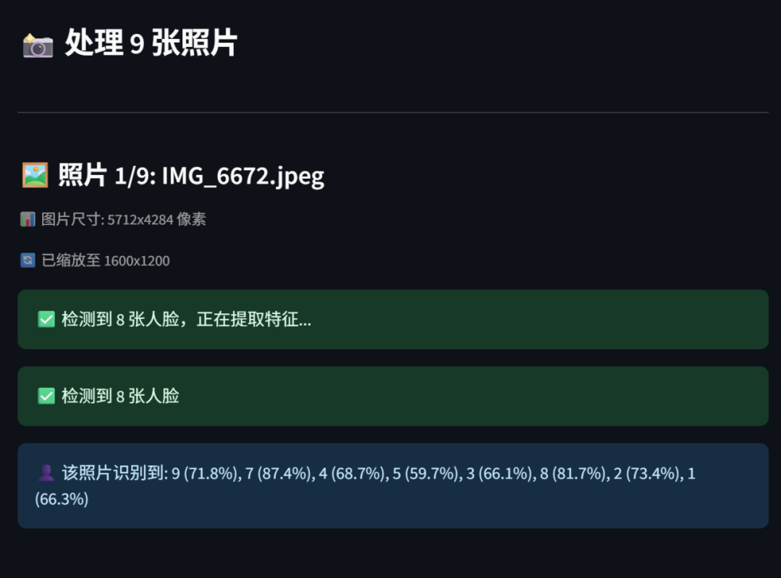


Experimental results and performance
This test enables smart attendance by uploading class photos, automatically completing face detection, feature comparison, and attendance statistics. efficiency and accuracy.
Attendance check-in feature

Slide 8
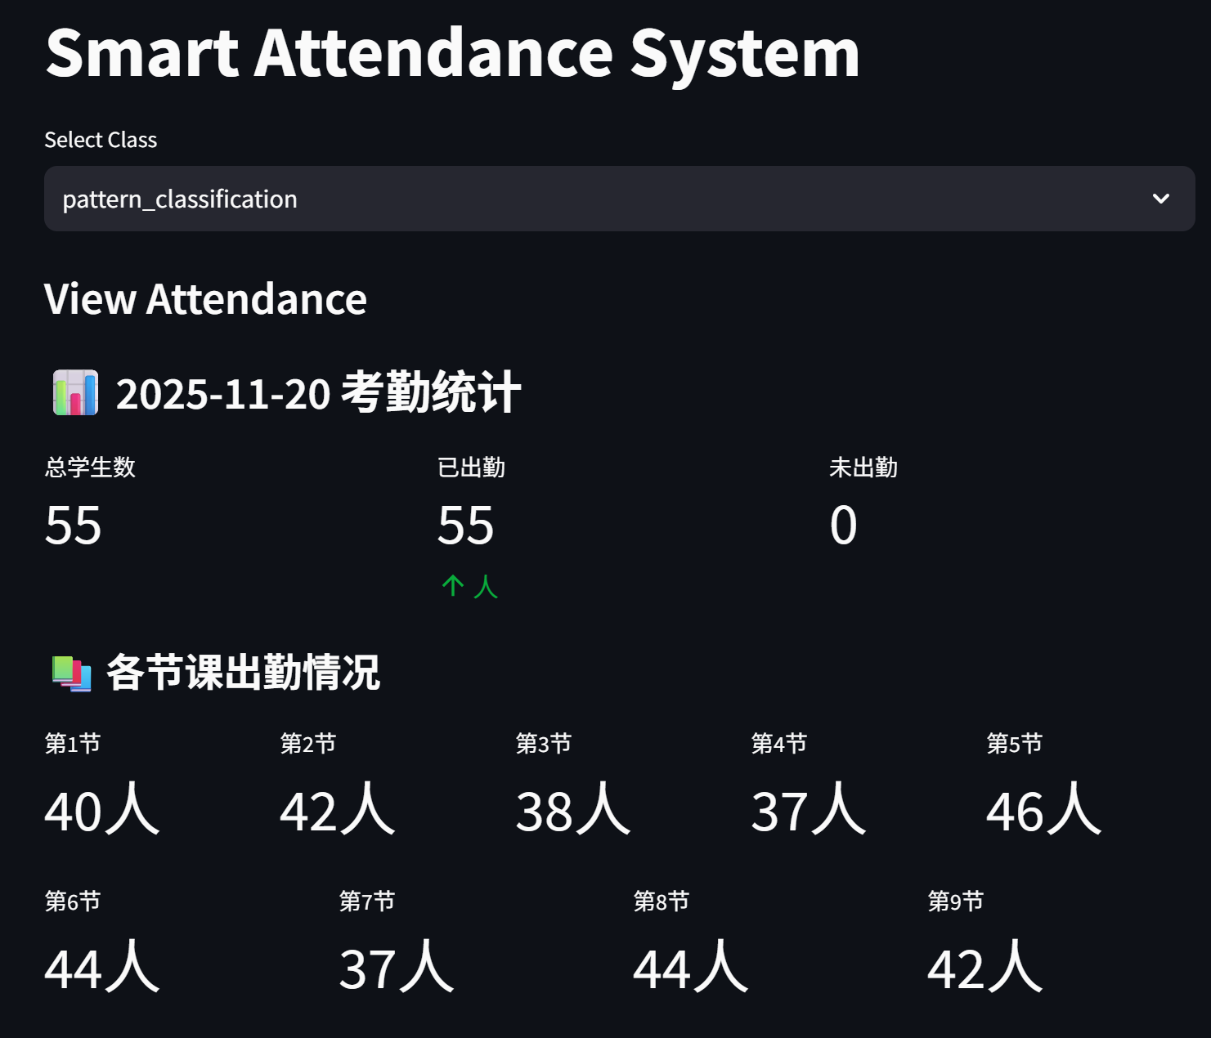
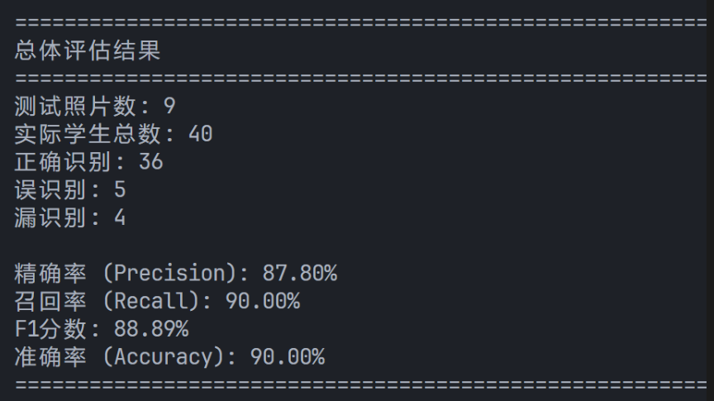
Experimental results and performance
Attendance results
Identify performance
This feature summarizes the total attendance of each class, displays each student's attendance in a table, and allows to export the table.

Slide 9















System advantages and limitations
System advantages:
System limitations
Truly realize "non-sensory attendance"
Extremely similar faces have limited ability to distinguish between them
Students do not need any cooperation, and teachers do not need to interrupt lectures, completely getting rid of the interference of traditional attendance on the teaching rhythm
Occasional misidentification of identical twins or two students who are extremely similar (misidentification rate 1.8%) is not suitable for classes with many twins
Zero hardware cost deployment
It can run on a regular laptop or an existing school computer with no additional hardware investment
The recognition rate of wearing a mask or bowing your head significantly decreased
High robustness
A number of optimizations were carried out for the complex classroom environment (side face, head down, uneven lighting, partial occlusion), and the actual accuracy rate reached more than 90%
When students wear masks or their heads hang down more than 60°, the detection rate drops significantly
In extreme cases of lighting, it may still fail
Complete closed-loop management
In extremely strong backlighting (window background) or extremely dark environment (suddenly turning off the lights), the image enhancement strategy is difficult to completely salvage, and individual photos will miss all inspections
From class creation→ student registration→ daily attendance → report viewing→ data export, all teaching needs are solved in one stop
These limitations are not system design flaws, but common problems of current static face recognition technology in complex classroom scenarios

Slide 10










Future improvement direction
In response to the current limitations of the system, we propose the following five key improvements to further improve the performance and usability of the system:
Introduce advanced models
Increase in liveness testing
Upgrading face_recognition (2018 technology) to InsightFace (2023-2025 mainstream) or RetinaFace+ArcFace combination, the feature dimension is increased to more than 512 dimensions, and the comprehensive accuracy is expected to increase to 98%-99%.
Integrated single-frame-based Silent-Live or multi-frame optical flow liveness detection algorithms completely eliminate the risk of photo/video spoofing and improve system security.
Support mask face recognition
Automatic report export
Train or call a special mask face model to recognize only the eye and forehead areas to solve the recognition problem in the mask wearing scenario.
It supports one-click export of PDF/Excel monthly attendance sheets to meet the archiving needs of the Academic Affairs Office and improve the practicability of the system.
Photo metainformation utilization
Automatically read the shooting time in the photo EXIF, and automatically select the session compared with the class schedule, further improving the intelligence level of the system.

Slide 11
校长奖学金答辩
SEU Pattern Classification
SOUTHEAST
Thanks!
Team members: 71123329 Jiawen Duan, 71123331 Xirui Yang
ＳＯＵＴＨEＡＳＴ ＵNＩＶＥＲＳＩＴＹ

