Slide 1


Generating comments from code
Munteanu Victor

Slide 2
Content
Context
Solution
Implementation
Datasets
Results
References

Slide 3
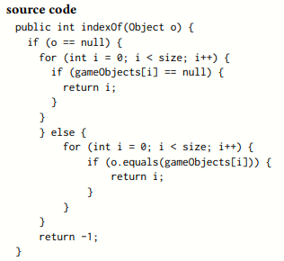

Context

Slide 4
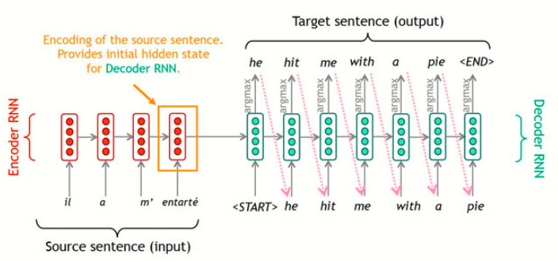
Solution
sequence to sequence model (seq2seq in short)

Slide 5
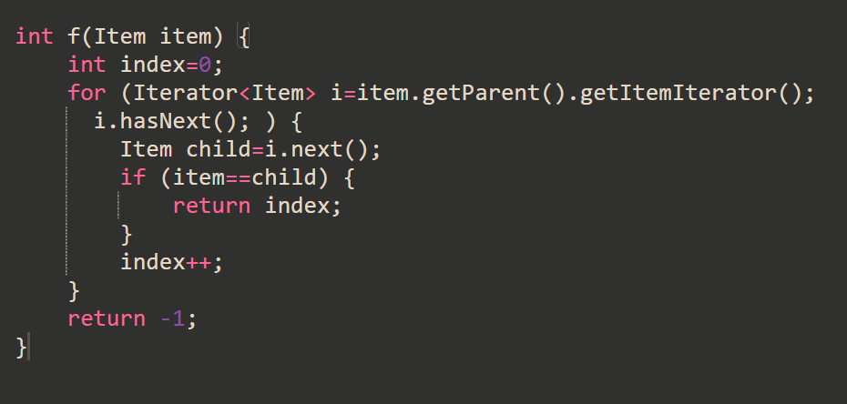
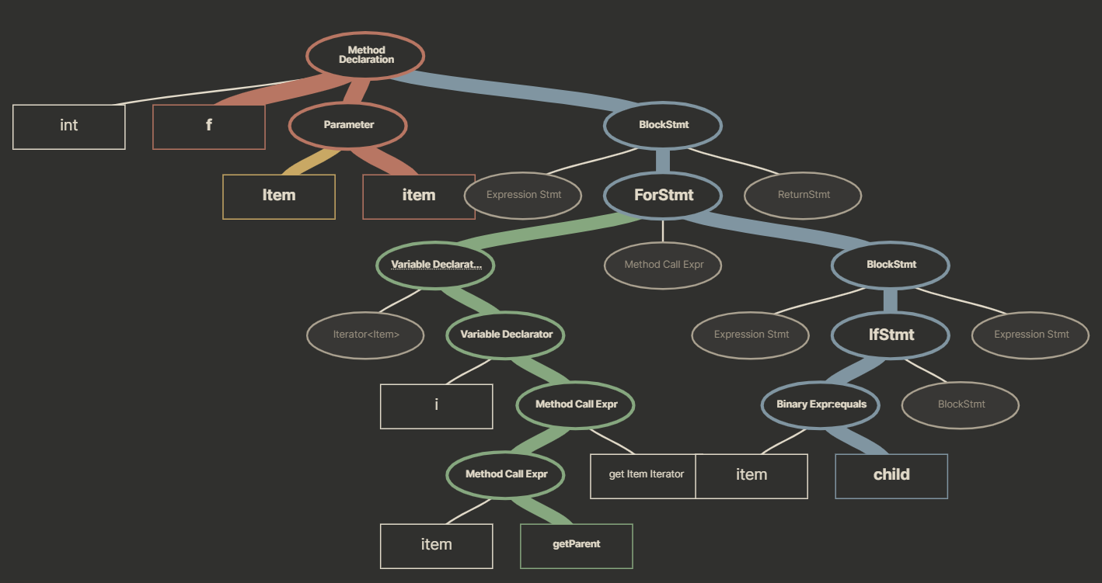
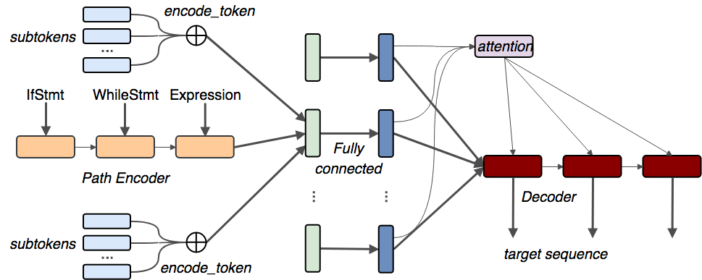
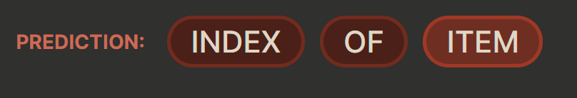
1st Implementation

Slide 6
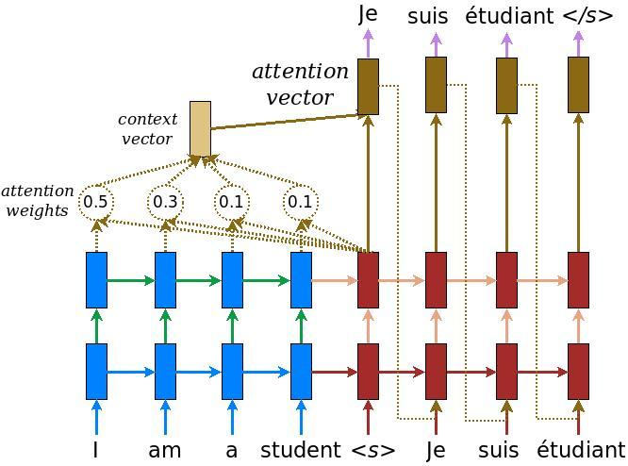
2nd Implementation

Slide 7
Preprocessing
The summary -> to_lower -> trim if too many words ( >100 ) -> tokenize -> add <BOS>, <EOS> -> word2idx -> padded with 0s -> to embedding
The code -> no ‘to_lower’, no trimming, no <BOS> and <EOS>

Slide 8
No perfect Dataset
JuICe: A Large Scale Distantly Supervised Dataset for Open Domain Context-based Code Generation
The code part was concentrated too much on regex
Code2seq’ java-large-preprocessed (over 100GB of java methods already preprocessed into ‘k’ paths) and java-med-preprocessed (20GB)
The summary is just the method name
ConCode: new large dataset with over 100.000 Java methods
The summary is not perfect, it contained incomplete sentences or even sentences in another language

Slide 9
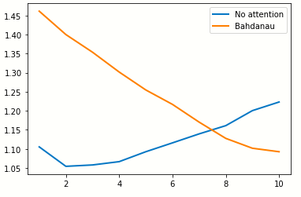
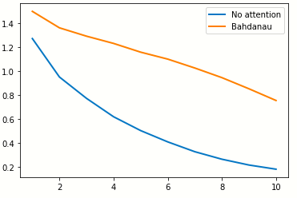
Results
Trained 10 epochs
No attention takes way less memory and is faster to train (about 2x) but the results are not as good
Bahdanau attention layer gives better results, but takes more time and consumes more memory
Validation loss
Training loss

Slide 10
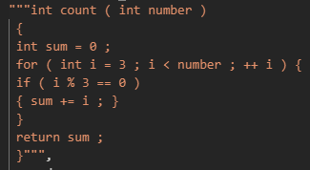
Output
Output with no attention
with attention

Slide 11
Thank you for your attention

Slide 12
References
JuICe dataset - https://arxiv.org/abs/1910.02216
https://www.tensorflow.org/text/tutorials/nmt_with_attention seq2seq implementation in Keras
https://openreview.net/pdf?id=H1gKYo09tX – Code2Seq
https://github.com/sriniiyer/concode - ConCode Dataset

