Slide 1
Image Similarity
ATAI/DNN Project
Munteanu Victor

Slide 2
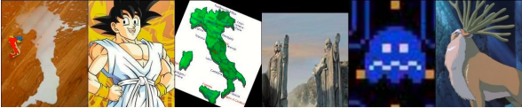
Recap
Find the pair

Slide 3
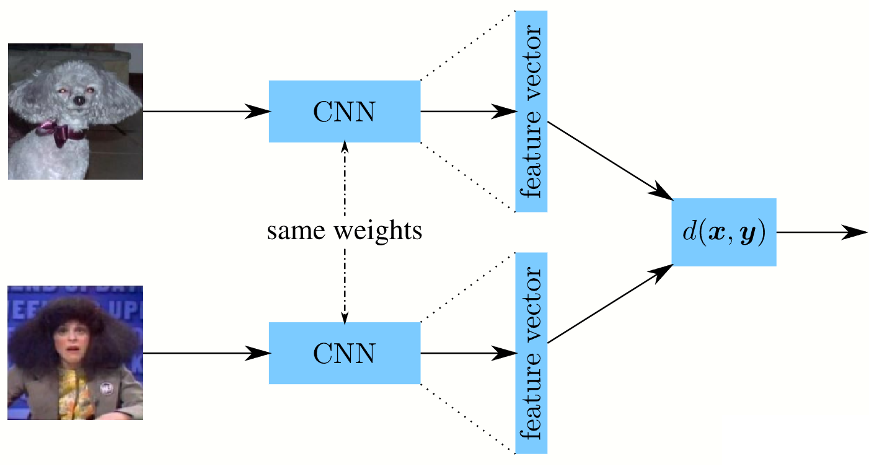
Siamese Network

Slide 4
Evaluation
Split train/test (1000/330)
Top-K: for a given image, find the top k closest images in the test dataset.

Slide 5
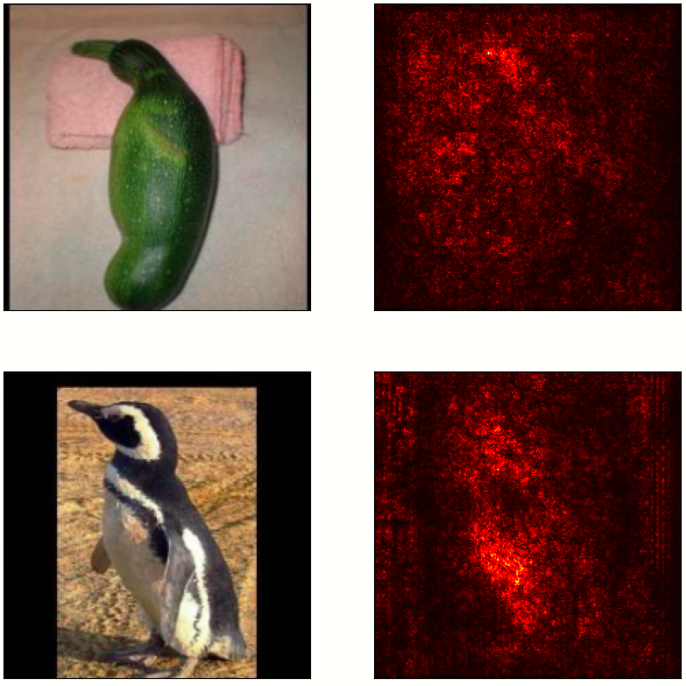
Experiments
Tried to learn the distance function: added adaptive layers, fine-tuned on Totally-Looks-Like dataset to predict the similarity between 2 images.
Results: Top-25 metric, the target image was found in the closest 25 images only in 1% cases.
Used Saliency maps to visualize the parts of the images based on which the network did the “matching”

Slide 6
Contrastive Learning
Pretrain using Barlow Twins (similar to SimCLR) on ImageNet
Add “Projection Layers” on top for an even lower embedding space
(from 2000 -> 256)
Use TripletLoss to finetune the model

Slide 7
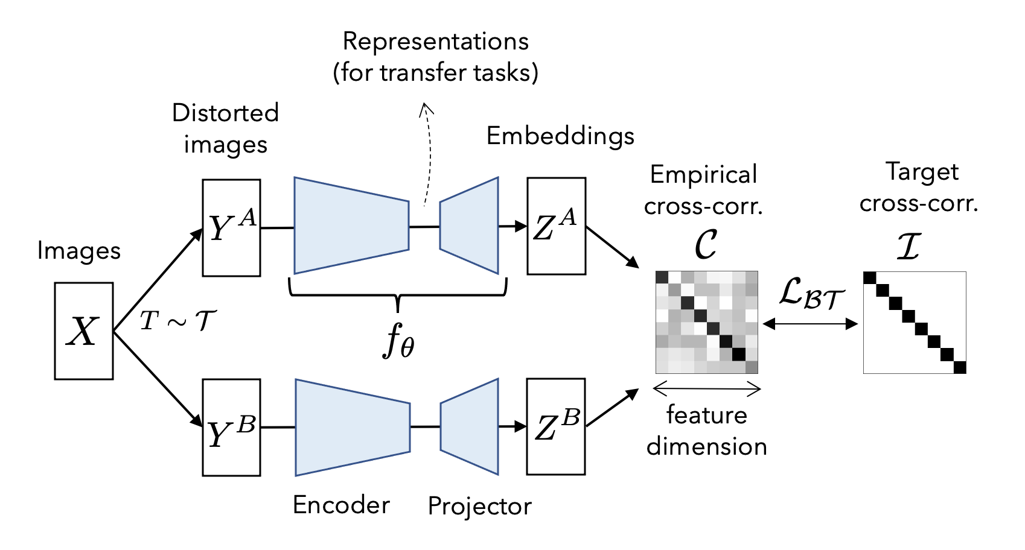
Barlow Twins

Slide 8
Results
Finetuned on 900 pairs of images
Used 325 pairs for validation
Found 51/325 in the top-1: 15.7%
Found 105/325 in the top-5: 32.3%
Found 131/325 in the top-10: 40.3%
Found 152/325 in the top-15: 46.7%
Found 184/325 in the top-25: 56.6%

Slide 9
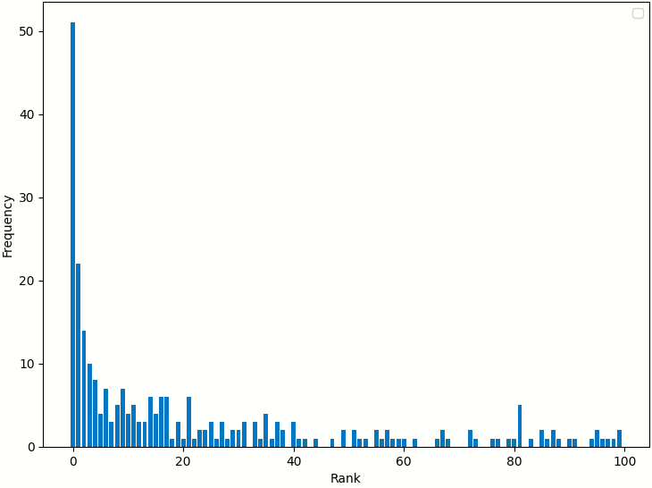
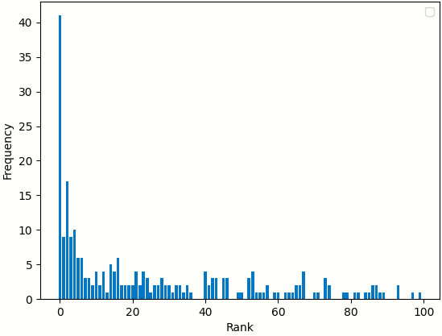
Barlow Twins vs Classification pretraining

Slide 10
Conclusion
Our results suggest that pretraining Siamese networks using contrastive learning, such as the Barlow Twins Loss, may be a promising approach for image similarity tasks.

Slide 11
Thanks for your attention!

