Slide 1
Image Similarity
ATAI/DNN Project
Munteanu Victor

Slide 2
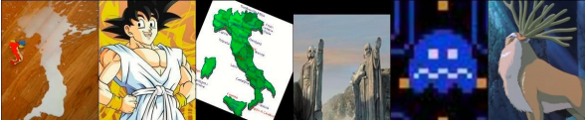
Recap
Find the pair

Slide 3
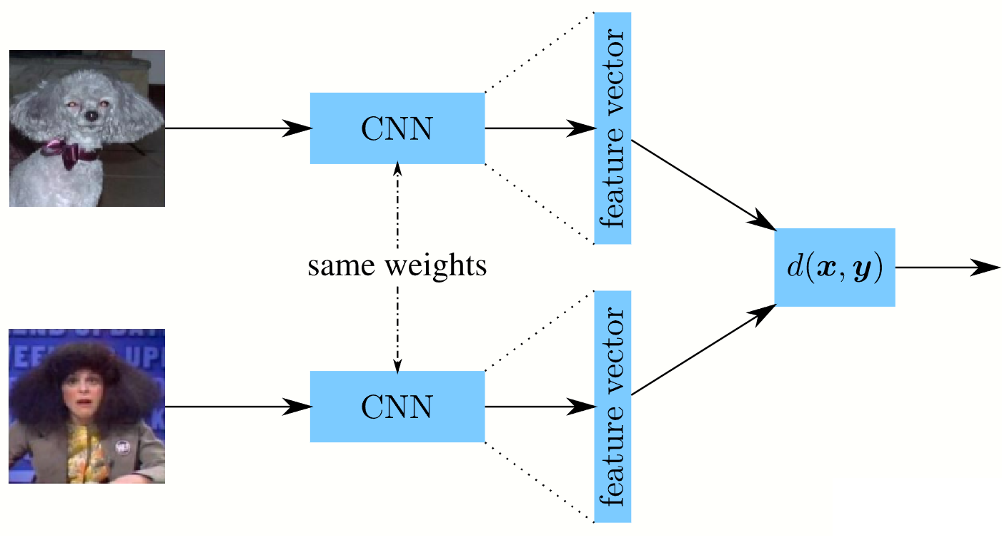
Siamese Network

Slide 4
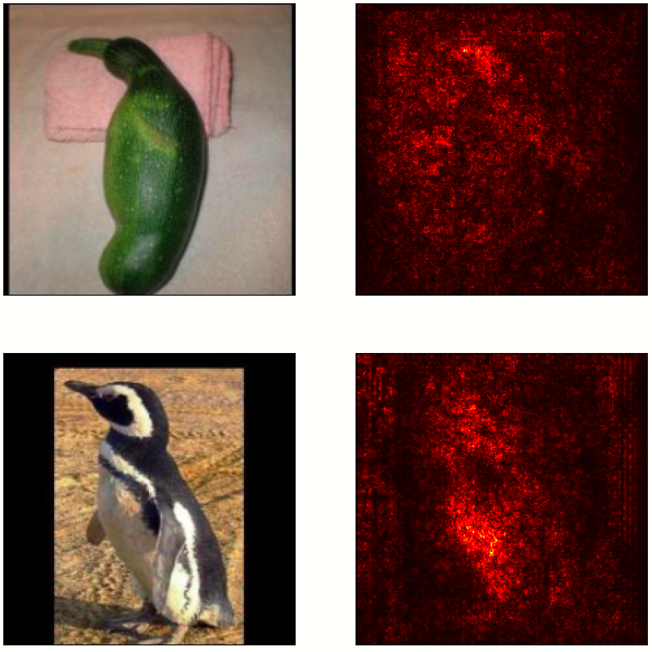
Experiments
Tried to learn the distance function: added adaptive layers, fine-tuned on Totally-Looks-Like dataset to predict the similarity between 2 images.
Results: Top-25 metric, the target image was found in the closest 25 images only in 14/1200 cases.
Used Saliency maps to visualize the parts of the images based on which the network did the “matching”

Slide 5
Contrastive Learning
Pretrain using Barlow Twins Loss (similar to SimCLR) on ImageNet
Add “Projection Layers” on top for an even lower embedding space
(from 2000 -> 256)
Use TripletLoss to finetune the model

Slide 6
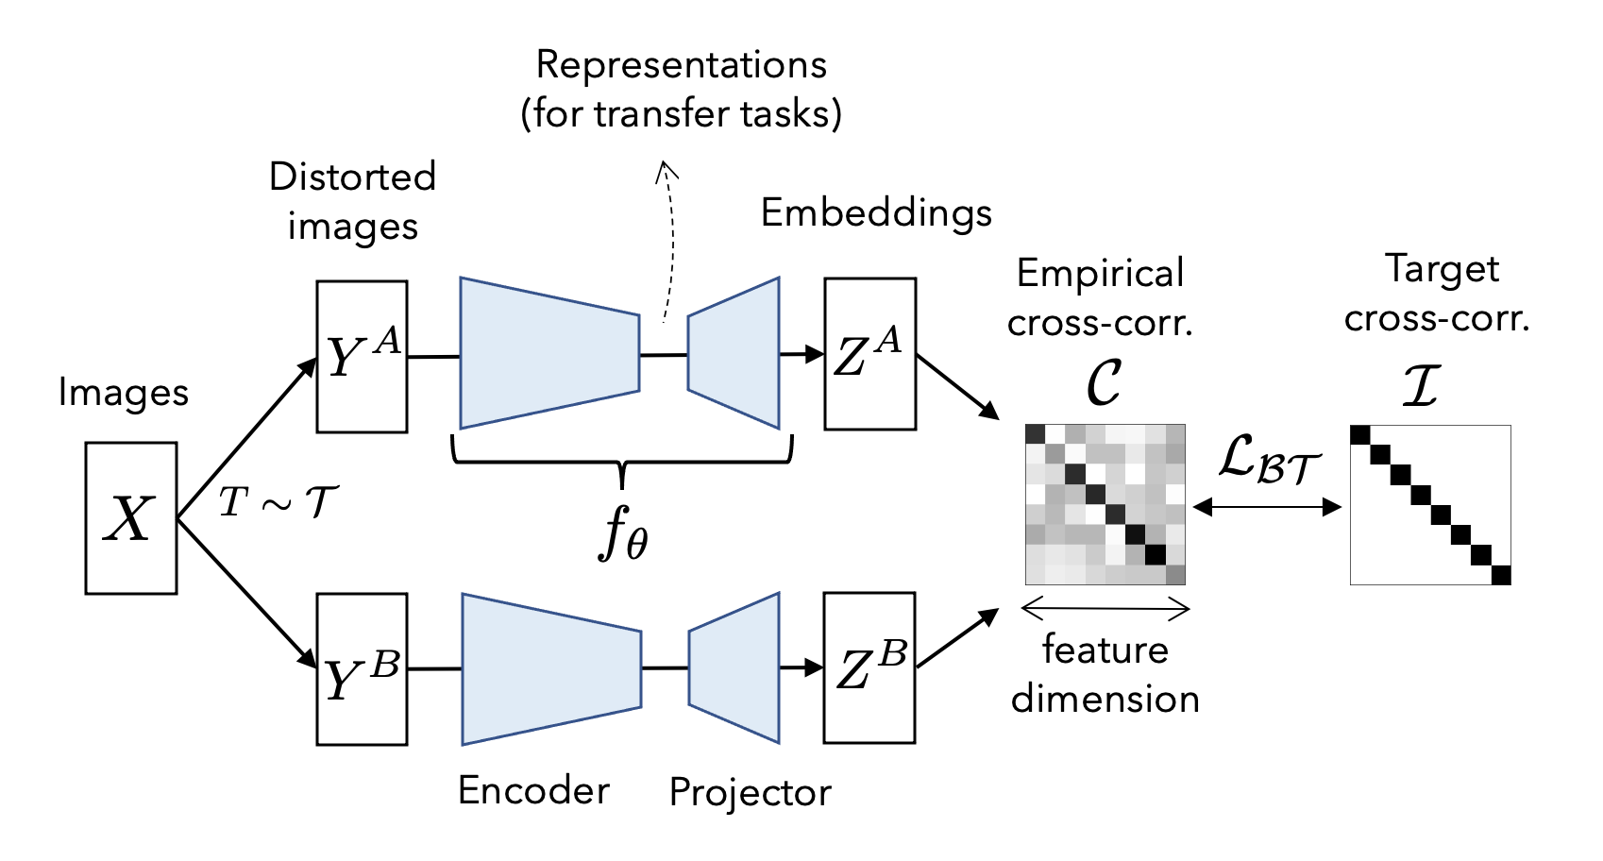
Barlow Twins

Slide 7
Results
Only ~1200 images are not matched based on facial features (biased dataset)
Finetuned on 900 pairs of images
Used 300 pairs for validation
Found 51/325 in the top-1
Found 105/325 in the top-5
Found 131/325 in the top-10
Found 152/325 in the top-15
Found 184/325 in the top-25
Found 222/325 in the top-50
Found 268/325 in the top-100

Slide 8
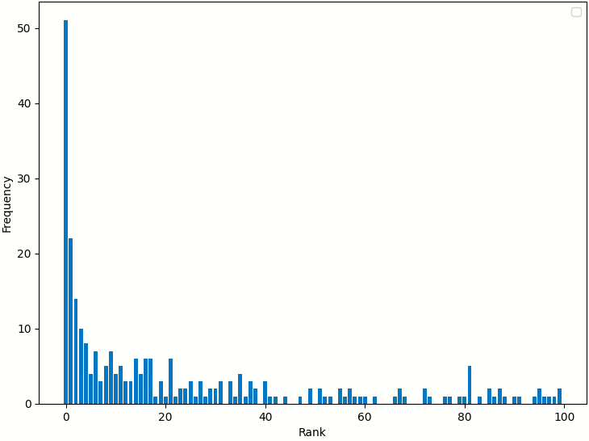
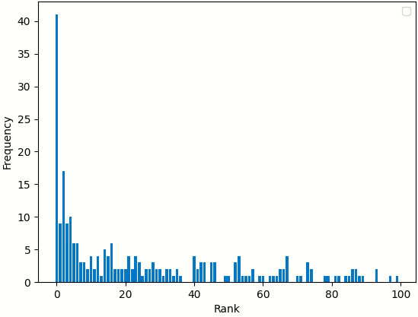
Barlow Twins vs ImageNet pretraining

Slide 9
Conclusion
Our results suggest that pretraining Siamese networks using contrastive learning, such as the Barlow Twins Loss, may be a promising approach for image similarity tasks.

Slide 10
Thanks for your attention!

