Slide 1
Image Similarity
ATAI/DNN Project
Munteanu Victor

Slide 2
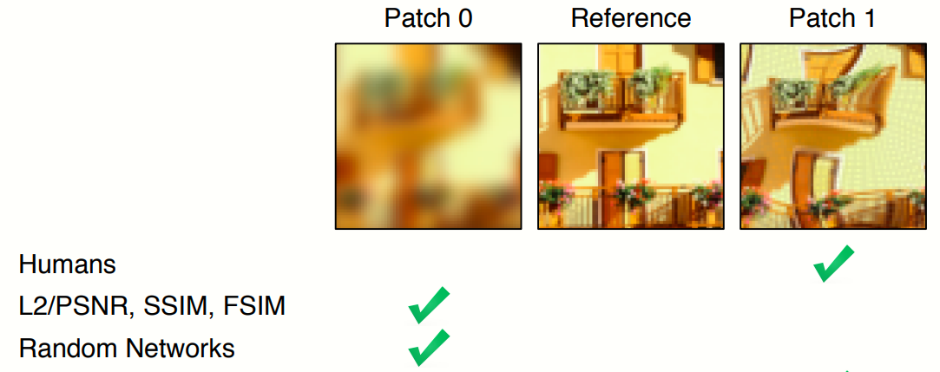
Introduction
For a given image, find the most “visually” similar image from a subset of images.
Notes:
While for humans is nearly effortless to assess the similarity between 2 images.

Slide 3
Motivation
image compression - where the decompressed image should be as indistinguishable as possible from the original image by a human observer, regardless of their pixel representations.

Slide 4
Challenges
The human judgment is asymmetric. For example, most humans will think image 1 looks more like image 2, but for image 2, will say that it looks more like image 3.
The following dataset, does not contain the direction information of which image from left or right is looking to the other one.

Slide 5
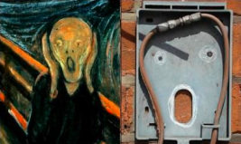
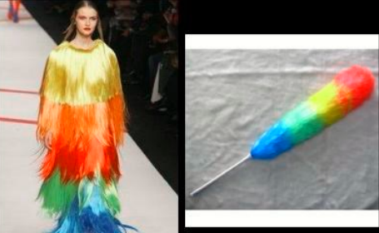
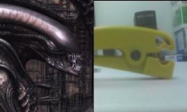
Dataset
Totally-Looks-Like
After a popular entertainment website, where people post pairs of images that they find as visually similar
~6000 pairs of images

Slide 6
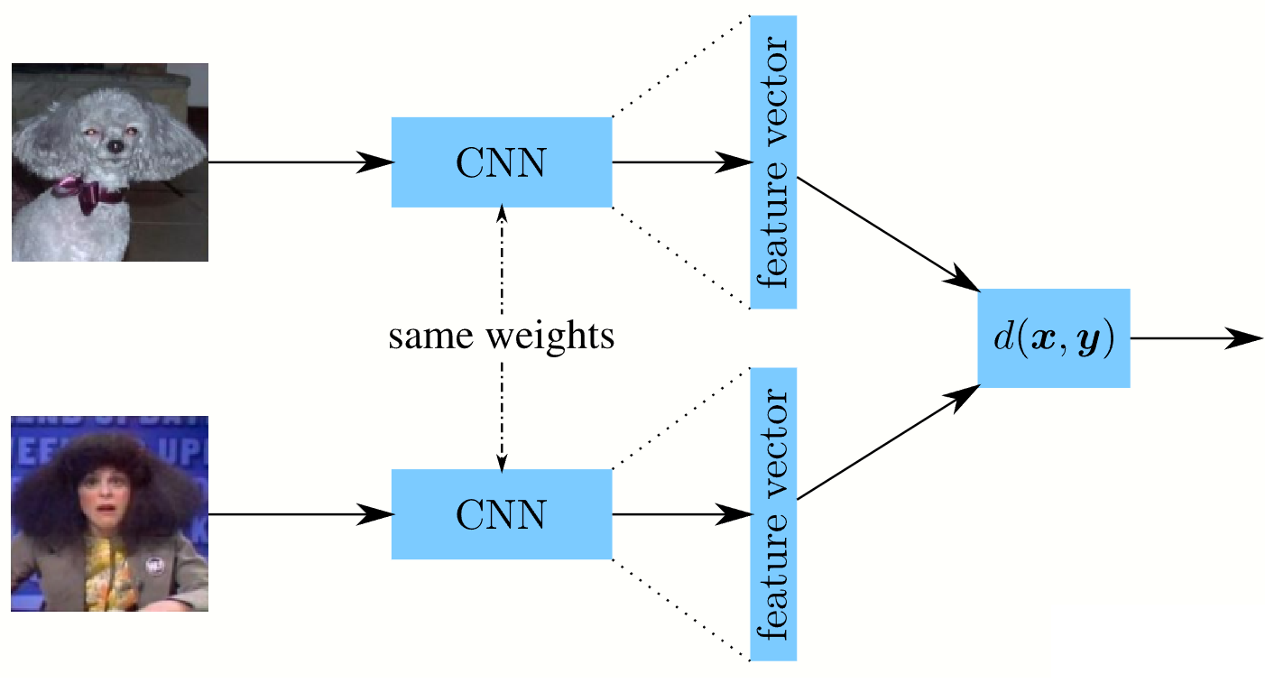
Related Work
The SoTA is to extract the features from each image by using some Convolutional Neural Network based architecture (ResNet, VGG, AlexNet, CoAtNet) and then check whether these features are close enough by using a distance function (cosine similarity, Euclidean distance).
Siamese Network
Triplet loss function

Slide 7
Evaluation
Will calculate a “confusion” matrix where each image in the dataset is compared with every other image in the dataset.
Recall curve at different ranks (should give a higher score the closer the ground-truth pair image is to the rank 1)

Slide 8
Thank you for your attention

