Slide 1
Image Similarity
ATAI/DNN Project
Munteanu Victor

Slide 2
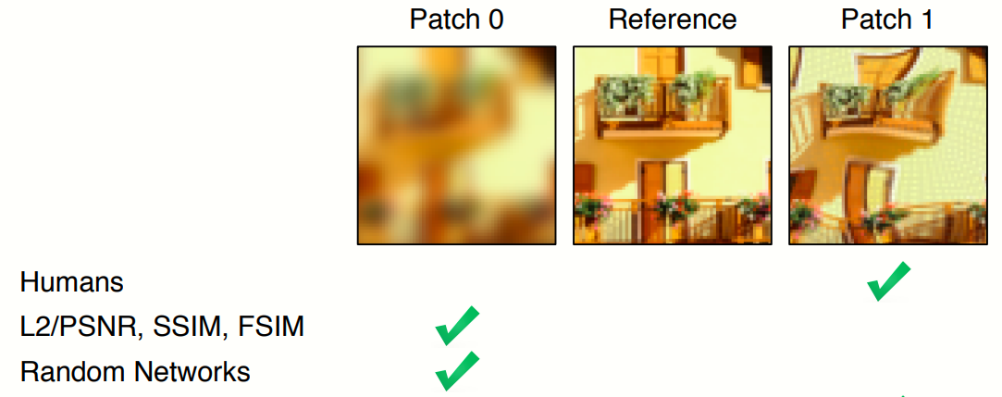
Recap

Slide 3
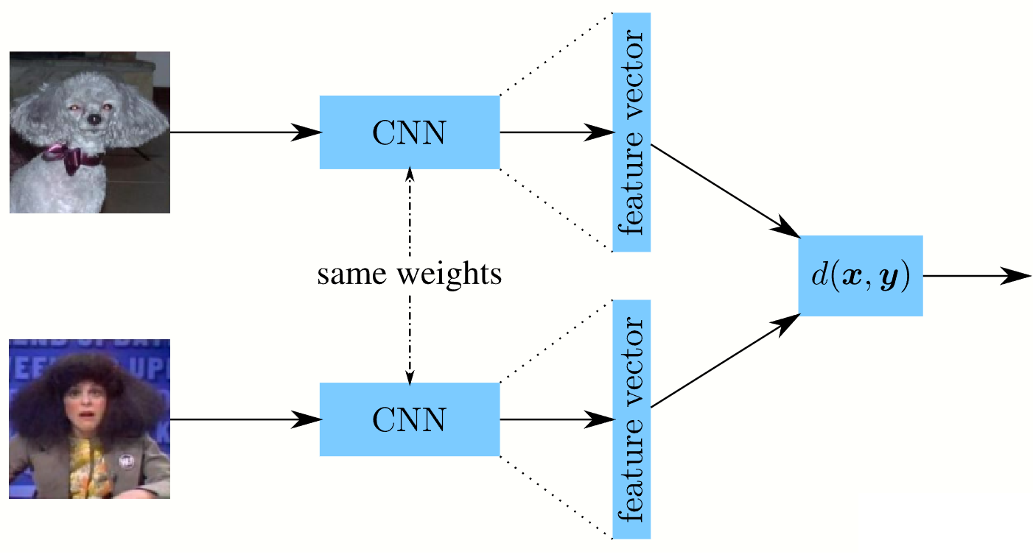
Siamese Network

Slide 4
Work so far
Evaluated a pretrained ResNet18 as a feature extractor
Fine-tuned ResNet18 on Totally-Looks-Like dataset
Used Saliency maps to visualize the parts of the images based on which the network did the “matching”

Slide 5
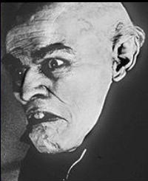

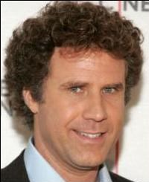
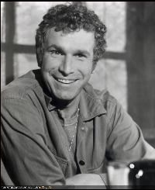
Evaluation
Totally-Looks-Like contains ~6000 pairs of images.
Only ~1200 images are not matched based on facial features (biased dataset)
Top-25 metric: given a reference image, look through all 1200 images from the right pair and choose the 25 most similar images. If the target image is among these, it will be added to the accuracy as correct.

Slide 6
Feature extractors
Used ResNet18 pretrained as a feature extractor
Removed the last layer
Used the cosine-similarity to see which images have the closest feature vectors
No training involved
Results:
Top-25 metric, the target image was between the 25 chosen only in 22/1200 cases.

Slide 7
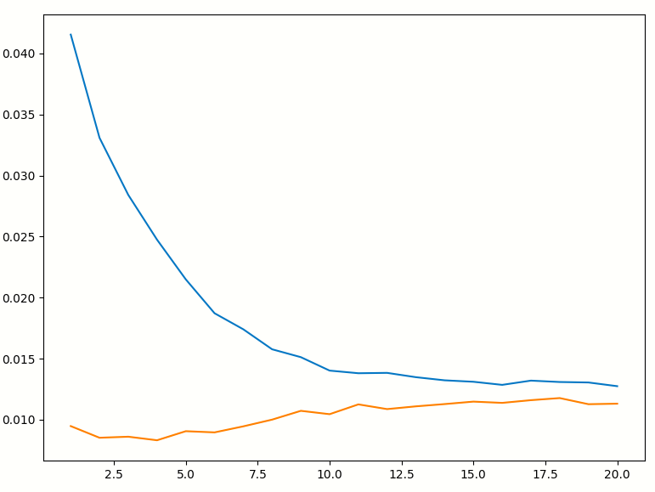
Fine-tune ResNet18 on Totally-Looks-Like
Added an “Adaptive function” formed of several linear layers that receive the concatenation of the features of the 2 images which outputs either:
a single probability value saying how similar the images are (Binary Cross Entropy Loss)
2 probabilities, so I can treat the problem as a classification problem (see later)
Results:
Top-25 metric, the target image was between the 25 chosen only in 14/1200 cases.

Slide 8
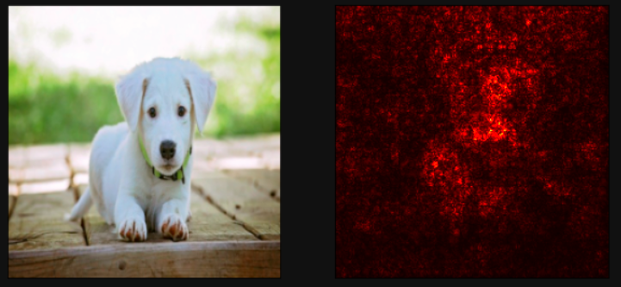
Saliency maps
What pixels from the input image helped the most in taking a decision.

Slide 9
Saliency maps for Siamese Networks
Had to make sure that I don’t use a method that relies on the gradients from the network since they get overridden when the 2nd image is passed through.
Since Saliency maps were better suited for classifiers, I “transformed” the Siamese Network into a classifier by making it output 2 probabilities, each for the labels “similar” and “dissimilar”.

Slide 10
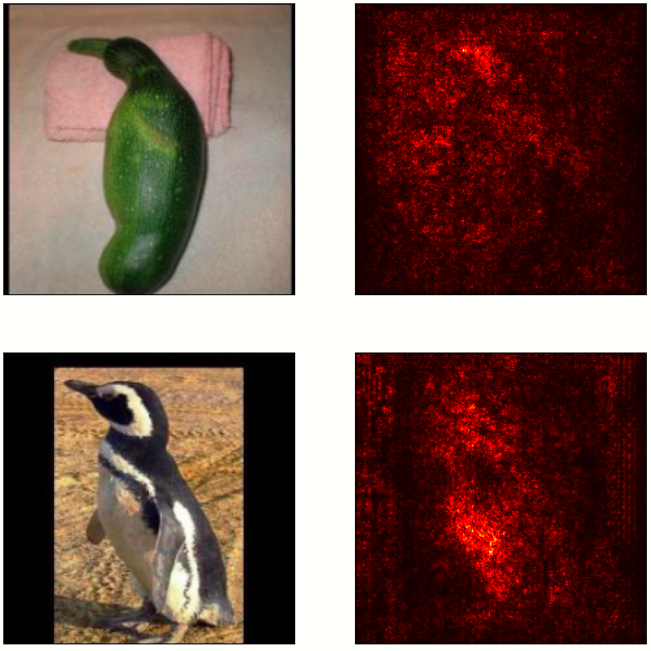
Backpropagations
For a Siamese Network that uses ResNet18 as feature extractor, 2 linear layers as the adaptive function and that output 2 probabilities, I backpropagated the gradients through the `similar` label:

Slide 11
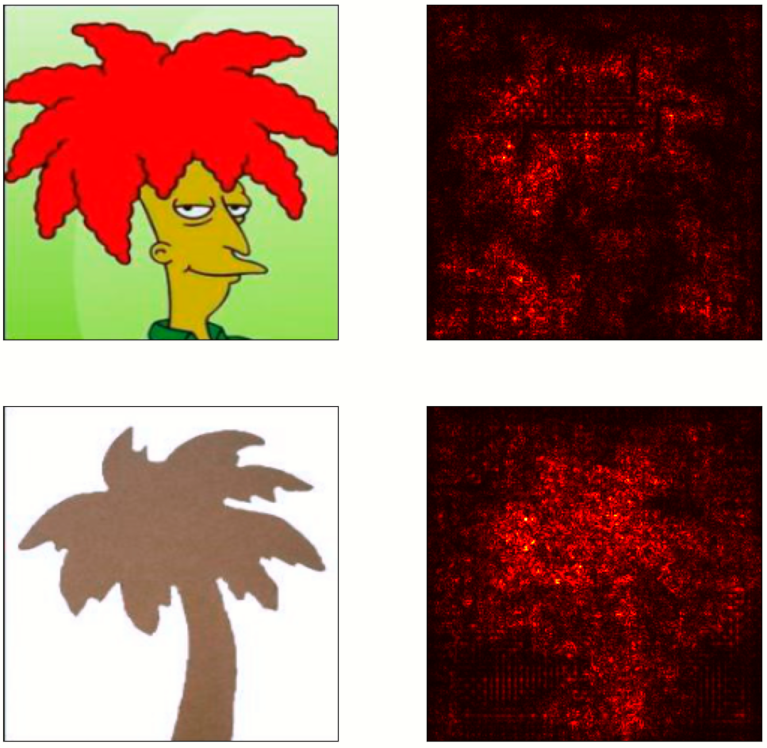
The MSELoss for the pretrained ResNet18 with only a feature extractor:

Slide 12
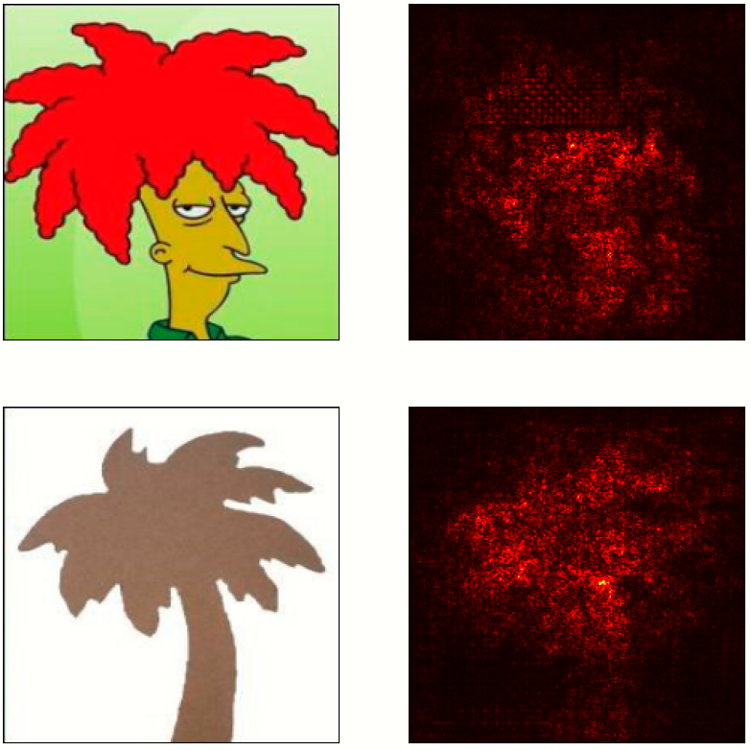
In the case where the Siamese Network output was a single probability value, I simply backpropagated the output.

Slide 13
Next steps
Test larger models
Change the dataset to Perceptual Similarity?

