Slide 1

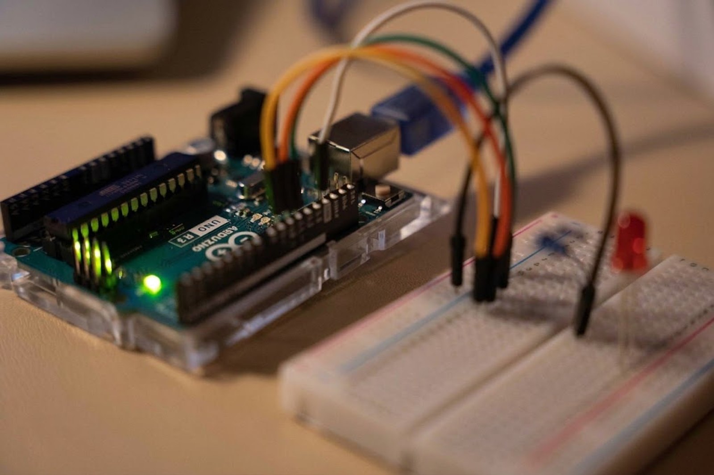
01 / TITLE
Joint-Agent
IDE
The idea should be the hardest part.
The autonomous AI agent that writes, compiles and flashes embedded firmware — from a browser tab.
SEED · $300,000 · LIVE IN PRODUCTION

Slide 2
02 / PROBLEM
Nobody quits because the idea was too hard.
Amara has a working idea for an irrigation controller. She loses the weekend to toolchains, drivers and a compiler error written for someone who already knows what it means.
Install toolchain
Match versions
Find the port
Decode errors
Build the actual thing
HER WEEKEND
And Amara is the lucky case — she owns a laptop. Plenty of students and first-time builders don’t. They own a phone. Today that rules them out of hardware entirely, before ability is ever tested.
That gap is where talent leaks out.
Notes:
"Everyone who's touched embedded knows this weekend. Two days lost to toolchains and drivers before a line of real code — and for a lot of talented people that's where the project dies. But notice Amara is the lucky one: she has a laptop. A huge share of the people who'd be best at this own a phone and nothing else, so they never start. The barrier isn't ability. It's setup — and hardware." (~30s)

Slide 3
03 / SOLUTION
Describe it. It compiles. It flashes.
BEFORE
IDE
drivers
SDK
board manager
build system
serial config
Plain English in. Working firmware running on your physical board — in a browser tab, with nothing installed.
WITH JOINT-AGENT IDE
"Blink the built-in LED twice a second"
▸ running on the board
Notes:
"One sentence in. A minute later, working firmware on physical hardware, nothing installed. The objection: 'isn't this ChatGPT for Arduino?' No — those hand you code and wish you luck. We run the whole loop, and the compiler proves it worked." (~22s)

Slide 4
04 / HOW IT WORKS
A real toolchain, not a chat box.
01 · DESCRIBE
02 · GENERATE
03 · COMPILE
04 · FLASH
Plain English
Board-specific C++
Joint-Agent Engine
Straight to metal
It asks which board and what behaviour.
Correct libraries pulled in automatically.
A genuine PlatformIO toolchain in the cloud.
Over Web Serial, with a live serial monitor.
The compiler is the evaluator.
The model cannot bluff.
Self-healing loop
Build fails → the agent reads its own compiler error and fixes it. Correctness is verifiable, not an opinion.
Notes:
"Four steps, one tab. Step three is what matters: a real PlatformIO toolchain in the cloud across 466 boards. That's the hard infrastructure — and it means the agent grades itself. When the build breaks it reads its own error and fixes it. Objection: 'can an LLM really debug firmware reliably?' It doesn't have to be perfect. It has to iterate against a compiler that tells the truth." (~28s)

Slide 5
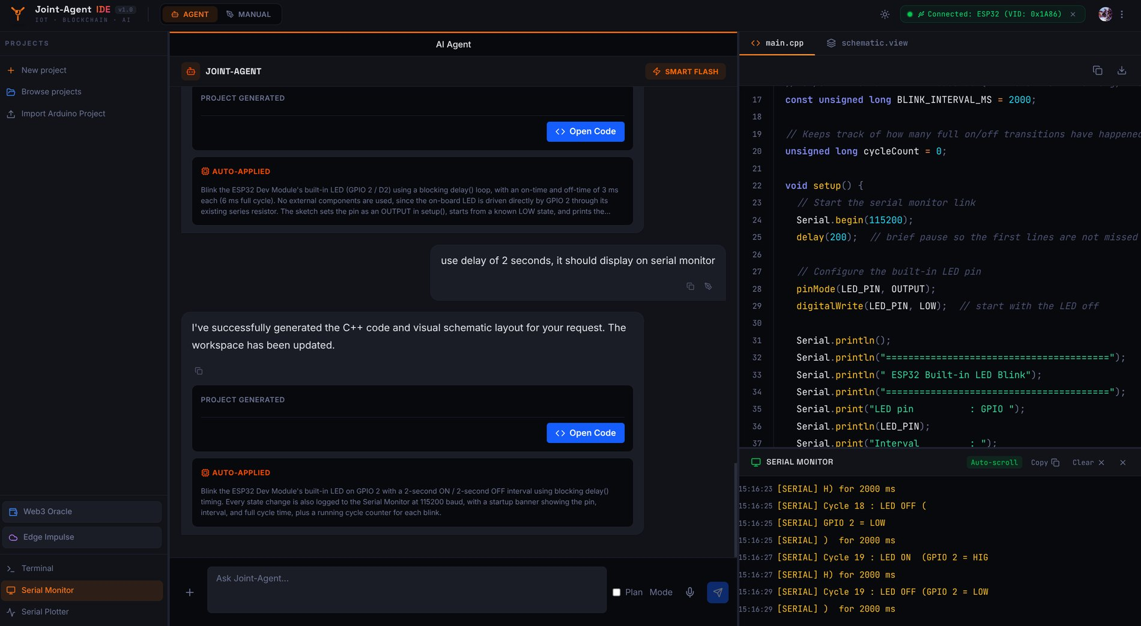
05 / TRACTION
Shipped, not slideware.
Live
466
In production, not a prototype
Supported boards
50
50
Discovery interviews
On the waitlist
Live
Solo
Payments — real, not mocked
Built end to end
The next dollar goes into scale — not into finding out whether this can be built.
Notes:
"This isn't a mockup. Auth, payments, the compiler, hardware flashing — all working, all built solo. That's the live serial monitor on the right of the screenshot: real hardware, reporting back. Fifty people I interviewed to shape it; a separate fifty already on the waitlist. Objection: 'fifty is small.' It is, deliberately. I'm raising to convert a waitlist and scale infrastructure, not to discover whether the thing works. That's answered." (~28s)

Slide 6
06 / MARKET
47.2M developers. The hardware ones have the worst tools.
The phone is the unlock [ V2 · ROADMAP ]
47.2M
developers worldwide — SlashData, 2025
Every embedded tool ever built assumes a laptop. Students, hobbyists and first-time builders are far likelier to own a phone than a dev-capable laptop. Flashing over OTG from Android reaches a population no desktop tool can address — that’s not a feature, it’s a second market.
×
~6M
in embedded / IoT (internal estimate)
×
$84
per Pro subscriber, per year
Universal problem
=
~$500M
TAM
Setup friction blocks a maker in Berlin exactly as it blocks one in Enugu.
Free distribution
This counts people already counted as developers. It excludes everyone shut out for owning a phone and not a laptop — the segment mobile flashing opens.
Founder runs the largest student hardware community in South-East Nigeria. A beachhead, not a boundary.
Notes:
"The 47.2 million is sourced. The 6 million embedded slice is my estimate and I label it as one. Times eighty-four a year, roughly a five-hundred-million TAM. But that figure only counts people already classified as developers — every one of whom owns a laptop. Mobile flashing is the interesting number, because a phone is the one computer almost every student already has. Objection: 'not venture-scale.' At seven dollars alone, no. Team seats, institutions, and a device class nobody else can serve change that." (~28s)

Slide 7
07 / BUSINESS MODEL
90% gross margin, live today.
FREE
PRO
$0
$7 /mo
50,000 tokens — roughly 15 complete projects. Enough to feel the value.
400,000 tokens — 100+ projects.
REVENUE $7.00
COST $0.25–0.56
$7 is the wedge, not the ceiling
Team seats, institutional and education licensing, and mobile all raise revenue per account on the same product.
Notes:
"Freemium. Free tier is about fifteen projects — enough to prove it. Pro is seven dollars, inference costs well under a dollar per active subscriber, so margin sits around ninety percent and improves with scale. The objection is always price — and the answer is the price per seat isn't fixed. Institutions, teams and mobile all move revenue per account up on the same product." (~24s)

Slide 8
08 / COMPETITION
Everyone else stops at the code.
 | Writes code | Compiles for real | Flashes hardware | Zero install
Arduino IDE / PlatformIO | ✕ | ✓ | ✓ | ✕
Wokwi & simulators | ✕ | ✕ | ✕ | ✓
Copilot / Cursor / ChatGPT | ✓ | ✕ | ✕ | ✓
Joint-Agent IDE | ✓ | ✓ | ✓ | ✓
Verifiable. The compiler grades the model.
Real infrastructure. Cloud compilation across 466 boards.
Browser to metal. No install, unlike every incumbent.
The full loop. Others hand you code. We hand you a running board.
Notes:
"Only our row is yes across the board. Simulators never touch real hardware. General assistants write code with nothing verifying it. Classic IDEs still need the install we removed. Objection: 'couldn't OpenAI or Arduino just add this?' They'd have to build the same cloud compiler and the same flashing layer. That's the moat, and we're already through it." (~28s)

Slide 9
09 / ROADMAP
From one board to the whole workflow.
NEAR — THE UNLOCK
Bridge Agent. A lightweight local companion connecting any microcontroller to the browser on Linux, Windows, macOS, iOS and Android — removing the Web Serial limit entirely.
Build hardware with no computer at all
An OTG cable turns any Android phone into the entire workbench — write, compile and flash. For a student who has a phone and no laptop, this is the difference between building and not building.
MID
Agentic circuit simulation and design · AI-powered CAD for embedded · custom component building · auto-generated IoT sketches.
LATER
Generated companion apps · OTA firmware updates · collaboration spaces · dashboards · no-code automations · AI/ML and LLM plugins · blockchain accountability plugin.
Every rival tool needs a laptop. We need a phone and a cable.
Notes:
"The Bridge Agent is the single most important thing on this slide. Today flashing needs a desktop browser with Web Serial. A small local helper removes that — and then you flash a board from an Android phone over OTG, using a cable that costs about a dollar. Think about what that means: a student with no laptop can build real hardware. Every competitor requires a computer they don't have. We require the phone already in their pocket. Everything after this is expansion — this is what turns a tool into a platform." (~28s)

Slide 10
10 / MILESTONES
What the next 18 months buy.
NOW
MONTHS 1–6
MONTHS 7–12
MONTHS 13–18
Live in production. 466 boards. 50 interviews. 50 on the waitlist. Payments working.
Bridge Agent on desktop and mobile — including OTG flashing from Android phones. Board coverage expanded. First paying cohort converted.
Circuit simulation and CAD in beta. Team and education licensing. Distribution beyond the founding community.
Collaboration, OTA, plugin ecosystem. Series A readiness on recurring revenue and retention.
Notes:
"'Now' is already done — that's the point of anchoring it on the timeline. First six months: the Bridge Agent and converting the waitlist into revenue. By month twelve, licensing launched and distribution past my own community. By eighteen, Series-A-ready on retention numbers, not promises." (~22s)

Slide 11

11 / TEAM
Built by someone who lived the problem.
Founder — Joint-Agent IDE
Full-stack embedded engineer. 4+ years embedded, 3+ years software including web and blockchain. Built the product end to end, solo.
Founder — Ogbontor Engineering Enterprise
The largest student hardware community in South-East Nigeria. Trains robotics, embedded, IoT, PCB and CAD. Builds products for market and incubates student hardware ideas.
Founder — CNG Protect
Edge-AI IoT safety device predicting explosions in retrofitted CNG vehicles and warning drivers. ✓ BACKED BY SEDC · $5,000
He teaches the users, ships hardware products, and has already been funded once for embedded AI.
Notes:
"I'm not an outsider guessing at this market. I run the community that trains these builders, I've shipped hardware products, and CNG Protect was already backed for embedded AI. Objection: 'solo founder, big roadmap.' True — part of what the raise is for. But the riskiest thing, proving the product works, is done, and I did it alone." (~24s)

Slide 12
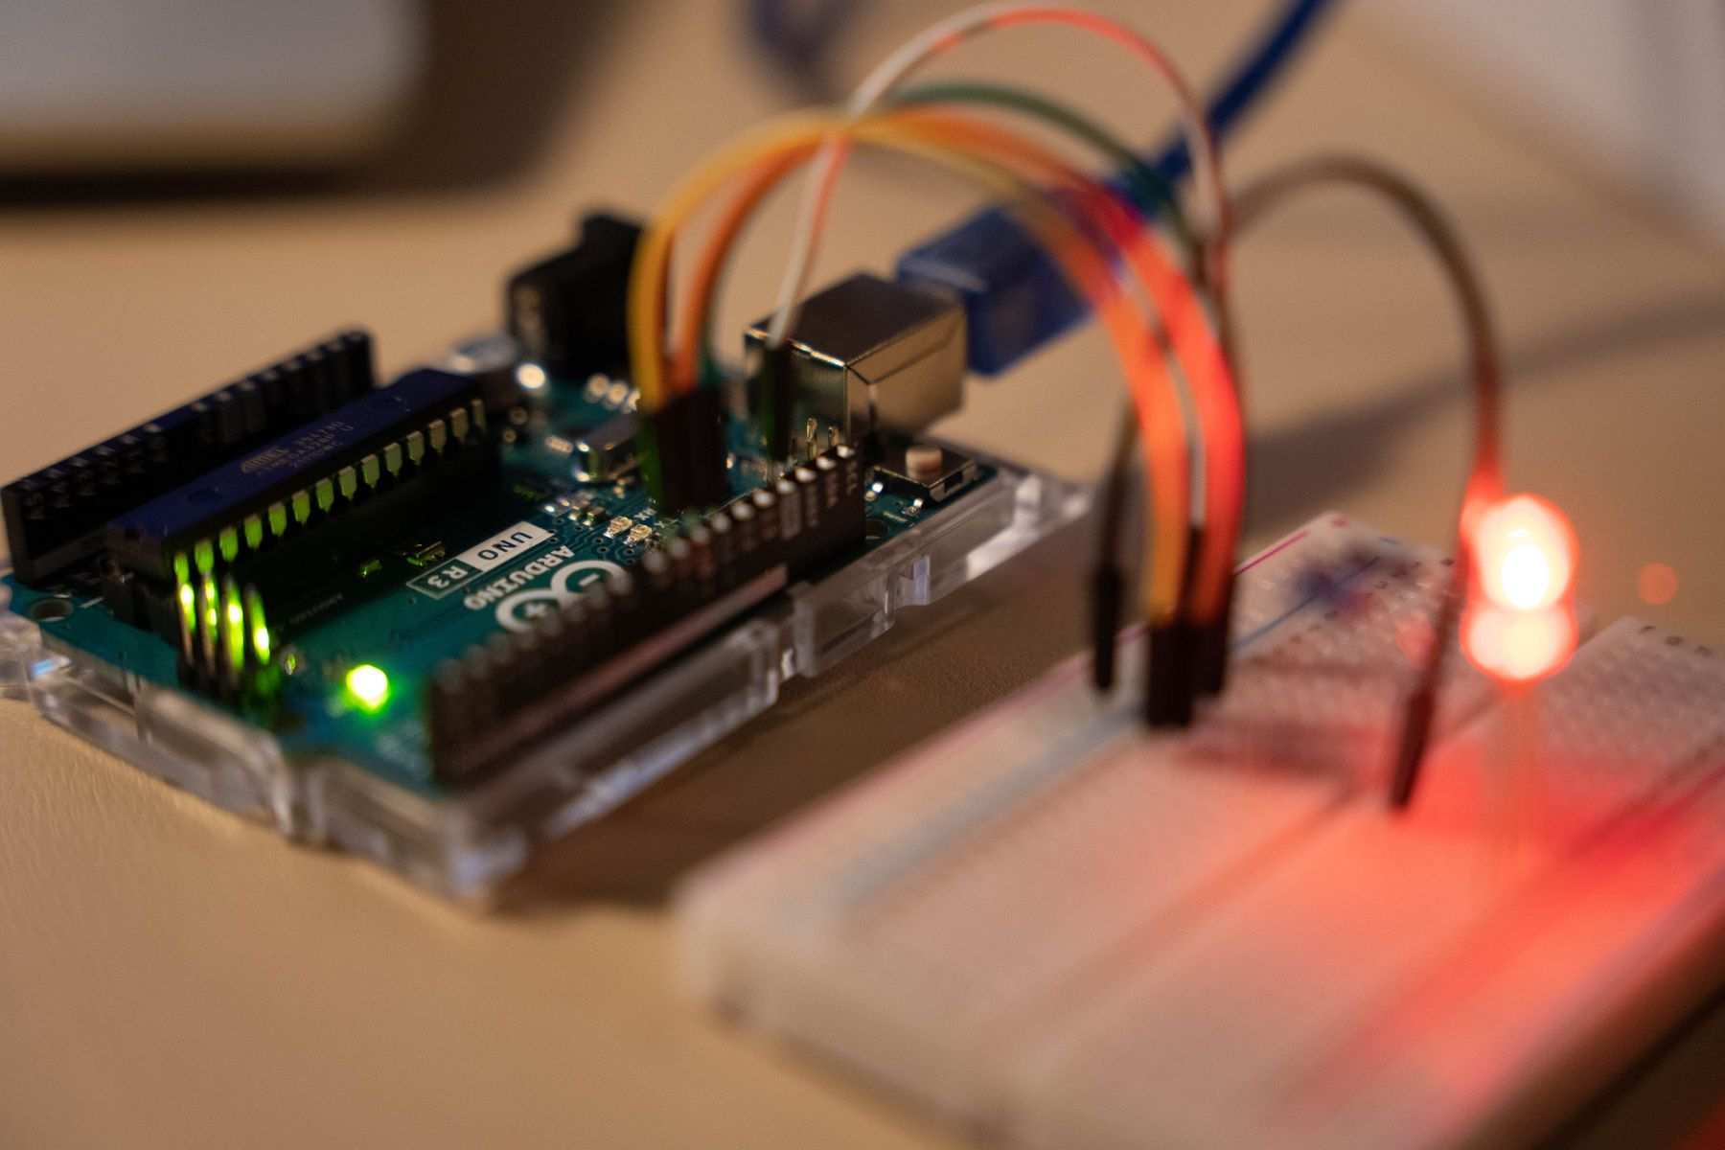
12 / THE ASK
$300,000 to make the idea the hardest part.
CLOUD INFRASTRUCTURE
Scale compilation and flashing capacity.
MARKETING & GROWTH
Convert the waitlist, reach embedded developers globally.
V2 DEVELOPMENT
Bridge Agent and phone-based flashing, circuit simulation and CAD, the plugin ecosystem.
Amara describes the irrigation controller and watches it run on the board. Her weekend goes into the idea.
The idea should be the hardest part.
JOINT-AGENT IDE · OGBONTOR ENGINEERING ENTERPRISE
Notes:
"Three hundred thousand: infrastructure, growth, and V2 — mainly the Bridge Agent, which is what puts this on a phone. The product is live, the margin works, the waitlist is waiting. Every hardware project that dies during setup is our market — and every builder who never got one because they don't own a laptop. It's running right now; happy to open it and build something live in the room." (~24s)

Slide 13
A1 / APPENDIX
ONLY IF ASKED
Technical architecture
Request
Browser sends plain English; the agent returns board-specific C++ plus a structured schematic.
Joint-Agent Engine
Containerised PlatformIO toolchain with espressif32 and atmelavr baked in — 466 boards from the real catalog.
Self-healing
On failure, compiler stderr feeds back to the agent, which patches and resubmits.
Flash
Binary streams to the browser and onto the board over Web Serial, with a live monitor reading back.

Slide 14
A2 / APPENDIX
ONLY IF ASKED
Unit economics
50,000
400,000
$0.25–0.56
Free cap — ~15 projects
Pro cap — 100+ projects
Inference / subscriber / month
Only output is metered
Prompts, system instruction and history aren’t charged to the user’s allowance.
Caching drives cost down
Automatic prefix caching discounts the repeated system instruction, so cost trends to the low end as usage grows.
Path beyond $7
Per-seat team billing, institutional and education site licences, and a mobile tier once the Bridge Agent ships.

Slide 15
A3 / APPENDIX
ONLY IF ASKED
Why incumbents can’t just add this.
Simulators
Model hardware in software. Closing the loop to a physical board means a flashing layer and a real toolchain — a different product, not a feature toggle.
General coding assistants
Have no evaluator. Nothing compiles it, nothing flashes it, nothing tells them when they’re wrong. Adding that is adding Joint-Agent Engine.
Classic IDEs
Already compile and flash — locally. Moving that to zero-install in the browser means rebuilding the toolchain as cloud infrastructure across hundreds of boards.

