Slide 1
Introduction to Operating Systems
Operating Systems I
Victor Yacovlev (Viktor Iakovlev)

Slide 2

Course Objective
The purpose of this course is to teach interaction of your programs to computer system
The layer between applications and hardware is called operating system

Slide 3
Course Objective
Topics we will cover:
  Linux Usage and Programming Tools
  Low-Level Topics in Programming
  System Calls for Files and Processes API’s
  Interprocess Communication – The next semester
Course Readings and Lectures will be published at GitHub:
https://github.com/victor-yacovlev/mipt-diht-caos/

Slide 4
Scoring System
70% - for Practice
  Four homeworks
  Starts from Week 4.
30% - for Exam

Slide 5
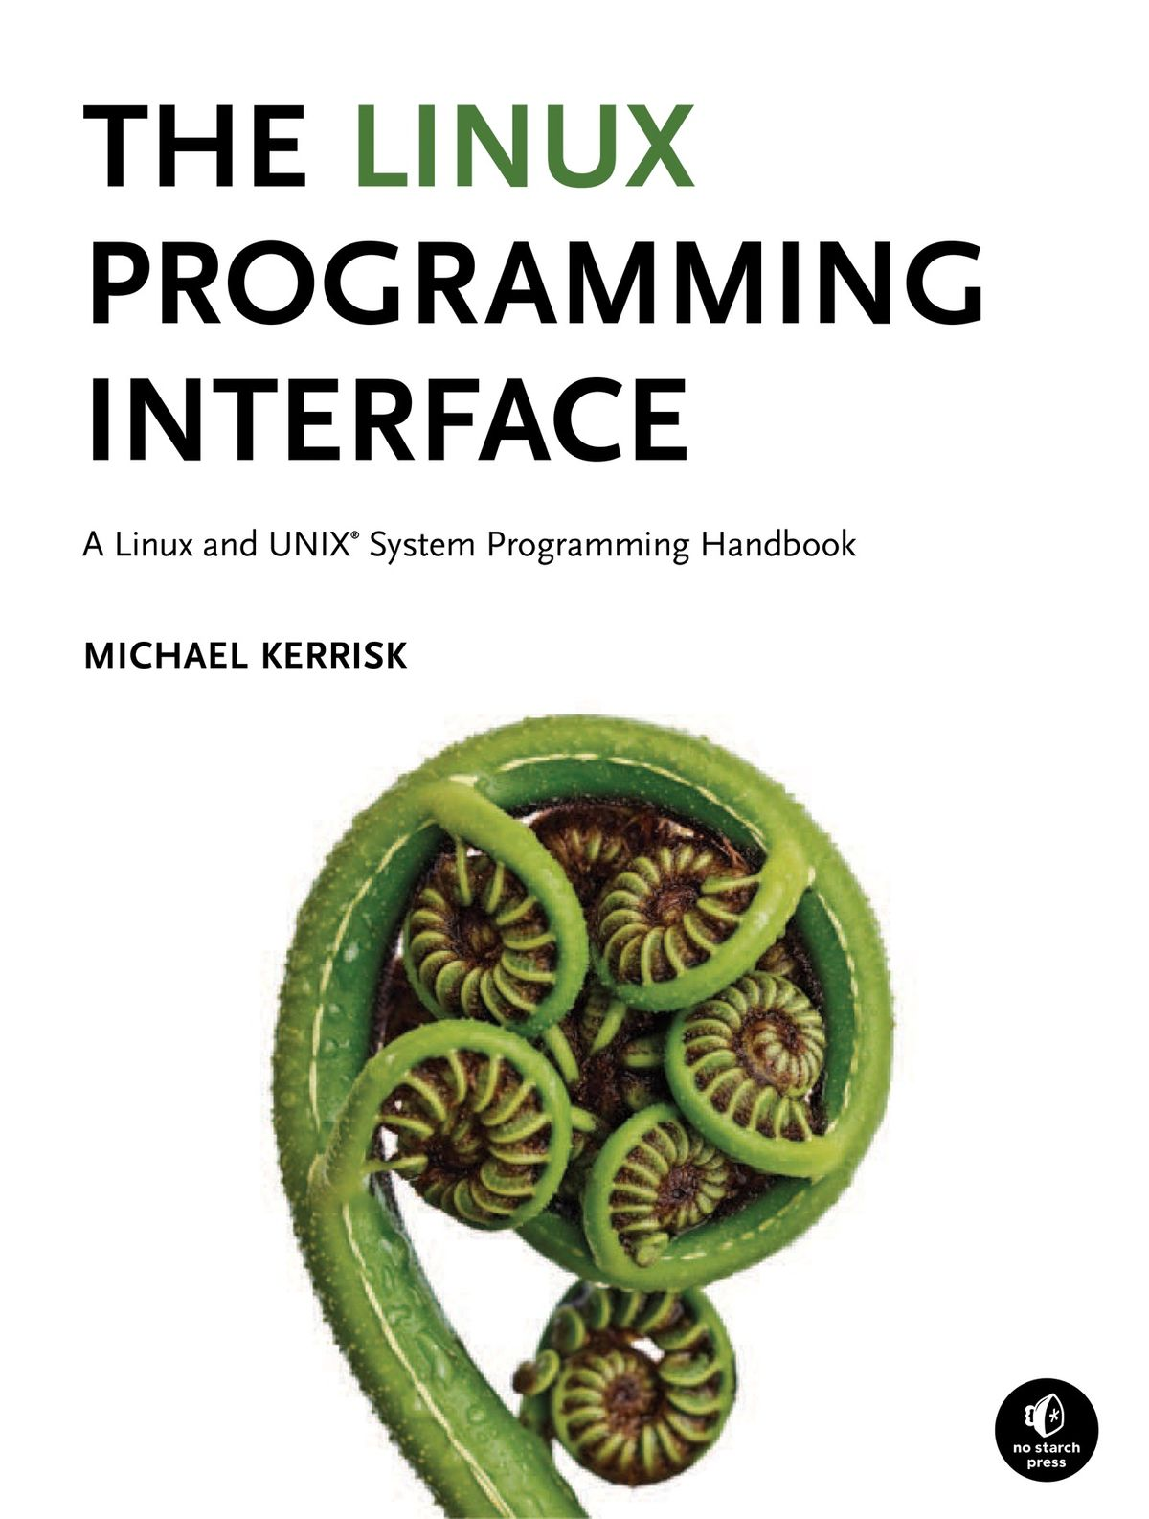
Course Textbook
The Linux Programming Interface
Michael Kerrisk, No Starch Press, 2010
This Course Reading
github.com/victor-yacovlev/mipt-diht-caos/
Linux Manual Pages
Will be discussed today

Slide 6
What is an Operating System
A set of programs that acts as an intermediary between user applications and computer hardware
The core program which interacts bare to metal is called kernel

Slide 7
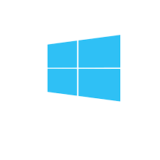




Which Operating System Do You Use?
All of them but Windows are UNIX-like systems

Slide 8
Operating System Layers
Applications
Unprivileged Operating System Components:
  Shell or Desktop Environment – provides interaction
  Services (Daemons) – work in background
  System Commands – called by users directly or by many components above
  System Libraries – used by all components above
Priveleged Level:
  The Kernel – interacts to hardware

Slide 9
This Course Operating System is GNU/LINUX
It is Open Source – well studied
It is UNIX-like
  [mostly] source-compatible to all UNIX variants
  if you know how Linux designed that you know how designed FreeBSD, Solaris, MacOS, Android etc.
It is Free – you can legally download and use without payment

Slide 10
But Linux – Just a Kernel...
Ubuntu [https://ubuntu.com/] – The most popular and user-friendly Linux distribution
Fedora [fedoraproject.org] – For technical minded users
ArchLinux [https://www.archlinux.org/] – For red eyed hackers
CentOS/RedHat/Debian/SUSE – For enterprise
There is no common recipe which distro to use

Slide 11
But if I have Windows installed?
Virtualization:
you can install almost any operating system as guest system as regular application
VirtualBox [https://www.virtualbox.org/]
  has good Linux support both as guest and host system
  works fast enough
  it’s free

Slide 12
The first task to be done at home
Install VirtualBox and Linux Operating System as guest to your laptop
Hints:
  do not allocate too much memory for guest system. 2Gb is usually enough if you follow Hint #2
  choose lightweight Desktop Environment (LXDE or XFCE)
It is NOT a home work to be scored…
… but it’s REQUIRED prerequisite to perform home works

