Slide 1
Version Control
C++ Programming Practice
Victor Yacovlev (Viktor Iakovlev)
and Julia Ivanova

Slide 2


What is Versioning

Slide 3
Versioning for Single Developer
Use of different computers (at work, at home)
Tracking of changes between versions

Slide 4
Version Control Systems
Centralized:
  Concurent Version System (cvs)
  Subversion (svn)
Distributed:
  Mercurial (hg)
  Git (git)

Slide 5


The Key Idea
X₀
∂X₀₋₁
∂X₁₋₂
X₂
Any text might be created by having initial text X₀ updated by set of patches ∂X₀₋₁ . . ∂X₁₋₂ . . ∂X_{M-N} . . X_{N}.

Slide 6
The Key Idea
Store initial version of files
Keep current version as-is (the working copy)
Commit changes from current version to previous by calculating differences
Store differences in history
X₀
∂X₀₋₁
∂X₁₋₂
X₂

Slide 7
Alternate Version (Branch)
X₀
∂X₀₋₁
∂X₁₋₂
X₂
It is possible to have
an alternate versions of working copy
∂Y₁₋₂
Y₂

Slide 8
Alternate Version
Do not make a full copy – just keep changes
Versions can be switched by reapplying patches
Typical use case: make new feature in project keeping mainstream untouched until feature ready

Slide 9
Merging Alternate Back
X₀
∂X₀₋₁
∂X₁₋₂
∂X₂₋₃
∂Y
X
∂Y₁₋₂
∂Y₁₋₂
∂Y₂₋₃
This join might have conflicts to be resolved manually!

Slide 10
Conflicts
Alternate history may affect the same files and the same parts of files
On merging there is a problem: which part of text to use
This can’t be performed automatically

Slide 11
What is a difference calculation
(a bit of mathematics to undestand)

Slide 12
Text Alignment Problem
fox jumps over dog
white fox dumbs dog

Slide 13
Text Alignment Problem
----- fox jumps over dog
white fox dumbs ---- dog
replacements
insertion
deletion
Patch := (+white), (j → d), (p → b), (-over)

Slide 14
How Patches are Calculated
The key idea – use the Dynamic Programming optimization method
Each string S₁ and S₂ to be compared have a substrings S₁^{N} and S₂^{N} of length N
Recursively calculate some measure function F(S₁^{N}, S₂^{N}) and choose the best value on recursion stage

Slide 15
How Patches are Calculated
The F(S₁^{N}, S₂^{N}) function is an edit distance
There is several way to calculate F(S₁^{N}, S₂^{N})
The notable methods to calculate F:
  Takes account only on insertions and deletions:
    Levenshtein Distance
    Longest Common Subsequence – used in git version control system
  Takes account boths insertions/deletions and symbols matching:
    Needleman-Wunsch Algorithm
    Smith-Waterman Algorithm
    Roytberg-Yacovlev Algorithm

Slide 16
The Levenshtein Distance
Measure Function

Slide 17
The Longest Common Sequence
Measure Fucntion

Slide 18
The Needle-Wunch
Measure Function
Score(i,j) - the Weight of symbols matching
GEP - the Gap Elongation Penalty for symbol deletion

Slide 19
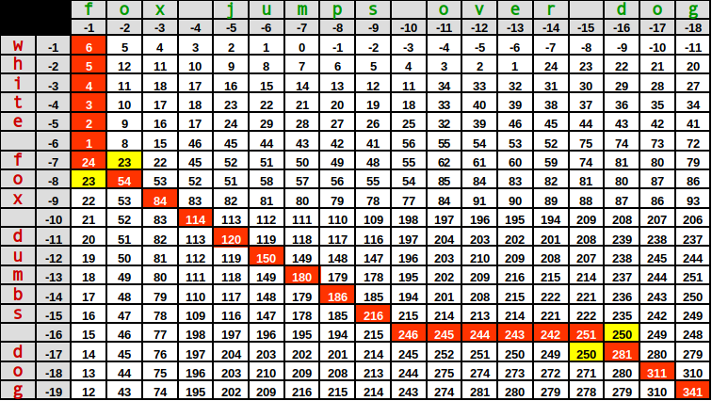
Example: Using NW to calculate difference
Space v.s. space 120
Exact symbol match 30
Letter v.s. letter 6
Space v.s. letter 0
Gap Elongation Penalty -1

Slide 20
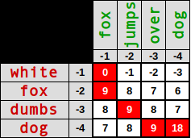
Block Alignment
Matrices might be too big
This might be solved by grouping symbols

Slide 21
Block Alignment
----- fox jumps over dog
white fox dumbs ---- dog
replacements
insertion
deletion
----- fox jumps over dog
white fox dumbs ---- dog
insertion
replacement
deletion

Slide 22
Git Version Control System

Slide 23
Git
master
HEAD
git init && git add && git commit

Slide 24
Git
master
HEAD
new-feature
git branch new-feature

Slide 25
Git
master
HEAD
new-feature
git checkout new-feature

Slide 26
Git
master
HEAD
new-feature
git commit

Slide 27
Git
master
HEAD
new-feature
git checkout master

Slide 28
Git
master
HEAD
new-feature
git commit

Slide 29
Distributed Storage

Slide 30
Distributed Git
BitBucket.org
GitHub.com
local server
PC1
PC2
PC3

Slide 31

Distributed Git
BitBucket.org
GitHub.com
RosKomNadzor
local server
PC1
PC2
PC3

Slide 32


Synchronization
x₁
x₂
x₃
master
HEAD
x₁
master
HEAD

Slide 33
Synchronization
x₁
x₂
x₃
master
x₂
x₃
HEAD
origin/master
x₁
master
git fetch
HEAD

Slide 34
Synchronization
x₁
x₂
x₃
master
x₂
x₃
HEAD
origin/master
x₁
master
git fetch
HEAD

Slide 35
Synchronization
x₁
x₂
x₃
master
x₂
x₃
HEAD
origin/master
x₁
Fast-Forward:
if no local changes
master
HEAD
git merge origin/master

Slide 36
Synchronization
x₁
x₂
x₃
master
HEAD
origin/master
x₁
y₁
y₂
z
master
HEAD
git commit

