Slide 1
Protocol Stack Architecture
APP
Apps
P
P
P
...
P
GAP
GATT
Host
ATT
SM
L2CAP
HCI
LL
Controller
PHY
Notes:
Provides the capability of updating code in deployed devices without the cost of physical access
Two different methods
Over-the-air BootLoader (OBL)
Image is downloaded and overwrites the run-code image
Maximum image size is slightly less than half of the available flash
Boot Image Manager (BIM)
Provides the flexibility of having two valid images, each capable of running on reset
Either image can execute an OAD on the other
Possible use cases
Dual stack (proprietary & BLE)
Dual image with selection made at boot-time (ex. heart-rate sensor & glucose sensor)
By restricting one of the images to a small, resident “OAD-only image,” the application image can be much larger than half of the available flash

Slide 2
TI Bluetooth low energy Hardware
蓝牙 BR/EDR
蓝牙4.0双模
BLE单模
Classic
Bluetooth Smart Ready
Bluetooth Smart
SPP
SPP
Attribute Profile
Attribute Profile
RFCOM
RFCOM
Attribute Protocol
Attribute Protocol
L2CAP
L2CAP
L2CAP
Link Manager
Link Manager
Link Layer
Link Layer
BR/EDR PHY
BR/EDR + LE PHY
LE PHY
Notes:
The ”single device solution” solution would be to use our flash based System-On-Chip as it’s true intent, put the complete solution in it. It will have the stack and application running on it.
The ”Dual Device solution” is a way for you to let the application run on another device, for example, if you would want to add bluetooth low energy functionality to an already existing design. Using a network processor configuration allows an external application and profiles to communicate by means of vendor-specific HCI commands using a hardware or UART interface, or using a virtual UART interface over USB. In these cases, the application can be developed externally while still running the Bluetooth low energy stack on the CC2540 or 41. This is the solution used with our CC2540 USB Dongle in the CC2540DK-MINI kit as we will see in a moment.

Slide 3
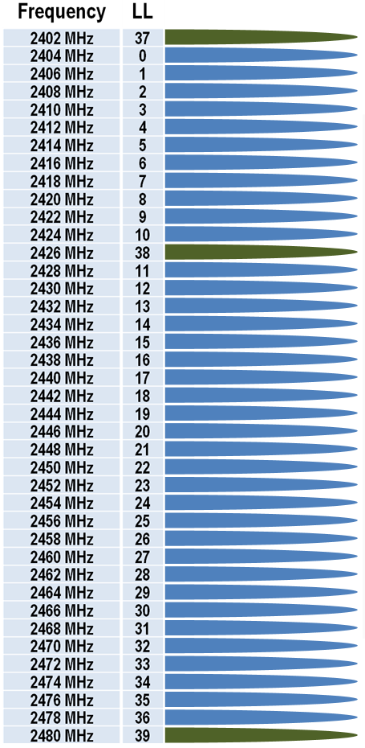
Physical Layer (PHY)
APP
RF Specifications
Operates in 2.4 GHz ISM band
GFSK modulation
40 channels with 2 MHz spacing
3 fixed advertisting channels for broadcasting, which avoid 802.11 interferance
37 adaptively frequency hopped dynamic data channels
Physical layer can be combined with standard Bluetooth RF in a dual-mode device
2 MHz spacing allows for better adjacent channel rejection
1
P
P
P
...
P
GAP
GATT
6
ATT
SM
L2CAP
HCI
11
LL
PHY
Notes:
Provides the capability of updating code in deployed devices without the cost of physical access
Two different methods
Over-the-air BootLoader (OBL)
Image is downloaded and overwrites the run-code image
Maximum image size is slightly less than half of the available flash
Boot Image Manager (BIM)
Provides the flexibility of having two valid images, each capable of running on reset
Either image can execute an OAD on the other
Possible use cases
Dual stack (proprietary & BLE)
Dual image with selection made at boot-time (ex. heart-rate sensor & glucose sensor)
By restricting one of the images to a small, resident “OAD-only image,” the application image can be much larger than half of the available flash

Slide 4
TI Bluetooth low energy Hardware
1
4
2-257
3
byte
Preamble
Access Address
PDU
CRC
LSB
MSB
Notes:
The ”single device solution” solution would be to use our flash based System-On-Chip as it’s true intent, put the complete solution in it. It will have the stack and application running on it.
The ”Dual Device solution” is a way for you to let the application run on another device, for example, if you would want to add bluetooth low energy functionality to an already existing design. Using a network processor configuration allows an external application and profiles to communicate by means of vendor-specific HCI commands using a hardware or UART interface, or using a virtual UART interface over USB. In these cases, the application can be developed externally while still running the Bluetooth low energy stack on the CC2540 or 41. This is the solution used with our CC2540 USB Dongle in the CC2540DK-MINI kit as we will see in a moment.

Slide 5
TI Bluetooth low energy Hardware
1
4
2
0-255
3
byte
Preamble
ADVERTISING CHANNEL PDU
CRC
Access Address
Header
Payload
LSB
MSB
1
4
2
0-251
4
3
byte
Preamble
DATA CHANNEL PDU
CRC
Access Address
Header
Payload
MIC
LSB
MSB
Notes:
The ”single device solution” solution would be to use our flash based System-On-Chip as it’s true intent, put the complete solution in it. It will have the stack and application running on it.
The ”Dual Device solution” is a way for you to let the application run on another device, for example, if you would want to add bluetooth low energy functionality to an already existing design. Using a network processor configuration allows an external application and profiles to communicate by means of vendor-specific HCI commands using a hardware or UART interface, or using a virtual UART interface over USB. In these cases, the application can be developed externally while still running the Bluetooth low energy stack on the CC2540 or 41. This is the solution used with our CC2540 USB Dongle in the CC2540DK-MINI kit as we will see in a moment.

Slide 6
TI Bluetooth low energy Hardware
1
4
2
0-37
3
byte
Preamble
Access Address
Header
Payload
CRC
LSB
MSB
4
2
1
1
6
2
bits
PDU Type
RFU
TxAdd
RxAdd
Length
RFU
LSB
MSB
Notes:
The ”single device solution” solution would be to use our flash based System-On-Chip as it’s true intent, put the complete solution in it. It will have the stack and application running on it.
The ”Dual Device solution” is a way for you to let the application run on another device, for example, if you would want to add bluetooth low energy functionality to an already existing design. Using a network processor configuration allows an external application and profiles to communicate by means of vendor-specific HCI commands using a hardware or UART interface, or using a virtual UART interface over USB. In these cases, the application can be developed externally while still running the Bluetooth low energy stack on the CC2540 or 41. This is the solution used with our CC2540 USB Dongle in the CC2540DK-MINI kit as we will see in a moment.

Slide 7
TI Bluetooth low energy Hardware
1
4
2
0-251
4
3
byte
Preamble
Access Address
Header
Payload
MIC
CRC
LSB
MSB
2
1
1
1
3
8
bits
LLID
ENSN
SN
MD
RFU
Length
LSB
MSB
Notes:
The ”single device solution” solution would be to use our flash based System-On-Chip as it’s true intent, put the complete solution in it. It will have the stack and application running on it.
The ”Dual Device solution” is a way for you to let the application run on another device, for example, if you would want to add bluetooth low energy functionality to an already existing design. Using a network processor configuration allows an external application and profiles to communicate by means of vendor-specific HCI commands using a hardware or UART interface, or using a virtual UART interface over USB. In these cases, the application can be developed externally while still running the Bluetooth low energy stack on the CC2540 or 41. This is the solution used with our CC2540 USB Dongle in the CC2540DK-MINI kit as we will see in a moment.

Slide 8
TI Bluetooth low energy Hardware
Access Address
Primary
Battery
Service
Primary
Temperature
Service
8
bits
8
32
reference
Secondary
Temperature
Service
LSB
8
Header
Notes:
The ”single device solution” solution would be to use our flash based System-On-Chip as it’s true intent, put the complete solution in it. It will have the stack and application running on it.
The ”Dual Device solution” is a way for you to let the application run on another device, for example, if you would want to add bluetooth low energy functionality to an already existing design. Using a network processor configuration allows an external application and profiles to communicate by means of vendor-specific HCI commands using a hardware or UART interface, or using a virtual UART interface over USB. In these cases, the application can be developed externally while still running the Bluetooth low energy stack on the CC2540 or 41. This is the solution used with our CC2540 USB Dongle in the CC2540DK-MINI kit as we will see in a moment.

Slide 9
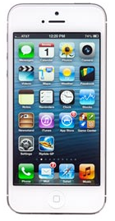
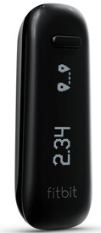
Standby
Standby
Advertising
Scanning
Standby
Initiating
Connection
Connection

Slide 10
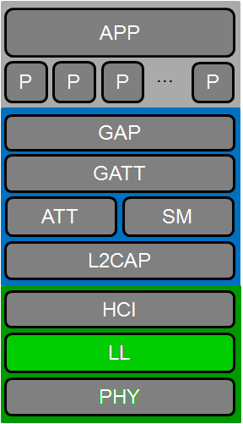
BLE Link Layer: State Flow Chart
TI Information – Selective Disclosure

Slide 11
BLE Link Layer: Advertisement Intervals
During one “advertising event”, an advertisement packet is transmitted on each of the three advertising channels (37, 38, and 39)
The advertising device has an “advertising interval”, which can be any amount of time between 20ms and 10.24s
The Link Layer generates a pseudo-random amount of time between 0ms and 10ms (“advertising delay”) during each advertising event. This delay is added to the advertising interval before the next advertising event, in order to prevent “beating” from multiple devices
TI Information – Selective Disclosure

Slide 12
BLE Link Layer: States Flow Chart
TI Information – Selective Disclosure

Slide 13
BLE Link Layer: Scanning
Passive Scanning
Scanner listens on advertising channels for advertising packets
When an advertisement packet is received, it passes the information up to the host
Active Scanning
Scanner listens on advertising channels for advertising packets
When an advertisement packet is received, it responds with a “scan request” packet
Advertiser then responds back with a “scan response” packet (this packet can contain additional data from advertiser)
TI Information – Selective Disclosure

Slide 14
BLE Link Layer: States Flow Chart
TI Information – Selective Disclosure

Slide 15
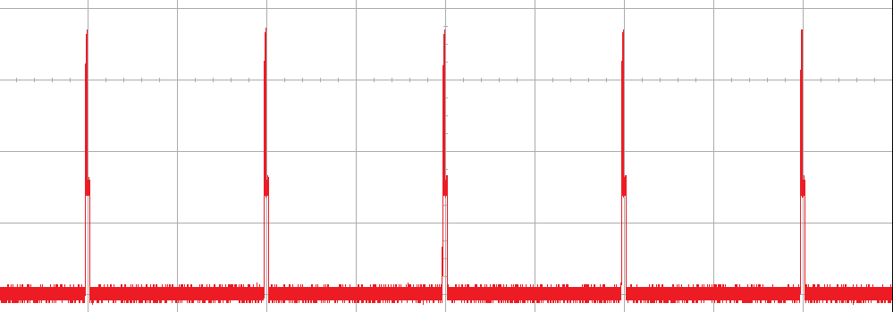
Link Layer (LL) – Connection Events
All communications between two connected devices occur in
Connection Events
Occur even when one (or both) sides have no data to send
Occur periodically
Connection Events
Current draw
[mA]
time
Connection interval
Notes:
All communications between two connected devices occur in “connection events”. These connection events occur periodically, with a connection interval parameter specifying the period
Each event occurs on one of the 37 data channel and the Master always communicates first and then the slave. They can continue to communicate back and forth as much as they want during one connection event. The limitation is in the radio buffer.
Connection events occur even when one (or both) sides have no data to send. This ensures that the link is still valid and if a certain number of user defined connection events occur with no acknowledgment, the connection will be considered lost by both devices.
The illustration shown is based on a real measurment of the current draw. As you can see, the device spends a lot of time in sleep which is typically around 1uA. This is the main reason why Bluetooth low energy really is low power. In the zoomed in part you can also see the power profile when slave device wakes up, does some processing, goes into RX then TX and then goes back into sleep after some post processing.

Slide 16
Link Layer (LL) – Initiator
HCI
Link Layer
PHY
Connection Parameters
Channel Map: Which data channels are used during the connection
Hop Increment: Random value (5-16) for channel selection algorithm
Connection Interval: Multiple of 1.25ms in range of 7.5ms and 4.0s
Supervision Timeout: Multiple of 10ms in the range of 100ms and 32.0s
SupervisionTimeout > (1 + SlaveLatency) * (2* ConnInterval)
Slave Latency: Any value between 0 and 499.
SlaveLatency < ((SupervisionTimeout / ConnInterval) – 1)

Slide 17
BLE Link Layer: Slave Latency
Event
Data to
Send
Slave Latency = OFF
M
S
M
S
M
S
M
S
M
S
No slave latency – slave responds with empty packets every connation interval.
Event
Data to
Send
Slave Latency = ON
M
S
M
M
M
M
S
Slave latency on. Slave can skip n connection events. Only wake up if slave has data to send.
TI Information – Selective Disclosure
17
Notes:
17

Slide 18
BLE Link Layer: Connection Update Request
The master device can send a connection update request to the slave at any time to change any of the connection parameters (interval, slave latency, supervision timeout) at any time
At the link layer, connection parameter updates are always initiated by the master, but a higher layer protocol (L2CAP) allows a slave to request the master to send a connection update
The ability to change parameters in the middle of a connection allows for dynamically adjustmenting the power / latency / throughput tradeoffs as required by the application
TI Information – Selective Disclosure

Slide 19
BLE Link Layer: Connection Termination
A connection can be voluntarily terminated by either the master or the slave for any reason
One side initiates termination, and the other side must respond accordingly before both devices exit the connected state
Connection can also be terminated as a result of a supervision timeout
The supervision timeout parameter specifies the maximum amount of time that either the master or slave can go before receiving a link-layer packet
Supervision timeout value must be greater than the effective connection interval and less than 32.0 seconds
Both slave and master device maintain their own “Supervision timer”, which resets to zero every time a packet is received
If supervision timer ever reaches the supervision timeout, the device considers the connection lost, and exits the connection state (returning to the advertising, scanning, or standby state)
TI Information – Selective Disclosure

Slide 20
Host Controller Interface (HCI)
Reused from standard Bluetooth specification,
additional commands for LE-specific functions
Thin layer; doesn’t perform any processing
In a dual-chip solution (with separate host and controller) allows for host to communicate with controller over a standard interface (UART, USB, SDIO, etc.)
Used internally by the TI BLE protocol stack
communication between higher and lower layers
custom “vendor-specific commands” which can be used by an external source to directly interface with the entire stack or application. (Network Processor)
APP
P
P
P
...
P
GAP
GATT
ATT
SM
L2CAP
HCI
LL
PHY

Slide 21
Host
The host uses the HCI API to communicate with the lower layers
The different layers of the host stack manage control messages, event messages, and transmission of data
APP
P
P
P
...
P
GAP
GATT
ATT
SM
L2CAP
HCI
LL
PHY

Slide 22
Security Manager (SM)
Performs authentication and key management
Uses AES-128 as the encryption algorithm for security procedures
Defines protocol to setup secure link
Enabled relationships between devices:
Pairing: encryption between two devices once a connection has been established between them
Authentication: verifying that a peer device can be trusted. Provides protection against “Man-in-the-Middle” attacks
Bonding: long-term relationship between devices; security and identity information is saved for re-use next time the devices are connected
APP
P
P
P
...
P
GAP
GATT
ATT
SM
L2CAP
HCI
LL
PHY

Slide 23
BLE Security Manager Protocol (SMP): Pairing
Pairing can be initiated by either the central or peripheral device
During pairing, the two devices generate and exchange short-term keys (STK) which can be used to decrypt data packets
In addition, either device can request to enable “bonding” to create a long-term relationship between the two devices
A long-term key (LTK) is generated, exchanged, and stored allowing device to re-encrypt the link quickly upon re-connection, without going through the complete pairing process once again
Profile / Service configuration data is remembered, so that the user does not need to re-configure the device every time they re-connect
TI Information – Selective Disclosure

Slide 24
BLE Security Manager Protocol (SMP) : Authentication
During the pairing process, each device states whether it wants authentication to the other device
Each device also states it’s input/output capabilities from among these options:
DisplayOnly – no way user can input anything into device, but it can output data
DisplayYesNo – user can input “yes” or “no” but nothing else; can also display data
KeyboardOnly – user can input a password or PIN, but no display
NoInputNoOutput – device has no means for user input, and has no display
KeyboardDisplay – device has a means for display as well as for input
Based on the combination of the capabilities of the two devices, one of two methods of pairing will be used:
Passkey entry – one device will display a randomly generator passkey, while the other will require the user to input the passkey. This allows for an authenticated link (MITM protection)
“Just Works” – the pairing process completes without requiring a passkey to be entered. The link will not be authenticated, but is encrypted
If either one of the two devices does not require authentication, then Just Works will be used by default, allowing the user to skip passkey entry
TI Information – Selective Disclosure

Slide 25
Attribute Protocol (ATT)
An attribute is a discrete value (Data) that has the following three properties associated with it:
A handle (address)
A type (UUID)
A set of permissions
ATT defines the over-the-air protocol for
Reading
Writing
Discovering attributes
Allows for different permissions to be assigned to attributes
Readable
Writeable
Protected (Additional security is required for access)
APP
P
P
P
...
P
GAP
GATT
ATT
SM
L2CAP
HCI
LL
PHY

Slide 26
ATT – Client / Server Architecture
GATT
ATT
SM
L2CAP
Servers have data, which are exposed using attributes
Clients want to use this data
The Client / Server role of a device is independent of the GAP central / peripheral role or the link layer master / slave role
It is possible for a device to act as both a client and server simultaneously, though the attributes on one device are independent of the attributes on the other device
ATT Requests or Commands
Server
Client
Attribute
Attribute
Attribute
…
ATT Responses

Slide 27
Generic Attribute Profile (GATT)
Designed for use by
Application
Profile
to enable an attribute client to communicate with attribute server
GATT defines:
Procedures for using the attribute protocol:
Discover attributes
Read attributes
Write attributes
Obtain indications of these attributes
The grouping and relationship of characteristics within a service or profile
Procedures for configuring the broadcast of attributes
APP
P
P
P
...
P
GAP
GATT
ATT
SM
L2CAP
HCI
LL
PHY

Slide 28
Profiles and Services
A Profile defines and describes the use of Services necessary to implement a given Application
Bluetooth SIG adopted examples:
Heart Rate Profile
Heart Rate Service (HRS)
Device Information Service (DIS)
Proximity Profile
Link Loss Service
Immediate Alert Service
Find Me Profile
Immidiate Alert Service
Profile
Heart Rate Profile
Service
HRS
Characteristic
Measurement
Properties
Notify
Value
98
Descriptor
User. Disc.
...
DIS
Characteristic
System ID
Properties
Read Only
Value
XX ... XX
Descriptor
User. Disc.
GATT = Generic Attribute Profile
Notes:
Bluetooth low energy is designed for data sharing. To ensure interoperability, Bluetooth SIG has developed a set of application specific profiles. A Profile defines and describes the use of Services necessary to implement a given Application. One example is the Heart Rate Profile, developed and adopted by Bluetooth SIG and its members. This means that a Bluetooth Smart Ready device, such as a smartphone, can work with Bluetooth Smart heart rate sensors from different vendors. As the illustration shows, a profile is composed of one or more services with associated characteristics. For a heart rate sensor the profile would consist of a Heart Rate Service with measurement as the associated characteristic. In the example, the measurement shows a heart rate of 98. In addition, the heart rate profile also includes the Device Information Service which provides information about the device, for example System ID. Note that both of these adopted services includes several other mandatory characteristics even though they are not shown in the example. There are two different types of profiles, the profiles adopted by Bluetooth SIG and proprietary profiles. Bluetooth SIG has adopted profiles such as Proximity and Find Me. The Proximity profile has services as Link Loss and Immediate alert. As you can see, several profiles may implement the same type of services, in this example the Immediate Alert Service is used by both the Proximity and Find Me Profiles. Proprietary profiles are user specific profiles such as the TI SensorTag services which we will see later.

Slide 29
GATT – Client / Server Architecture
GAP
GATT
ATT
SM
GATT specifies the structure in which profile data is exchanged
Same client server architecture as Attribute Protocol, except that data is encapsulated in “Services” and data is exposed in “Characteristic”
Server
Service
Characteristic
Characteristic
…
Service
Characteristic
Characteristic
…
Client
Requests or Commands
Responses

Slide 30
GATT – Client
GAP
GATT
ATT
SM
When two BLE devices are in the connected state, the GATT client device can perform several different sub-procedures to communicate with the GATT server device:
Discover Characteristic by UUID: search the GATT server for all attributes with type that matches the specified UUID
Read Characteristic Value: read the value of the characteristic at the specified handle
Write Characteristic Value: write a new value to the characteristic at the specified handle
A GATT server device, when configured to do so, can send out messages to the GATT client device without being prompted:
Notification: The value a characteristic is sent from the server to the client without receiving a read request, and does not need to be acknowledged
Indication: The value a characteristic is sent from the server to the client without receiving a read request, but must be acknowledged before any further data can be sent

Slide 31
Generic Access Profile (GAP)
Defines generic procedures for connection-related services:
Device Discovery
Link Establishment
Link Management
Link Termination
Initiation of security features
Many GAP functions correspond directly to the functions of the Link Layer in the controller
APP
P
P
P
...
P
GAP
GATT
ATT
SM
L2CAP
HCI
LL
PHY

Slide 32
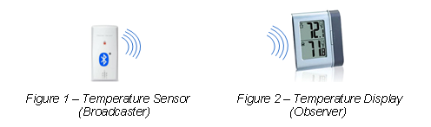
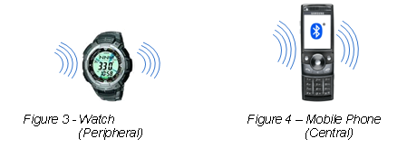
GAP - Roles
P
P
P
GAP
PHY
A Bluetooth low energy device can operate in four profile roles:
Broadcaster
An advertiser that is non-connectable
Example: Temperature Sensor
Observer
Scans for advertisements, but cannot initiate connections
Example: Temperature Display
Peripheral
An advertiser that is connectable
Operates as a slave in a connection
Example: Watch
Central
Scans for advertisements and initiates connections
Operates as a master in connections.
Example: Smart Phone
Notes:
A Bluetooth low enrgy device can operate in four profile roles.
A Broadcaster is an advertiser that is non-connectable, for example a Temperature Sensor that transmits current temperature
An Observer scans for advertisements, but cannot initiate connections. This could be a Temperature display that receives temperature data and presents it on a screen.
A Peripheral device is an advertiser that is connectable and can operate as a slave in a single link layer connection This could for example be a watch or a heart rate sensor.
A central device scans for advertisements and initiates connections. It operates as a master in a single or multiple link layer connections. A good example is a Smart Phone or a PC.
Note that a Bluetooth low energy can operate in multiple roles at the same time: Supported ones are
Peripheral + Broadcaster
Peripheral + Observer
Central + Broadcaster
These device roles also explain how the Bluetooth low energy ecosystem is built up and how it is set up to interact with other devices.

Slide 33
GAP – Multiple Roles
P
P
P
GAP
PHY
The BLE specification multiple-role configurations:
Peripheral and Broadcaster
device operates as a slave in a single link layer connection
send out non-connectable advertisements
Peripheral and Observer:
device operates as a slave in a single link layer connection
Scan for advertisements without initiating a connection
Central and Broadcaster:
Device scans for advertisements and initiates connections as a master
Broadcast non-connectable advertisements

Slide 34
Bluetooth Low Energy Ecosystem Overview

Slide 35


BLE Interoperability
Our device/BLE stack has been tested with many other devices from different vendors
Minor differences in BLE features across vendors
iOS
Apple guidelines
30ms by default – not configurable in app
Send connection parameter update
Private resolvable address
Android
New BLE feature release
Android 5.0 supports Central/Peripheral
Debug using sniffer captures
Notes:
TI provides a selection of powerful tools as part of the Bluetooth low energy software offering. BTool provides complete control of a connected network processor via a graphical user interface. It allows a developer to test every aspect of the Bluetooth low energy stack, including pass-key security, advertisement data, device whitelist, service discovery and more. The BLE Device Monitor is a windows application that displays all services and characteristics on any connected Bluetooth low energy device. It can also be used to read and write to the exposed characteristics. The TI SmartRF Protocol Packet Sniffer is a powerful development assistant which displays the Bluetooth low energy packets as they are sent over the air. This live view and the generated logs can be used for effective debugging during evaluation and development. The SmartRF Flash Programmer is a tool that can be used to program the flash memory of TI’s Bluetooth low energy devices and read out and change the IEEE [I Triple E] address of the device.

Slide 36
Backup

Slide 37
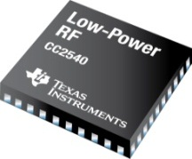
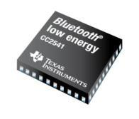
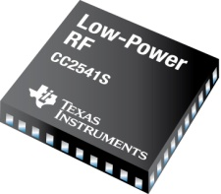
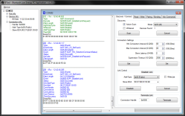
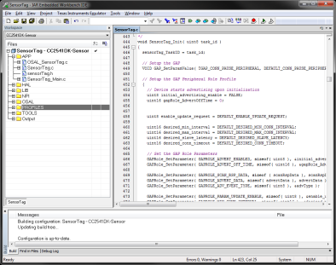
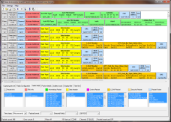
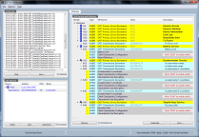
Bluetooth low energy Solutions
Hardware
Software
Bluetooth low energy SDK
Fully Featured BT4.0 LE Stack
BT 4.0 Qualified
Broadest range of certified profiles
Unique Features
Over-the-air-download
High throughput
miniBLEBroadcaster
Standalone Solution for CC2543
Size optimized BLE Broadcaster
 | CC2540 | CC2541 | CC2543
Max Output Power | +4dBm | 0 dBm | +5 dBm
TX current (0 dBm) | 26 mA | 18.2 mA | 26 mA
Flash | 128/256kB | 128/256kB | 32kB
Ram | 8kB | 8kB | 1kB
Sleep Timer | Crystal or RC | Crystal or RC | RC
Dual Boot | YES | YES | NO
Size | 40 pin 6x6 QFN | 40 pin 6x6 QFN | 32 pin 5x5 QFN
Key Benefits | Full BLE stack USB | Full BLE stack I2C | Broadcast Only Low Cost

Slide 38
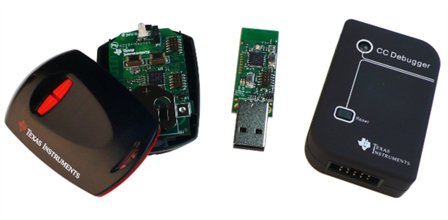
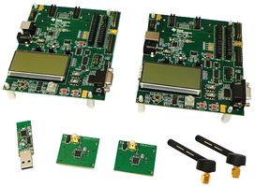
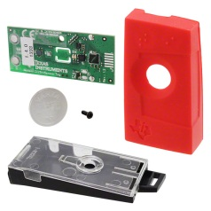
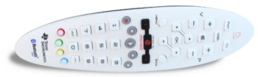
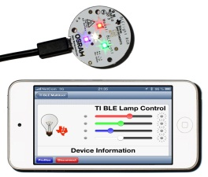
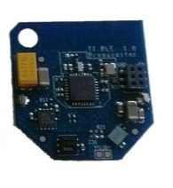
Bluetooth low energy Kits
Development Kits on eStore.ti.com
CC2540DK-MINI
CC2541DK-MINI
The easiest
way of evaluating
Bluetooth low
energy
CC2540DK
CC2541EMK
Advanced development platform
CC2541DK-SENSOR
Targeting Smart Phone App developers.
Provides sensor data
from 6 sensors
CC2541DK-RC
Operates as a multiple HID mouse, keyboard and RC
Kits Available on Request
BLE Lighting
Reference Design
Prototype Board
iOS App
BLE RC Voice
Reference Design
Prototype Board
CC2543 Broadcaster / Beacon
Reference Design
Prototype Board
BLE broadcast Software
Low power, low cost
Notes:
Our various development kits target different applications and development approaches. The mini development-kits are two of our most widely used kits. The kits include a combined debugger and programmer, a USB dongle for profile debugging and packet sniffing, and a Keyfob with either a CC2540 or 41. The Keyfob is powered by a coin cell battery and has LEDs, buttons, a buzzer and an accelerometer. The USB-dongle can be used together with our powerful PC application, BTool. This kit is the typical beginners kit and comes with a great out of box experience and is an easy way to get started with Bluetooth low energy. The _more_ extensive CC2540 Development Kit targets more advanced developers. The development kit includes two CC2540 evaluation modules and two evaluation boards with sockets for the modules. With this kit you have the possibility to access more peripherals such as LCD, Joystick and serial interfaces. All pins on the chip are accessible on the evaluation board, making it suitable for more in depth testing and development. The kit is also suitable for RF measurements. The CC2541 Evaluation Module Kit, EMK, is an add-on to the development kit containing two CC2541 evaluation modules for use with the evaluation boards in the development kit. The SensorTag kit is a CC2541 solution with six different sensors which can be individually controlled by a Bluetooth Smart Ready phone or any other Bluetooth Smart ready device. The kit targets app developers who want an easy and fun entry into Bluetooth low energy application development. It’s also the perfect kit to evaluate adding mobile connectivity to your product. The Advanced Remote Control kit is a Bluetooth low energy remote control which implements the Bluetooth SIG adopted Human Interface Device profile, enabling seamless connection with Smart Ready devices supporting this profile, such as Windows 8 computers with Bluetooth 4 hardware. The remote uses inertial motion sensors for mouse control and has an IR LED and consumer control keys like play/pause as well as a numeric keypad. The entire application runs on the CC2541 system on chip.

Slide 39
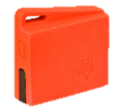
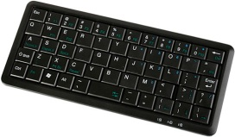

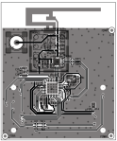

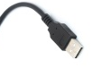
Additional Reference Features CC2640
Reference Designs
Remote Control
PDM, NFC,
Voice, Motion,
Wireless Charging
Medical Designs
Heart Rate Dev. Pack for Sensor Tag
PulseOx Sensor
Wireless ECG
HID Keyboard
Range Extender
BLE + CC2592
Up to +10dBm
WiFi + BLE Gateway
Software Features
Full BT4.1 support
Multiple Dev. Environments:
IAR, CCS, GCC
Apple HomeKit
Master/Slave - Mesh
IP over BLE
6LowPAN
Flexible OTA Firmware Update (OAD)
Apple iBeacon
TI Confidential - NDA Restrictions

Slide 40

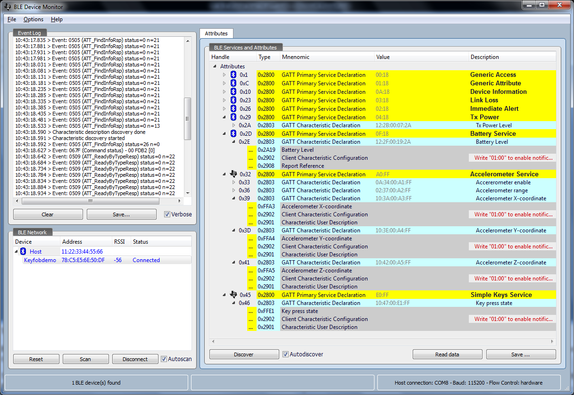
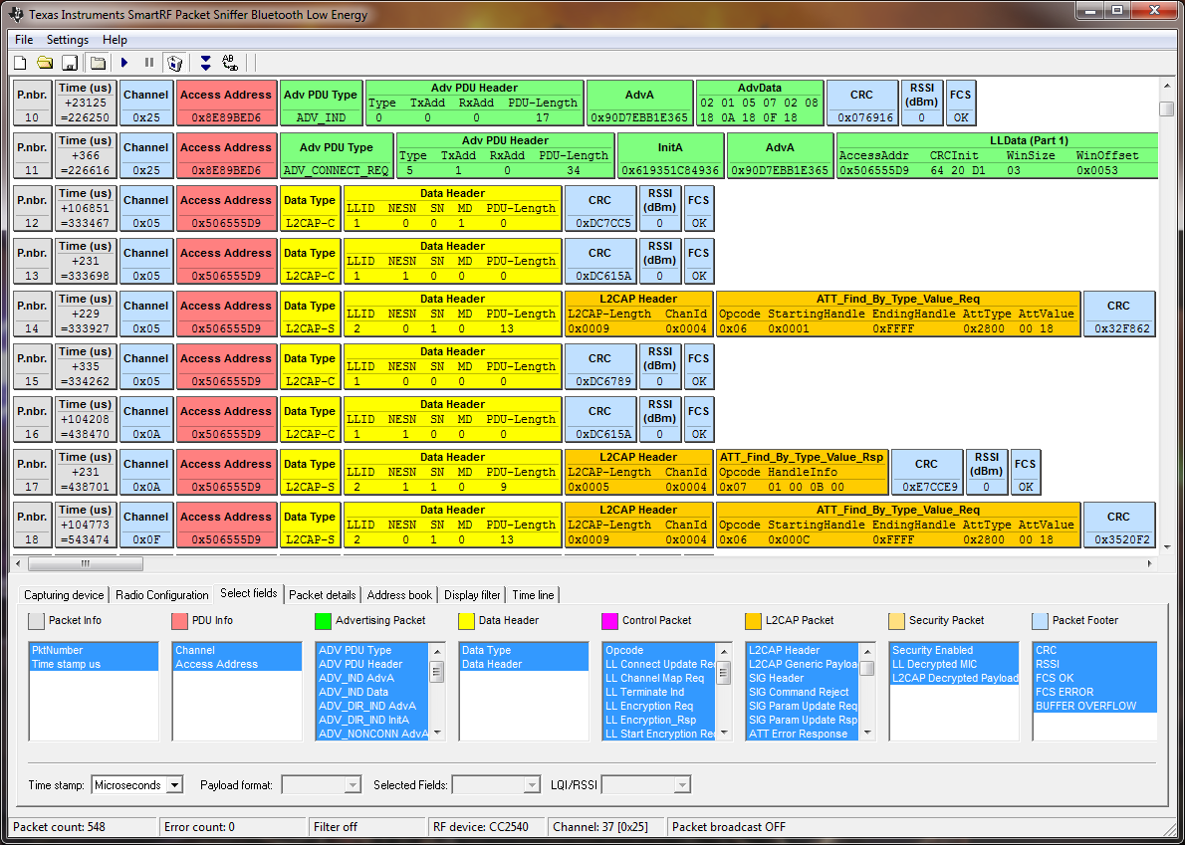
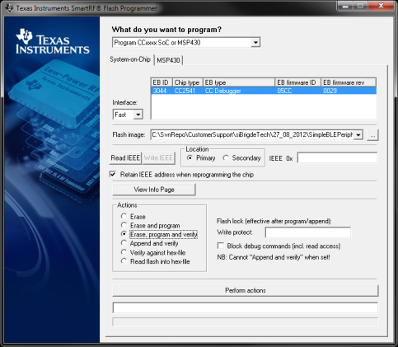
Bluetooth low energy Free Tools
BTool
Run and test all possible Bluetooth low energy functionality controlled from the PC tool.
BLE Device Monitor
Provides an intuitive and graphical way to explore Bluetooth low energy Services and Characteristics.
SmartRF™ Protocol Packet Sniffer
Capture Bluetooth low energy communication live with full overview.
SmartRF™ Flash Programmer
Program devices and Read/write IEEE addresses
Notes:
TI provides a selection of powerful tools as part of the Bluetooth low energy software offering. BTool provides complete control of a connected network processor via a graphical user interface. It allows a developer to test every aspect of the Bluetooth low energy stack, including pass-key security, advertisement data, device whitelist, service discovery and more. The BLE Device Monitor is a windows application that displays all services and characteristics on any connected Bluetooth low energy device. It can also be used to read and write to the exposed characteristics. The TI SmartRF Protocol Packet Sniffer is a powerful development assistant which displays the Bluetooth low energy packets as they are sent over the air. This live view and the generated logs can be used for effective debugging during evaluation and development. The SmartRF Flash Programmer is a tool that can be used to program the flash memory of TI’s Bluetooth low energy devices and read out and change the IEEE [I Triple E] address of the device.

Slide 41
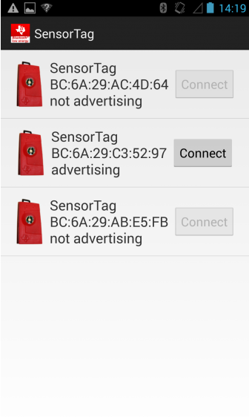
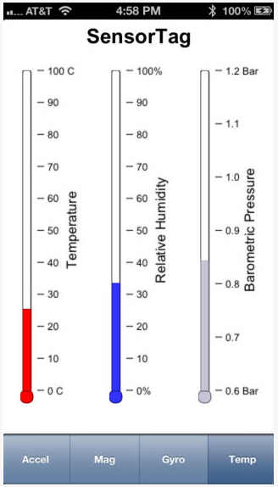
More Cool Tools
Sensor Tag App
GUI for connecting to and controlling the Sensor Tag and viewing graphs for different sensors.
MultiTool
Allows connection to other devices besides Sensor Tags.
Notes:
TI provides a selection of powerful tools as part of the Bluetooth low energy software offering. BTool provides complete control of a connected network processor via a graphical user interface. It allows a developer to test every aspect of the Bluetooth low energy stack, including pass-key security, advertisement data, device whitelist, service discovery and more. The BLE Device Monitor is a windows application that displays all services and characteristics on any connected Bluetooth low energy device. It can also be used to read and write to the exposed characteristics. The TI SmartRF Protocol Packet Sniffer is a powerful development assistant which displays the Bluetooth low energy packets as they are sent over the air. This live view and the generated logs can be used for effective debugging during evaluation and development. The SmartRF Flash Programmer is a tool that can be used to program the flash memory of TI’s Bluetooth low energy devices and read out and change the IEEE [I Triple E] address of the device.

Slide 42

Bluetooth 4.2 – What is it?
BT 4.2 is the latest version of the Bluetooth Core Specification. It was officially adopted by the BT SIG on December 3, 2014.
Main new features being added in BT 4.2:
LE Secure Connections
Based on Diffie-Helman Key Exchange, similar to the Secure Simple Pairing feature in classic Bluetooth
Closes the well-known security holes in BLE that exist in the BT 4.0/4.1 specs
LE Privacy 1.2
Keeps BLE devices from being tracked
Significant improvement over the confusing and little-used privacy features in BT 4.0/4.1 (which are being deprecated)
LE Data Length Extension
Increases data throughput by up to 2.5x by increasing the packet capacity by 10x
IPv6-over-BLE is not an actual feature of BT 4.2; however two BLE profiles (which will be based on BT 4.2 features), targeted for adoption in late 2014 or early 2015, will enable this.
BT 4.2 does not include any mesh support; for now any BLE mesh systems that are being used are not based on any Bluetooth standard.
It will probably take a while for phones and other Bluetooth Smart Ready devices to add support for BT 4.2 (most don’t even support BT 4.1 yet), so the features of BT 4.2 would not really be useful right now unless you are working in a closed system with only BT 4.2 enabled devices.
TI Confidential – NDA Restrictions

Slide 43
Bluetooth 4.2 – TI Status
CC2540 / CC2541
Currently only supports BT 4.0
Possibility to add some (but not all) BT 4.1 features to CC254x in 2015
No BT 4.2 support is planned for CC254x. This is mainly due to the limited processing capabilities and RAM on the CC254x. In addition, the CC254x radio core does not support the PHY requirements for the higher data rates in BT 4.2
CC2640 / CC2650
Will have full support for BT 4.1 at RTM in February
Hardware is fully capable of supporting all BT 4.2 features. We will be working on BT 4.2 software in 2015 (schedule TBD)
TI Confidential – NDA Restrictions

