Slide 1
Exploring Differences in the Sentiment Analysis Tools using Twitter Data concerning Autism Awareness

Slide 2
Outline
Overview
Background
Data set
Data Preprocessing
Sentiment Analysis: Tools and Models
Results
Discussion/Conclusion

Slide 3
Overview
Goal: Analyze twitter data concerning autism awareness and find out which is the better tool for sentiment analysis
Sentiment analysis is the identification of opinions from text to determine how the writer feels about a topic
Evaluate two Python based sentiment analysis tools:
  VADER
  Scikit Learn
Comparing performance of the tools
  Comparison of the results each output and human judgement

Slide 4
Background
Analysis of text data can extract information about business, medicine, and health related topics(e.g autism)
    (Knudson et al., 2016, Ghiassi at al., 2015, Rodrigues et al., 2013)
Twitter is a popular data source for text analytics
    (Ghiassi et al., 2015, Abbasi et al., 2014, Marquez et al., 2013)
Sentiment polarity refers to the tweet being positive or negative
    (Knudson et al., 2016, Marquez et al., 2013)
To validate the results, the accuracy, precision, and recall are calculated
    (Ghiassi et al., 2015, Abbasi et al., 2014, Rodrigues et al., Marquez at al, 2013, Knudson et al., 2016, Georgiou et al., 2015)

Slide 5
Data Set
Twitter data set in CSV format:
  Expressing opinions about Autism
  Obtained from the College of Public Health, GSU(Dr. Yin, Thank you ☺)
Data set contains 25 columns and 2000 rows:
  Tweets
  Retweets
  Location
  User ID
  Language
Tweets in different language
Tweets have:
  Emoticons
  Hashtags
  URLS
  Usernames
Notes:
Subset of data: we only used 2000 rows over 50,000 rows available which are essentially next steps

Slide 6
Data Preprocessing
The texts are used only for this study: Column header ‘tweets’
Rows containing non-English tweets removed
All $URLS, emoticons, #hashtags and @mentions remained
Data exported and saved in a separate CSV file using python’s pandas
Notes:
Pandas is a python library: Very good. Do I insert a code snippet here ?

Slide 7
Sentiment Analysis: Tools & Models
Tools used for sentiment analysis:
  VADER:
    Python based sentiment analysis tool
    Has scored sentiment corpus
  Scikit Learn:
    Python based machine learning library
    Provides platform for creating model for sentiment analysis
    Sentiment corpus must be provided by user
Notes:
Vader has a list of scored positive and negative words
During classification it extracts the text body and weighs it based on score corpus

Slide 8
Sentiment Analysis: Vader
Labeled data corpus for Sentiment Analysis
SentimentIntensityAnalyzer: library for classifying into groups of sentiments
Results exported in text files
Outputs:
  Probability of positive, neutral and negative
  Compound values in a range of -1 to 1, where -1 represents negative for each tweet
The compound value is comparable to a single measure of polarity

Slide 9
Sentiment Analysis: Scikit Learn
Used to built a sentiment analysis tool:
  Sanders labeled data corpus used for model building
  Vectors created used TFIDF Vectorizer: min DF = 0.02, max DF = 0.8
  30% for training set, 70% for test set
  Support vector machine algorithm and the classifier library used
Classifies tweets into three groups: Positive, negative, neutral
Values in a range of -1 to 1, where negative(-1), neutral(0), positive(+1)
Notes:
SVM statistical model

Slide 10
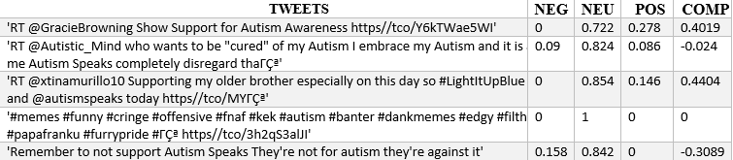
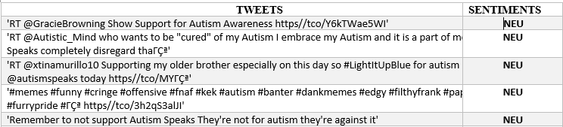
Results
Vader: Sentiment Classification
Scikit Learn: Sentiment Classification

Slide 11
Results
Performance of model examined using the measures:
  Accuracy: (True Positive + True Negative)/N
    Number of instances classified correctly
  Recall: True Positive/(False Negative + True Positive)
    True positive rate: How many positive instances are predicted correctly
  Precision: True Negative / (False Positive + True Negative)
    True negative rate: How negative instances are predicted correctly
  F1-score: 2*(Recall * Precision)/(Recall + Precision)
    Weighted Average of precision and recall
Notes:
true positives (TP): These are cases in which we predicted yes (they have the disease), and they do have the disease.
true negatives (TN): We predicted no, and they don't have the disease.
false positives (FP): We predicted yes, but they don't actually have the disease. (Also known as a "Type I error.")
false negatives (FN): We predicted no, but they actually do have the disease. (Also known as a "Type II error.")
Accuracy: (TP+ TN)/TN
Precision: TN/(FP+TN)
Recall: TP/(FN+TP)

Slide 12
Results
Tool | Accuracy | Precision | Recall | F1-Score
Vader | 67% | 44% | 67% | 53%
Scikit Learn | 60% | 36% | 45% | 45%
In comparison with Human judges

Slide 13
Conclusion
Mostly when people spoke of autism it was in an information sharing or supportive sentiment
  Overall there were few negative tweets and most were found as neutral and/or positive
Vader has a higher accuracy: 67%
Vader has predicted more values correctly than scikit learn
Thus for this study, Vader is the better tool
Next Steps:
  Apply Vader sentiment analysis to remaining autism set of twitter data (100,000+ tweets)

