Slide 1
Sentiment Analysis
What is Sentiment Analysis?

Slide 2
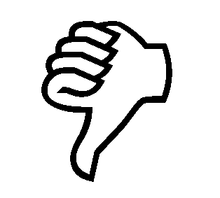

Positive or negative movie review?
unbelievably disappointing
Full of zany characters and richly applied satire, and some great plot twists
this is the greatest screwball comedy ever filmed
It was pathetic. The worst part about it was the boxing scenes.

Slide 3
Google Product Search
a

Slide 4
Bing Shopping
a

Slide 5
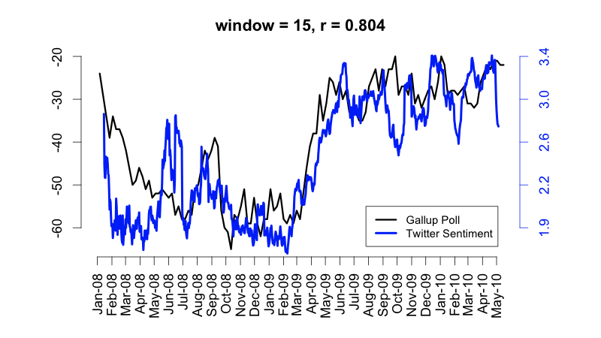
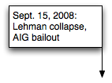
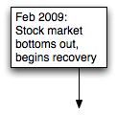
Twitter sentiment versus Gallup Poll of Consumer Confidence
Brendan O'Connor, Ramnath Balasubramanyan, Bryan R. Routledge, and Noah A. Smith. 2010. From Tweets to Polls: Linking Text Sentiment to Public Opinion Time Series. In ICWSM-2010
Notes:
Thanks to Brendan O’Connor and Noah Smith (email, 1/18/12) for permission to use this figure.

Slide 6
Twitter sentiment:
Johan Bollen, Huina Mao, Xiaojun Zeng. 2011. Twitter mood predicts the stock market,
Journal of Computational Science 2:1, 1-8. 10.1016/j.jocs.2010.12.007.
Notes:
Thanks to Johan Bollen (email, 1/18/12) for permission to use this figure.

Slide 7
Bollen et al. (2011)
CALM predicts DJIA 3 days later
At least one current hedge fund uses this algorithm
Dow Jones
CALM
Notes:
Thanks to Johan Bollen (email, 1/18/12) for permission to use this figure.

Slide 8
Target Sentiment on Twitter
Twitter Sentiment App
Alec Go, Richa Bhayani, Lei Huang. 2009. Twitter Sentiment Classification using Distant Supervision

Slide 9
Sentiment analysis has many other names
Opinion extraction
Opinion mining
Sentiment mining
Subjectivity analysis

Slide 10
Why sentiment analysis?
Movie: is this review positive or negative?
Products: what do people think about the new iPhone?
Public sentiment: how is consumer confidence? Is despair increasing?
Politics: what do people think about this candidate or issue?
Prediction: predict election outcomes or market trends from sentiment

Slide 11
Scherer Typology of Affective States
Emotion: brief organically synchronized … evaluation of a major event
  angry, sad, joyful, fearful, ashamed, proud, elated
Mood: diffuse non-caused low-intensity long-duration change in subjective feeling
  cheerful, gloomy, irritable, listless, depressed, buoyant
Interpersonal stances: affective stance toward another person in a specific interaction
  friendly, flirtatious, distant, cold, warm, supportive, contemptuous
Attitudes: enduring, affectively colored beliefs, dispositions towards objects or persons
  liking, loving, hating, valuing, desiring
Personality traits: stable personality dispositions and typical behavior tendencies
  nervous, anxious, reckless, morose, hostile, jealous

Slide 12
Scherer Typology of Affective States
Emotion: brief organically synchronized … evaluation of a major event
  angry, sad, joyful, fearful, ashamed, proud, elated
Mood: diffuse non-caused low-intensity long-duration change in subjective feeling
  cheerful, gloomy, irritable, listless, depressed, buoyant
Interpersonal stances: affective stance toward another person in a specific interaction
  friendly, flirtatious, distant, cold, warm, supportive, contemptuous
Attitudes: enduring, affectively colored beliefs, dispositions towards objects or persons
  liking, loving, hating, valuing, desiring
Personality traits: stable personality dispositions and typical behavior tendencies
  nervous, anxious, reckless, morose, hostile, jealous

Slide 13
Sentiment Analysis
Sentiment analysis is the detection of attitudes
  “enduring, affectively colored beliefs, dispositions towards objects or persons”
  Holder (source) of attitude
  Target (aspect) of attitude
  Type of attitude
    From a set of types
      Like, love, hate, value, desire, etc.
    Or (more commonly) simple weighted polarity:
      positive, negative, neutral, together with strength
  Text containing the attitude
    Sentence or entire document

Slide 14
Sentiment Analysis
Simplest task:
  Is the attitude of this text positive or negative?
More complex:
  Rank the attitude of this text from 1 to 5
Advanced:
  Detect the target, source, or complex attitude types

Slide 15
Sentiment Analysis
Simplest task:
  Is the attitude of this text positive or negative?
More complex:
  Rank the attitude of this text from 1 to 5
Advanced:
  Detect the target, source, or complex attitude types

Slide 16
Sentiment Analysis
What is Sentiment Analysis?

Slide 17
Sentiment Analysis
A Baseline Algorithm

Slide 18
  Sentiment Classification in Movie Reviews
Bo Pang, Lillian Lee, and Shivakumar Vaithyanathan. 2002. Thumbs up? Sentiment Classification using Machine Learning Techniques. EMNLP-2002, 79—86.
Bo Pang and Lillian Lee. 2004. A Sentimental Education: Sentiment Analysis Using Subjectivity Summarization Based on Minimum Cuts. ACL, 271-278
Polarity detection:
  Is an IMDB movie review positive or negative?
Data: Polarity Data 2.0:
  http://www.cs.cornell.edu/people/pabo/movie-review-data

Slide 19
IMDB data in the Pang and Lee database
✓
✗
when _star wars_ came out some twenty years ago , the image of traveling throughout the stars has become a commonplace image . […]
when han solo goes light speed , the stars change to bright lines , going towards the viewer in lines that converge at an invisible point .
cool .
_october sky_ offers a much simpler image–that of a single white dot , traveling horizontally across the night sky . [. . . ]
“ snake eyes ” is the most aggravating kind of movie : the kind that shows so much potential then becomes unbelievably disappointing .
it’s not just because this is a brian depalma film , and since he’s a great director and one who’s films are always greeted with at least some fanfare .
and it’s not even because this was a film starring nicolas cage and since he gives a brauvara performance , this film is hardly worth his talents .

Slide 20
Baseline Algorithm (adapted from Pang and Lee)
Tokenization
Feature Extraction
Classification using different classifiers
  Naïve Bayes
  MaxEnt
  SVM

Slide 21
Sentiment Tokenization Issues
Deal with HTML and XML markup
Twitter mark-up (names, hash tags)
Capitalization (preserve for
words in all caps)
Phone numbers, dates
Emoticons
Useful code:
  Christopher Potts sentiment tokenizer
  Brendan O’Connor twitter tokenizer
Potts emoticons
[<>]? # optional hat/brow
[:;=8] # eyes
[\-o\*\']? # optional nose
[\)\]\(\[dDpP/\:\}\{@\|\\] # mouth
| #### reverse orientation
[\)\]\(\[dDpP/\:\}\{@\|\\] # mouth
[\-o\*\']? # optional nose
[:;=8] # eyes
[<>]? # optional hat/brow

Slide 22
Extracting Features for Sentiment Classification
How to handle negation
  I didn’t like this movie
  vs
  I really like this movie
Which words to use?
  Only adjectives
  All words
    All words turns out to work better, at least on this data

Slide 23
Negation
Das, Sanjiv and Mike Chen. 2001. Yahoo! for Amazon: Extracting market sentiment from stock message boards. In Proceedings of the Asia Pacific Finance Association Annual Conference (APFA).
Bo Pang, Lillian Lee, and Shivakumar Vaithyanathan. 2002. Thumbs up? Sentiment Classification using Machine Learning Techniques. EMNLP-2002, 79—86.
Add NOT_ to every word between negation and following punctuation:
didn’t like this movie , but I
didn’t NOT_like NOT_this NOT_movie but I

Slide 24
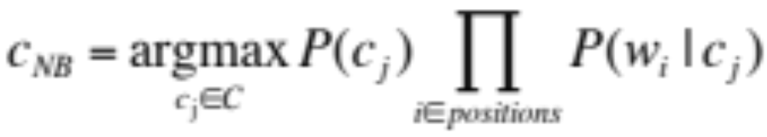
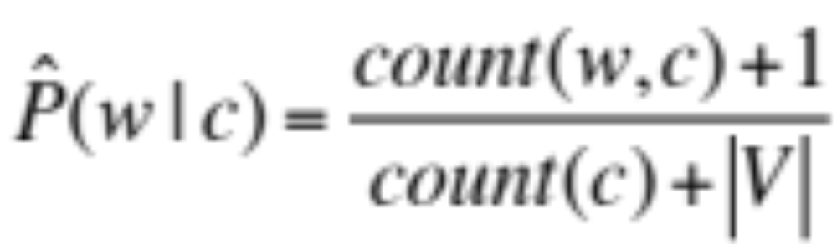
Reminder: Naïve Bayes

Slide 25
Binarized (Boolean feature) Multinomial Naïve Bayes
Intuition:
  For sentiment (and probably for other text classification domains)
  Word occurrence may matter more than word frequency
    The occurrence of the word fantastic tells us a lot
    The fact that it occurs 5 times may not tell us much more.
  Boolean Multinomial Naïve Bayes
    Clips all the word counts in each document at 1

Slide 26
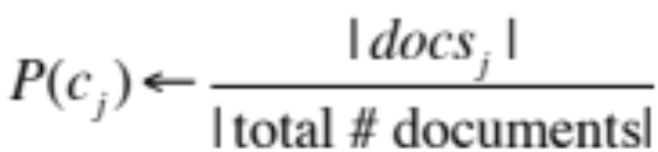
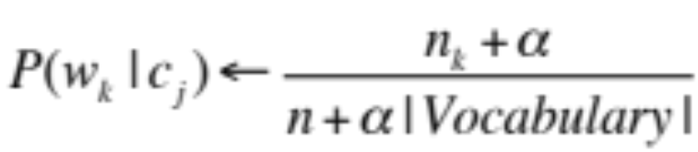
Boolean Multinomial Naïve Bayes: Learning
From training corpus, extract Vocabulary
Calculate P(c_{j}) terms
  For each c_{j} in C do
    docs_{j} ← all docs with class =c_{j}
Calculate P(w_{k} | c_{j}) terms
  Text_{j} ← single doc containing all docs_{j}
  For each word w_{k} in Vocabulary
    n_{k} ← # of occurrences of w_{k} in Text_{j}
  Remove duplicates in each doc:
    For each word type w in doc_{j}
      Retain only a single instance of w

Slide 27
Boolean Multinomial Naïve Bayes on a test document d
First remove all duplicate words from d
Then compute NB using the same equation:

Slide 28
Normal vs. Boolean Multinomial NB
Normal | Doc | Words | Class
Training | 1 | Chinese Beijing Chinese | c
 | 2 | Chinese Chinese Shanghai | c
 | 3 | Chinese Macao | c
 | 4 | Tokyo Japan Chinese | j
Test | 5 | Chinese Chinese Chinese Tokyo Japan | ?
Boolean | Doc | Words | Class
Training | 1 | Chinese Beijing | c
 | 2 | Chinese Shanghai | c
 | 3 | Chinese Macao | c
 | 4 | Tokyo Japan Chinese | j
Test | 5 | Chinese Tokyo Japan | ?

Slide 29
Binarized (Boolean feature)
Multinomial Naïve Bayes
B. Pang, L. Lee, and S. Vaithyanathan. 2002. Thumbs up? Sentiment Classification using Machine Learning Techniques. EMNLP-2002, 79—86.
V. Metsis, I. Androutsopoulos, G. Paliouras. 2006. Spam Filtering with Naive Bayes – Which Naive Bayes? CEAS 2006 - Third Conference on Email and Anti-Spam.
K.-M. Schneider. 2004. On word frequency information and negative evidence in Naive Bayes text classiﬁcation. ICANLP, 474-485.
  JD Rennie, L Shih, J Teevan. 2003. Tackling the poor assumptions of naive bayes text classifiers. ICML 2003
Binary seems to work better than full word counts
  This is not the same as Multivariate Bernoulli Naïve Bayes
    MBNB doesn’t work well for sentiment or other text tasks
Other possibility: log(freq(w))

Slide 30
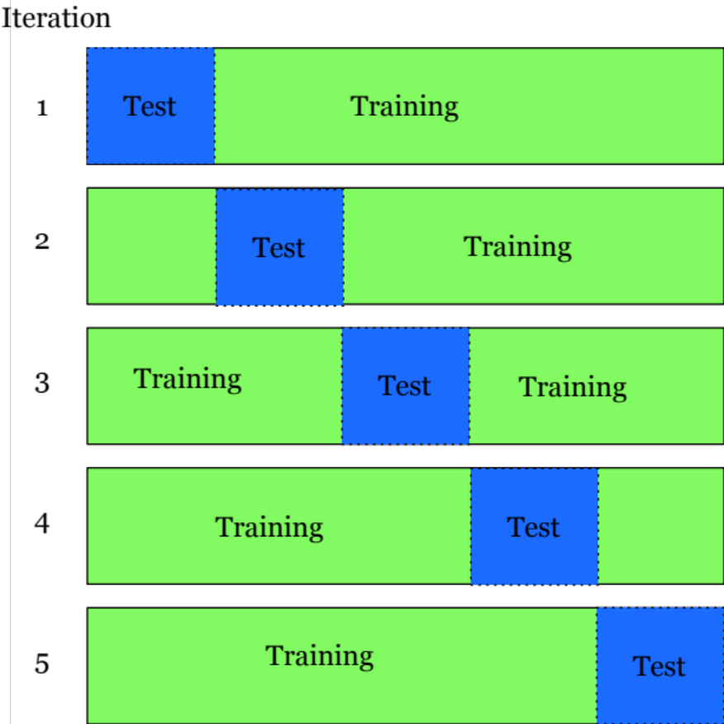
Cross-Validation
Break up data into 10 folds
  (Equal positive and negative inside each fold?)
For each fold
  Choose the fold as a temporary test set
  Train on 9 folds, compute performance on the test fold
Report average performance of the 10 runs

Slide 31
Other issues in Classification
MaxEnt and SVM tend to do better than Naïve Bayes

Slide 32
Problems:
What makes reviews hard to classify?
Subtlety:
  Perfume review in Perfumes: the Guide:
    “If you are reading this because it is your darling fragrance, please wear it at home exclusively, and tape the windows shut.”
  Dorothy Parker on Katherine Hepburn
    “She runs the gamut of emotions from A to B”

Slide 33
Thwarted Expectations and Ordering Effects
“This film should be brilliant. It sounds like a great plot, the actors are first grade, and the supporting cast is good as well, and Stallone is attempting to deliver a good performance. However, it can’t hold up.”
Well as usual Keanu Reeves is nothing special, but surprisingly, the very talented Laurence Fishbourne is not so good either, I was surprised.

Slide 34
Sentiment Analysis
A Baseline Algorithm

Slide 35
Sentiment Analysis
Sentiment Lexicons

Slide 36
The General Inquirer
Philip J. Stone, Dexter C Dunphy, Marshall S. Smith, Daniel M. Ogilvie. 1966. The General Inquirer: A Computer Approach to Content Analysis. MIT Press
  Home page: http://www.wjh.harvard.edu/~inquirer
  List of Categories: http://www.wjh.harvard.edu/~inquirer/homecat.htm
  Spreadsheet: http://www.wjh.harvard.edu/~inquirer/inquirerbasic.xls
Categories:
  Positiv (1915 words) and Negativ (2291 words)
  Strong vs Weak, Active vs Passive, Overstated versus Understated
  Pleasure, Pain, Virtue, Vice, Motivation, Cognitive Orientation, etc
Free for Research Use

Slide 37
LIWC (Linguistic Inquiry and Word Count)
  Pennebaker, J.W., Booth, R.J., & Francis, M.E. (2007). Linguistic Inquiry and Word Count: LIWC 2007. Austin, TX
Home page: http://www.liwc.net/
2300 words, >70 classes
Affective Processes
  negative emotion (bad, weird, hate, problem, tough)
  positive emotion (love, nice, sweet)
Cognitive Processes
  Tentative (maybe, perhaps, guess), Inhibition (block, constraint)
Pronouns, Negation (no, never), Quantifiers (few, many)
$30 or $90 fee

Slide 38
MPQA Subjectivity Cues Lexicon
Theresa Wilson, Janyce Wiebe, and Paul Hoffmann (2005). Recognizing Contextual Polarity in
Phrase-Level Sentiment Analysis. Proc. of HLT-EMNLP-2005.
Riloff and Wiebe (2003). Learning extraction patterns for subjective expressions. EMNLP-2003.
Home page: http://www.cs.pitt.edu/mpqa/subj_lexicon.html
6885 words from 8221 lemmas
  2718 positive
  4912 negative
Each word annotated for intensity (strong, weak)
GNU GPL

Slide 39
Bing Liu Opinion Lexicon
Minqing Hu and Bing Liu. Mining and Summarizing Customer Reviews. ACM SIGKDD-2004.
Bing Liu's Page on Opinion Mining
http://www.cs.uic.edu/~liub/FBS/opinion-lexicon-English.rar
6786 words
  2006 positive
  4783 negative

Slide 40
SentiWordNet
  Stefano Baccianella, Andrea Esuli, and Fabrizio Sebastiani. 2010 SENTIWORDNET 3.0: An Enhanced Lexical Resource for Sentiment Analysis and Opinion Mining. LREC-2010
  Home page: http://sentiwordnet.isti.cnr.it/
  All WordNet synsets automatically annotated for degrees of positivity, negativity, and neutrality/objectiveness
  [estimable(J,3)] “may be computed or estimated”
  Pos 0 Neg 0 Obj 1
  [estimable(J,1)] “deserving of respect or high regard”
  Pos .75 Neg 0 Obj .25

Slide 41
Disagreements between polarity lexicons
Christopher Potts, Sentiment Tutorial, 2011
 | Opinion Lexicon | General Inquirer | SentiWordNet | LIWC
MPQA | 33/5402 (0.6%) | 49/2867 (2%) | 1127/4214 (27%) | 12/363 (3%)
Opinion Lexicon |  | 32/2411 (1%) | 1004/3994 (25%) | 9/403 (2%)
General Inquirer |  |  | 520/2306 (23%) | 1/204 (0.5%)
SentiWordNet |  |  |  | 174/694 (25%)
LIWC

Slide 42
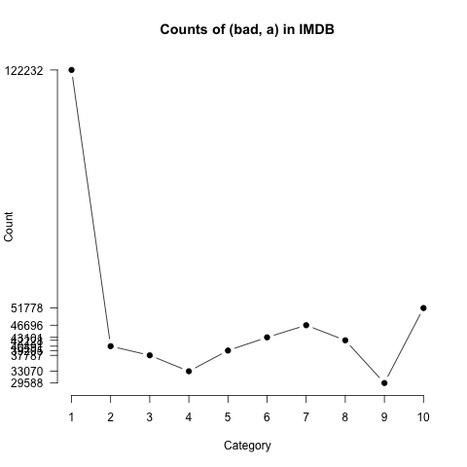
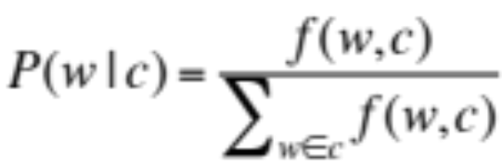
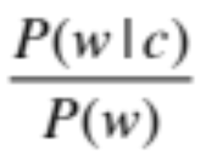
Analyzing the polarity of each word in IMDB
Potts, Christopher. 2011. On the negativity of negation. SALT 20, 636-659.
How likely is each word to appear in each sentiment class?
Count(“bad”) in 1-star, 2-star, 3-star, etc.
But can’t use raw counts:
Instead, likelihood:
Make them comparable between words
  Scaled likelihood:
Notes:
Thanks to Chris Potts for permission to use figure

Slide 43
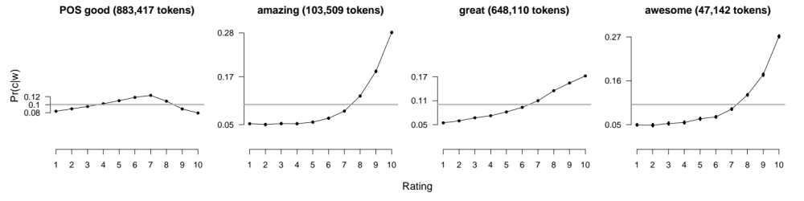
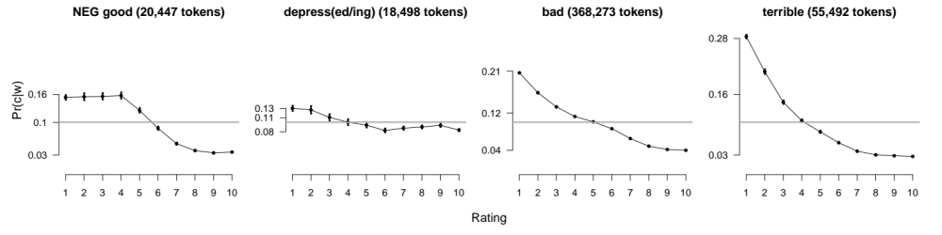
Analyzing the polarity of each word in IMDB
Potts, Christopher. 2011. On the negativity of negation. SALT 20, 636-659.
Scaled likelihood
P(w|c)/P(w)
Scaled likelihood
P(w|c)/P(w)
Notes:
Thanks to Chris Potts for permission to use figures

Slide 44
Other sentiment feature: Logical negation
Potts, Christopher. 2011. On the negativity of negation. SALT 20, 636-659.
Is logical negation (no, not) associated with negative sentiment?
Potts experiment:
  Count negation (not, n’t, no, never) in online reviews
  Regress against the review rating

Slide 45
Potts 2011 Results:
More negation in negative sentiment
a
Scaled likelihood
P(w|c)/P(w)
Notes:
Thanks to Chris Potts for permission to use figures

Slide 46
Sentiment Analysis
Sentiment Lexicons

Slide 47
Sentiment Analysis
Learning Sentiment Lexicons

Slide 48
Semi-supervised learning of lexicons
Use a small amount of information
  A few labeled examples
  A few hand-built patterns
To bootstrap a lexicon

Slide 49
Hatzivassiloglou and McKeown intuition for identifying word polarity
Vasileios Hatzivassiloglou and Kathleen R. McKeown. 1997. Predicting the Semantic Orientation of Adjectives. ACL, 174–181
Adjectives conjoined by “and” have same polarity
  Fair and legitimate, corrupt and brutal
  *fair and brutal, *corrupt and legitimate
Adjectives conjoined by “but” do not
  fair but brutal

Slide 50
Hatzivassiloglou & McKeown 1997
Step 1
Label seed set of 1336 adjectives (all >20 in 21 million word WSJ corpus)
  657 positive
    adequate central clever famous intelligent remarkable reputed sensitive slender thriving…
  679 negative
    contagious drunken ignorant lanky listless primitive strident troublesome unresolved unsuspecting…

Slide 51
Hatzivassiloglou & McKeown 1997
Step 2
Expand seed set to conjoined adjectives
nice, helpful
nice, classy

Slide 52
Hatzivassiloglou & McKeown 1997
Step 3
Supervised classifier assigns “polarity similarity” to each word pair, resulting in graph:
brutal
helpful
corrupt
irrational
nice
fair
classy

Slide 53
Hatzivassiloglou & McKeown 1997
Step 4
Clustering for partitioning the graph into two
+
-
brutal
helpful
corrupt
irrational
nice
fair
classy

Slide 54
Output polarity lexicon
Positive
  bold decisive disturbing generous good honest important large mature patient peaceful positive proud sound stimulating straightforward strange talented vigorous witty…
Negative
  ambiguous cautious cynical evasive harmful hypocritical inefficient insecure irrational irresponsible minor outspoken pleasant reckless risky selfish tedious unsupported vulnerable wasteful…

Slide 55
Output polarity lexicon
Positive
  bold decisive disturbing generous good honest important large mature patient peaceful positive proud sound stimulating straightforward strange talented vigorous witty…
Negative
  ambiguous cautious cynical evasive harmful hypocritical inefficient insecure irrational irresponsible minor outspoken pleasant reckless risky selfish tedious unsupported vulnerable wasteful…

Slide 56
Turney Algorithm
Turney (2002): Thumbs Up or Thumbs Down? Semantic Orientation Applied to Unsupervised Classification of Reviews
Extract a phrasal lexicon from reviews
Learn polarity of each phrase
Rate a review by the average polarity of its phrases

Slide 57
Extract two-word phrases with adjectives
First Word | Second Word | Third Word (not extracted)
JJ | NN or NNS | anything
RB, RBR, RBS | JJ | Not NN nor NNS
JJ | JJ | Not NN or NNS
NN or NNS | JJ | Nor NN nor NNS
RB, RBR, or RBS | VB, VBD, VBN, VBG | anything

Slide 58
How to measure polarity of a phrase?
Positive phrases co-occur more with “excellent”
Negative phrases co-occur more with “poor”
But how to measure co-occurrence?

Slide 59
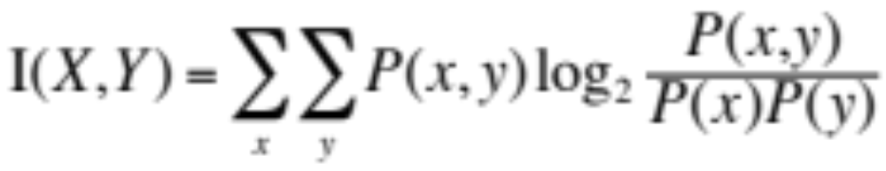
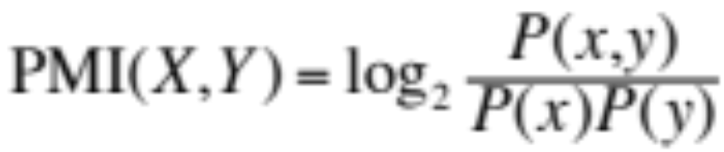
Pointwise Mutual Information
Mutual information between 2 random variables X and Y
Pointwise mutual information:
  How much more do events x and y co-occur than if they were independent?

Slide 60
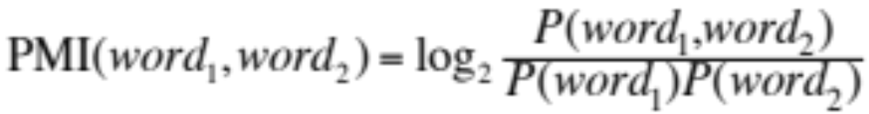
Pointwise Mutual Information
Pointwise mutual information:
  How much more do events x and y co-occur than if they were independent?
PMI between two words:
  How much more do two words co-occur than if they were independent?

Slide 61
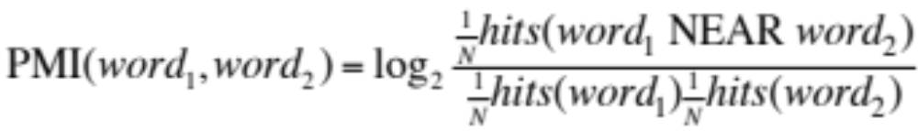
How to Estimate Pointwise Mutual Information
  Query search engine (Altavista)
    P(word) estimated by hits(word)/N
    P(word₁,word₂) by hits(word1 NEAR word2)/N
      (More correctly the bigram denominator should be kN, because there are a total of N consecutive bigrams (word1,word2), but kN bigrams that are k words apart, but we just use N on the rest of this slide and the next.)

Slide 62
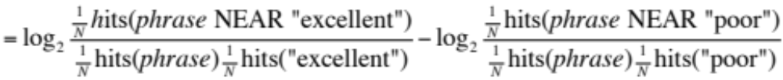
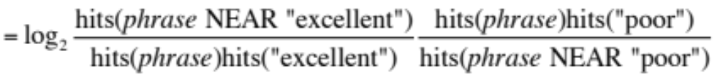
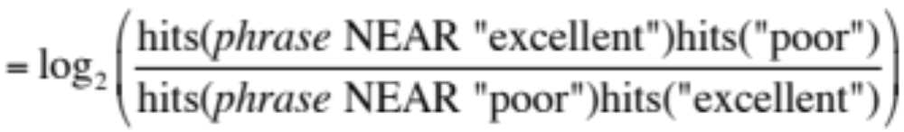
Does phrase appear more with “poor” or “excellent”?

Slide 63
Phrases from a thumbs-up review
Phrase | POS tags | Polarity
online service | JJ NN | 2.8
online experience | JJ NN | 2.3
direct deposit | JJ NN | 1.3
local branch | JJ NN | 0.42
…
low fees | JJ NNS | 0.33
true service | JJ NN | -0.73
other bank | JJ NN | -0.85
inconveniently located | JJ NN | -1.5
Average |  | 0.32

Slide 64
Phrases from a thumbs-down review
Phrase | POS tags | Polarity
direct deposits | JJ NNS | 5.8
online web | JJ NN | 1.9
very handy | RB JJ | 1.4
…
virtual monopoly | JJ NN | -2.0
lesser evil | RBR JJ | -2.3
other problems | JJ NNS | -2.8
low funds | JJ NNS | -6.8
unethical practices | JJ NNS | -8.5
Average |  | -1.2

Slide 65
Results of Turney algorithm
410 reviews from Epinions
  170 (41%) negative
  240 (59%) positive
Majority class baseline: 59%
Turney algorithm: 74%
Phrases rather than words
Learns domain-specific information

Slide 66
Using WordNet to learn polarity
S.M. Kim and E. Hovy. 2004. Determining the sentiment of opinions. COLING 2004
M. Hu and B. Liu. Mining and summarizing customer reviews. In Proceedings of KDD, 2004
WordNet: online thesaurus (covered in later lecture).
Create positive (“good”) and negative seed-words (“terrible”)
Find Synonyms and Antonyms
  Positive Set: Add synonyms of positive words (“well”) and antonyms of negative words
  Negative Set: Add synonyms of negative words (“awful”) and antonyms of positive words (”evil”)
Repeat, following chains of synonyms
Filter

Slide 67
Summary on Learning Lexicons
Advantages:
  Can be domain-specific
  Can be more robust (more words)
Intuition
  Start with a seed set of words (‘good’, ‘poor’)
  Find other words that have similar polarity:
    Using “and” and “but”
    Using words that occur nearby in the same document
    Using WordNet synonyms and antonyms
    Use seeds and semi-supervised learning to induce lexicons

Slide 68
Sentiment Analysis
Learning Sentiment Lexicons

Slide 69
Sentiment Analysis
Other Sentiment Tasks

Slide 70
Finding sentiment of a sentence
Important for finding aspects or attributes
  Target of sentiment
The food was great but the service was awful

Slide 71
Finding aspect/attribute/target of sentiment
M. Hu and B. Liu. 2004. Mining and summarizing customer reviews. In Proceedings of KDD.
S. Blair-Goldensohn, K. Hannan, R. McDonald, T. Neylon, G. Reis, and J. Reynar. 2008. Building a Sentiment Summarizer for Local Service Reviews. WWW Workshop.
Frequent phrases + rules
  Find all highly frequent phrases across reviews (“fish tacos”)
  Filter by rules like “occurs right after sentiment word”
    “…great fish tacos” means fish tacos a likely aspect
Casino | casino, buffet, pool, resort, beds
Children’s Barber | haircut, job, experience, kids
Greek Restaurant | food, wine, service, appetizer, lamb
Department Store | selection, department, sales, shop, clothing

Slide 72
Finding aspect/attribute/target of sentiment
The aspect name may not be in the sentence
For restaurants/hotels, aspects are well-understood
Supervised classification
  Hand-label a small corpus of restaurant review sentences with aspect
    food, décor, service, value, NONE
  Train a classifier to assign an aspect to asentence
    “Given this sentence, is the aspect food, décor, service, value, or NONE”

Slide 73
Putting it all together:
Finding sentiment for aspects
S. Blair-Goldensohn, K. Hannan, R. McDonald, T. Neylon, G. Reis, and J. Reynar. 2008. Building a Sentiment Summarizer for Local Service Reviews. WWW Workshop
Sentences
& Phrases
Sentences
& Phrases
Sentences
& Phrases
Final
Summary
Reviews
Text
Extractor
Sentiment
Classifier
Aspect
Extractor
Aggregator

Slide 74
Results of Blair-Goldensohn et al. method
Rooms (3/5 stars, 41 comments)
  (+) The room was clean and everything worked fine – even the water pressure ...
  (+) We went because of the free room and was pleasantly pleased ...
  (-) …the worst hotel I had ever stayed at ...
Service (3/5 stars, 31 comments)
  (+) Upon checking out another couple was checking early due to a problem ...
  (+) Every single hotel staff member treated us great and answered every ...
  (-) The food is cold and the service gives new meaning to SLOW.
Dining (3/5 stars, 18 comments)
  (+) our favorite place to stay in biloxi.the food is great also the service ...
  (+) Offer of free buffet for joining the Play

Slide 75
Baseline methods assume classes have equal frequencies!
If not balanced (common in the real world)
  can’t use accuracies as an evaluation
  need to use F-scores
Severe imbalancing also can degrade classifier performance
Two common solutions:
  Resampling in training
    Random undersampling
  Cost-sensitive learning
    Penalize SVM more for misclassification of the rare thing

Slide 76
How to deal with 7 stars?
Bo Pang and Lillian Lee. 2005. Seeing stars: Exploiting class relationships for sentiment categorization with respect to rating scales. ACL, 115–124
Map to binary
Use linear or ordinal regression
  Or specialized models like metric labeling

Slide 77
Summary on Sentiment
Generally modeled as classification or regression task
  predict a binary or ordinal label
Features:
  Negation is important
  Using all words (in naïve bayes) works well for some tasks
  Finding subsets of words may help in other tasks
    Hand-built polarity lexicons
    Use seeds and semi-supervised learning to induce lexicons

Slide 78
Scherer Typology of Affective States
Emotion: brief organically synchronized … evaluation of a major event
  angry, sad, joyful, fearful, ashamed, proud, elated
Mood: diffuse non-caused low-intensity long-duration change in subjective feeling
  cheerful, gloomy, irritable, listless, depressed, buoyant
Interpersonal stances: affective stance toward another person in a specific interaction
  friendly, flirtatious, distant, cold, warm, supportive, contemptuous
Attitudes: enduring, affectively colored beliefs, dispositions towards objects or persons
  liking, loving, hating, valuing, desiring
Personality traits: stable personality dispositions and typical behavior tendencies
  nervous, anxious, reckless, morose, hostile, jealous

Slide 79
Computational work on other affective states
Emotion:
  Detecting annoyed callers to dialogue system
  Detecting confused/frustrated versus confident students
Mood:
  Finding traumatized or depressed writers
Interpersonal stances:
  Detection of flirtation or friendliness in conversations
Personality traits:
  Detection of extroverts

Slide 80
Detection of Friendliness
Ranganath, Jurafsky, McFarland
Friendly speakers use collaborative conversational style
  Laughter
  Less use of negative emotional words
  More sympathy
    That’s too bad I’m sorry to hear that
  More agreement
    I think so too
  Less hedges
    kind of sort of a little …

Slide 81
Sentiment Analysis
Other Sentiment Tasks

